Slide 1
“A family including small kids trapped in the below address plz help them, water level is increasing.” (real tweet, Kerala 2018)
Finding the People Who Need Help First
Disaster response triage with sentiment analysis, tested on real tweets from the 2018 Kerala floods
Module V: NLP Applications and Ethics
Presented by: [Your Name] | [Roll No.] | [College / Department]
Notes:
Open with the real Kerala tweet. During the floods, thousands of people posted for help on Twitter, buried among prayers, news and donation appeals. Our system finds them first.

Slide 2
The Problem: Calls for Help Get Buried
• During disasters, people post for help when phone lines fail
• Only 189 of 1,582 Kerala tweets (12%) come from people who need help
• The rest: prayers, news, donation appeals, opinions
• Reading in posting order, a responder must read 1,343 posts to find 90% of them
Why plain sentiment analysis fails
“Praying for everyone in Kerala, so heartbreaking”
Negativity 0.78 → no action needed
“Need a boat at Aluva, 3 kids stuck on the roof, water rising fast”
Negativity 0.78 → life at risk
Same sentiment score, opposite urgency. We need what the post is about AND how distressed it sounds.
Disaster Response Triage | Sentiment analysis for crisis tweets
2
Notes:
Key insight: a standard sentiment model gives a prayer and a rescue request the same negativity. Sorting by sentiment alone is actually worse than reading in order.

Slide 3
System Architecture
Category classifier
fine-tuned DistilBERT, 10 classes
Incoming tweet
live stream / replay
Clean text
links, @users, RT
Priority rule
Critical / High / Medium / Low
Ranked queue
command-centre app + reason
Emotion model
distress = fear + sadness
Priority rule (transparent, every post shows its reason)
Predicted category | Distress ≥ 0.6 | < 0.6
Request / injured / missing | Critical | High
Displaced / evacuations | High | Medium
Damage / caution | Medium | Medium
Donations, prayers, other | Low | Low
Plain sentiment model
comparison only (RoBERTa)
Within a level, posts are sorted by 0.75 × P(urgent category) + 0.25 × distress.
Disaster Response Triage | Sentiment analysis for crisis tweets
3
Notes:
Two signals per post: what it is about (DistilBERT classifier) and how distressed it sounds (emotion model). A transparent rule combines them. The plain sentiment model is only used to show why sentiment alone is not enough.

Slide 4
Data and Models
1. Baseline classifier
HumAID dataset (QCRI)
• Human-labelled tweets from 19 real disasters, 2016–2019
• 10 humanitarian categories
• 53,531 train | 7,793 validation | 15,160 test
Kerala floods 2018 replay
• 1,582 held-out tweets used for the live demo
• 0 overlap with training text (verified)
• 189 truly need help (human labels)
TF-IDF (1–2 word n-grams) + logistic regression, class-balanced. Trains in 41 s on a laptop.
2. Main classifier
DistilBERT fine-tuned on HumAID: 2 epochs, max 64 tokens, AdamW, Colab T4 GPU.
3. Distress (sentiment core)
j-hartmann/emotion-english-distilroberta-base: 7 emotions; distress = fear + sadness.
4. Plain sentiment (comparison)
cardiffnlp/twitter-roberta-base-sentiment-latest: negativity score.
Disaster Response Triage | Sentiment analysis for crisis tweets
4
Notes:
Models 1 and 2 answer 'what is the post about'. Model 3 answers 'how distressed is the writer'. Model 4 is only a comparison point.

Slide 5
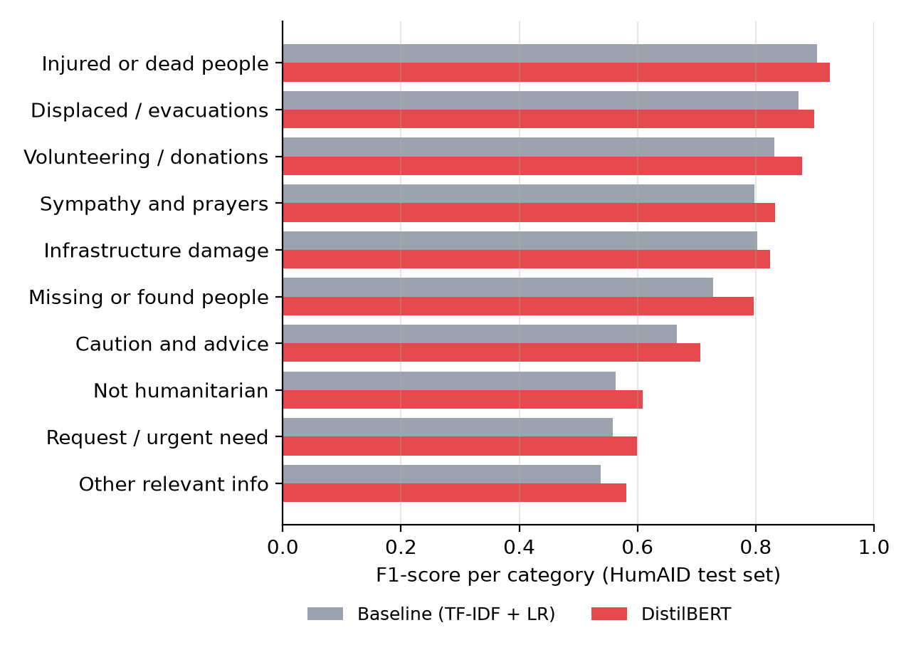
Classifier Accuracy
HumAID test set (15,160 tweets, 19 disasters)
Model | Accuracy | Macro F1 | Weighted F1
TF-IDF + logistic regression | 74.2% | 0.726 | 0.743
DistilBERT (fine-tuned) | 78.6% | 0.765 | 0.782
Kerala floods replay (unseen disaster)
Model | Accuracy | Macro F1
TF-IDF + logistic regression | 74.0% | 0.584
DistilBERT (fine-tuned) | 78.3% | 0.657
Macro F1 weights all 10 categories equally, which matters because classes range from 14,891 donation tweets to 250 missing-people tweets.
Disaster Response Triage | Sentiment analysis for crisis tweets
5
Notes:
DistilBERT beats the baseline overall and on the unseen Kerala disaster. The hardest category is 'request / urgent need': requests use very varied language and are often confused with donation drives.

Slide 6
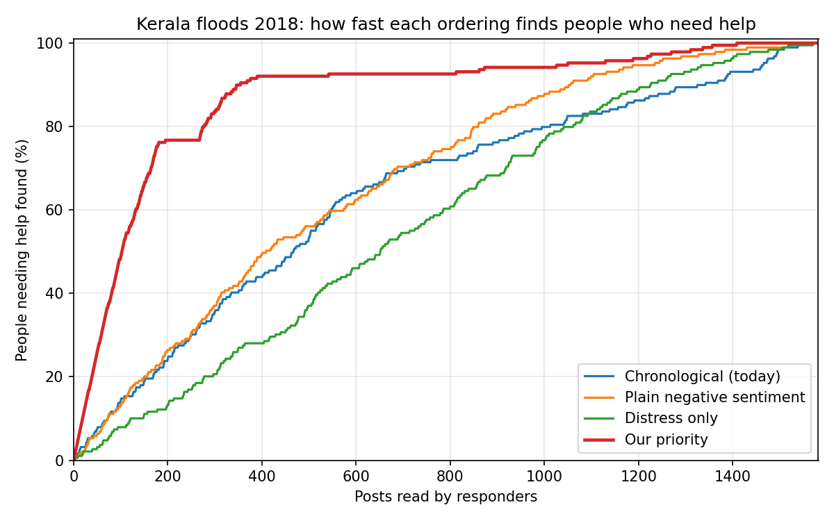
Key Result: Responders Find People Faster
49 of 50
top posts need help with our ranking (vs 14 in posting order)
3.8× faster
to find 90% of people: 355 posts instead of 1,343
24%
Ordering | Top 20 | Top 50 | Top 100 | Posts to find 90%
Chronological (today) | 30% | 28% | 27% | 1,343
Plain negative sentiment | 20% | 24% | 25% | 1,057
Distress only | 15% | 12% | 15% | 1,227
Our priority | 100% | 98% | 92% | 355
top-50 precision when sorting by plain sentiment: worse than posting order
Disaster Response Triage | Sentiment analysis for crisis tweets
6
Notes:
Ground truth is the human labels of 1,582 Kerala tweets never seen in training. 49 of our top 50 posts are real people needing help. Emotion alone is the worst ordering, because prayers are full of sadness: you need both signals.

Slide 7
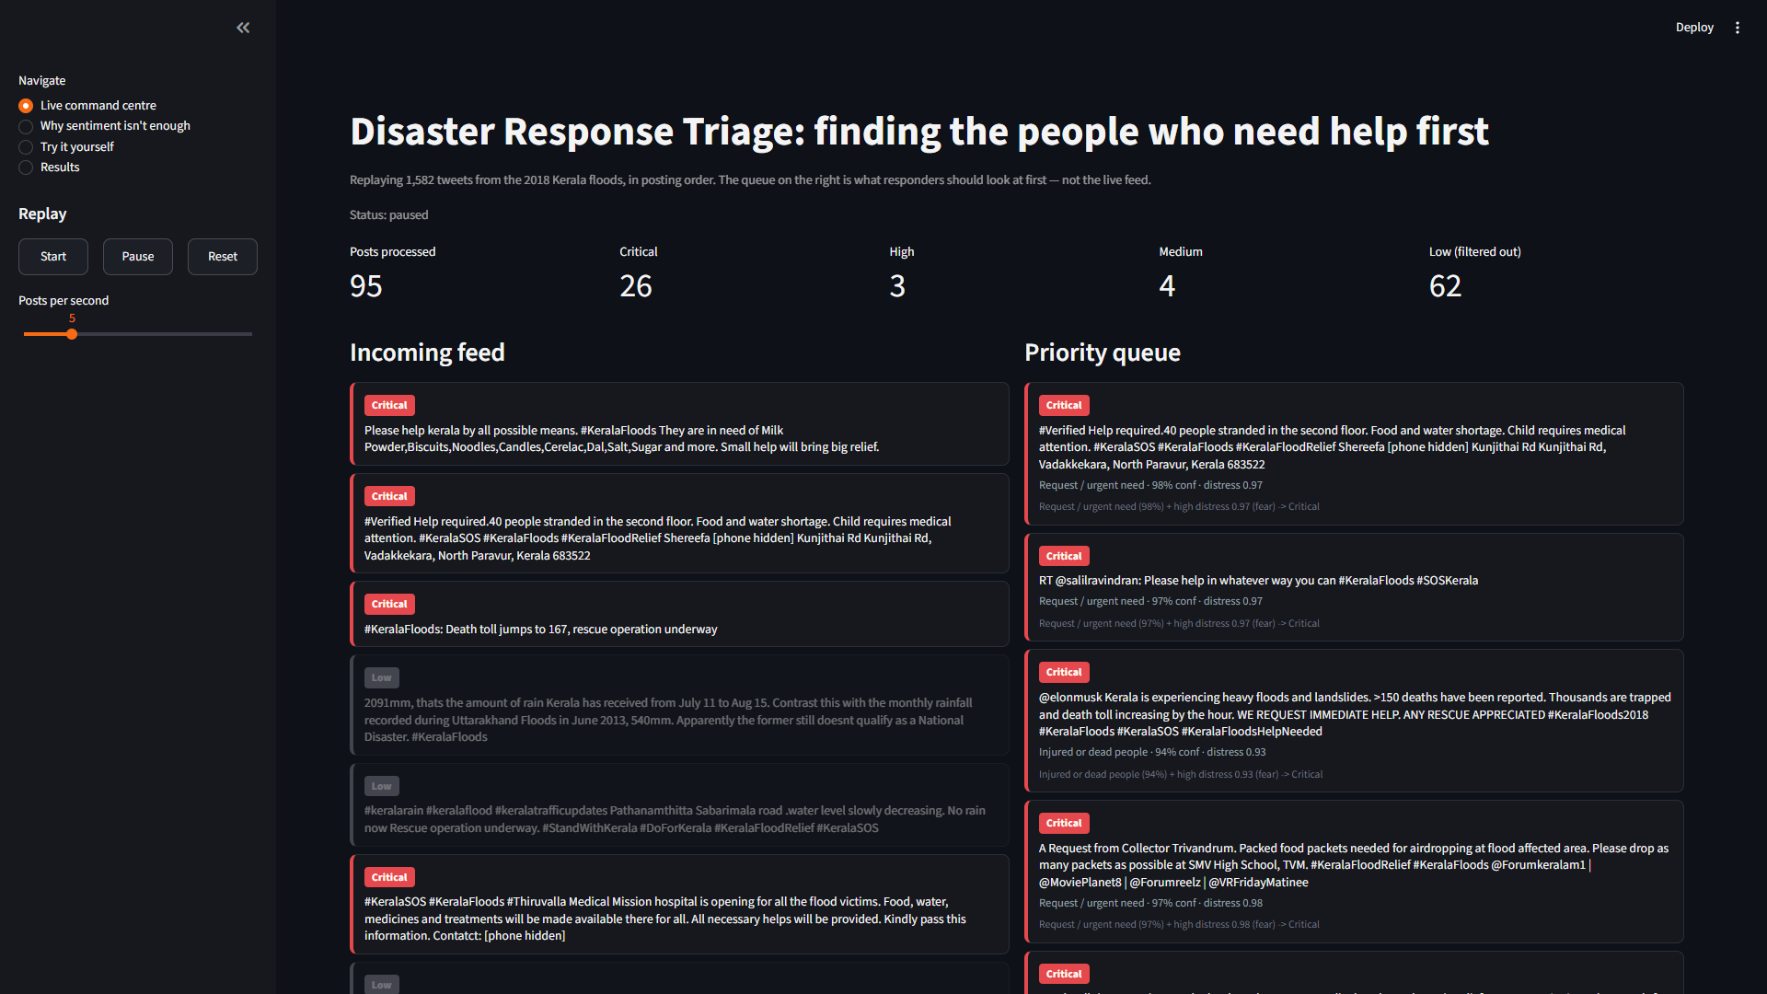
Live Demo: Command Centre
Live command centre
Kerala tweets replayed in posting order; urgent ones rise to the top with a reason.
Why sentiment isn't enough
Top 10 by sentiment vs top 10 by our priority.
Try it yourself
Type any post and see its category, distress and priority.
Privacy
Phone numbers are masked automatically.
Disaster Response Triage | Sentiment analysis for crisis tweets
7
Notes:
Switch to the app here. Replay at 10 posts per second, pause and read the top card's reason. Then type: 'Praying for Kerala, so heartbreaking' (Low) and 'Please help! My grandmother is trapped on the second floor of our house in Chengannur, she cannot walk and water is rising' (Critical).

Slide 8
Limitations and Future Improvements
Limitations
Future improvements
• English only: many Kerala posts were in Malayalam or Hinglish
• Implicit requests missed: “my grandmother is stuck, she can't walk” is ranked Low without the words “please help”
• 25% of real requests are confused with donation drives
• “Injured or dead” includes death-toll news, which ranks high but is not a rescue
• Distress saturates: most disaster posts sound fearful, so the category does most of the work
• Evaluated on human labels, not on real rescue outcomes
• Multilingual model (XLM-R / MuRIL) for Malayalam, Hindi and code-mixed text
• Train urgency directly on labelled examples instead of a hand-written rule
• Extract locations with NER and show incidents on a live map
• Group duplicate reports of the same incident
• Separate first-hand reports from news and rumours
• Phone SOS page and a live social-media stream
Disaster Response Triage | Sentiment analysis for crisis tweets
8
Notes:
Be upfront: false negatives are the biggest risk in disaster response, so the system only ranks posts and never hides them. A human always makes the final call.

Slide 9
Thank you! Questions?
49 of our top 50 posts are people who need help | 3.8× faster than reading in order
Code: github.com/ayush123-code/disaster-response-triage
Data: HumAID (Alam et al., ICWSM 2021), CrisisNLP / QCRI

