Slide 1

Simple Linear Regression: A Step-by-Step Guide
Learn how to predict test scores based on study hours using simple linear regression. This tutorial walks through a complete example with real calculations.
STATISTICS
REGRESSION ANALYSIS
The Problem
A teacher wants to investigate whether the number of hours a student studies (X) can predict their test score (Y). We'll use simple linear regression to find the relationship and make predictions.
Sample Size
Variables
Goal
n = 5 students
X = Study hours
Find equation \hat{Y} = \beta_1 X + \beta_0
Y = Test score
Our Dataset
Study Hours (X)
Test Score (Y)
This small dataset shows the relationship between study time and performance. Notice that generally, more study hours lead to higher scores, though there's some variation.
1
2
2
4
Our Question: What score would we predict for a student who studies 6 hours?
3
5
4
4
5
5

Slide 2
Step 1: Calculate Necessary Sums
The first step in simple linear regression is computing the basic sums we'll need for our formulas. We calculate four key totals: \sum X, \sum Y, \sum X^2, and \sum XY.
Building Our Calculations Table
X
Y
X^2
XY
1
2
1
2
2
4
4
8
3
5
9
15
4
4
16
16
5
5
25
25
Totals:
15
20
55
66
\sum X
\sum Y
\sum X^2
\sum XY
Sum of study hours
Sum of test scores
Sum of squared hours
Sum of products
These sums form the foundation for calculating the slope and intercept of our regression line. Each value plays a specific role in the formulas we'll use next.

Slide 3




STEP 2
Calculate the Slope (\beta_1)
The slope tells us how much the test score changes for each additional hour of study. We calculate it using the simple linear regression formula.
The Slope Formula
This formula measures the strength and direction of the linear relationship between our variables.
Plugging in Our Values
01
02
03
Substitute the sums
Calculate numerator and denominator
Simplify to get final slope
Interpretation: For every additional hour studied, the test score increases by 0.6 points on average. This positive slope confirms our intuition that more study time leads to better performance.

Slide 4
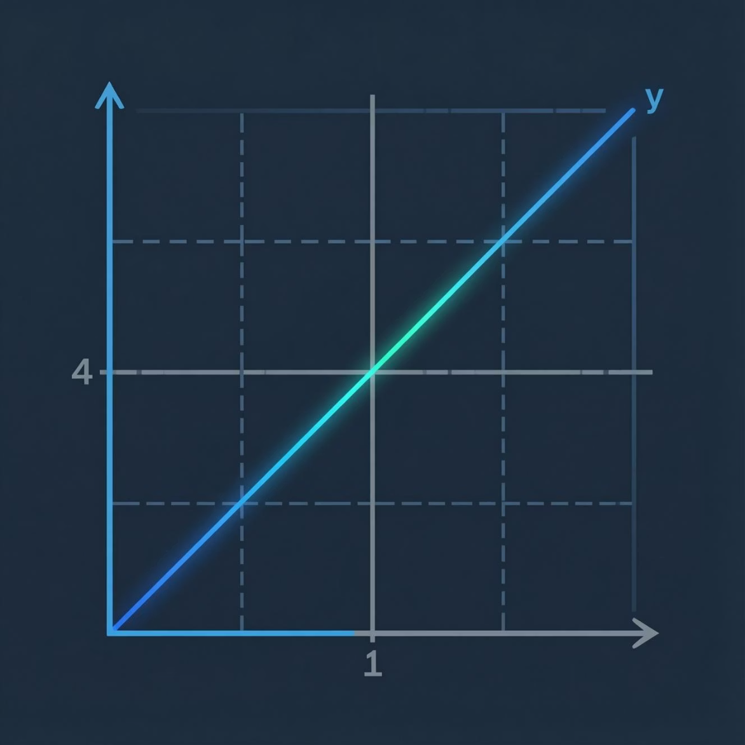




STEP 3
Calculate the Intercept (\beta_0)
The intercept represents the predicted test score when study hours equal zero. We use the intercept formula to find this value.
The Intercept Formula
This formula uses the means of our variables and the slope we just calculated to find where the regression line crosses the Y-axis.
Step-by-Step Calculation
Insert values
Multiply
Simplify
What does this mean? The intercept of 2.2 suggests a baseline score even with zero study hours—perhaps reflecting guessing or prior knowledge.

Slide 5




Form the Equation and Make Predictions
FINAL STEP
Now we combine our slope and intercept to create the complete regression equation, then use it to predict test scores for any number of study hours.
Our Regression Equation
This equation describes the linear relationship between study hours and test scores for our dataset.
Making a Prediction
Let's predict the test score for a student who studies 6 hours (X = 6):
01
Substitute X = 6
02
Calculate
03
Final result
5.8
Predicted Score
Expected test score for 6 hours of study
Next Steps
Calculate R^2 Value
Try a Different Scenario
Explore Multiple Regression
Measure how well the model fits the data by calculating the coefficient of determination.
Apply these same steps to a new dataset with different variables and relationships.
Learn how to predict outcomes using two or more independent variables.

