Slide 1

Step 1: Calculate the Total Sum of Squares (SStot)
SStot measures the total variation in observed scores (Y) relative to their grand mean (Ȳ = 4). This represents the baseline variability we're trying to explain with our regression model.
First, we calculate the mean: \bar{Y} = \frac{2+4+5+4+5}{5} = 4
Then we compute: SS_{tot} = \sum(Y_i - \bar{Y})^2 = (2-4)^2 + (4-4)^2 + (5-4)^2 + (4-4)^2 + (5-4)^2
Result: SStot = 4 + 0 + 1 + 0 + 1 = 6

Slide 2
Step 2: Calculate the Residual Sum of Squares (SSres)
SSres measures the variation that our regression model (Ŷ = 0.6X + 2.2) fails to explain. These are the differences between actual scores and predicted scores—the "residuals" or errors in our model.
X = 1, Ŷ = 2.8
X = 2, Ŷ = 3.4
X = 3, Ŷ = 4.0
X = 4, Ŷ = 4.6
(2 − 2.8)² = 0.64
(4 − 3.4)² = 0.36
(5 − 4.0)² = 1.00
(4 − 4.6)² = 0.36
X = 5, Ŷ = 5.2
(5 − 5.2)² = 0.04
Result: SSres = 0.64 + 0.36 + 1.00 + 0.36 + 0.04 = 2.4

Slide 3

Step 3: Compute R²
The R² (coefficient of determination) represents the proportion of variance explained by our regression model. It tells us how well our independent variable (study hours) predicts our dependent variable (test scores).
R² = 0.6 means 60% of the variation in test scores is explained by study hours.

Slide 4
Interpretation of Results
R² = 0.6
The R² value is 0.6, meaning that 60% of the variation in test scores can be explained by the number of hours studied. This indicates a moderately strong relationship between study time and performance.
Standard Error: 0.894
The Standard Error of the Estimate (Se) is approximately 0.894. This tells us the typical distance between observed scores and the regression line—the average "miss" of our predictions.

Slide 5

Understanding the Standard Error Formula
The Standard Error of the Estimate measures the average distance that observed values fall from the regression line. It quantifies the precision of our predictions.
SSres (Residual Sum of Squares)
n (Sample Size)
n − 2 (Degrees of Freedom)
Number of data points: 5
Why subtract 2? We estimated two parameters (slope and intercept)
The value we calculated: 2.4

Slide 6

Step 2: Calculate Degrees of Freedom
Why n − 2?
For simple linear regression, the degrees of freedom is n - 2 because we have estimated two parameters from our data:
\beta_0: the y-intercept (where the line crosses the y-axis)
\beta_1: the slope (the rate of change in Y per unit of X)
Each estimated parameter "costs" us one degree of freedom.
With 5 data points, we have 3 degrees of freedom for our error estimate.

Slide 7
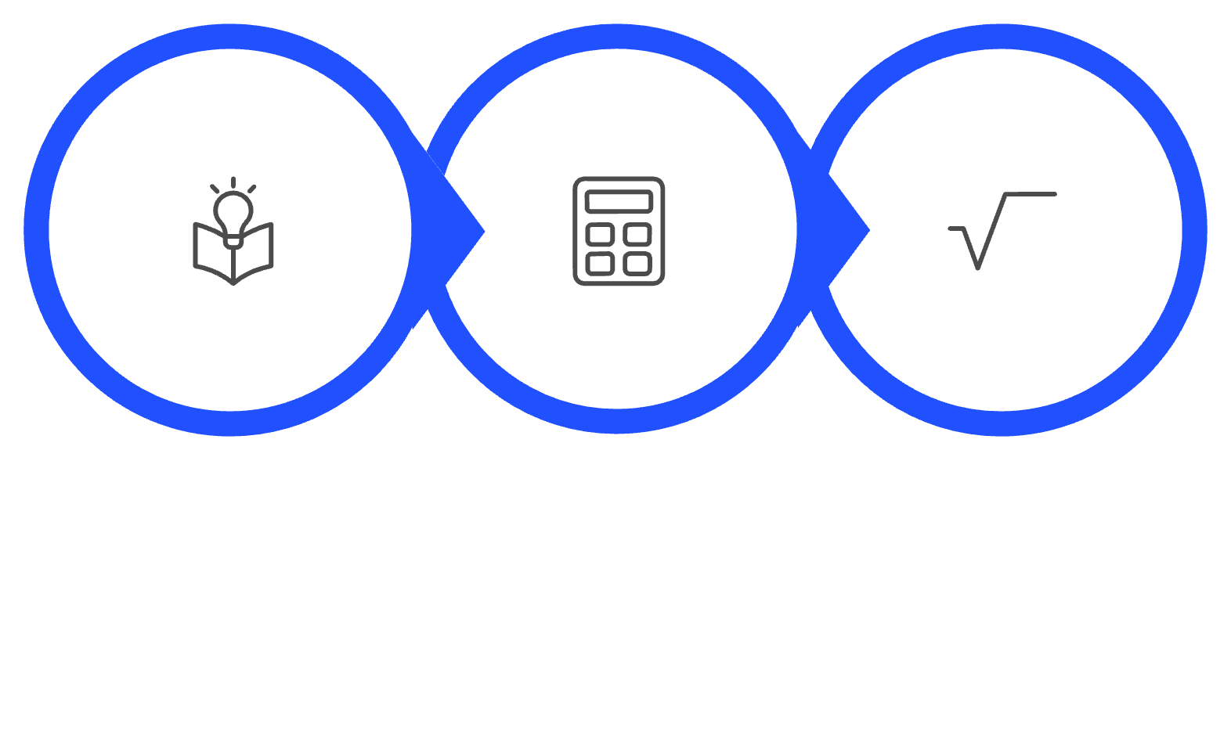
Step 3: Compute the Standard Error
Now we substitute our calculated values into the formula and solve step by step:
SS_res/df
0.8
√0.8 ≈ 0.894
We typically round to three decimal places: Se ≈ 0.894

Slide 8
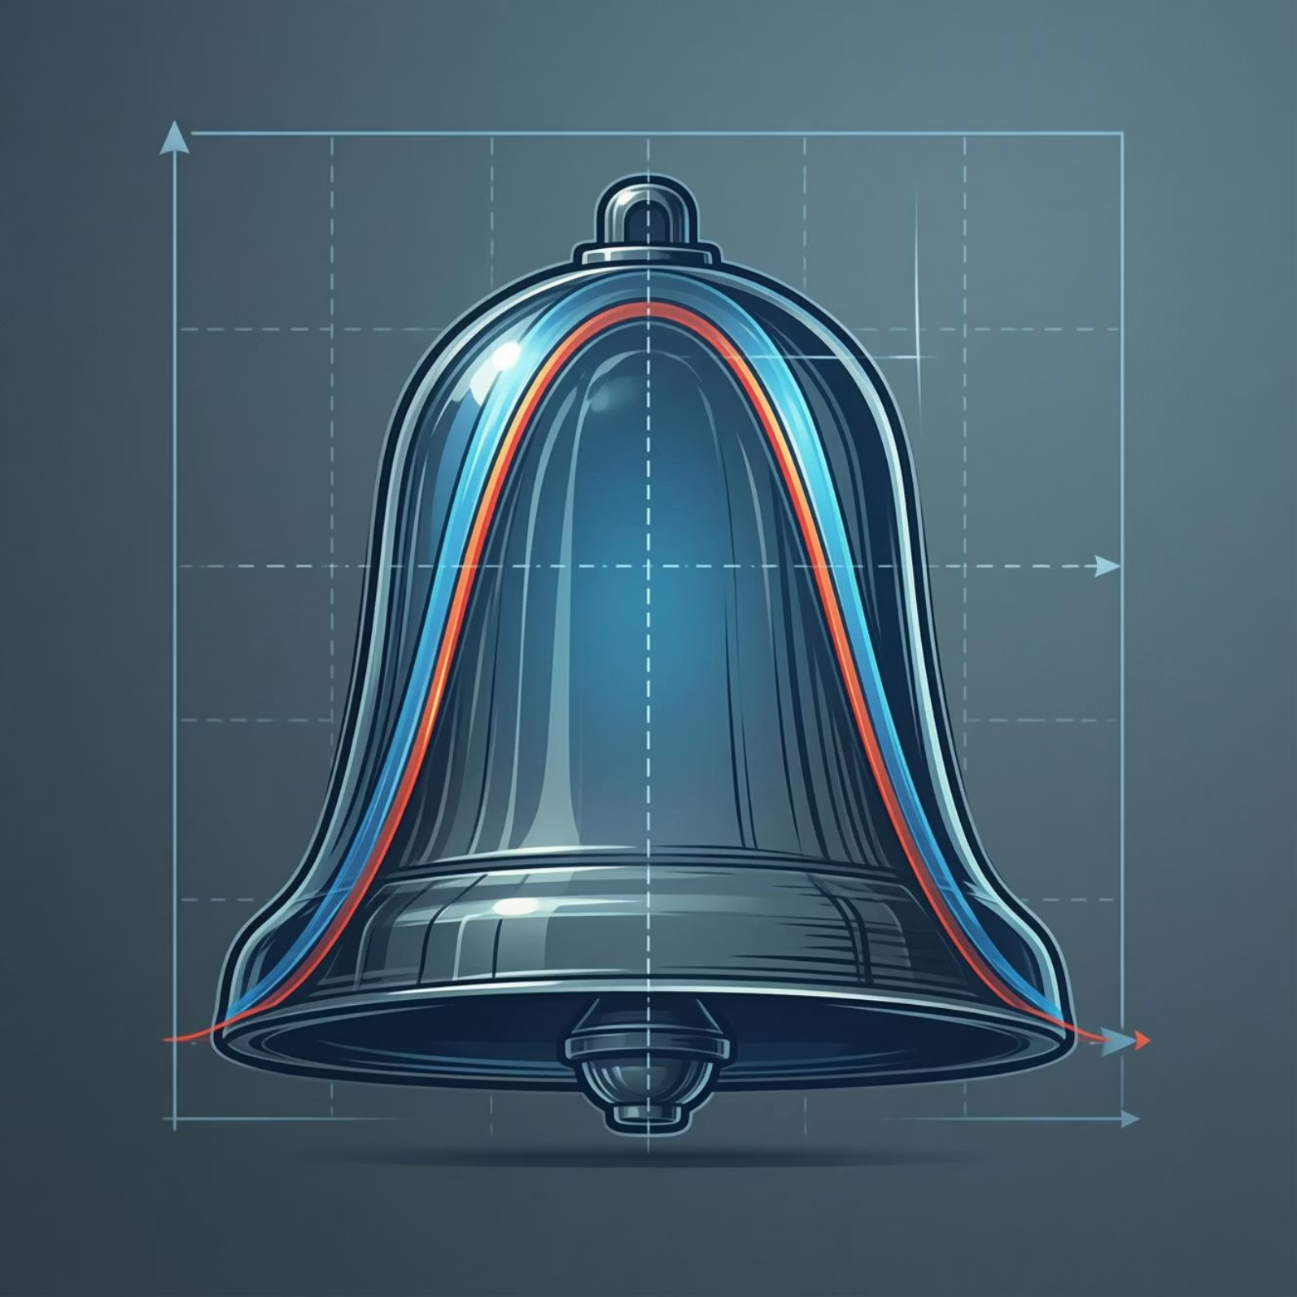
Standard Error Interpretation
What Does 0.894 Mean?
The Standard Error of the Estimate is approximately 0.894. This indicates that, on average, the observed test scores deviate from the predicted regression line by about 0.894 points.
Think of it as the "typical prediction error"—when we use study hours to predict test scores, we're usually off by less than 1 point.
Confidence Interval Preview
For a predicted score of 5.8 (at 6 hours of study), the 95% confidence interval is approximately [2.815, 8.785].

Slide 9
Step 1: Identify Parameters for Confidence Interval
To construct a 95% confidence interval for the predicted mean score, we need to gather all relevant parameters from our regression analysis:
Predicted Value (Ŷ)
Standard Error (Se)
Mean of X (X̄)
SSx
5.8
0.894
3.0
10.0
The sum of squares for X: \sum(X_i - \bar{X})^2 = 10.0

Slide 10
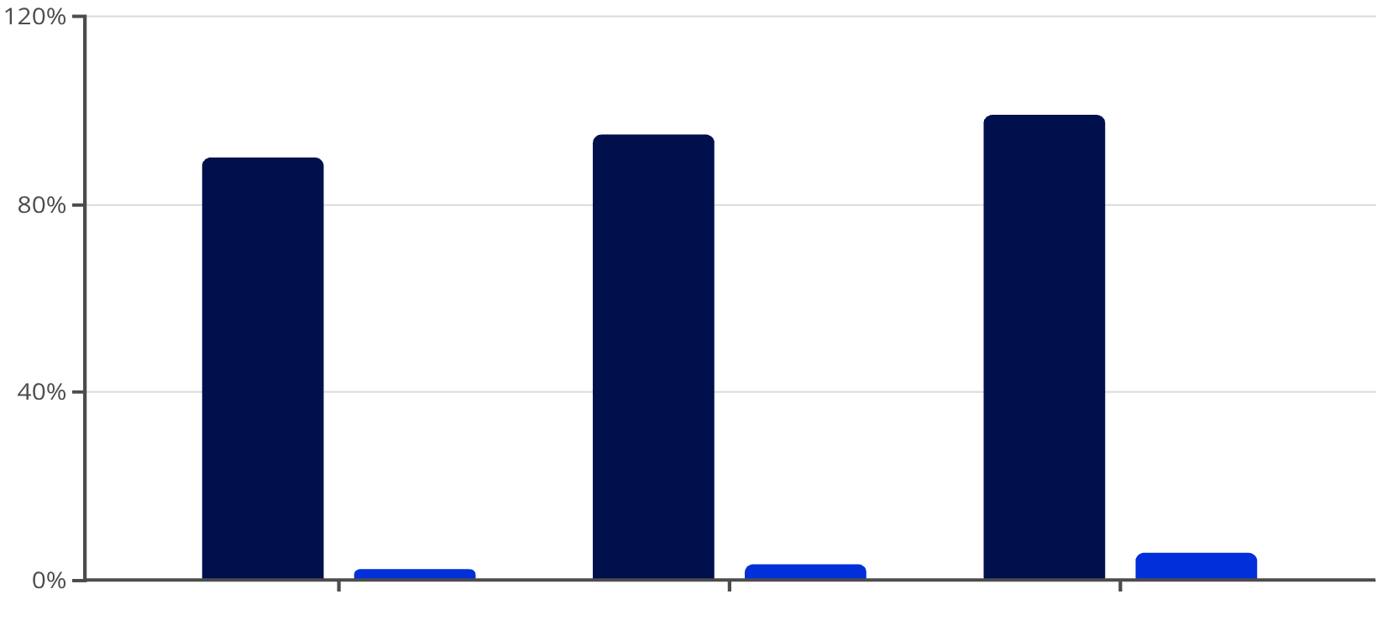
Step 2: Determine the Critical t-Value
For a 95% confidence level with n - 2 = 3 degrees of freedom, we consult a t-distribution table to find the critical value.
Critical Value
For our 95% confidence interval with 3 degrees of freedom:
This t-value of 3.182 means we're capturing the middle 95% of the t-distribution, leaving 2.5% in each tail.
Confidence Level
t-value (df=3)
The higher t-value (compared to z = 1.96 for normal) reflects the additional uncertainty from our small sample size.

