Slide 1
School of Computer Science and Engineering
B.Tech (CSE) 4th Semester
Project ID- BTP2CSE024
Project Title- Comparative Analysis of Classical Image Enhancement Techniques For Low Contrast Images
Submitted To- Mrs.Aanchal Vij
Team Members- Ayush Kumar Singh
Harshita Shandilya
Manish Kumar Jaiswal
Prashant Kumar Yadav

Slide 2
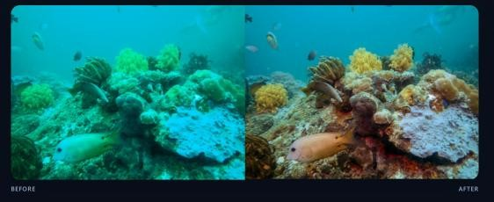
Abstract
Underwater images frequently suffer from severe quality degradation due to light absorption, scattering, suspended particles, and varying underwater conditions. These problems result in low contrast, color distortion, blur, reduced visibility, and loss of important image details negatively affecting marine exploration, underwater surveillance, object detection, and scientific analysis
Color Correction
Restore natural underwater colors through multichannel compensation
Detail Sharpening
Enhance edges and structural visibility using advanced filtering
Contrast Enhancement
Improve local and global contrast through Clahe and Retinex methods

Slide 3
Introduction & Challenges in Underwater Imaging
Underwater imaging is critical for marine biology, underwater robotics, ocean resource exploration, surveillance systems, archaeological exploration, and environmental monitoring. However, seawater significantly affects light propagation, creating unique imaging challenges.
Light Absorption
Water absorbs light wavelengths unevenly. Red light disappears first, causing bluish or greenish color casts in images
Light Scattering
Suspended particles scatter light and reduce visibility, causing haze and blur effects that degrade image quality.
Low Contrast
Intensity values become compressed, making objects difficult to distinguish and reducing image clarity.
Color Distortion
Natural colors are lost underwater due to differential absorption, resulting in faded and unrealistic appearances.
Blur & Noise
Water movement and suspended particles reduce image sharpness and introduce noise into captured images.

Slide 4
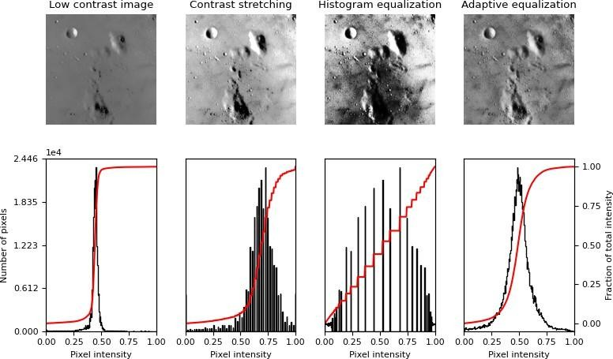
Literature
Classical image enhancement methods improve image quality by directly manipulating pixel intensity values in the spatial domain. These techniques are fundamental to underwater image processing
Histogram Equalization (HE)
Redistributes intensity values across the histogram to enhance overall image contrast. Effective for global enhancement but may cause over-enhancement and unnatural brightness in some cases.
CLAHE
Contrast Limited Adaptive Histogram Equalization works on small image regions called tiles. Enhances local contrast while controlling noise amplification, producing clearer and more natural results.

Slide 5
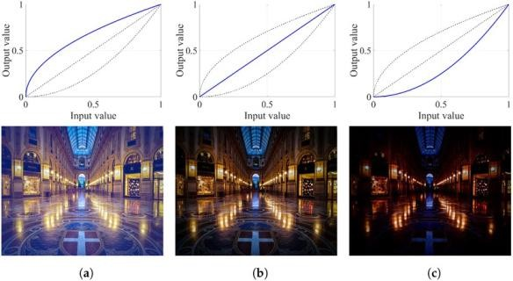
Gamma Correction
Uses power-law transformation to adjust image brightness. Helps balance dark and bright regions, with gamma values controlling enhancement intensity.
Contrast Stretching
Expands narrow intensity ranges to full pixel range (0–255). Improves visibility while preserving image details, particularly useful for low contrast images.
Advantages
Simple implementation
Fast processing speed
Low computational cost
Wide applicability
Limitations
Sensitive to noise
Limited adaptability in complex environments
May cause over-enhancement

Slide 6
Color Correction
Underwater images lose natural colors because different light wavelengths are absorbed at different depths. Color correction techniques restore realistic appearances.
White Balance Adjustment
Removes color casts and makes white objects appear natural under underwater lighting conditions.
Retinex-Based Enhancement
Improves illumination consistency and enhances visibility and color balance simultaneously for better results.
RGB Color Compensation
Restores weakened red and green channels, significantly improving natural appearance and color fidelity
Histogram-Based Color Adjustment
Enhances color distribution and intensity balance across all channels for optimal appearance

Slide 7
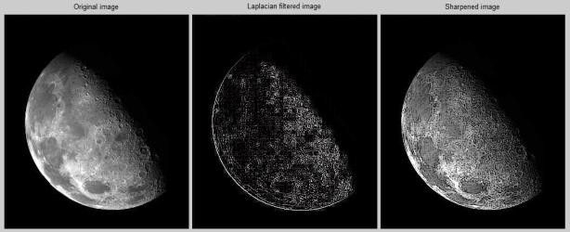
Detail Sharpening Techniques
Detail sharpening improves edge visibility and image clarity through high-frequency enhancement.
> Unsharp Masking
Enhances high-frequency edge information, making object boundaries sharper and more defined.
> Laplacian Filtering
Detects intensity changes and edges while enhancing fine image details and structural features.
> High Boost Filtering
Sharpens image while preserving low-frequency regions for balanced enhancement results.
Image to show detail sharpening technique.

Slide 8
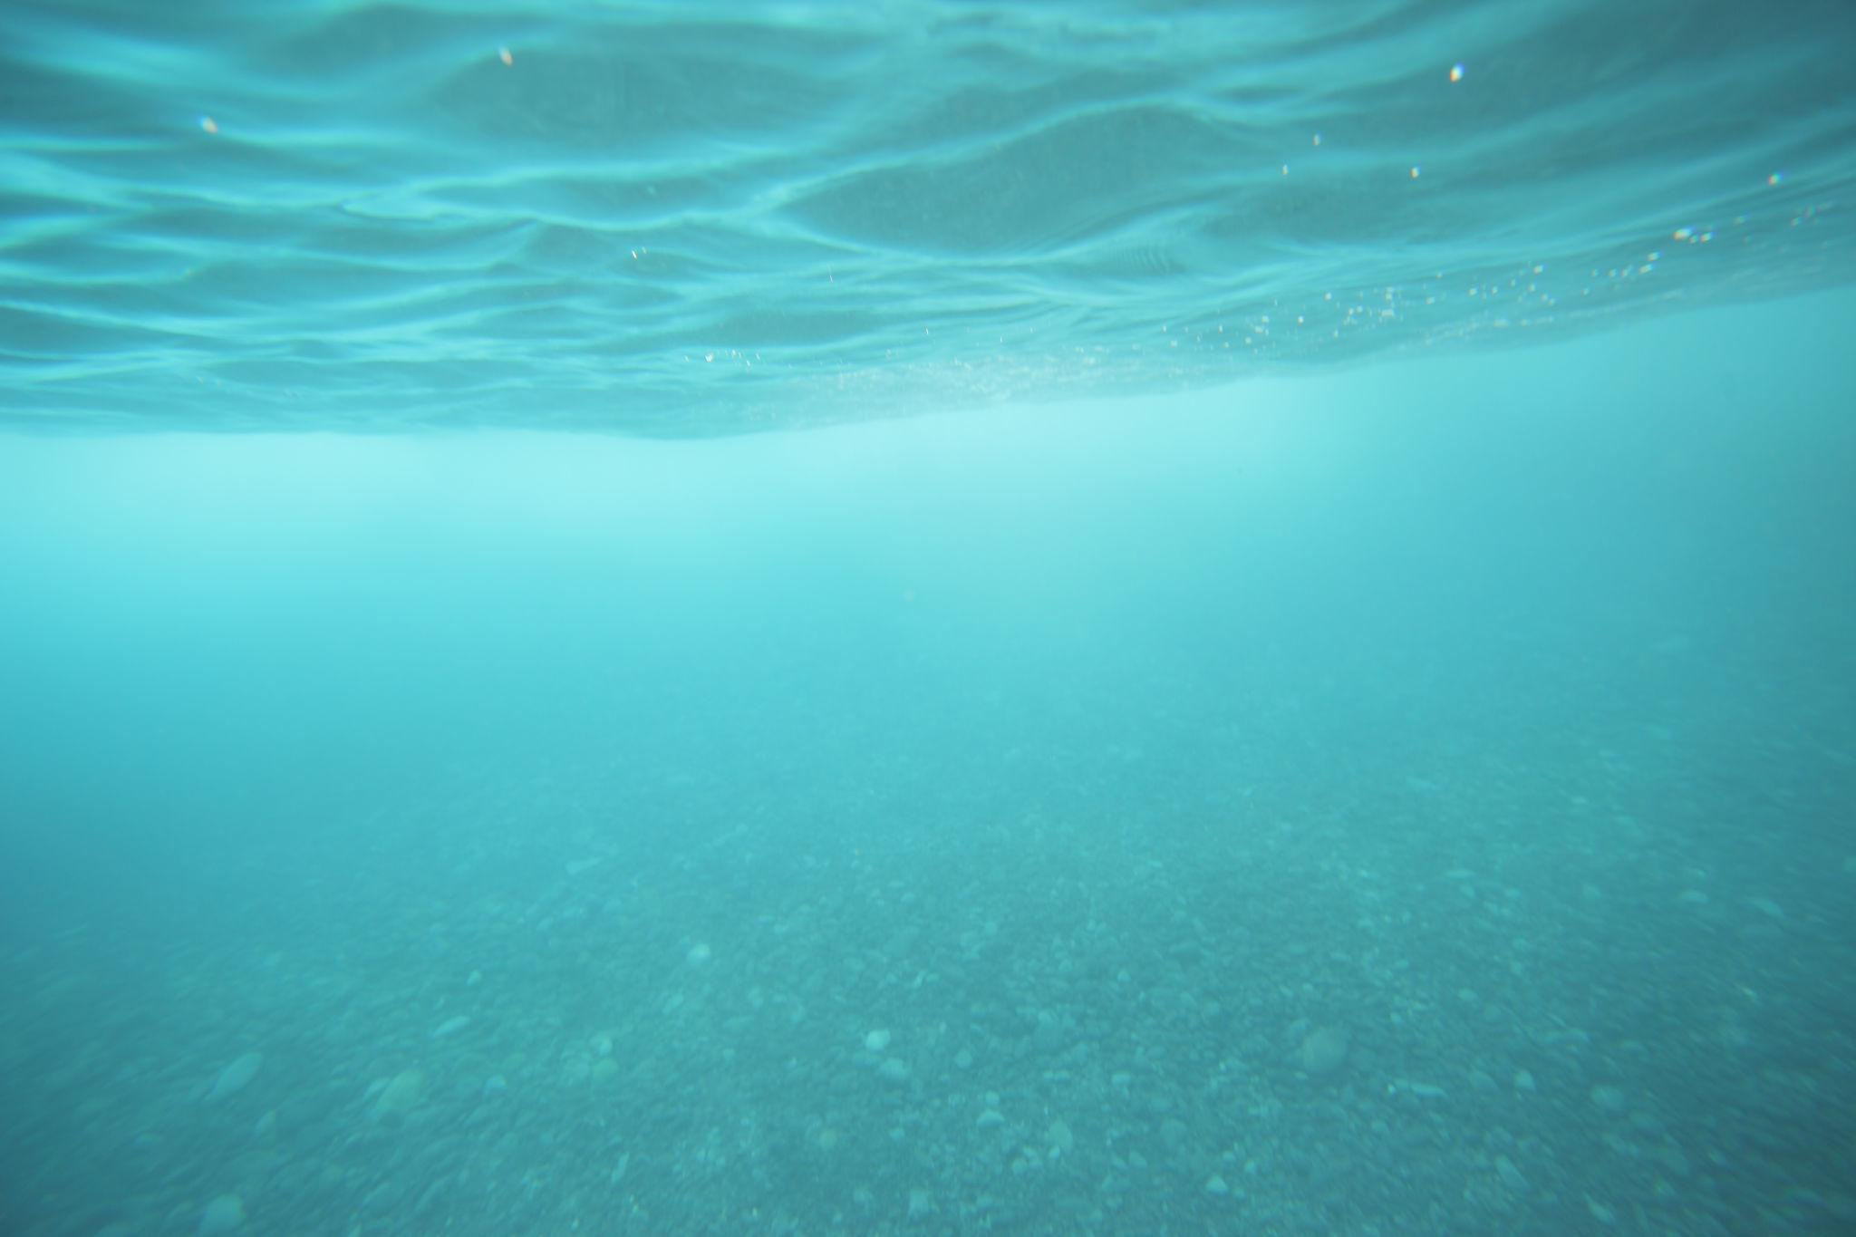
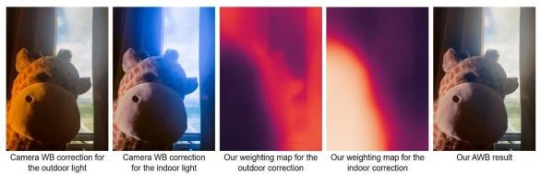
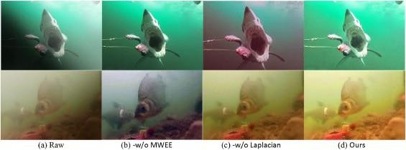
Contrast Enhancement & Methodology
Contrast enhancement improves image visibility by expanding intensity differences between objects and background regions. Multiple techniques work together to produce optimal results.
<> Input Image
Low contrast underwater image
<> Color Correction
Restore natural colors
<> Retinex Enhancement
Improve illumination
Low contrast underwater image
Restore natural colors
<> Gaussian Pyramid
Enhance details
<> CLAHE
Final enhancement
Improve illumination
Final enhancement

Slide 9

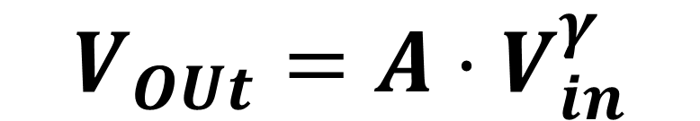


Gamma Correction
Adjusts image brightness using power-law transformation with controllable intensity.
$$V_{OUt}=A⋅V_{ⅈn}^{γ}$$
Where:
$$v_{in}=\text{Input pixel value}\text{.}$$
$$V_{OUt}=\text{Output pixel value}$$
$A=\text{Constant value}$.
$$γ=\text{Gamma value controlling brightness}$$
showing gamma correction curve and contrast enhancement technique.

Slide 10
Implementation
<> Tools and Technologies
Digital Image Processing
MATLAB / Python-based processing
Classical enhancement algorithms
Steps Used in the Proposed System
1. Input low contrast or underwater image
2.Apply color correction techniques
  White balance
  Retinex enhancement
3. Perform detail sharpening
  Unsharp masking
  Laplacian filtering
4. Apply contrast enhancement
  Histogram Equalization
  CLAHE
  Gamma Correction
4. Generate enhanced output image

Slide 11
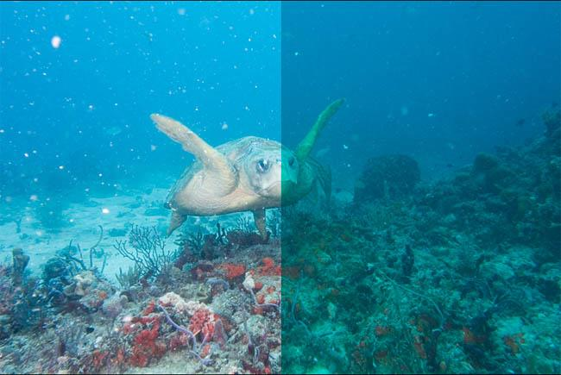
Results & Performance Analysis
The enhancement techniques were tested on several low contrast underwater images obtained from public datasets. CLAHE produced the best visual quality with effective local contrast improvement while preserving edges and reducing noise amplification.
Before HE
Original low contrast image
After HE
Improved overall contrast with possible over-enhancement
After CLAHE
Best visual quality with local contrast enhancement

Slide 12
Performance Evaluation Metrics
PSNR
Peak Signal-to-Noise Ratio
Measures image reconstruction quality. Higher PSNR values indicate better enhancement performance.
MSE
Mean Squared Error
Measures error between original and enhanced image. Lower MSE values indicate better performance.
SSIM
Structural Similarity Index
Measures structural similarity and visual quality. Higher SSIM values indicate better detail preservation.
<> Key Finding: CLAHE achieved the best balance between contrast enhancement, detail preservation, and visual quality among all classical methods tested.

Slide 13
Applications of Underwater Image Enhancement
Enhanced underwater imaging has diverse applications across multiple real-world fields, enabling better visibility, accurate analysis, improved object detection, and enhanced decision-making capability.
Marine Exploration
Study underwater ecosystems, marine biology, and ocean resources with improved visibility and color fidelity.
Medical Imaging
Enhancement techniques improve visibility in medical scans and diagnostic imaging applications
Surveillance Systems
Underwater object detection, monitoring, and security systems benefit from enhanced image quality.
Remote Sensing
Oceanographic and environmental analysis through satellite and aerial remote sensing platforms
Underwater Robotic
Navigation and obstacle detection for autonomous underwater vehicles and robotic systems
Digital Photography
Improved visual quality and color restoration in professional and recreational underwater photography.

Slide 14
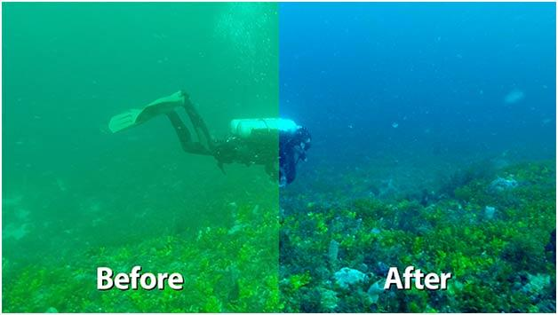
Conclusion & Future Scope
# Conclusion
> Framework successfully enhances low contrast underwater images
> Color correction restores natural appearance effectively
> Detail sharpening improves edge clarity and structural visibility
> Contrast enhancement techniques significantly improve visibility
> CLAHE produced best enhancement results among classical
methods
> Framework preserves important visual information while reducing
distortions

Slide 15
Future Scope
<> AI & Deep Learning Integration
Convolutional Neural Networks (CNN) and Generative Adversarial Networks (GAN) based enhancement models for superior results.
<> Real-Time Enhancement Systems
Faster processing for underwater robotics, surveillance, and live monitoring applications.
<> Automated Restoration Frameworks
Self-adaptive enhancement systems that automatically optimize parameters for different underwater conditions.
<> Hybrid Enhancement Techniques
Combination of classical image processing methods with deep learning approaches for optimal performance.
<> Advanced Quality Evaluation
AI-driven quality assessment techniques using machine learning for objective performance measurement.

Slide 16
Publication
> Conference: International Conference on Intelligent Computing, Control & Communication (ICICCC2026).
> Track: Artificial Intelligence and Expert Systems
> Paper ID: 470
> Paper Title: Comparative analysis of classical image enhancement techniques for low contrast images
> Status: Submitted
> Submission link: https://www.iciccc.in/

Slide 17
Thank You

