Slide 1
GOOGLE AI-ML
Virtual Internship Report
AYUSH KUMAR SINGH
B.Tech (Computer Science and Engineering)
IILM University, Greater Noida
August–October 2026 | 8 Weeks

Slide 2
Candidate & Program Overview
Candidate Details
Internship Profile
Student Name: Ayush Singh
Degree: B.Tech
Branch: Computer Science and Engineering
Institute: IILM University, Greater Noida
Internship period: August–October 2026
Program: AICTE–EduSkills Virtual Internship
Domain: Google AI-ML
Duration: 8 weeks
Support: Google for Developers / India Edu Program
Learning focus: Neural networks, object detection, product image search and image classification
Ayush Kumar Singh | IILM University, Greater Noida | Google AI-ML Internship • 2

Slide 3
Program & Organization Context
• The offer letter identifies EduSkills as the organization issuing the internship offer.
• The internship is presented as an AICTE–EduSkills Virtual Internship.
• The certificate identifies the AI-ML Virtual Internship and shows support from Google for Developers / India Edu Program.
• The completion certificate states that the 8-week internship was completed during August–October 2026.
• The program combines structured weekly learning with assessments and practical assignments.
Ayush Kumar Singh | IILM University, Greater Noida | Google AI-ML Internship • 3

Slide 4
Learning Context & Purpose
Industry-Relevant Learning
Practical Exposure
Build foundational understanding of machine learning and neural networks, including image recognition and classification.
Explore object detection, TensorFlow Lite, Model Maker, visual product search and custom image-classification models.
Ayush Kumar Singh | IILM University, Greater Noida | Google AI-ML Internship • 4

Slide 5
Eight-Week Learning Plan
Week 1 | Neural networks with TensorFlow
Week 2 | Introduction to object detection
ML fundamentals and convolutional neural networks for image recognition/classification.
Use pretrained object detectors in mobile apps.
Week 3 | Advanced object detection
Week 4 | Product image search
Train custom object-detection models with TensorFlow Lite and Model Maker.
Build a product image-search feature using on-device object detection.
Week 5 | Product image search
Week 6 | Product image search integration
Detect objects in static images and live camera feeds.
Build backend integration for mobile visual product search.
Week 7 | Image classification
Week 8 | Image classification integration
Build custom image-classification models.
Create and integrate a custom image classifier into an app.
Ayush Kumar Singh | IILM University, Greater Noida | Google AI-ML Internship • 5

Slide 6
Core Technical Learning Areas
Neural Networks
Object Detection
Visual Search & Classification
• Machine learning fundamentals
• TensorFlow
• Convolutional neural networks
• Image recognition and classification
• Pretrained detectors
• Custom object-detection models
• TensorFlow Lite
• Model Maker
• Mobile app integration
• Product image search
• Static image and live camera inputs
• Backend integration
• Custom image classifiers
• App integration
Ayush Kumar Singh | IILM University, Greater Noida | Google AI-ML Internship • 6

Slide 7
Internship Workflow & Evaluation
01 Structured Learning
02 Practical Work
03 Weekly Assessments
Follow the week-wise module plan.
Apply concepts in technical modules.
Track understanding and progress.
04 Assignments
05 Final Assessment
06 Completion
Submit project documentation where required.
Complete the final-week assessment test.
Certificate awarded after required steps.
The offer letter states that the final grade depends on weekly assessments, project submissions and the final test.
Ayush Kumar Singh | IILM University, Greater Noida | Google AI-ML Internship • 7

Slide 8
Learning Outcomes
• Develop a stronger understanding of machine learning and neural networks.
• Understand how object detection can be used in mobile applications.
• Gain exposure to TensorFlow Lite and Model Maker for custom detection models.
• Understand the workflow behind product image search and backend integration.
• Explore building and integrating custom image-classification models.
• Strengthen technical documentation, assessment and practical problem-solving skills.
Ayush Kumar Singh | IILM University, Greater Noida | Google AI-ML Internship • 8

Slide 9
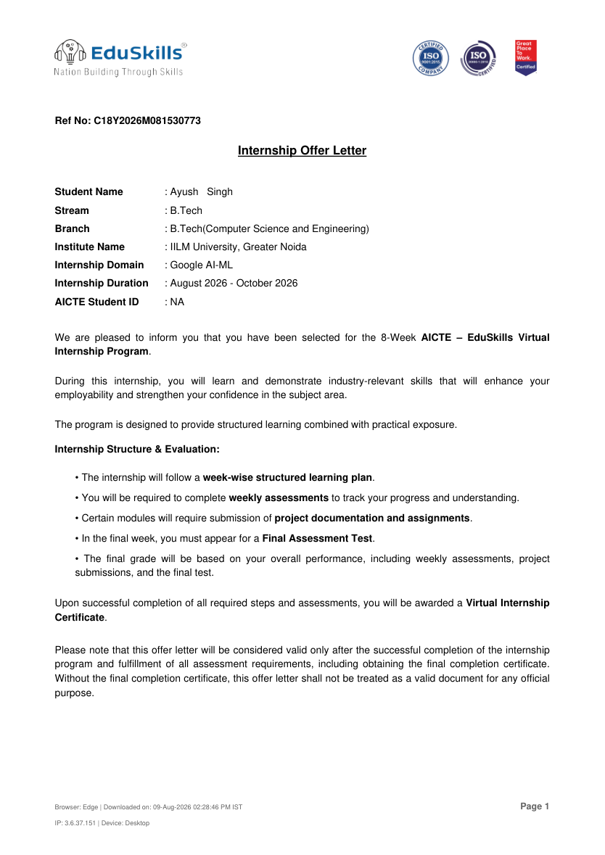
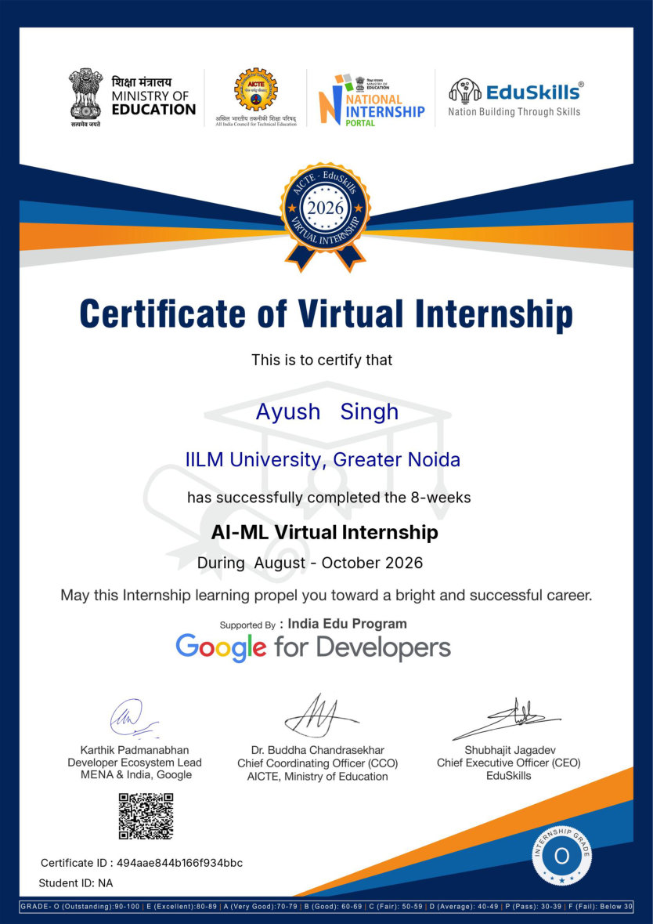
Official Internship Documents
INTERNSHIP OFFER LETTER
COMPLETION CERTIFICATE
Ayush Kumar Singh | IILM University, Greater Noida | Google AI-ML Internship • 9

Slide 10
Official Verification Details
Offer Letter
Completion Certificate
Reference No.: C18Y2026M081530773
Internship Domain: Google AI-ML
Duration: August 2026–October 2026
Program: 8-week AICTE–EduSkills Virtual Internship
Note: The offer letter says it is valid for official purposes only after successful completion and issuance of the completion certificate.
Certificate: AI-ML Virtual Internship
Student: Ayush Singh
Institute: IILM University, Greater Noida
Duration: August–October 2026
Supported by: India Edu Program / Google for Developers
Certificate ID: 494aae844b166f934bbc
Ayush Kumar Singh | IILM University, Greater Noida | Google AI-ML Internship • 10

Slide 11
Internship Summary
Duration
Main Topics
Assessment
8 weeks
August–October 2026
Neural networks
Object detection
Product image search
Image classification
Weekly assessments
Required assignments
Final assessment test
A structured learning experience focused on applied AI/ML concepts and computer-vision use cases.
Ayush Kumar Singh | IILM University, Greater Noida | Google AI-ML Internship • 11

Slide 12
THANK YOU
AYUSH KUMAR SINGH
B.Tech (Computer Science and Engineering)
IILM University, Greater Noida
Google AI-ML Virtual Internship | August–October 2026

