Slide 1
Improving Teleoperation Performance using Spatial Ability

Slide 2
Introduction
Teleoperation (or remote operation) indicates operation of a system or machine at a distance.Teleoperation helps in the execution of various tasks which are not feasible for humans due to various working conditions. Using teleoperation, a human operator can remotely give instructions to a robot and accomplish a task. Teleoperation requires a complex combination of the operator's cognitive, perceptual, and motor skills.
Therefore, a teleoperator needs to have a certain level of spatial cognitive ability to perform a task successfully. Spatial cognitive ability scores can be used to increase precision of a teleoperation task.

Slide 3
Aim
We aim to achieve the following two tasks -
Assess the fitness level of a teleoperator - There exists a relation between spatial ability and the ability to teleoperate, We can identify a list of computer implementable and repeatable test that can be used to assess spatial ability. These test scores can be used to measure if the person is fit for the role.
Increase the precision of the teleoperation task - We can find the relation between spatial ability and other parameters pertaining to a teleoperation task. This equation can be used to improve the precision of the movements which will help in preventing any accidents and improve the efficiency of teleoperation task.

Slide 4
Spatial Ability
Definition - Spatial ability is the capacity to understand and remember the spatial relations among objects. This ability can be viewed as a unique type of intelligence distinguishable from other forms of intelligence, such as verbal ability, reasoning ability, and memory skills.
Importance - Good spatial awareness allows us to understand the environment and our relationship to it. Spatial perception also consists of understanding the relationship between two objects when there is a change in their position in space. It helps us think in two and three dimensions, which allows us to visualize objects from different angles and recognize them no matter the perspective that we see them from.

Slide 5
Types of Spatial Ability
Spatial Perception - Spatial perception is defined as the ability to perceive spatial relationships in respect to the orientation of one's body despite distracting information.
Mental rotation - Mental rotation is the ability to mentally represent and rotate 2D and 3D objects in space quickly and accurately, while the object's features remain unchanged.
Spatial Visualization - Spatial visualization involves imagining and working with visual details of measurement, shapes, motion, features and properties through mental imagery.

Slide 6
Measuring Spatial Ability
The following tests might be employed to measure the spatial cognitive ability of a person -
Cube Comparison Test
Paper Folding Test
Hegarty’s Perspective-taking Test
Vandenberg mental rotation test
Purdue Spatial Visualization Test

Slide 7
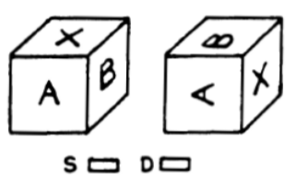
Cube Comparison Test
Cube Comparison Test -Based on the limited images presented, the participant must decide whether the two cubes are the same or different.

Slide 8
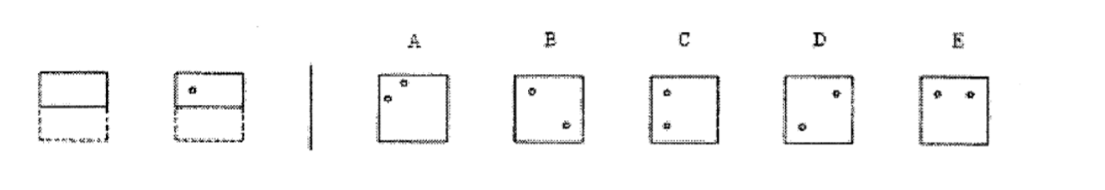
Paper Folding Test
Each item presents an image of a piece of paper, and two to four additional images demonstrating a sequence of the piece of paper being folded. On the final folded image, a hole punched through the paper. The objective of the task is to select one of five correct image representations of the unfolded piece of hole-punched paper.

Slide 9
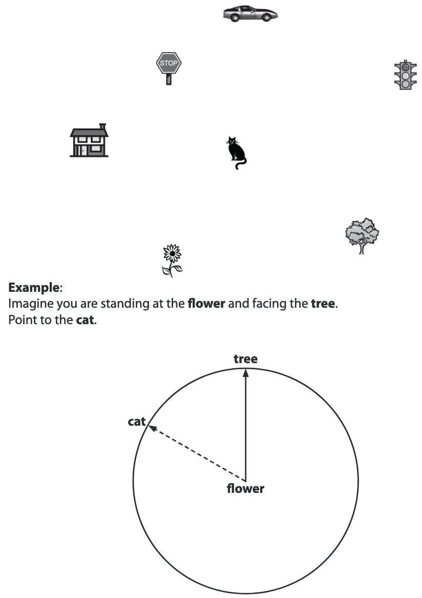
Hegarty’s Perspective-taking
Test
This is a test of ability to imagine different perspectives or orientations in space. On each of the questions, there is a picture of an array of objects and an “arrow circle” with a question about the direction between some of the objects. The task is to draw an arrow from the center object showing the direction to a third object from this facing orientation.

Slide 10
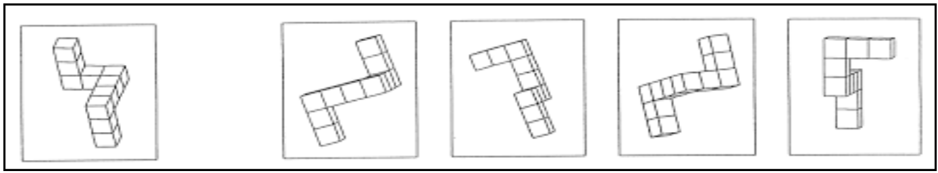
Vandenberg mental rotation test
Here each target stimulus is presented along with four other options. All the four options are similar looking three-dimensional tube like figures with three arms. However, only two among these images are that of the target stimulus. The subject has to identify both the correct images.

Slide 11
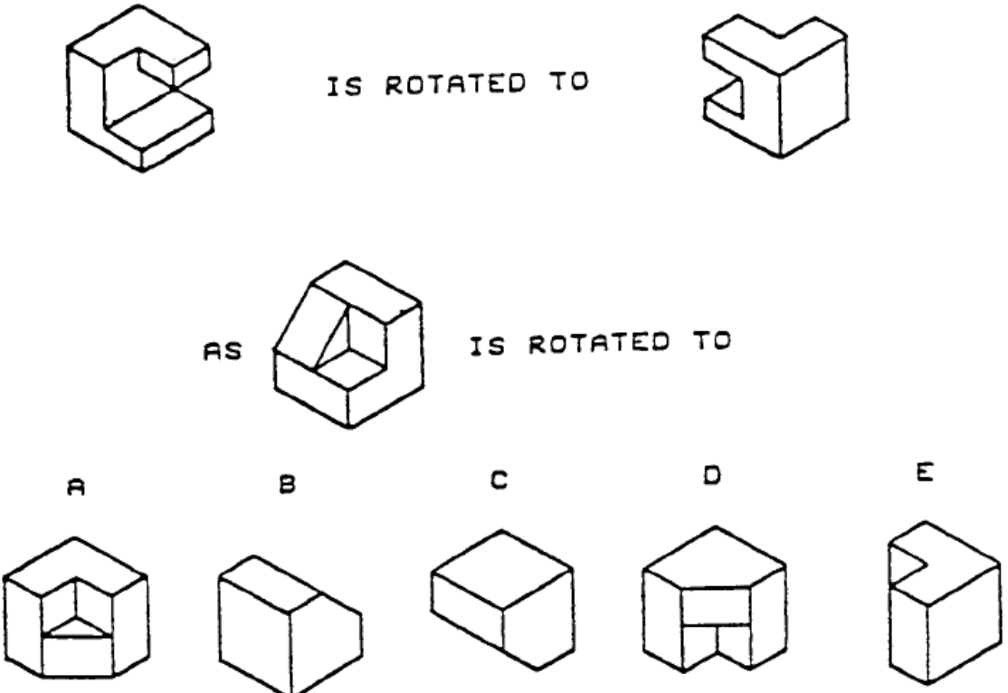
Purdue Visualization Test
The Purdue Visualization Test measure spatial visualization ability. Participants are given 2 images of a block in rotated manner. They have to tell how will the given block look like after similar rotation.

Slide 12
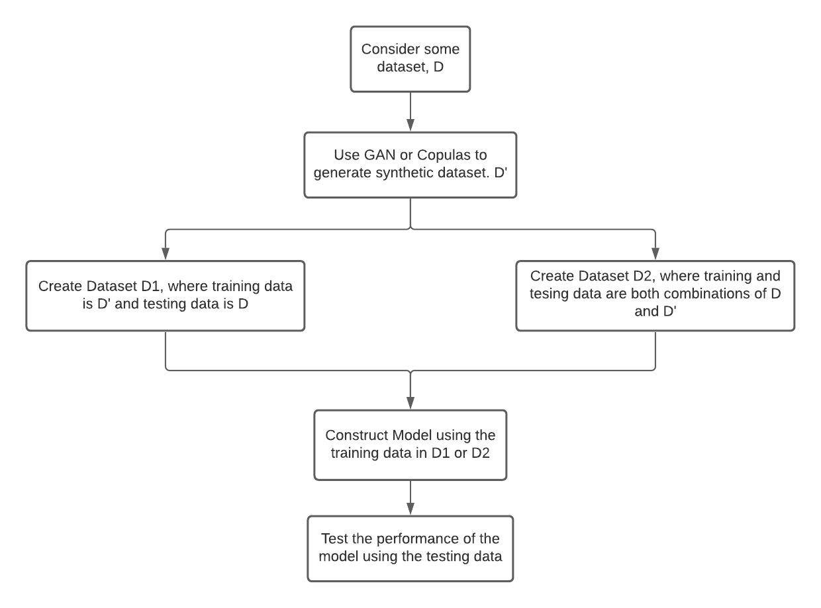
Methodology
To find the relationship between spatial ability and teleoperation, we perform the following steps -

Slide 13
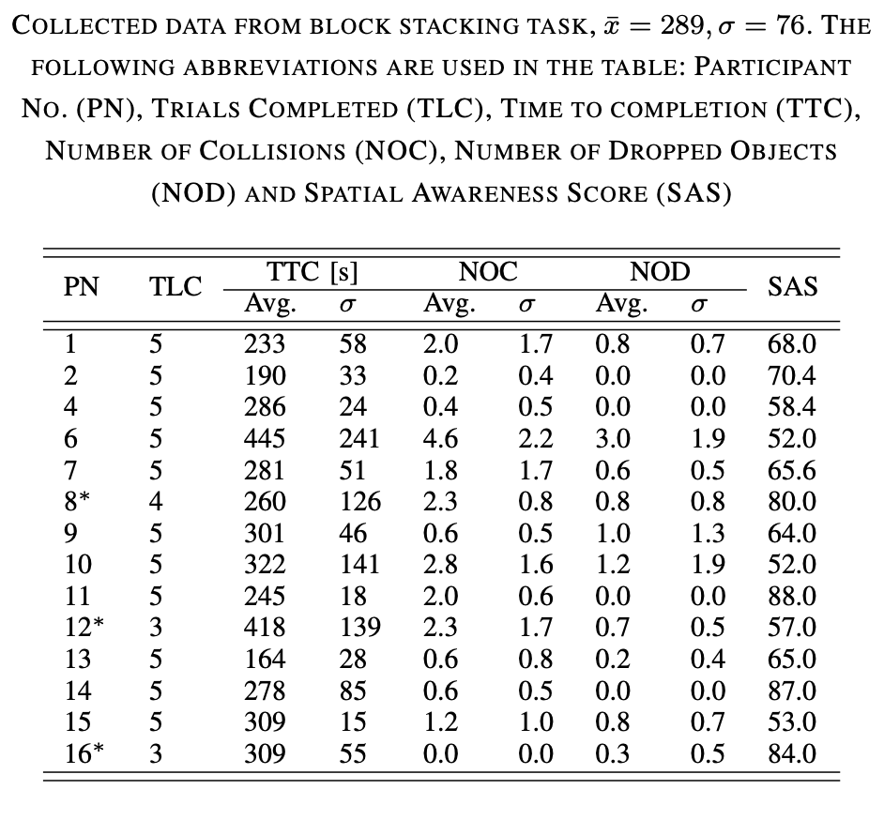
Initial Dataset
The following dataset is used as a base for synthetic data generation -
Teleoperation Task - Each participant was tasked with grasping and stacking five wooden cubes to assemble a tower.
Spatial Ability Test - Two questions assessed 2D rotation, two questions assessed assembly and four questions assessed 3D rotation/folding. A final question consisted of matching 2D rotations between two groups of 25 images. Scores were scaled to 100.
Dataset Taken from https://www.researchgate.net/publication/312322490_Towards_robotic_decommissioning_of_legacy_nuclear_plant_Results_of_human-factors_experiments_with_tele-robotic_manipulation_and_a_discussion_of_challenges_and_approaches_for_decommissioning

Slide 14
Data Generation
Since the number of participants in the initial data are too low to create a viable model, we decided to generate synthetic data first. We tried two methods -
ctGAN (Conditional Tabular Generative Adversarial Network) -
Copulas
We discuss both these methods and their outputs ahead. We give reasons for why we found one to be better than the other as well.

Slide 15
ctGAN (Conditional Tabular Generative Adversarial Network)
A GAN (Generative Adversarial Network) is a model consisting of two main components - A generator and a discriminator. The generator produces the synthesized data, while the discriminator learns to distinguish the synthetic data from the real data. These two components compete against each other to drive the whole system towards optimization.
Tabular data can present the challenges of mixed data types, different distributions in each column and imbalanced datasets. To tackle these issues CTGAN (Conditional Tabular GAN) was developed. In CTGAN, the mode-specific normalization technique is leveraged to deal with columns that contain non-Gaussian and multimodal distributions, while a conditional generator and training-by-sampling methods are used to combat class imbalance problems

Slide 16
Copulas
Given a table containing numerical data, we can use Copulas to learn the distribution and later on generate new synthetic rows following the same statistical properties. The key intuition underlying copula functions is the idea that marginal distributions can be modeled independently from the joint distribution. For example, consider a dataset with two columns containing age and income. A copula-based modeling approach would -
Model age and income independently, transforming them into uniform distributions using the probability integral transform.
Model the relationship between the transformed variables using the copula function.

Slide 17
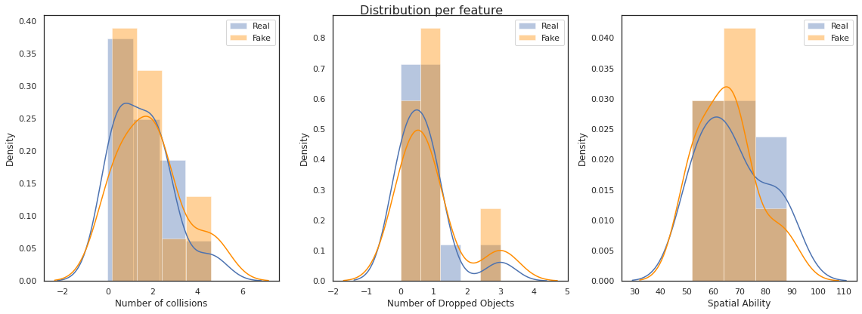
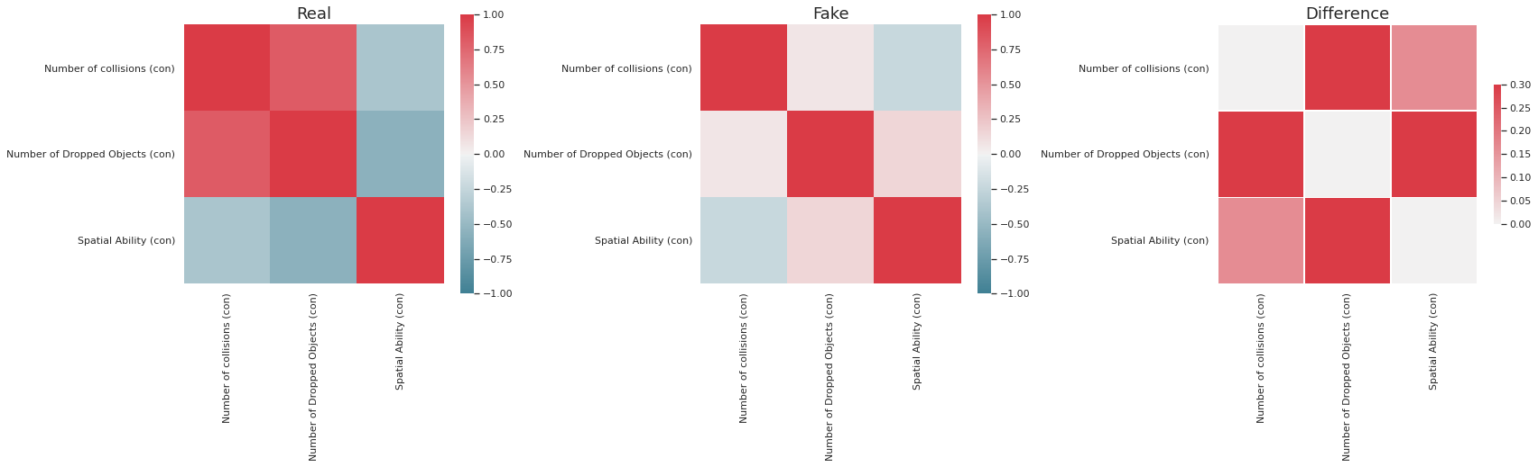
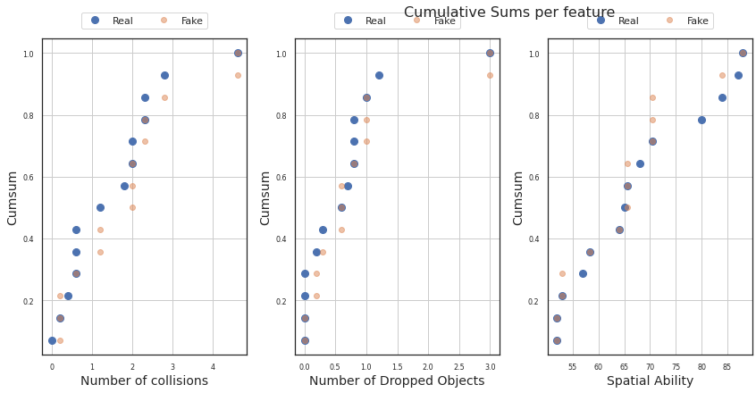
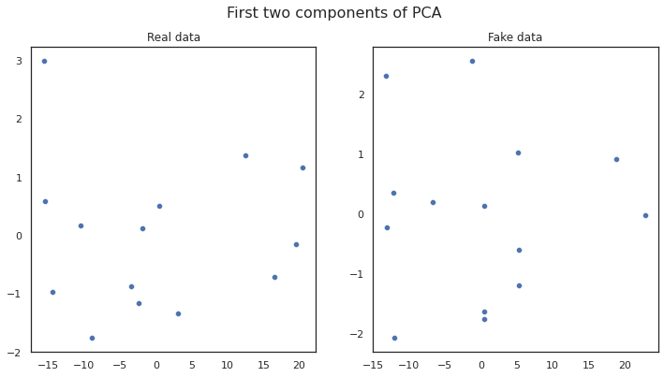
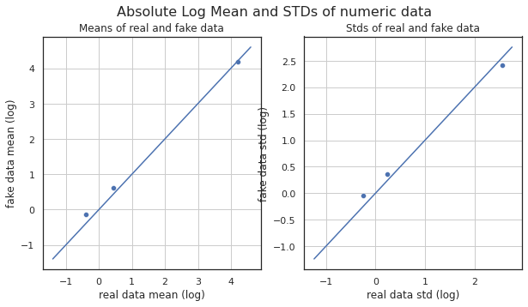
ctGAN
As visible from the below graphs, while most parameters seem appropriate, the correlation of features in the two datasets come out to be very different. Hence, we consider another model to generate the required synthetic data.

Slide 18
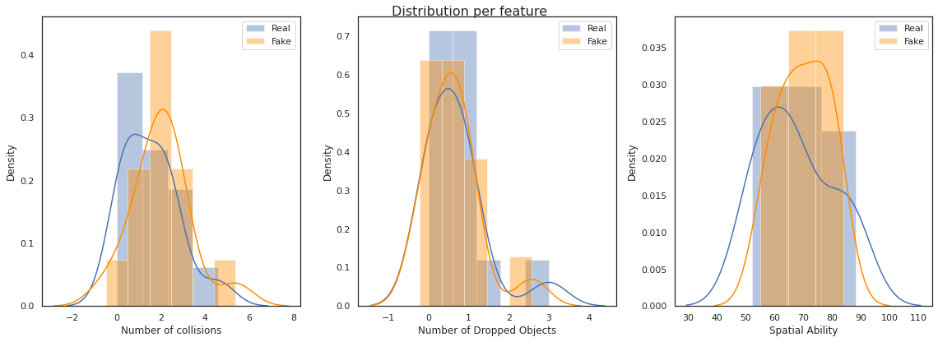
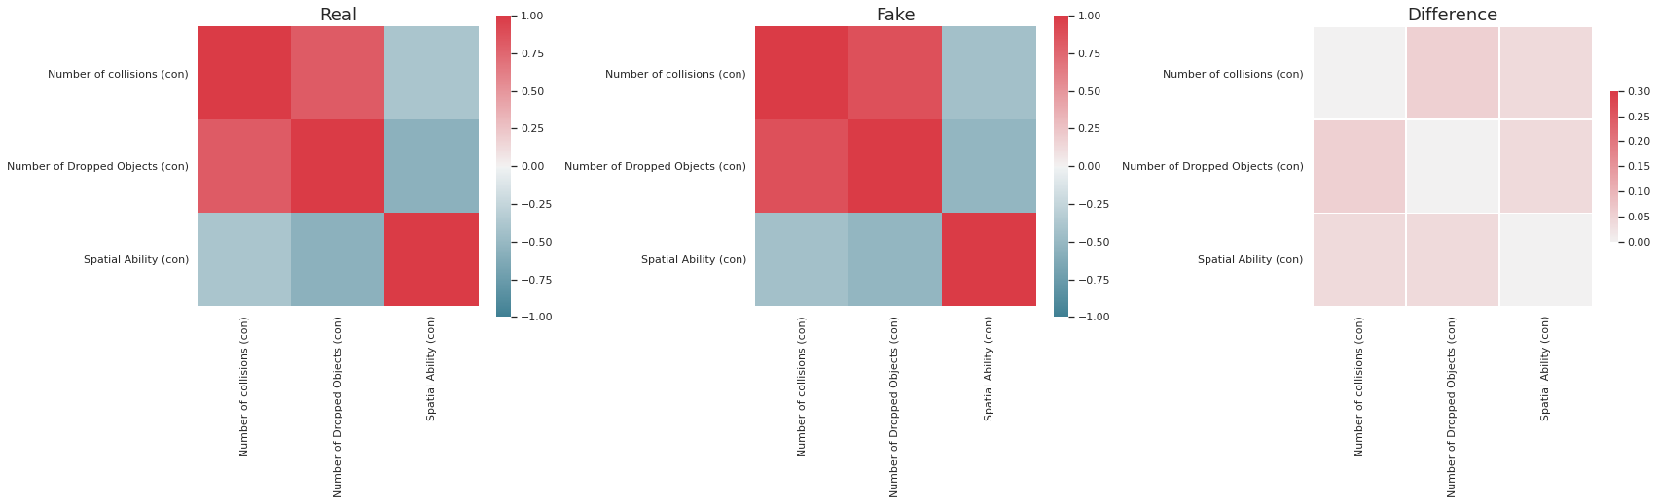
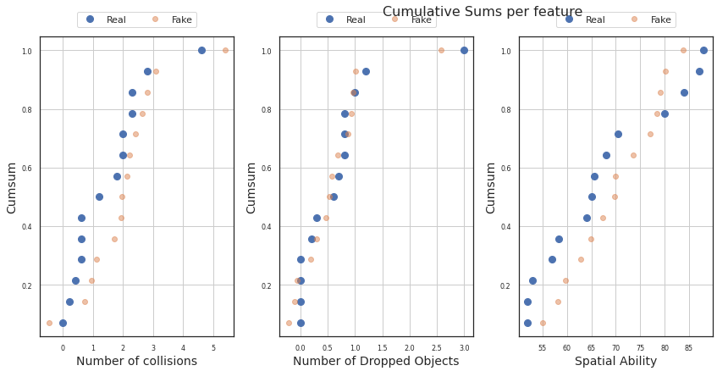
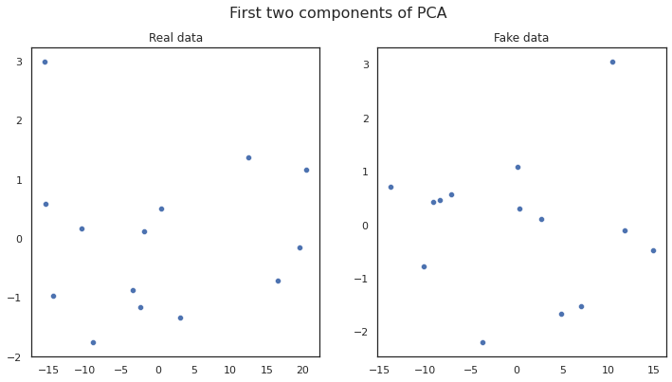
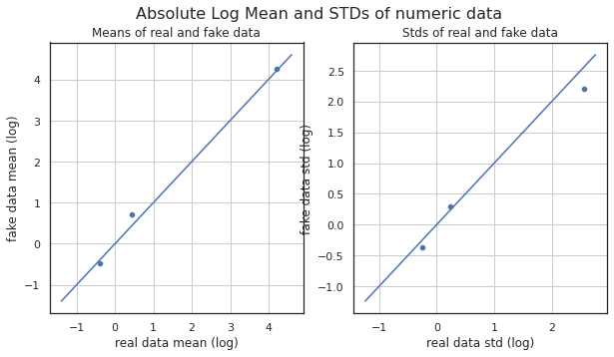
Copulas
Using Copulas, we are able to generate better data which more aptly simulates the original dataset

Slide 19
Differences between Copulas and ctGAN
ctGAN
Copulas
While most parameters such as distribution, mean and standard deviation of both Copulas and ctGAN came out to be close to the real data, the correlation between features in the two methods came out to be very different. As observed from Figure 4.3, we can see that the correlations between the features is much closely simulated in case of Copulas than when compared with ctGAN.
Hence, we found copulas to generate better synthetic data from our initial dataset.
The distribution mean and standard deviation for the data generated has been displayed below when compared to the real data.

Slide 20
Splitting into test and train
We create two different datasets once we have generated synthetic data. The datasets are created in the following way -
Dataset 1 -
Train Data - Same as synthetic dataset
Test Data - Same as the real dataset
Dataset 2
Train Data - We consider 80 percent of the synthesized data and 10 rows from the real dataset
Test Data - We consider the remaining 20 percent of the synthesized data and the remaining 4 rows from the original dataset
We train our model on the train data and then measure its performance using the test data

Slide 21
Predicting Spatial Ability from Number of Collisions and Number of Dropped Objects
We ran various machine learning model on both the datasets. The table shown below shows the deviation of the predicted spatial ability value from the original spatial ability value(Ground truth) when a model is constructed using Number of Dropped Objects and Number of Collisions as the features and Spatial Ability is used as the target.
The table displays the deviation of the predicted spatial ability from the ground truth. Each cell displays the percentage of data within the deviation threshold defined in that column. Hence, we can conclude that if we want to predict spatial ability from number of dropped objects and number of collisions, then SVM performs well and can predict 92 percent of the data with less than 20 percent deviation.

Slide 22
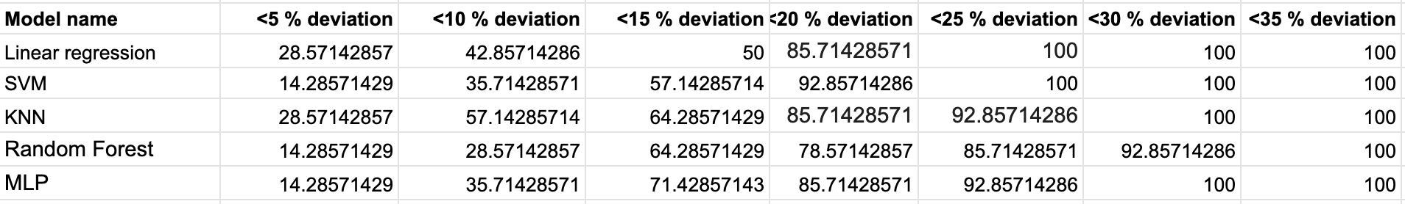
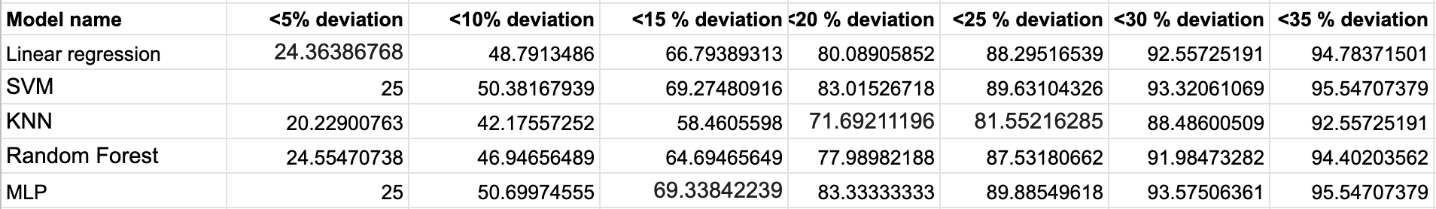
Results
Dataset 1
Dataset 2

Slide 23
Predicting Number of Collisions and Number of Dropped Objects from Spatial Ability
We then constructed separate models for predicting Number of Collisions from Spatial Ability and Number of Dropped Objects from Spatial Ability. To test the performance of these models, we feed the predicted values back into the model defined above and compare the input Spatial Ability and the predicted spatial ability.
The above table displays the deviation of the predicted spatial ability by model 1 from the input spatial ability for model 2. Each cell displays the percentage of data within the deviation threshold defined in that column. Hence, we can conclude that if we want to predict number of collisions and number of dropped objects from spatial ability, then Linear Regression performs well and can predict 90 percent of the data with less than 25 percent deviation.

Slide 24
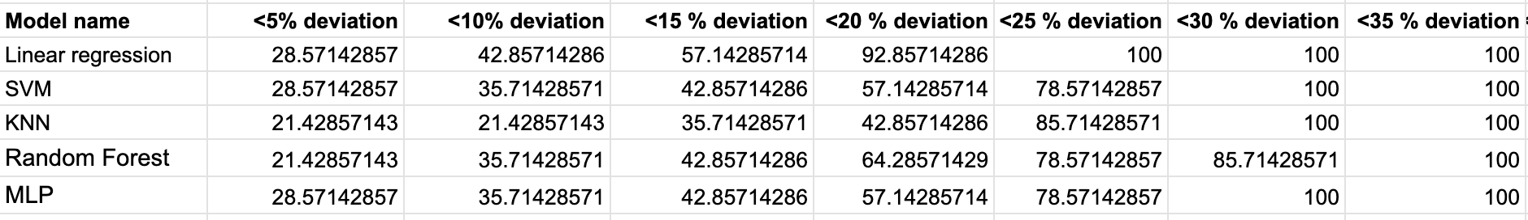
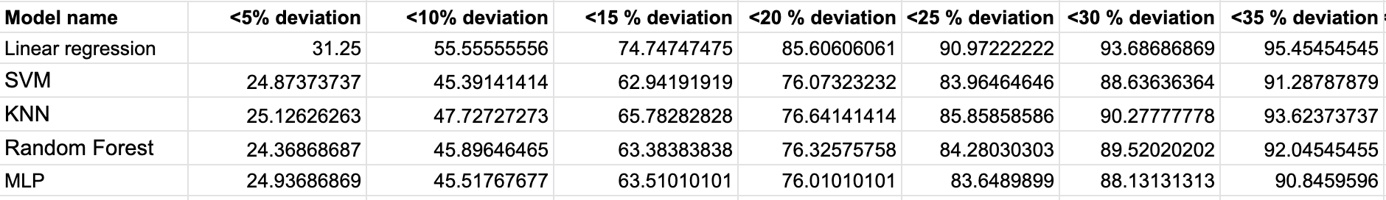
Results
Dataset 1
Dataset 2

Slide 25
Conclusion
The above findings along with the Spatial Ability Tests explained earlier in Chapter 2 can be used to achieve our first aim, i.e. assessing the fitness level of a teleoperator. We can use the following steps to assess a teleoperator's spatial ability -
Employ one or a combination of multiple spatial ability tests on a potential teleoperator.
Get an aggregate Spatial Ability Score for the teleoperator.
This spatial ability score can then be passed as input into the model derived above.
Hence, we can get the predicted number of collisions and the predicted number of dropped objects for the teleoperation task.
These quantities can then be used to identify if a teleoperator is fit to perform the task.

Slide 26
Future Work
We have currently looked into how we can predict spatial ability using total number of collisions and total number of dropped objects as features. Using the model obtained we would like to estimate number of collisions and number of dropped objects using spatial ability calculated from standardized tests discussed before. Further, we can conduct our own study where we can record the angular and positional offsets as well similar to Influence of perspective-taking and mental rotation abilities in space teleoperation . Using such a data set, we should be able to predict the adjustments that one needs to make according to the spatial ability of the operator.

