Slide 1
OHM LAB TERM PROJECT
GENETIC ALGORITHM BASED MODEL
FOR OPTIMIZING BANK LENDING DECISIONS
AYUSH RAJ
19IM30006

Slide 2
Identifying an Optimal Lending Decision for Banks
Distribution of limited credit available during the time of Financial Crisis.
Optimal way to maximize the bank profit and minimize the crediting cost.
Two techniques are used : Genetic Algorithm and Simulated Annealing.
We are assuming that each customer has a set of predefined loan characteristics :
Loan age (α)
Credit limit
Loan size (L)
Loan type (ϕ)
Loan interest rate ( rL)
Expected loan loss (λ) and Borrow credit rating

Slide 3






Fitness function
The GA’s fitness function (Fx) consists of loan revenue (ϑ), loans cost (μ), total transaction cost (ϖ), and cost of demand deposit (β), Predetermined institutional cost (δ). The main objective is to maximize F(x).
N represents number of customers

Slide 4
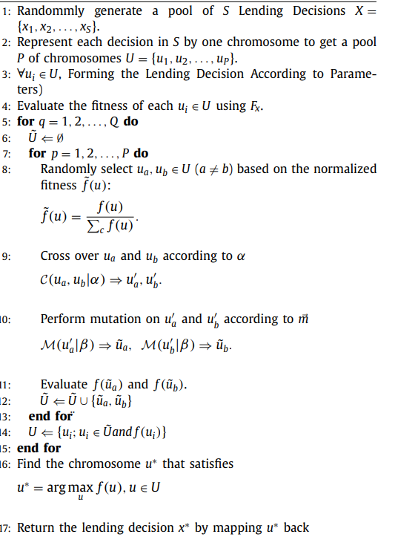
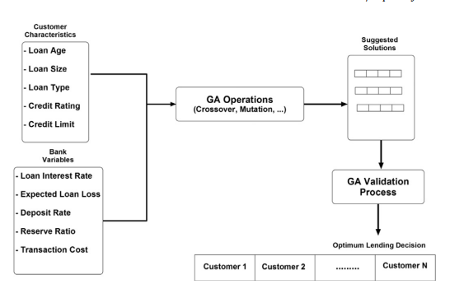
GENETIC ALGORITHM APPROACH

Slide 5
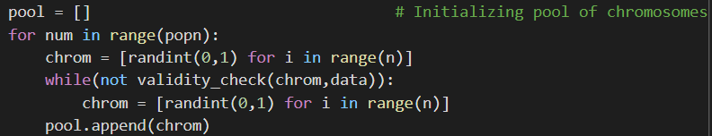
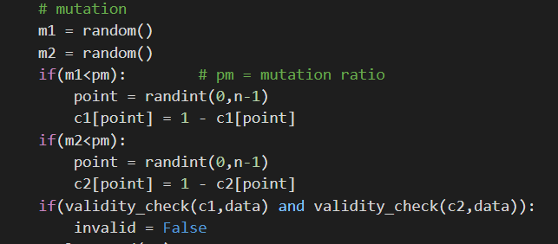
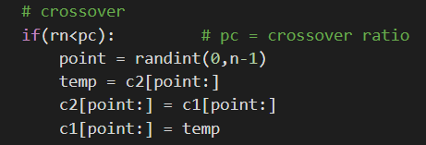
validity_check() function helps us validate that the loans given (L) satisfy the condition (1 − 𝐾)𝐷 ≥ ∑𝐿.
rn = random()
This function returns a random float number between 0.0 to 1.0.

Slide 6
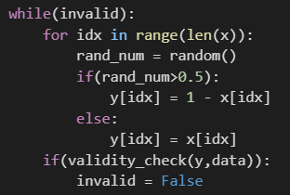
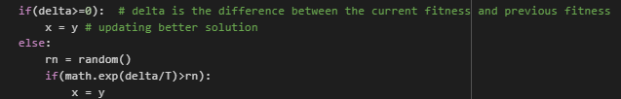
Simulated Annealing Algorithm
Generating 10 random solution to calculate initial temperature.
Generating all kind of possible permutations of 0 and 1 until our chosen customers satisfy loan limit .
After that we will update our solution if it is giving us the better solution otherwise we will check if the probability of getting it is greater than the random number generated between 0 and 1 and will update the solution .
Decreasing temperature until it becomes equal to final temperature.

Slide 7
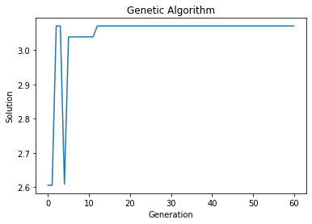
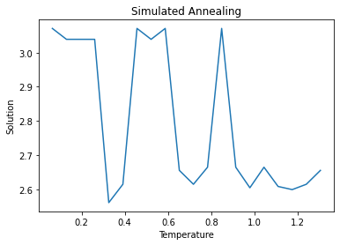
Comparing Results

Slide 8
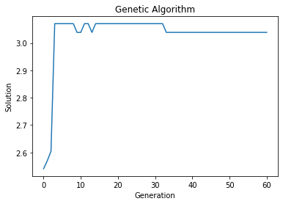
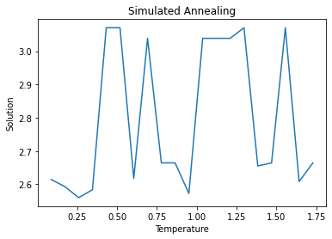

Slide 9
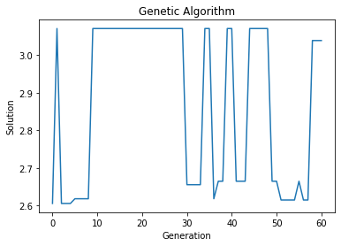
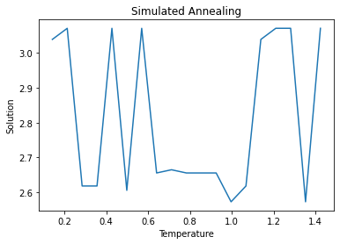

Slide 10
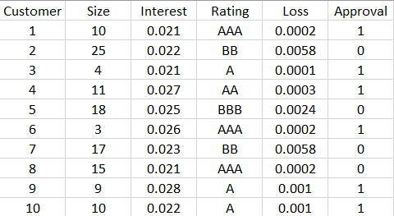
Customers who are approved have Approval = 1 and those who are not have Approval = 0

Slide 11
THANK YOU

