Slide 1

Unveiling the Future of Careers: A Data-Driven Exploration of LinkedIn Job Postings
Presented By:
Saikeshav Motwani
Ayush Patel
Viraj Bhavsar Mitesh Singh
Vedant Pandya
Sherin Jacob
Notes:
Unveiling the Future of Work: Insights from 33,000+ LinkedIn Job Postings
This presentation explores key trends and in-demand skills from a massive data analysis of LinkedIn jobs. We'll use this data to empower individuals, organizations, and policymakers to navigate the changing job market and make informed decisions for a successful future.

Slide 2


Job search or Career Switch

Slide 3
Project Significance
Unveils strategic guidance for individuals on emerging career paths, sought-after skills, and promising locations for career advancement, facilitating well-informed decisions regarding education and professional growth.
Empowers organizations to benchmark competitive compensation, pinpoint trending benefits to attract top talent, and identify skill gaps, shaping talent acquisition and development strategies.
Informs policymakers and educational institutions on industry trends and the evolving demand for job roles, guiding the formulation of educational curricula and policy decisions to prepare a future-ready workforce.
Notes:
Benefits for All:
Individuals: Discover promising careers, high-demand skills, and strategic locations to fuel career growth.
Organizations: Attract top talent with competitive compensation, trending benefits, and targeted skill development.
Policymakers & Educators: Align education and policies with industry needs for a future-ready workforce.

Slide 4
Project Methodology
Data Cleaning and Preprocessing: Standardize, clean, and prepare the dataset for analysis, including handling missing values and categorizing textual data.
Data Description / Exploratory Data Analysis (EDA): Conduct an initial exploration to understand the distribution of key variables such as salaries, benefits, and job locations.
Clustering: Group job postings based on similar characteristics to identify patterns and trends.
Predictive Modeling: Employ machine learning algorithms to predict salaries and identify key factors influencing job benefits and skill requirements.
Trend Analysis: Analyze time-based trends in job postings to forecast shifts in the job market, focusing on remote work and emerging job titles.
Visualization: Use data visualization techniques to present findings, highlighting trends and patterns in a user-friendly manner.
Notes:
Uncovering Insights:
Data Cleaning & Preprocessing: Ensured data accuracy and consistency for analysis.
Advanced Techniques: Clustering, predictive modeling, and trend analysis revealed key insights.
Data Visualization: Clear and compelling presentation of our findings.

Slide 5
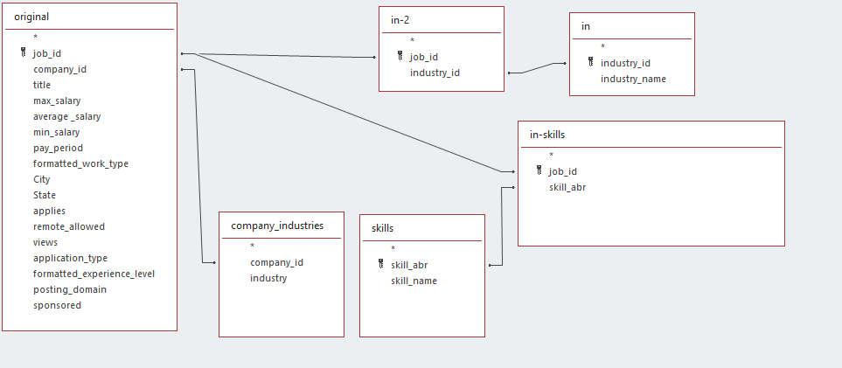
Data Cleaning and Preprocessing
We used Excel to clean the datasets (i.e. removing the blank, null, irrelevant fields)
We then added all datasets to Microsoft Access and form a relationship between these Datasets.
Then we executed the query to get the final Data table.
Made by using Microsoft Excel, Microsoft Access
License: CC BY-SA 4.0
Notes:
The project employed a meticulous methodology to extract the maximum value from the LinkedIn job posting data. The initial phase involved data cleaning and preprocessing, ensuring the data's accuracy and consistency for subsequent analysis. Exploratory data analysis provided a foundational understanding of the data's distribution and key characteristics. Clustering techniques then grouped job postings with similar attributes, revealing underlying patterns and trends. Predictive modeling harnessed the power of machine learning algorithms to forecast salaries and identify factors influencing job benefits and skill requirements. Trend analysis focused on uncovering temporal trends in job postings, particularly regarding remote work opportunities and the emergence of new job titles. Finally, data visualization techniques effectively presented the project's findings in a clear and comprehensible manner.

Slide 6
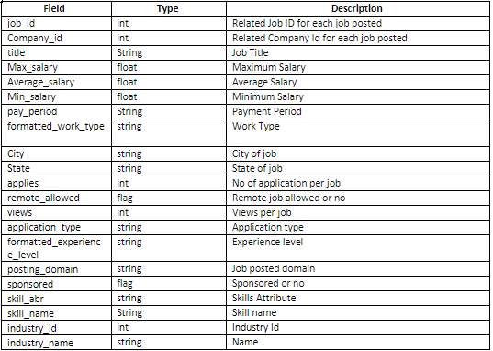
Data Description
After cleaning we can finally describe the data that we are going to use to do some analysis on the prediction of the jobs that are more common or popular in the US.

Slide 7
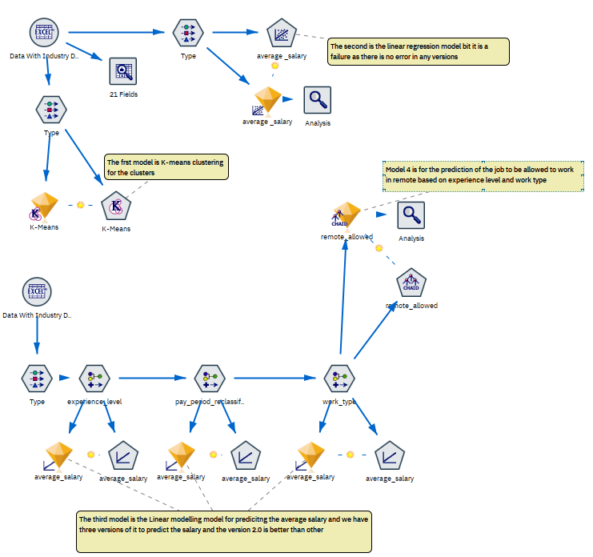
Modelling
K-Means : Work Type
Linear Regression
Linear Modelling (3)
CHAID
Made by using IBM SPSS Modeler

Slide 8
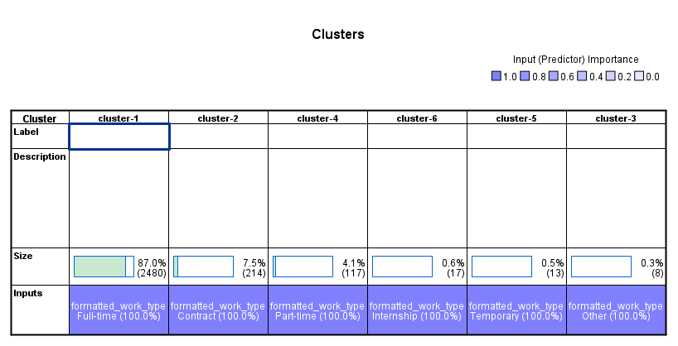
Clustering
Analyzing job postings by work type and application type for employment trend insights.
K–Means : Applied to categorize postings into distinct clusters.
Cluster Distribution:
Largest Cluster: 2480 (87%) for full-time work type.
Smallest Cluster: 8 (0.3%) for other work type.
Insights:
Dominance of full-time positions suggests high demand.
Minority of postings fall under other work types, indicating potential niche opportunities.

Slide 9
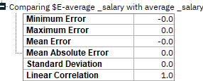
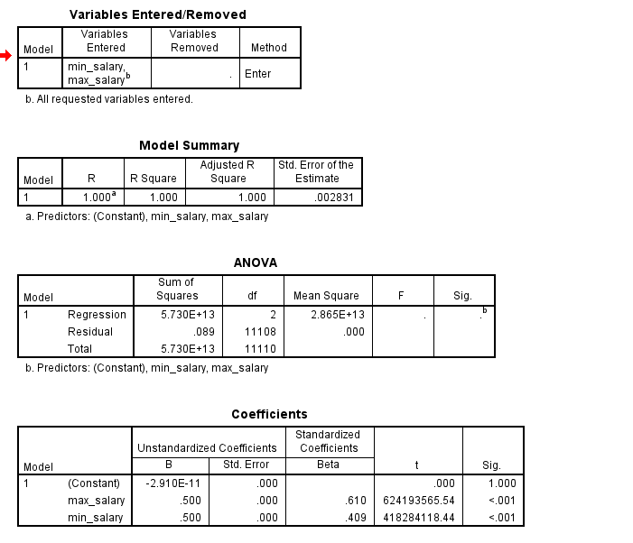
Linear Regression
Model Evaluation Result:
No errors detected during evaluation process.
Consistent predictions with accuracy exceeding 99%.
Outcome Assessment:
Model deemed a failure due to lack of variability in predictions.
Unusable for practical applications as it failed to provide meaningful insights or detect errors.

Slide 10
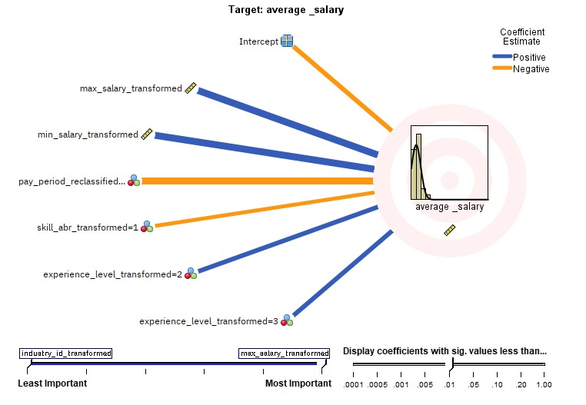
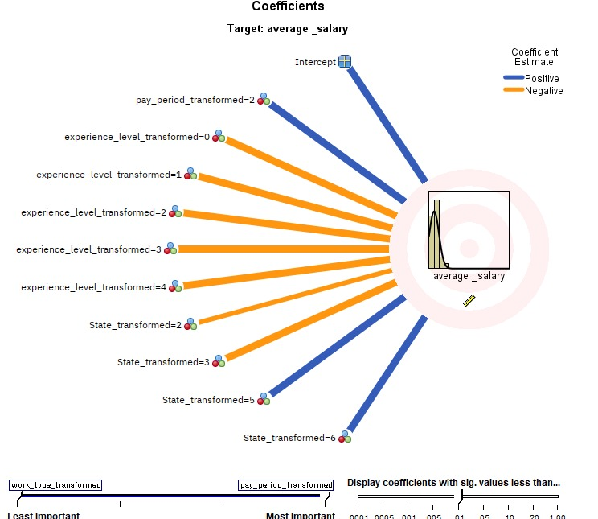
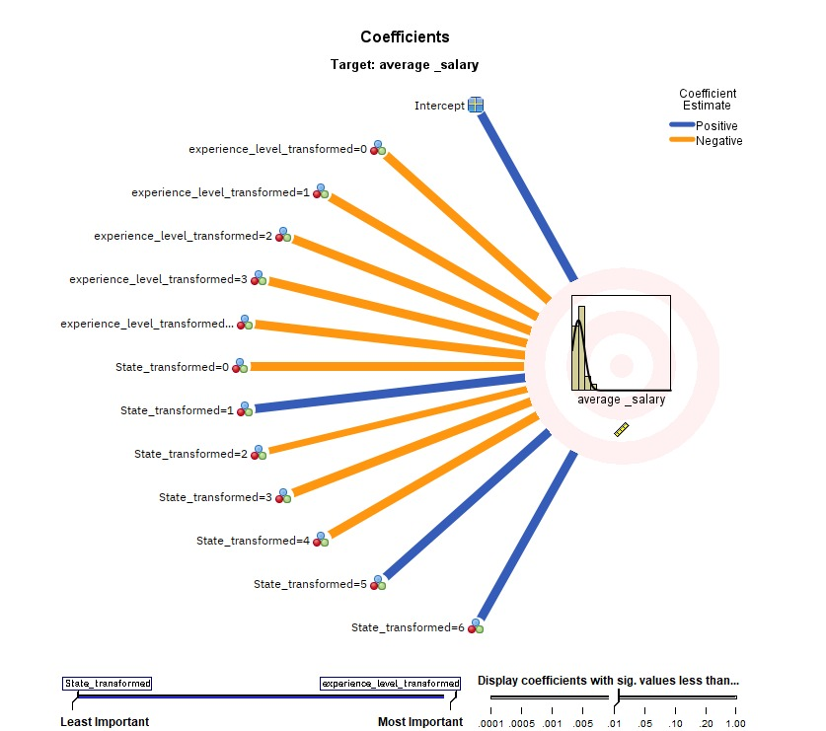
Linear Model
Linear Model 2
Model 2.0 stands out with superior accuracy in predicting average salary due to its incorporation of additional inputs, notably maximum and minimum salary data.
Recognizing the significance of these extra inputs, we opt to test both Model 2.0 and Model 3.0 to determine the most effective choice.
The decision underscores the importance of comparative testing to validate model performance and ensure optimal predictive capabilities.
Beyond accuracy, considerations such as computational efficiency and scalability will inform the final model selection, aligning with project objectives.
Linear Model 3
Linear Model 1

Slide 11
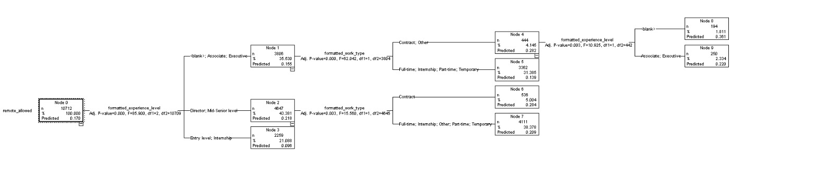
Chaid Model
We came to the conclusion that this model is a good way to forecast whether a job will be approved for remote work or not.
We will determine whether the project has effectively reached its initial objectives by summarizing the assessment results in terms of business success criteria.

Slide 12
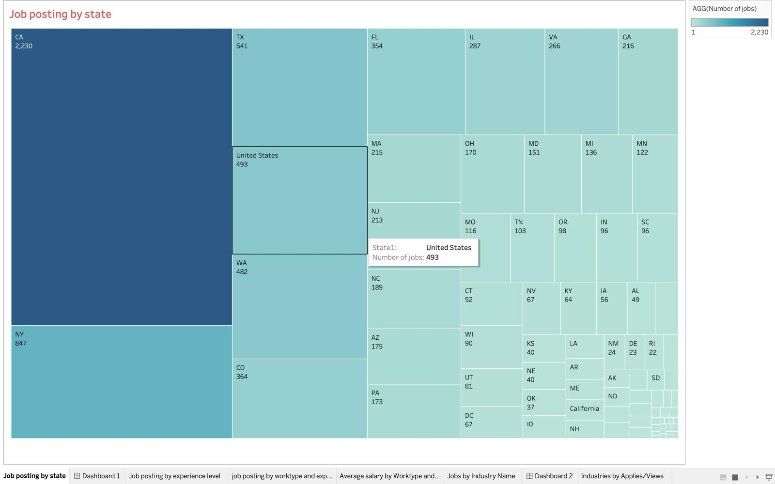
Key Findings: Job Posting by State
Understanding geographical distribution of job postings provides insights into regional job markets and economic activity.
Notes:
California boasts the highest number of job postings (2290), followed by New York (868) and Texas (566).
Examining relationships between states can reveal economic dynamics and labor market trends.
Insights from this analysis empower policymakers, businesses, and job seekers to make informed decisions.

Slide 13
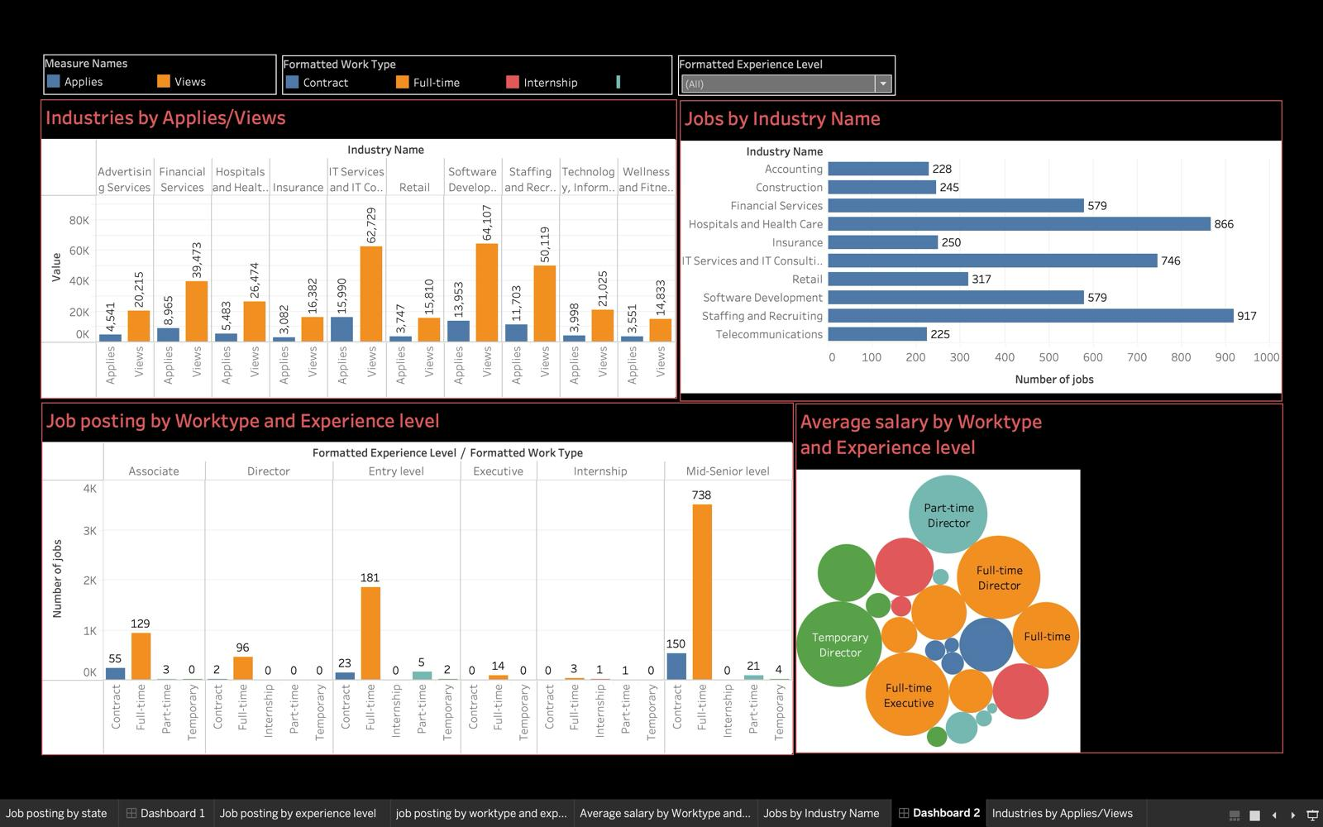
Dashboard
Notes:
Job posting by worktype/experience level:
This slide focuses on the interplay between work types and experience levels within the job market.
The chart depicts the distribution of job postings across various work categories, such as full-time, part-time, contract, and freelance, while simultaneously considering the experience level requirements (entry-level, mid-level, senior) for each position.
By analyzing this data, we can identify work types that are currently in high demand based on the sheer number of postings advertised. Additionally, we can pinpoint the experience level (entry-level, mid-level, or senior) that employers are seeking most frequently within each work type.
This information
Salary by Worktype and Experience:
The chart titled "Average salary by Worktype and Experience level" displays the average salary offered for different worktypes and experience levels. This allows us to understand:
Salary disparity: We can see how salaries vary across worktypes and how much experience influences earning potential.
Competitive compensation: Worktypes with high average salaries for specific experience levels might be more competitive in attracting talent.
By analyzing both charts together, we can gain valuable insights into the job market. We can identify worktypes with high demand and the corresponding experience level employers seek. Additionally, we can understand how salaries are distributed across worktypes and how experience influences compensation.
can be particularly helpful for job seekers in tailoring their resumes and highlighting relevant skills and experiences to match employer preferences.
(Point to the graph) As you can see on this slide, the average salary offered varies depending on both the work type and the experience level.
(Discuss specific observations from the graph) For instance, we can see that full-time positions generally offer a higher average salary compared to part-time work for experienced professionals. Additionally, the average salary increases steadily as we move from entry-level to senior experience within most work types.
(Highlight key takeaways) By understanding these trends, job seekers can make informed decisions about their career paths and salary expectations. They can target work types that offer competitive compensation for their experience level.
Industry by Applies/views:
This chart analyzes applications and views for job postings categorized by industry.
Industry Attractiveness: Industries with high applications and views relative to others are likely more attractive to job seekers, potentially due to factors like salary, work-life balance, or industry growth.
Job Seeker Interest: The application/view ratio provides insights into competition for jobs within an industry. High applications relative to views suggest a competitive landscape, while the opposite might indicate a lack of qualified candidates.

Slide 14
Outcomes and Practical Implications:
Enhanced Career Navigation:
Job seekers can better navigate their career paths with data on in-demand skills and emerging job trends, informed by the LinkedIn data analysis.
Data-Informed Recruitment:
Organizations gain a competitive edge in recruitment by understanding the landscape of job applications and views, allowing them to tailor their talent acquisition strategies effectively.
Policy and Curriculum Development:
Educational institutions and policymakers can utilize the insights to develop curricula and policies that are responsive to the shifting demands of the job market.
Optimized Talent Management:
The analysis provides employers with benchmarks for competitive compensation and insights into benefits that attract top talent, optimizing talent management.
Labor Market Adaptability:
The project's findings enable the workforce to adapt to technological advancements and economic shifts, ensuring resilience in an ever-changing job landscape.
Notes:
Continuing from the insights gathered on our previous slide, it's clear that understanding the intersection between work types, experience levels, and salary offers a comprehensive view of the job market landscape. With a deep understanding of in-demand skills and emerging job trends, job seekers can navigate their paths with clarity, while organizations gain a competitive edge in recruitment and talent acquisition strategies. Moreover, educational institutions and policymakers can utilize these insights to craft responsive curricula and policies, and employers can optimize talent management with benchmarks for compensation and benefits. Ultimately, these findings foster resilience in the workforce, enabling adaptation to technological advancements and economic shifts, ensuring a future where talent thrives amidst change.

Slide 15
Conclusion
Actionable Insights:
The analysis provides actionable insights for individuals to enhance career choices and for organizations to refine talent acquisition strategies.
Strategic Workforce Planning:
Data-driven findings support strategic workforce planning, enabling educational institutions and policymakers to align programs with market demands.
Market Dynamics Understanding:
We now have a deeper understanding of job market dynamics, including the geographic distribution of opportunities and industry-specific growth trends.
Predictive Modeling for Future Trends:
The project demonstrates the effective use of predictive modeling to anticipate future employment trends and the evolving nature of work.
Economic and Societal Growth:
Insights from the project contribute to broader economic growth and societal resilience by informing better career development pathways.
Basis for Continuous Improvement:
The analysis establishes a foundation for ongoing research and improvement in labor market analytics, with potential for expanded impact over time.
Alignment with Digital Transformation:
The project aligns with the digital transformation of the job market, highlighting the role of platforms like LinkedIn in shaping the future of hiring and professional development.
Notes:
By looking at lots of data, we can figure out which skills are most important for different jobs and where those jobs are growing. This helps you pick the best path for your career and helps companies hire the right people. It also helps schools and governments make sure they're teaching the right things for the jobs that are out there. Plus, by using data to look into the future, we can be ready for the changes that are coming in the job market. This isn't just about helping individuals and companies—it's about making our whole economy stronger and giving everyone more opportunities. And by doing this research, we're laying the groundwork for even more improvements down the road. So, let's work together to make sure everyone has a chance to succeed in the ever-changing world of work. Thank you!

Slide 16
References
https://www.kaggle.com/datasets/arshkon/linkedin-job-postings?resource=download
Anderson, B.A., Knestrick, J.M., & Barroso, R. (2015). Capstone Projects: Exemplars of Excellence in Practice: Springer Publishing Company.
Heddle, N. M. (2007). The research question. Transfusion, 47(1), 15-17.
TopResume. https://www.topresume.com/career-advice/soft-skills-and-how-to-showcase-them-on-resume
Tukey, John (1977), Exploratory Data Analysis, Addison-Wesley.

Slide 17

Thank You!

