Slide 1

Color Switch
Presented by
Akhil Anand (2019349)
Ayush Mahant (2019353)

Slide 2

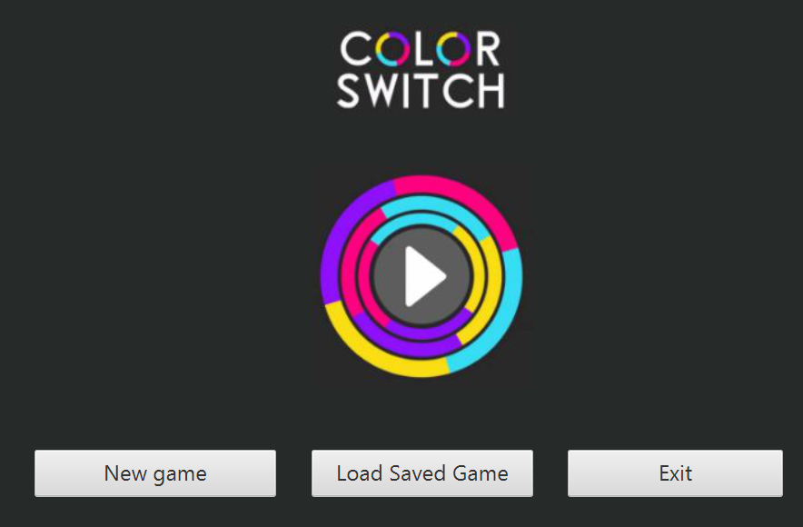
Game Rules and Features
To increase your score, collect more and more stars.
Catching 1 star increases your score by 1.
Hitting a color switch changes the current color of ball
Whenever you hit an obstacle part which is of different color than the current color of ball, the game gets over.
You can go back to your previous game by using 2 stars that you have collected.
You can pause and resume your game.
You can also save and load your games.

Slide 3
Game implementation details
Implemented the game using JavaFx.
Designed the ball and obstacles by using various javafx components such as Circle, Line, ImageView,etc. (The shapes are available in the javafx.Shape class.)
To ensure responsiveness, we used threads using the timelines provided by javafx.
Used the animation feature in javafx.Animation class.
Solved the problem of detecting collision using intersection() method of javafx.Shape class.
Used the concept of stage and scenes in the game to switch between different screens.
Used the scene builder and fxml files for the graphic designing.
Used Label component for showing score, PasswordField component for the password entering, Buttons for user input, ImageView component for holding images.
Solved the problem of implementing the gravity and collision checking using timelines.
Used programming concepts like object oriented programming, file handling, game dynamics, serialisation, multithreading, event handlers, anonymous class, etc.

Slide 4

Hey Kids ! Are you got irritated now because your younger brother and friends keep spoiling your saved games ?
No need to worry now !
The game has a password protection feature, which you can use to prevent your high score saved games from being spoiled by your novice friends and brothers.
Nobody can stop you from achieving your highest score now !
Just enter the password and click on go button.
(Bonus component of project)

Slide 5
Individual Contributions
Akhil Anand:
Designed the UML class diagram, added the graphics, designed the main page, designed the various obstacles using javafx components, implemented the game logic and code, added the color switch, added the animations including the gravity and ball color changing feature, added the collision feature, added the bonus component.
Ayush Mahant:
Designed the UML use case diagram, added jump animation in tha ball, added various user interactive features of game like pausing, resuming and restarting the game, added “go to main menu” feature, added the feature of saving and loading game, added the score increment and decrement feature, added the feature of using stars to continue on game over..

