Slide 1

Notes:
Sources:
- C:\Users\PRO\Downloads\AIC_Talent-Brand_PPT-Template (1).pptx, first slide used as opening visual per user request.

Slide 2
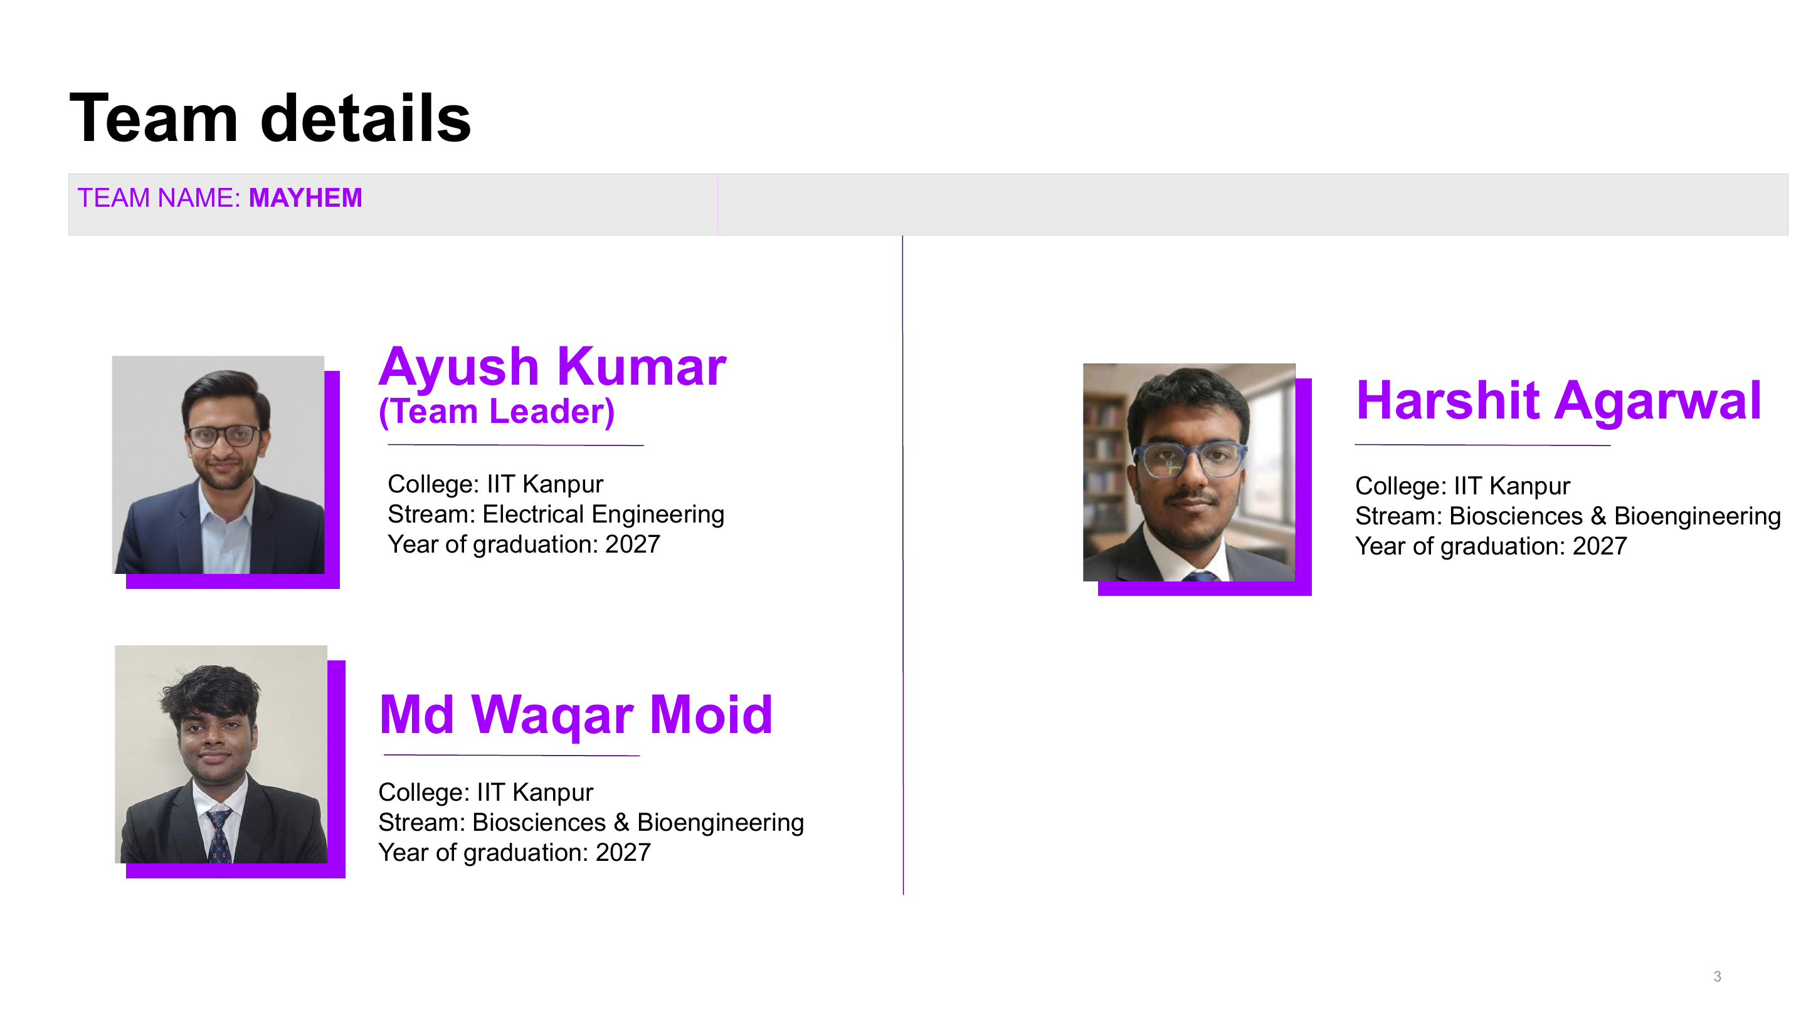
Notes:
Sources:
- C:\Users\PRO\Desktop\Accenture_Innovation_Challenge_2026\mayhem.pdf, page 2 rendered and used as slide 2 per user request.

Slide 3
PatientTriage.ai
>
DETAILED BUSINESS PROPOSAL
The queue is alive.
Triage should be too.
A static, offline-capable decision-support layer for emergency-department waiting rooms.
Live prototype
patient-triage-ai-three.vercel.app
Notes:
Sources:
- User request: Detailed Business Proposal for PatientTriage.ai.
- Template reference: AIC_Talent-Brand_PPT-Template (1).pptx.
- Live deployment provided by user: https://patient-triage-ai-three.vercel.app/.

Slide 4
PatientTriage.ai
01
ED triage has a blind spot: time.
The current system remembers the first answer.
A patient can become unsafe while still sitting in the same waiting-room chair.
3.3%
undertriaged life-stabilising encounters in the PRD evidence base
Patient risk does not.
43%
That gap is where quiet crashes happen.
reported ESI decision point B accuracy
14h
consultation delay cited for a high-volume Indian ED context
WHAT GOES WRONG DURING THE WAIT
Arrival
>
Queue
>
Drift
>
Miss
Sparse history, one-time category
Crowding delays reassessment
Vitals and symptoms move
Atypical risk stays invisible
Notes:
Sources:
- docs/01-PRD.md, problem framing and cited evidence table.
- docs/08-BRIEF-COVERAGE.md, Round 2 coverage map.

Slide 5
PatientTriage.ai
02
PatientTriage.ai keeps the waiting room clinically visible.
It does not replace triage. It watches for the cases that static triage is most likely to miss.
Nurse decides.
SENSE
Arrival complaint, vitals, age band, pregnancy status, visual signs, sparse reassessments.
No patient movement. No treatment order. No hidden automation.
SCORE
Hard rules + physiology + presentation risk + time hazard + uncertainty.
EXPLAIN
Confidence, derivation, fired rules, resolving question, and override state.
The product earns trust by showing what it knows, what it does not know, and why it escalated.
Notes:
Sources:
- docs/01-PRD.md, core principles.
- docs/02-TRD.md, engine and deployment constraints.
- docs/03-APP-FLOW.md, board and inspector flow.

Slide 6
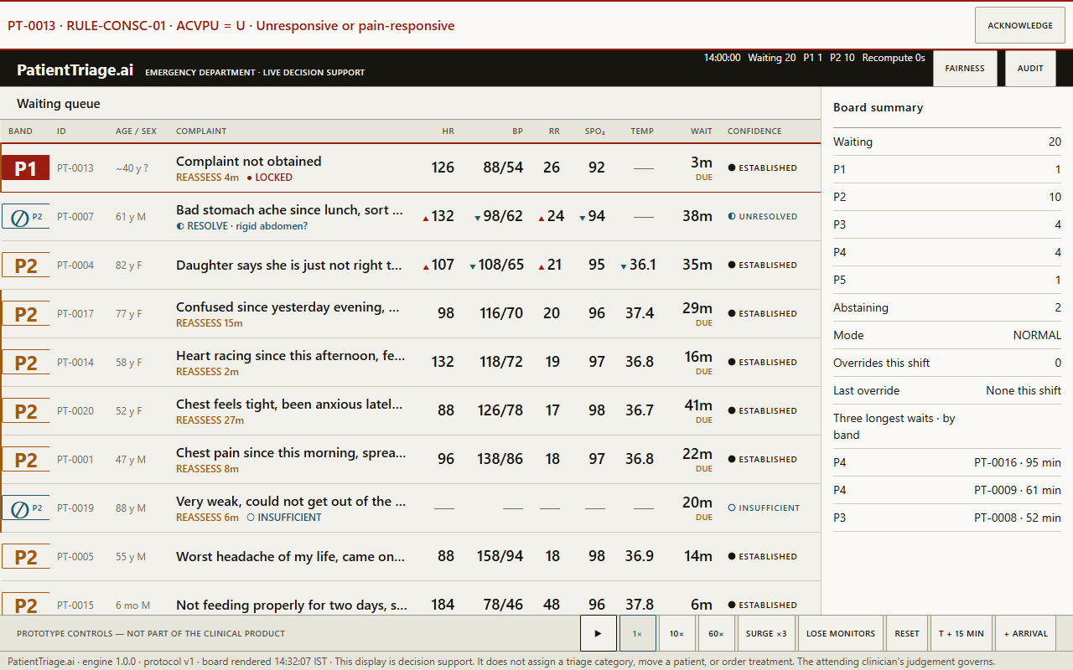
PatientTriage.ai
03
The prototype already tests the awkward cases.
The demo is not just a happy path queue; it includes ambiguity, missing data, surge, and age-specific risk.
20
keyframed simulated patients
PT-0007
ambiguous abdominal pain
PT-0013
zero-history P1 lockout
3x
surge stress mode
Every score
confidence + derivation
Notes:
Sources:
- docs/08-BRIEF-COVERAGE.md, prototype coverage.
- assets/data/cohort.json, simulated cohort and expectation blocks.
- docs/ui-survey/S1-queue-NORMAL-1280x800-light.png, app screenshot.

Slide 7
PatientTriage.ai
04
Designed for the people carrying the ED queue.
The interface and operating model are built for interruption, sparse data, and clinical accountability.
TRIAGE NURSE
CHARGE NURSE / ED PHYSICIAN
Needs a fast second set of eyes, not another form.
Needs to know who is deteriorating before the next loud event.
CLINICAL GOVERNANCE
HOSPITAL LEADERSHIP
Needs evidence: derivation, fairness monitor, override trail, protocol history.
Needs a low-friction pilot before committing to integration spend.
Notes:
Sources:
- docs/01-PRD.md, target users, adoption constraints, and rollout assumptions.
- docs/08-BRIEF-COVERAGE.md, target user mapping.

Slide 8
PatientTriage.ai
05
The safety architecture is intentionally conservative.
Undertriage is treated as more costly than overtriage, and uncertainty is shown rather than averaged away.
Hard clinical gates
PIN_P1 and FLOOR_P2 outrank the model.
8:1
Population-specific physiology
Age band and pregnancy path selected before thresholds.
undertriage asymmetry
Presentation floors
Dangerous symptoms can escalate despite normal vitals.
Uncertainty states
UNRESOLVED asks; UNRESOLVABLE escalates; INSUFFICIENT refuses false certainty.
Notes:
Sources:
- docs/AGENTS.md, clinical invariants.
- docs/02-TRD.md, scoring engine, band floors, cost matrix, and rule evaluation.
- docs/05-BACKEND-SCHEMA.md, engine assertions and constraints.

Slide 9
PatientTriage.ai
06
The business case is safer escalation without rip-and-replace IT.
PatientTriage.ai creates value before deep integration: it gives clinicians a live queue signal and gives leaders an auditable safety record.
1
Reduce quiet-crash risk
Earlier visibility for patients becoming unsafe while waiting.
What not to optimise
Average wait time
2
Pilot quickly
The success metric is whether the highest-risk waiting patients are seen sooner.
Stage 1 runs on one offline-capable tablet with no new integration.
Notes:
Sources:
- docs/01-PRD.md, success metrics and rollout logic.
- README.md, static deployment and local execution instructions.

Slide 10
PatientTriage.ai
07
Pilot economics are small enough to test, but measurable enough to judge.
The proposal does not need a claimed ROI to be credible; it needs a falsifiable pilot model.
PILOT ENVELOPE
4-6 weeks
1 tablet
No EHR
Weekly review
one ED observation window
Stage 1 hardware footprint
manual/simulated data entry for first pilot
clinical governance cadence
BREAK-EVEN LOGIC
MEASURED IMPACT, NOT GUESSED SAVINGS
If the pilot prevents even a small number of clinically significant waiting-room escalations, the value case moves from software efficiency to risk reduction.
Track P95 time-to-clinician for highest-risk rows, override direction, abstention response, fairness drift, and post-triage acuity upgrades.
Decision gate: continue only if safety signal quality improves without adding unacceptable nurse workload.
Notes:
Sources:
- docs/01-PRD.md, success metrics and Day 1 offline-tablet rollout.
- README.md, prototype scope and local execution model.
- Business-case numbers are pilot-planning assumptions derived from the documented Stage 1 scope, not claimed measured ROI.

Slide 11
PatientTriage.ai
08
Accountability is part of the product, not a footnote.
The hospital owns the protocol. The clinician owns the decision. Compliance is designed for review, not claimed by slogan.
PROTOCOL FILE
Clinical constants and thresholds are data, not hidden code.
DERIVATION
Every band carries the layers, fired rules, confidence, and reason.
OVERRIDE
Clinicians can override without friction; the act is visible and logged.
COMPLIANCE POSTURE
DPDP-first minimisation, with HIPAA/GDPR compatibility subject to site validation.
Notes:
Sources:
- docs/05-BACKEND-SCHEMA.md, audit model and retention.
- docs/01-PRD.md, nurse authority and fairness monitoring.
- docs/08-BRIEF-COVERAGE.md, jurisdiction and compliance-review framing.

Slide 12
PatientTriage.ai
09
Roadmap: prove safety first, integrate second.
Each phase adds capability only after the previous loop is trusted clinically.
Day 1
Month 3
Stage 3
Offline tablet
Read-only listener
Flow network
Standalone board, local protocol, simulated cohort, override and audit.
HL7/FHIR feed updates arrivals and vitals without workflow writeback.
Bed pressure, regional capacity, and overflow signalling.
Notes:
Sources:
- docs/01-PRD.md, staged rollout.
- docs/02-TRD.md, static deployment and future integration boundaries.

Slide 13
PatientTriage.ai
10
The main risks are real; the design already answers them.
The proposal should not pretend an ED AI product is low-risk. It should show where the risk is contained.
Alert fatigue
Only true P1 uses interruptive filled styling; degraded mode sorts by provisional band.
Clinical liability
Decision support only; derivation and override trail make responsibility explicit.
Bias
Fairness monitor surfaces subgroup upgrade patterns for governance review.
Protocol drift
Fixtures and tests catch drift; clinical constants stay in protocol.v1.json.
Privacy
Stage 1 avoids direct identifiers and deep integration.
Notes:
Sources:
- docs/01-PRD.md, risks, success metrics, and adoption model.
- docs/AGENTS.md and docs/02-TRD.md, non-negotiable invariants.
- docs/08-BRIEF-COVERAGE.md, risk and compliance coverage.

Slide 14
>
Pilot ask
One ED. One tablet. Four to six weeks.
Measure high-risk time-to-clinician, quiet-crash signals, override direction, abstention response, fairness drift, and clinician trust.
If the board cannot help a nurse answer 'who do I see next, and why?', it does not scale.
Notes:
Sources:
- docs/01-PRD.md, pilot and success metrics.
- UI-SURVEY-BRIEF.md, arm's-length usability test.
- User-provided live deployment link.

