Slide 1
Gröbner Basis Methods for the Kinematics of Planar and Spatial Robotic Mechanisms
BACHELOR THESIS PROJECT · IIT KHARAGPUR
2R1P robot, 3-RPR manipulator and Stewart platform
Ayush Verma
23MF10008
Supervisor: Prof. Mousumi Mandal
Department of Mathematics
Notes:
Good morning. My project is about solving robot kinematics with Gröbner bases. Many robot problems reduce to polynomial equations, and Gröbner bases give an algorithm for solving them. I worked under Prof. Mousumi Mandal in the Department of Mathematics, and I tested the method on three mechanisms: a planar 2R1P robot, a planar 3-RPR manipulator and a Stewart platform.

Slide 2
Kinematics as Polynomials
THEORY · 01
Forward kinematics: joints known, find the pose
Inverse kinematics: pose known, find the joints
Replace each angle θ by (cos θ, sin θ) with c² + s² = 1
Write every leg or link as a squared distance
Mechanism geometry
Polynomial equations f1, …, fn
Gröbner basis of the ideal
Triangular system, back-substitution
Real, admissible solutions
Every equation is now polynomial, so we can solve the whole system.
Notes:
A robot has joint variables, and its end-effector pose depends on them. In forward kinematics we know the joints and want the pose; in inverse kinematics it is the other way round. If we replace every joint angle by a cosine and sine pair, and write every leg or rigid link as a squared distance, all the equations become polynomial. The workflow on the right is the same for every mechanism: geometry, polynomial equations, a Gröbner basis, a triangular system, and finally the real solutions that are physically admissible.

Slide 3
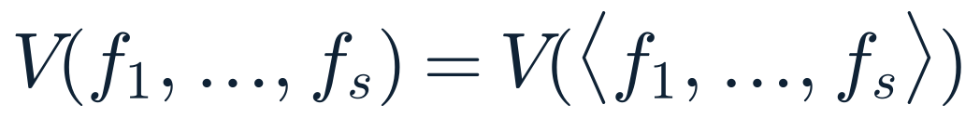
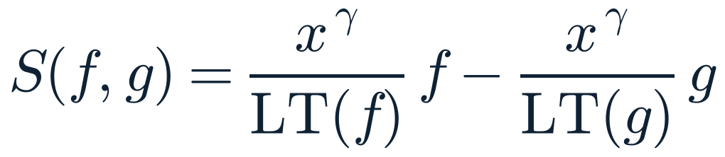
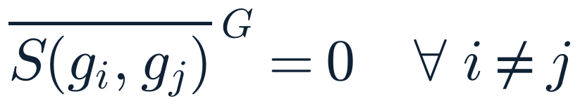
Gröbner Bases
THEORY · 02
The solutions depend only on the ideal, not on the chosen equations
A Gröbner basis is a better generating set of the same ideal
Buchberger's algorithm builds it from S-polynomials
A monomial ordering decides which term of each polynomial leads
IDEAL AND VARIETY
S-POLYNOMIAL
BUCHBERGER'S CRITERION
Same solutions, but the new equations are much easier to solve.
Notes:
Two ideas matter here. First, the set of solutions depends only on the ideal generated by the equations, so we may replace the equations by any other generating set of the same ideal. A Gröbner basis is a generating set with very good properties. Second, Buchberger's algorithm computes one. It forms S-polynomials, which cancel the leading terms of two polynomials, reduces them, and adds any non-zero remainder. When every S-polynomial reduces to zero, we have a Gröbner basis. All of this depends on a monomial ordering, which I look at next. Proofs are in Cox, Little and O'Shea.

Slide 4
Monomial Orderings
THEORY · 03
Lex: leftmost exponent decides and eliminates variables
Grlex: total degree first, then lex
Grevlex: total degree first, then the rightmost exponent
The ordering changes both the output and the cost
Ordering | Rule | x²z vs xy²
lex | leftmost entry decides | x²z larger
grlex | degree, then lex | x²z larger
grevlex | degree, then rightmost entry | xy² larger
Example with x > y > z
3 orderings
compared on every mechanism
Same ideal, same solutions, very different computation time.
Notes:
A monomial ordering decides which term of a polynomial is the leading term. Lex compares the leftmost exponent first, and it eliminates variables one by one, which gives a triangular output. Grlex compares total degree first and breaks ties with lex. Grevlex also compares total degree first, but breaks ties by the rightmost exponent. The small table shows that with x greater than y greater than z, x squared z beats x y squared in lex and grlex, but not in grevlex. The solutions do not depend on the ordering, but the computation time does, and I compare all three later.

Slide 5
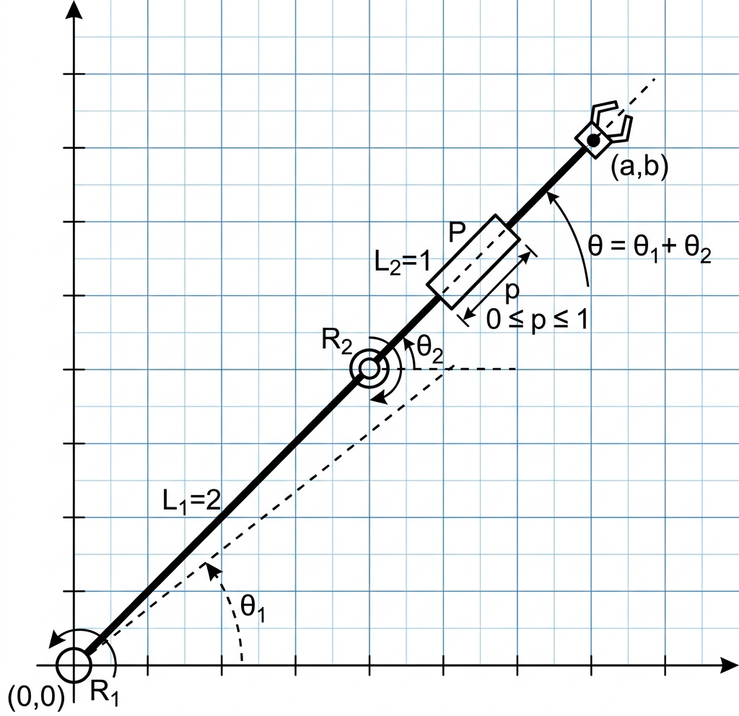
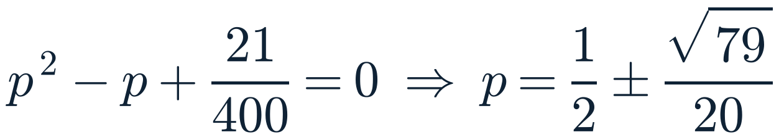
2R1P Robot
CASE STUDY · 01
Two revolute joints and one prismatic joint
Target pose: a = 3/2, b = 39/20, θ = 0°
Six equations in five unknowns, still consistent
The basis is triangular, ending in one equation in p
2
real solutions
p | θ1 | θ2
0.056 | 77.2° | −77.2°
0.944 | 102.8° | −102.8°
RESULT OF THE BASIS
Both roots lie in 0 ≤ p ≤ 1, so both configurations are physical.
Notes:
First case: a planar robot with two revolute joints and one prismatic joint, solving the inverse problem. The target is a equals 3 over 2, b equals 39 over 20, with the end effector pointing along the x-axis. That gives six equations in five unknowns, which is overdetermined but consistent. The Gröbner basis ends in a single quadratic in p, so p is one half plus or minus root 79 over 20. Both values satisfy the limit 0 to 1, so there are two physical configurations, with the arm leaning left or right.

Slide 6
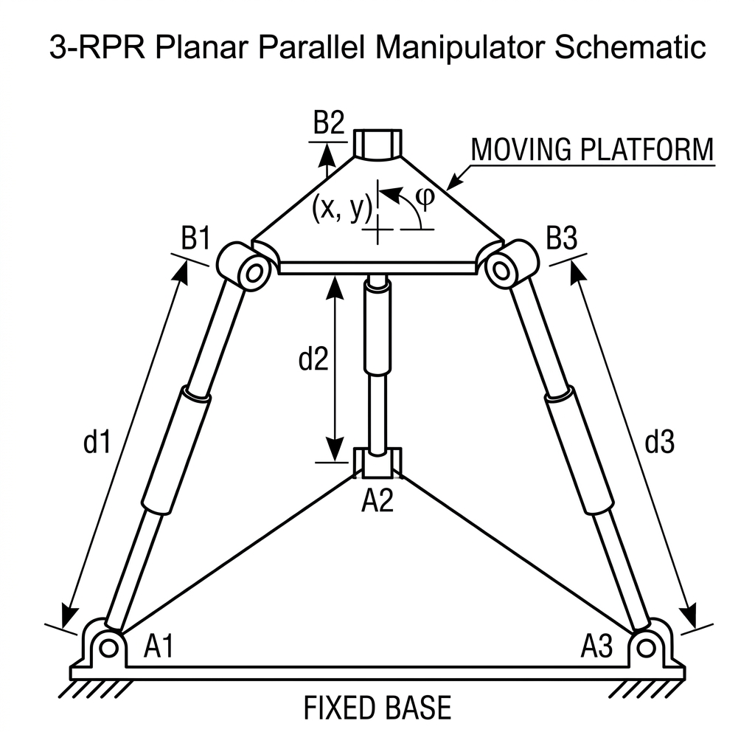
3-RPR Manipulator
CASE STUDY · 02
Three R-P-R legs: a forward kinematics problem
Four equations in x, y, c, s with c² + s² = 1
A degree-6 polynomial in s: up to six poses
Both quadratic factors have no real roots
1
real pose
Pose
(x, y, φ) = (0, 1, 0°)
RESULT OF THE BASIS
Only s = 0 is real: the platform just moves one unit up.
Notes:
Second case: a planar 3-RPR parallel manipulator, where the forward problem is the hard one. We know the three leg lengths and want the platform pose. The Gröbner basis gives x, y and c as polynomials in s, plus one univariate polynomial of degree six, matching the classical bound of six assembly modes. Two quadratic factors have negative discriminant, so the only real root is s equals zero. Back-substitution gives a single real pose: the platform is translated one unit upward with no rotation.

Slide 7
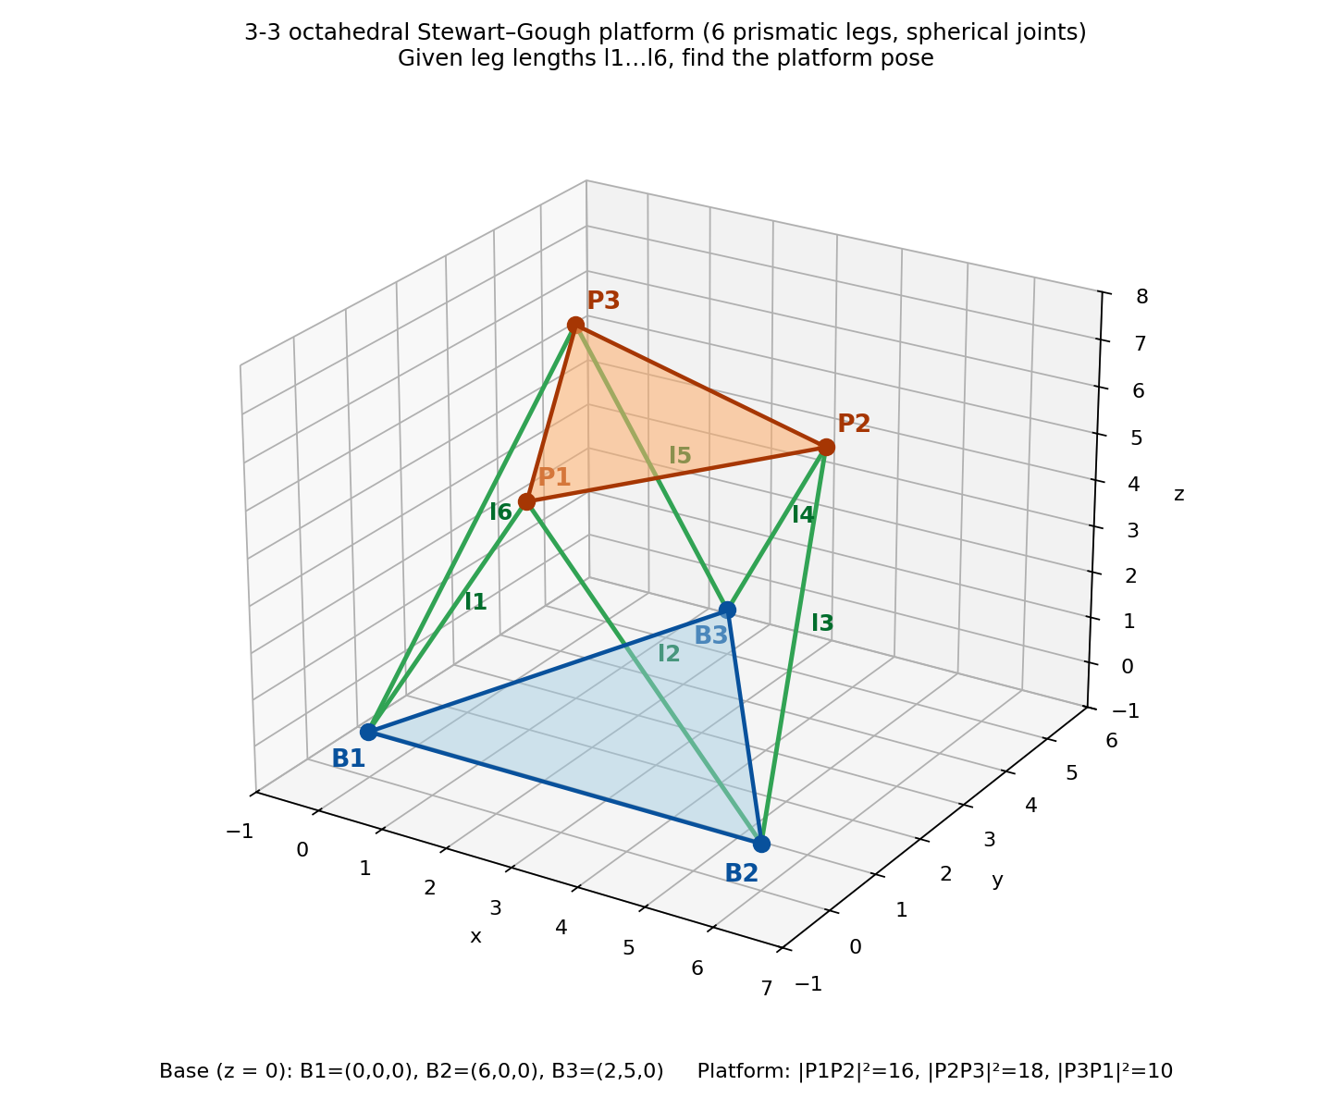
Stewart Platform
CASE STUDY · 03
Octahedral (3-3) form with six legs
Nine equations in nine unknowns: the nodes P1, P2, P3
Basis gives x1 = 1 and a degree-16 polynomial in z3
Sixteen complex poses; four are real
4 of 16
real poses
Two mirror pairs under z → −z
RESULT OF THE BASIS
Real poses come in mirror pairs through the base plane.
Notes:
Third case, and the hardest: an octahedral Stewart platform, where each platform node is joined to two base joints. The unknowns are the three platform nodes, giving nine equations in nine unknowns. The Gröbner basis shows that x1 equals 1 for every solution, and ends in a univariate polynomial of degree 16 in z3. That is an octic in z3 squared, so the 16 complex solutions come in mirror pairs. Only two positive real roots exist for z3 squared, which gives four real poses: two mirror pairs about the base plane.

Slide 8
Python vs Macaulay2
RESULTS · 01
SymPy Buchberger against Macaulay2 gb
Macaulay2 is 100 to 10,000× faster
Lex is the slowest ordering in Macaulay2 on all three
Python lex on the Stewart platform ran past 600 s
Python times are whole-script times, so read the ratios as practical.
Notes:
I also compared my SymPy-based Buchberger implementation with the built-in gb command of Macaulay2, under lex, grlex and grevlex. The vertical axis is logarithmic. Macaulay2 is about two to four orders of magnitude faster, and lex is the most expensive ordering in Macaulay2 for all three mechanisms. For the Stewart platform, my Python lex run was stopped after 600 seconds, which is the tall bar, while Macaulay2 finished in about 35 milliseconds. Python times are whole-script times, so the ratios are practical rather than purely algorithmic.

Slide 9
Conclusions
CONCLUSION
Each mechanism became a polynomial system, solved with a Gröbner basis
Real poses: 2 for 2R1P, 1 for 3-RPR, 4 of 16 for the Stewart platform
Macaulay2 is far faster than my Python code, and lex costs the most
NEXT STEPS
General 6-6 Stewart platform, with up to 40 solutions
Compute in grevlex, then convert to lex (FGLM) for larger systems
Gröbner bases turn robot kinematics into algebra we can solve.
Notes:
To conclude: every mechanism was turned into a polynomial system and solved with a Gröbner basis. The 2R1P robot has two real configurations, the 3-RPR manipulator has one real pose, and the Stewart platform has four real poses among sixteen complex ones. Macaulay2 is much faster than my Python implementation, and lex is the most expensive ordering. For next steps, the general 6-6 Stewart platform has up to 40 solutions, and for larger systems one can compute a basis in the cheaper grevlex ordering and then convert it to lex.

Slide 10
Thank You
IN CLOSING · REFERENCES
D. A. Cox, J. Little, D. O'Shea. Ideals, Varieties, and Algorithms. Springer, 5th ed., 2025.
S. Şahin. Solving the forward position problem of an in-parallel planar manipulator in the Gauss plane. arXiv:1511.05060, 2015.
M. Manubens, G. Moroz, D. Chablat, P. Wenger, F. Rouillier. Cusp points in the parameter space of degenerate 3-RPR planar parallel manipulators. arXiv:1204.5580, 2012.
N. Rojas, J. Borràs, F. Thomas. The octahedral manipulator revisited. IEEE ICRA, 2012, pp. 2293–2298.
J. M. Porta, F. Thomas. Yet another approach to the Gough–Stewart platform forward kinematics. IEEE ICRA, 2018, pp. 974–980.
X. Huang, G. He. Forward kinematics of the general Stewart–Gough platform using Gröbner basis. IEEE Conference Proceedings, 2009, pp. 3557–3561.
Notes:
Thank you. These are the main references. I am happy to take questions.

