Slide 1
Chameli Devi Group Of Institutions, Indore Department of Information Technology
Grocery Management System
By :-
Ayush Vijayvargiya
Yashvardhan Singh Chouhan
Abuzer Pathan
Anoop Singh Parmar

Slide 2
Introduction
The “Grocery Management System” has been developed to override the problems prevailing in the practicing manual system.
The main objective of the application is to automate the existing system of manually maintaining the records of the groceries, counter sales, purchases, bills and customer monetary positions and other related transactions made at the counter.

Slide 3
Problem
At present the Inventory Management System was done manually. It is difficult to manage different file system and it is slow and steady process. This phase of management system also lead to false information.
The Shopkeeper use manually to keeping the record of the store, but the system is difficult to maintain due to human errors, less data integrity, difficulty in searching and retrieving product and feasible loss of records and retrieving files.

Slide 4
Solution
A desktop based software is designed to handle all the primary information required to maintain the stock. Database is maintained to handle all the details required for maintaining groceries.
This project intends to introduce more user friendliness in the various activities such as record, updating, maintenance, and searching.
The entire information has maintained in the database or Files and only authorized user can retrieve the necessary information which can be easily be accessible from the file.

Slide 5
Functions
Can Able To Create New Admin Account
Can Recover Password
Add,Delete,Modify Stock Items
Generate Bills
Can Check Daily Income
Can Check Expiry of Items

Slide 6
Technology
Python Programming Language is used to develope Grocery Management System
For front–end(GUI) : tkinter library of python
For database : sqlite3

Slide 7
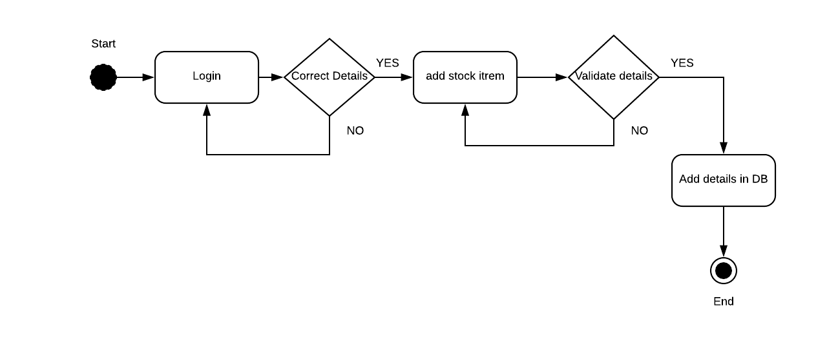
Activity Diagram

Slide 8
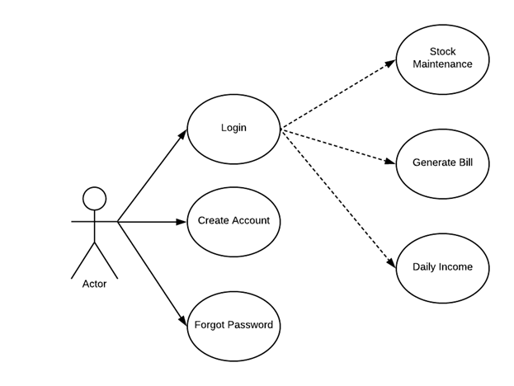
Usecase Diagram

Slide 9
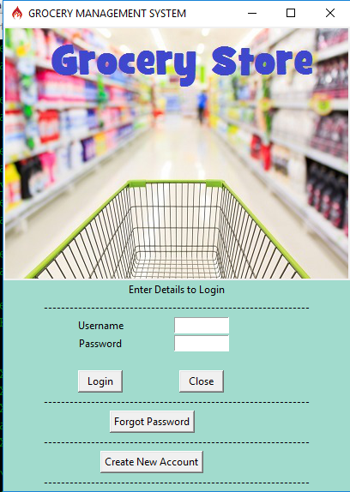
Front Page

Slide 10
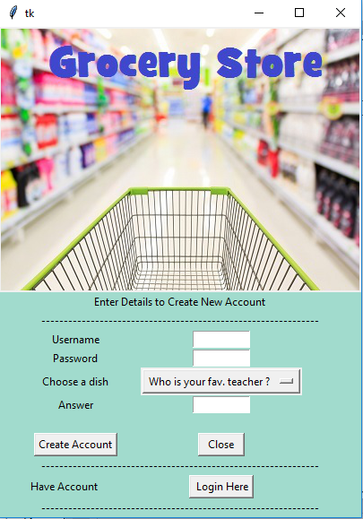
Create Account

Slide 11
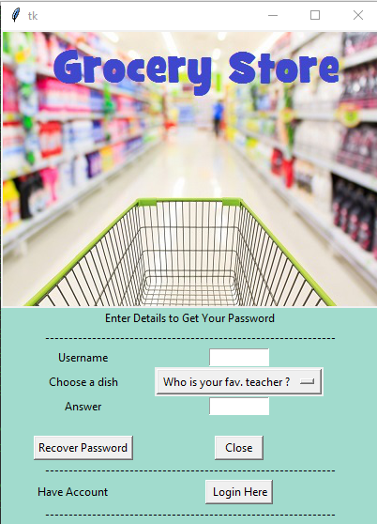
Recover Password

Slide 12
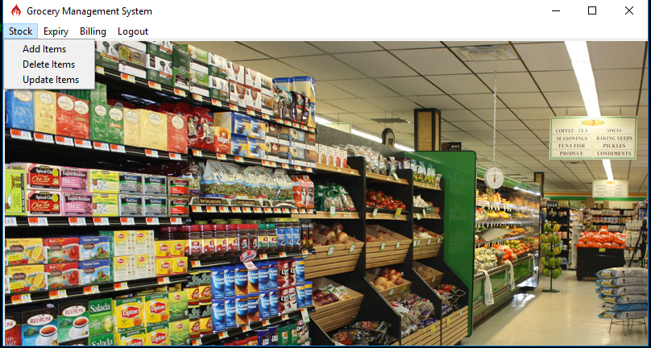
Main Page

Slide 13
Thank You

