Slide 1

PROJECT & INTERNSHIP PRESENTATION
EcoNexus
AI-Powered Wildlife Intelligence Platform
Internship Presentation
EcoNexus
AI Powered Wildlife Conflict Prediction and Management System
STUDENT
Ayush Rastogi
PROGRAM
Btech-Computer Science and Engineering
Batch 2025-2026
MARS – Centre for Sustainable Community Development
Full Stack Development • 01 June – 15 July 2026
ROLE
Wildlife Data & GIS Analyst
MENTOR
Dr. Saurabh Shanu
MARS
AYUSH RASTOGI • IILM UNIVERSITY • ECONEXUS

Slide 2
Candidate & Internship Overview
CANDIDATE DETAILS
INTERNSHIP PROFILE
Student Name: Ayush Rastogi Roll Number: 25SCS1003000430 Degree: B.Tech (Computer Science & Engineering) Academic Batch: 2025–2026 University: IILM University, Greater Noida, U.P.
Organization: MARS – Centre for Sustainable Community Development Domain: Full Stack Development Duration: 01 June 2026 – 15 July 2026 Mentor: Dr. Saurabh Shanu Role: Project Team Member
AYUSH RASTOGI• IILM UNIVERSITY • ECONEXUS

Slide 3
Organization & Problem Context
MARS – CENTRE FOR SUSTAINABLE COMMUNITY DEVELOPMENT
THE PROBLEM
Human-wildlife conflict can occur where wildlife corridors intersect with settlements, agriculture, roads and other human activity. Information may be fragmented across: • Incident reporting • Location intelligence • Risk analysis • Alerts and response • Historical reporting EcoNexus unifies these capabilities.
A technology-focused Section 8 organization working on sustainable development initiatives. The internship connected software engineering with practical sustainability and wildlife-conservation objectives. Key alignment: • Technology-enabled sustainability • Wildlife conservation • Life on Land / biodiversity • Web and application development
AYUSH RASTOGI • IILM UNIVERSITY • ECONEXUS

Slide 4
Core Project Objectives
1 Unified Monitoring
2 Incident Reporting
3 AI Risk Prediction
One command center for wildlife incidents and field intelligence.
Capture structured conflict information with location and severity.
Estimate conflict severity using a Random Forest model.
4 Geospatial Intelligence
5 Alerts & Reports
6 Scalable Architecture
Visualize corridors and incident locations on an interactive map.
Provide operational alerts, analytics and downloadable reports.
Separate frontend, backend, database, services and ML layers.
AYUSH RASTOGI • IILM UNIVERSITY • ECONEXUS

Slide 5
Technology Stack
Frontend
Backend
React.js • Vite • JavaScript • Tailwind CSS React Router DOM • Lucide React
Python • Flask • Flask Blueprints Flask-CORS • REST APIs
Database
AI / ML
SQLite • SQLAlchemy ORM Structured incident persistence
Scikit-learn • Random Forest Model artifacts / inference
Maps & GIS
Development
Google Maps JavaScript API, QGIS Software, Latitude/longitude • GeoJSON
VS Code • Git • GitHub ,NPM • Python virtual environment
AYUSH RASTOGI • IILM UNIVERSITY • ECONEXUS

Slide 6
EcoNexus System Architecture
Modular architecture connecting UI, APIs, data, machine learning and decision support.
SQLite + SQLAlchemy
React Frontend
Flask REST API
Persistent data
Decision Support
Dashboard • Forms • Map
Auth • Incidents • Analytics
Alerts • Reports
Random Forest ML
Risk inference
DATA FLOW
Officer → React UI → Flask APIs → Database / ML → Risk, Alerts, Maps & Reports
AYUSH RASTOGI • IILM UNIVERSITY • ECONEXUS

Slide 7
AI / Machine Learning Methodology
Random Forest classification used for wildlife conflict severity prediction.
1
2
3
4
5
6
Historical Data
Preprocessing
Feature Vector
Model Training
Inference
Decision Output
Conflict records + corridor/geographical information
Cleaning, validation and categorical encoding
Species
• State
• Corridor
• Conflict Type
• Coordinates
Random Forest classifier trained on severity labels
Backend loads model and aligns incoming features
Risk score + severity + recommendation
AYUSH RASTOGI• IILM UNIVERSITY • ECONEXUS

Slide 8
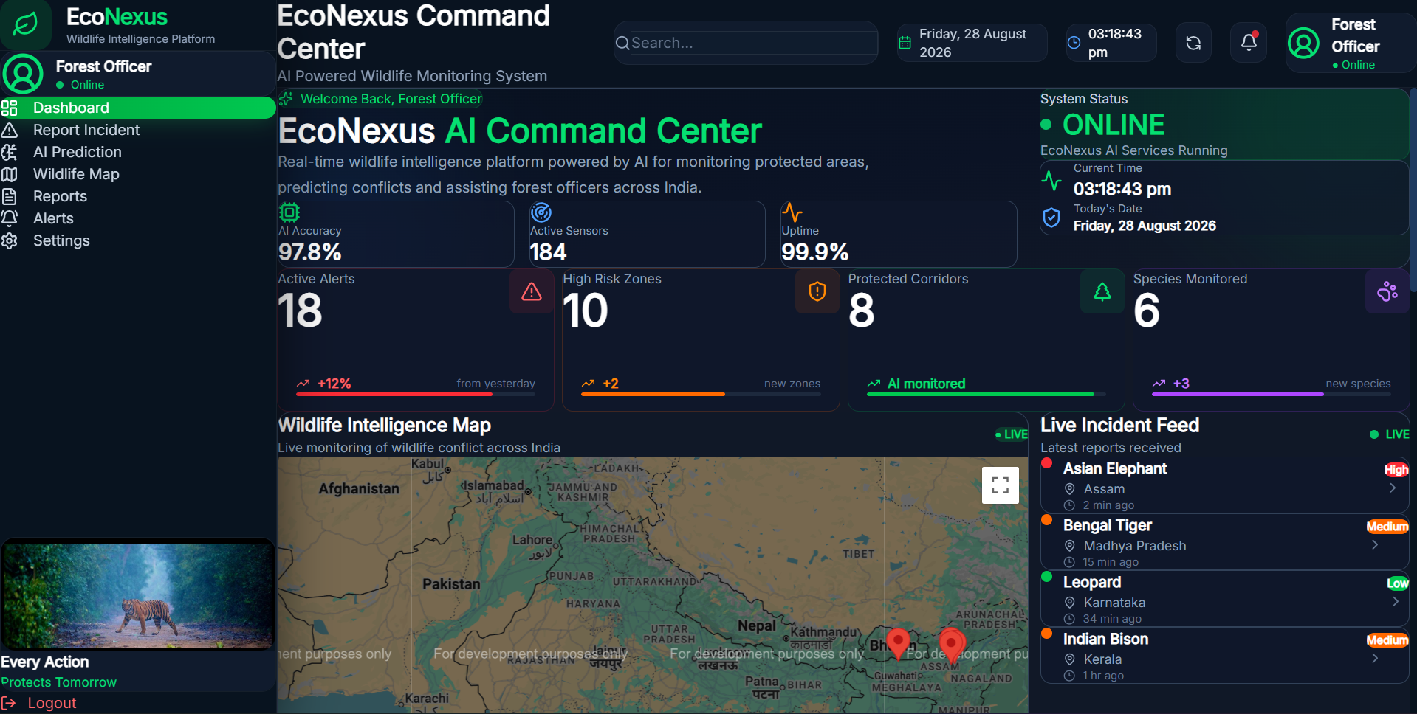
EcoNexus Command Center
Operational dashboard for real-time wildlife intelligence.
AYUSH RASTOGI • IILM UNIVERSITY • ECONEXUS

Slide 9
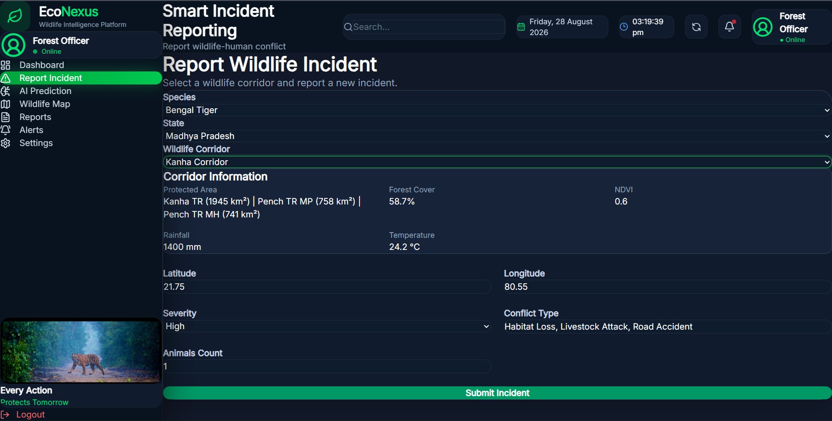
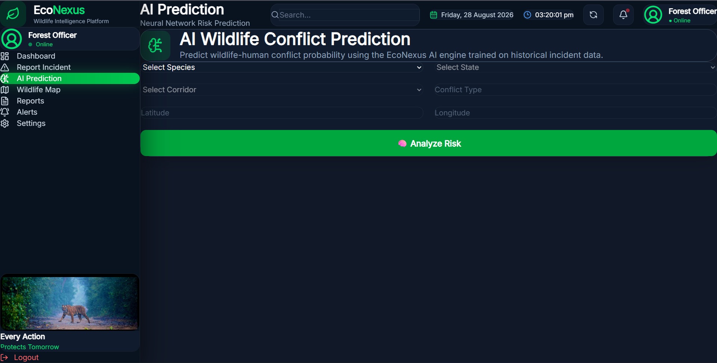
Smart Incident Reporting & AI Prediction
SMART INCIDENT REPORTING
AI WILDLIFE CONFLICT PREDICTION
AYUSH RASTOGI• IILM UNIVERSITY • ECONEXUS

Slide 10
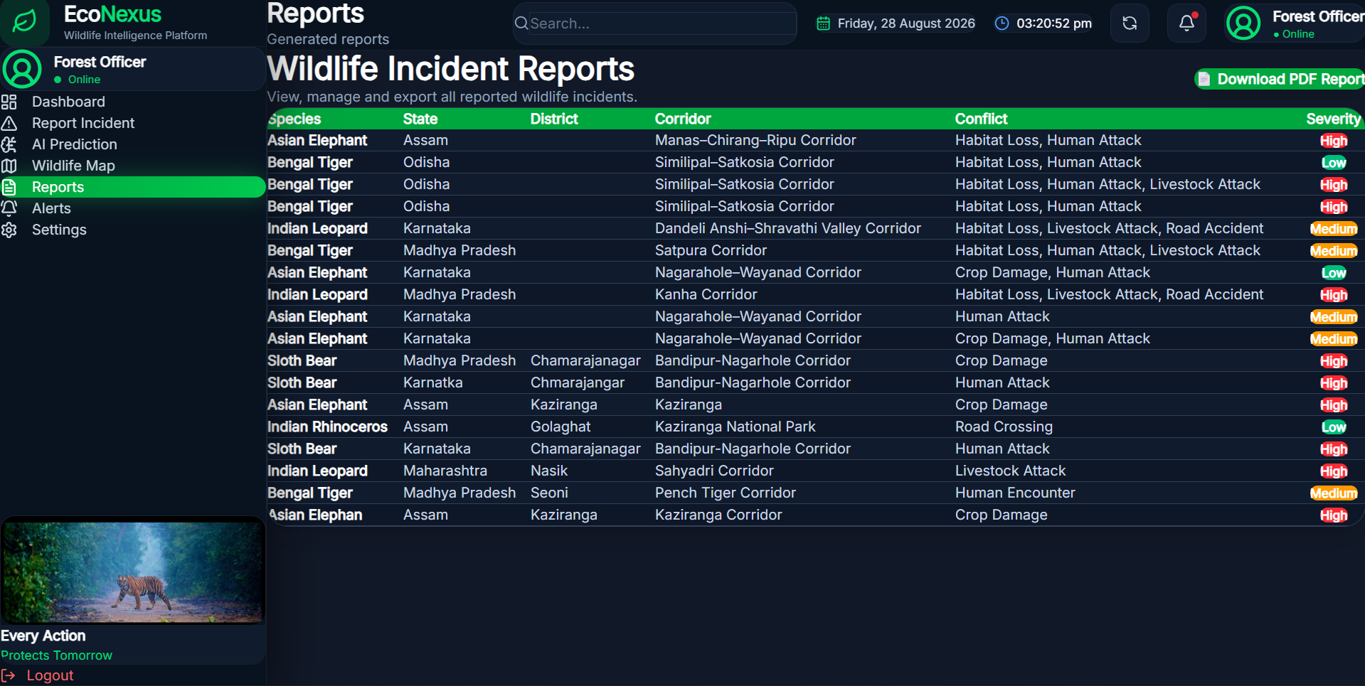
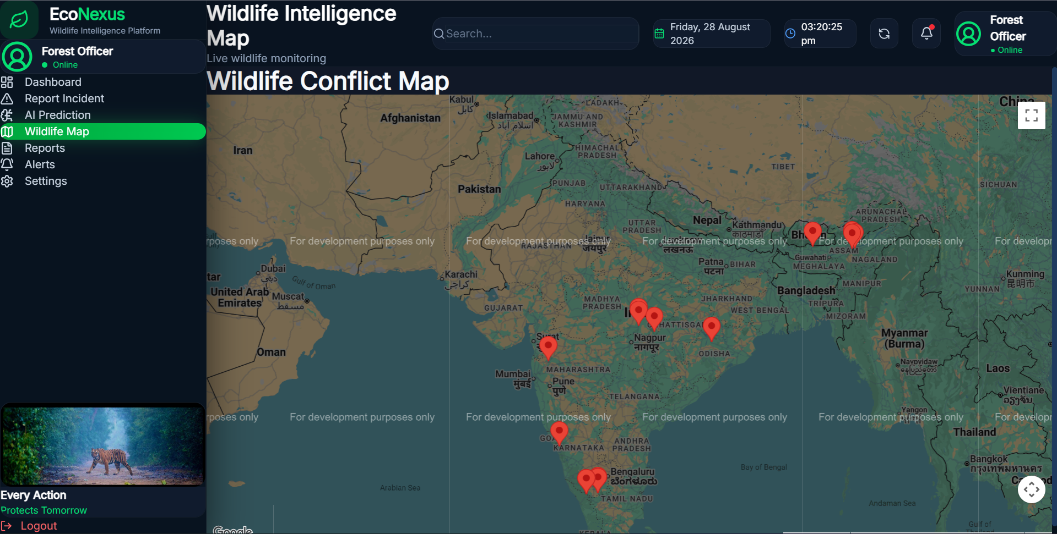
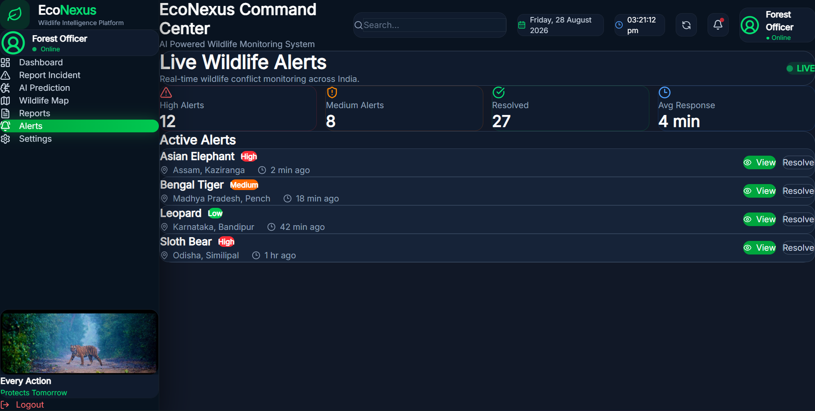
Operational Intelligence: Map, Reports & Alerts
AYUSH RASTOGI • IILM UNIVERSITY • ECONEXUS

Slide 11
Key Demonstrated Results
97.8%
184
99.9%
18
Dashboard AI accuracy indicator
Active sensors displayed
System uptime indicator
Active alerts displayed
PREDICTION VERIFICATION
FUNCTIONAL OUTCOMES
Representative project scenarios: • Tiger movement — 81.5% risk — High • Elephant movement — 92.1% risk — High • Leopard sighting — 34.2% risk — Low • Bear movement — 76.8% risk — High
• Incident reporting workflow • REST API integration • ML inference service • Interactive wildlife map • Reports and alerts • Modular database-backed architecture
AYUSH RASTOGI • IILM UNIVERSITY • ECONEXUS

Slide 12
My Role, Responsibilities & Learning
TEAM LEADERSHIP
SKILLS DEVELOPED
Team Members: Prangita Baruah Kumar, Ayush Rastogi, Adarsh Singh, Himoghno Ghosh My responsibilities: • Coordinated the team and divided tasks • Monitored progress and resolved blockers • Handled backend / ML integration • Assisted with debugging • Coordinated frontend-backend integration • Managed the final project presentation
Technical: • React + Flask full-stack development • REST API design and integration • SQLite / SQLAlchemy • ML model integration • Geospatial visualization • Git / GitHub Professional: • Team coordination • Problem solving • Technical communication • Presentation and project ownership
AYUSH RASTOGI • IILM UNIVERSITY • ECONEXUS

Slide 13
Future Scope
Real-Time Data
Remote Sensing
IoT sensors, camera traps and continuous incident streams.
Satellite imagery and environmental indicators.
Field Mobility
Advanced AI
Offline-first mobile/PWA workflows for forest officers.
Temporal and spatial forecasting with continuous retraining.
Connected Response
Cloud Scale
GPS telemetry, patrol coordination and automated alerts.
Multi-department deployment and centralized analytics.
AYUSH RASTOGI • IILM UNIVERSITY • ECONEXUS

Slide 14

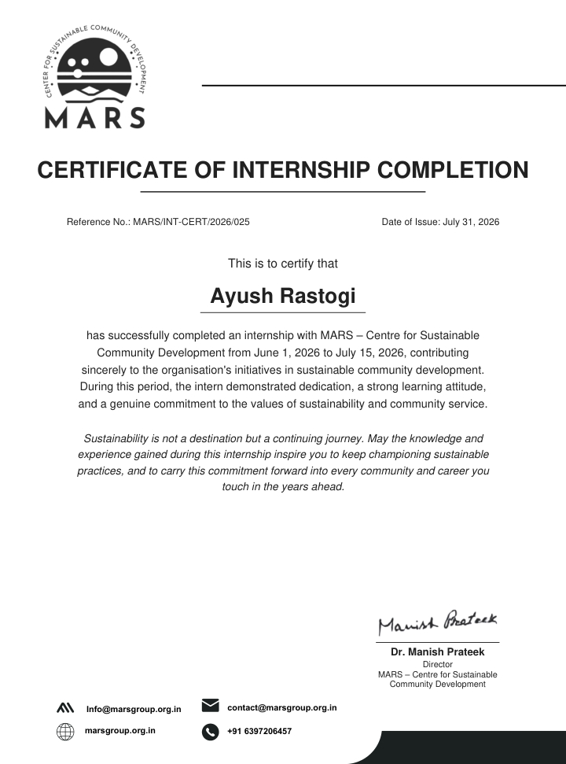
Internship Evidence
AYUSH RASTOGI • IILM UNIVERSITY • ECONEXUS

Slide 15
Thank you!
AYUSH RASTOGI
25SCS1003000430 . BTECH CSE
SCHOOL OF COMPUTER SCIENCE & ENGINEERING
IILM UNIVERSITY GREATER NOIDA , UTTAR PRADESH
Econexus
Ai powered wildlife intelligent for protective conservation

