Slide 1



IILM UNIVERSITY
C++ Programming Internship
#include <iostream> // C++ Projects at CodSoft <iostream> // Practical Software Development at CodSoft
Student Name Ayush Ranjan
Organization Name CodSoft
Enrollment Number __________________ 25SCS1003001068
Program & Semester B.Tech CSE — 3rd Semester

Slide 2

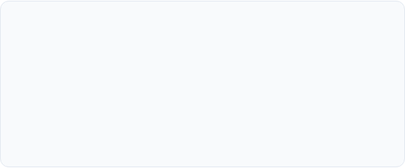
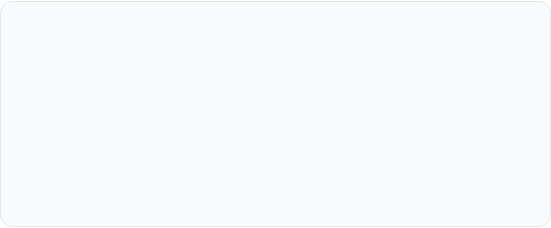
Executive Summary
Internship Purpose
Key Highlights
During my 3rd semester B.Tech CSE internship at CodSoft, I worked on three practical C++ projects. The tasks helped me apply programming fundamentals and improve my problem-solving through hands-on coding.
Completed a Number Guessing Game, Simple Calculator, and Tic-Tac-Toe Game using C++ with focus on conditions, loops, functions, arrays, input handling, and basic game logic.

Slide 3
About Organization
CodSoft Overview
CodSoft is a vibrant IT services and software development platform dedicated to offering practical, industry-aligned virtual internships and mentorship in cutting-edge technologies.
The program emphasizes project-based skill acquisition, algorithmic efficiency, hands-on code development, and real-world problem-solving methodologies.

Slide 4
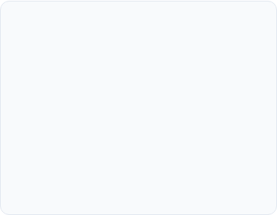
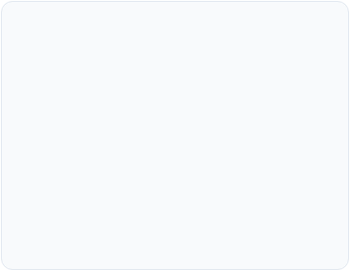
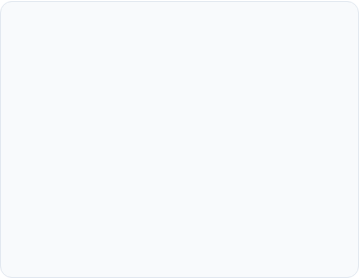



Internship Objectives
Core Concepts
OOP Principles
Problem Solving
Build confidence with C++ basics such as variables, operators, conditions, loops, and functions.
Apply programming concepts while turning simple project requirements into working console applications.
Improve problem-solving by testing different inputs and handling cases such as invalid choices, repeated guesses, division by zero, and game-ending conditions.

Slide 5
Key Projects Completed
Simple Calculator: Menu-driven program for addition, subtraction, multiplication, and division with basic validation. Performs fundamental arithmetic operations using functional modules and validation.
Tic-Tac-Toe Game: Two-player 3×3 board game using arrays, turn handling, and win/draw checks. Multi-player interactive console game incorporating 2D array matrix state checks.
Number Guessing Game: Console game where the player guesses a randomly generated number with higher/lower hints. Console-based task tracking application supporting dynamic addition, status updating, and deletion of user tasks.

Slide 6
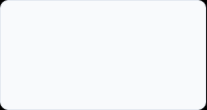
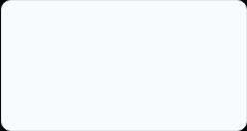
Internship Roadmap
Week 1
Week 2
Week 3
Week 4
C++ setup, basic syntax, input/output, conditions, loops, and the Number Guessing Game.
Operators, switch-case, functions, input handling, and the Simple Calculator.
3×3 arrays, loops, functions, turn handling, and Tic-Tac-Toe game logic.
Testing all three projects, fixing errors, organizing GitHub, and preparing the final submission.

Slide 7
C++ Skill Distribution
Skills Practiced
• C++ fundamentals — variables, operators, conditions, loops and functions
• Console programming — menus, user input and program flow
• Arrays & game logic — 3×3 board and win/draw checking
• Debugging & GitHub — testing, fixing errors and maintaining project files
Hands-on application development at CodSoft resulted in balanced technical growth across foundational and advanced C++ programming constructs.

Slide 8

Quantifiable Outcomes
3
Software Quality Highlights
Completed the three assigned C++ projects: Number Guessing Game, Simple Calculator, and Tic-Tac-Toe.
Tested the applications with different inputs and corrected issues found during compilation and execution.
Projects Completed

Slide 9
Core Competencies Gained
C++ Fundamentals: Improved my understanding of variables, operators, conditions, loops, functions, and arrays. Gained proficiency in modern C++ features including auto, lambda expressions, and smart pointers.
Debugging: Learned to read compiler errors, identify the cause of issues, and test the program again after making changes. Utilized GDB and IDE diagnostic toolsets to track memory leaks and stack overflow issues.
GitHub: Organized the three projects in a repository and practiced basic commits and version control. Maintained structured Git repositories with descriptive commit messages and branch management.
Project Documentation: Added clear project descriptions and kept the code structure easy to follow. Documented algorithms clearly using inline comments and standardized Markdown Readme files.

Slide 10
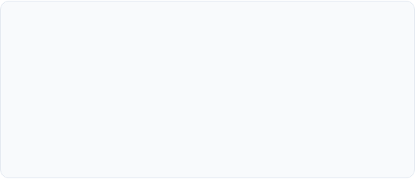
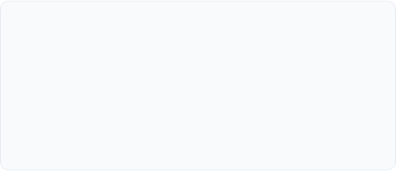
Challenges & Solutions
Game Logic & Conditions
Input Handling
Challenge: The game projects required several conditions to correctly handle guesses, turns, winners, and draws. Managing dynamic memory allocation using raw pointers resulted in dangling references during early testing.
Challenge: Different user choices and values could affect the program flow if they were not handled carefully. Infinite loops occurred when non-numeric data was inputted into numeric console fields.
Solution: Broke the logic into clear conditions and tested different game outcomes to verify the results. Adopted RAII design patterns and smart pointers (std::unique_ptr) to automate memory cleanup.
Solution: Added checks for cases such as division by zero, invalid menu choices, and repeated guesses. Integrated cin.fail() checks and cin.ignore() stream buffer clear functions.

Slide 11



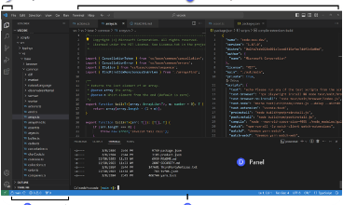

Future Learning Path
1. Data Structures & Algorithms
2. Larger C++ Projects
3. Better Development Practices
Strengthening problem-solving and learning more data structures and algorithms in C++.
Building larger applications that combine multiple C++ concepts and features.
Improving debugging, Git/GitHub usage, code organization, and documentation.

Slide 12
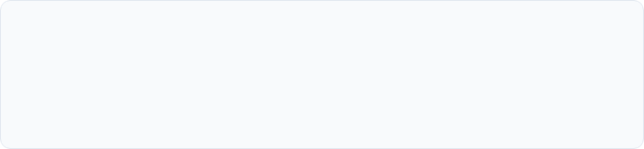
Thank You!
Questions & Discussion
Acknowledgements
Special thanks to my mentors at CodSoft for providing this valuable opportunity, and to the faculty members of the CSE Department at IILM University for their constant support during my 3rd semester internship.

Slide 13






Image Sources
https://f2.leadsquaredcdn.com/t/iilmuniversity/content/common/images/landingpages/circular%20logo-01.png
Source: admissions.iilm.edu
https://cdn-ilehile.nitrocdn.com/rvtTEKnNlfWfxEHgVdBZMuGGdqGuuvbT/assets/images/optimized/rev-5ac25bd/www.religroupinc.com/wp-content/uploads/2026/06/engineers-collaborating-in-office.jpg
Source: www.religroupinc.com
https://i.ytimg.com/vi/t7bxv0FCQbQ/maxresdefault.jpg
Source: www.youtube.com
https://external-preview.redd.it/introducing-dataviz-a-data-structure-visualization-library-v0-5fcRfLSI1VdWvDjHMjjnyzXiyXFXvX5aov8j8s-R--s.jpg?width=640&crop=smart&auto=webp&s=0de0b6a37caa07076831b55565b2ab93c92b6a44
Source: www.reddit.com
https://code.visualstudio.com/assets/docs/editing/userinterface/hero.png
Source: code.visualstudio.com
https://www.serverbasket.com/wp-content/uploads/2021/02/High-Performance-Computing-Server.png
Source: www.serverbasket.com

