Slide 1
MACHINE LEARNING
Internship Presentation
Artificial Intelligence & Machine Learning in the Real World
Ayush Kashyap
InAmigos Foundation
28 August 2026 – 10 September 2026
Machine Learning Internship • Ayush Kashyap 1

Slide 2
Presentation Overview
A concise visual summary of the internship learning and practical exploration
AI & ML Foundations
Learning Systems
Core concepts, terminology, and the relationship between AI, ML, and Deep Learning.
How data, training, testing, and prediction work together.
Practical Exploration
Real-World Applications
A beginner-friendly model development workflow using examples.
Healthcare, agriculture, education, transportation, and environment.
Machine Learning Internship • Ayush Kashyap 2

Slide 3
Foundations of AI & Machine Learning
Artificial Intelligence
Machine Learning
Deep Learning
The broader field of creating systems that can perform tasks involving perception, reasoning, language, and decision-making.
A way of building AI systems that learn patterns from data and use them to make predictions or decisions.
A branch of ML using multi-layer neural networks, especially useful for images, audio, and language.
Supervised Learning
Unsupervised Learning
Reinforcement Learning
Learns from labeled examples. Example: spam detection.
Finds patterns or groups without labels. Example: customer clustering.
Learns through actions and feedback. Example: game-playing agents.
Machine Learning Internship • Ayush Kashyap 3

Slide 4
How a Machine Learning System Learns
From raw examples to useful predictions
01
02
03
04
05
06
Collect
Prepare
Train
Test
Improve
Predict
Gather relevant examples
Clean, label, and organize data
Learn patterns from examples
Evaluate on unseen inputs
Analyze errors and retrain
Apply the model to new data
Machine Learning Internship • Ayush Kashyap 4

Slide 5
Practical Model Exploration
Understanding model training without requiring advanced programming
• Define categories the model should recognize.
• Collect varied examples for every category.
• Train the model so it can learn distinguishing patterns.
• Test it with new inputs that were not used for training.
• Study incorrect predictions and improve the examples.
• Repeat the cycle until the model becomes more reliable.
Key Insight
A model does not simply “memorize” the task. It learns statistical patterns from the examples it receives.
Better variety and representative data generally improve its ability to handle new inputs.
Machine Learning Internship • Ayush Kashyap 5

Slide 6
Example: Recommendation Systems
How machine learning can turn user behaviour into useful suggestions
Input Data
Learning Process
Output
• Viewing history
• Ratings
• Searches
• Clicks and interactions
• Similar users/items
The system identifies patterns and relationships between users, items, and preferences.
It continuously updates its understanding as new interactions appear.
Personalized recommendations that estimate which items are most likely to be relevant to the user.
Machine Learning Internship • Ayush Kashyap 6

Slide 7
Real-World AI/ML Applications
Agriculture
Healthcare
Education
Crop disease detection and yield-related decision support.
Pattern detection and risk estimation to support professionals.
Personalized learning paths and identification of learning gaps.
Transportation
Environment
Business
Traffic prediction, travel-time estimation, and route optimization.
Air-quality forecasting and analysis of sensor or satellite data.
Demand forecasting, customer segmentation, and recommendation systems.
Machine Learning Internship • Ayush Kashyap 7

Slide 8
Problem → AI/ML Solution → Impact
Problem | AI/ML approach | Potential impact
Late crop disease detection | Image classification | Earlier intervention
High traffic congestion | Traffic forecasting | Better routing and flow
Different student needs | Learning recommendation | Personalized support
Complex medical data | Pattern/risk analysis | Decision support
Changing pollution levels | Time-series forecasting | Earlier environmental response
Machine Learning Internship • Ayush Kashyap 8

Slide 9
Project Methodology
A practical problem-solving framework for ML projects
Problem Definition
Data Understanding
Clarify the problem, users, desired output, and constraints.
Identify available data, quality, labels, and representativeness.
Model Selection
Training & Testing
Choose classification, regression, clustering, or another suitable approach.
Train on examples and evaluate with unseen data.
Evaluation
Iteration & Deployment
Measure performance and inspect errors.
Improve the model and consider monitoring, safety, and maintenance.
Machine Learning Internship • Ayush Kashyap 9

Slide 10
Key Learning Outcomes
• Built a structured understanding of AI, ML, and Deep Learning.
• Understood major machine learning paradigms and their use cases.
• Learned how data quality and variety influence model performance.
• Gained practical awareness of training, testing, prediction, and iteration.
• Learned to convert real-world problems into realistic AI/ML solution ideas.
• Developed awareness of responsible AI considerations such as bias, privacy, and human oversight.
Machine Learning Internship • Ayush Kashyap 10

Slide 11
Challenges & Future Scope
Important Considerations
Future Development
• Data quality and labeling
• Bias and fairness
• Generalization to unseen data
• Privacy and security
• Model interpretability
• Human oversight in high-impact decisions
• Build projects with Python and ML libraries
• Compare multiple algorithms
• Use formal evaluation metrics
• Create web/mobile model interfaces
• Explore neural networks and deep learning
• Deploy and monitor models in real settings
Machine Learning Internship • Ayush Kashyap 11

Slide 12
Conclusion
The internship provided a practical foundation for understanding how AI and Machine Learning can address real-world challenges. The experience connected fundamental concepts with model training, testing, and application design, while emphasizing that successful ML solutions depend on suitable data, careful evaluation, responsible use, and continuous improvement.
Thank You
Machine Learning Internship • Ayush Kashyap 12

Slide 13
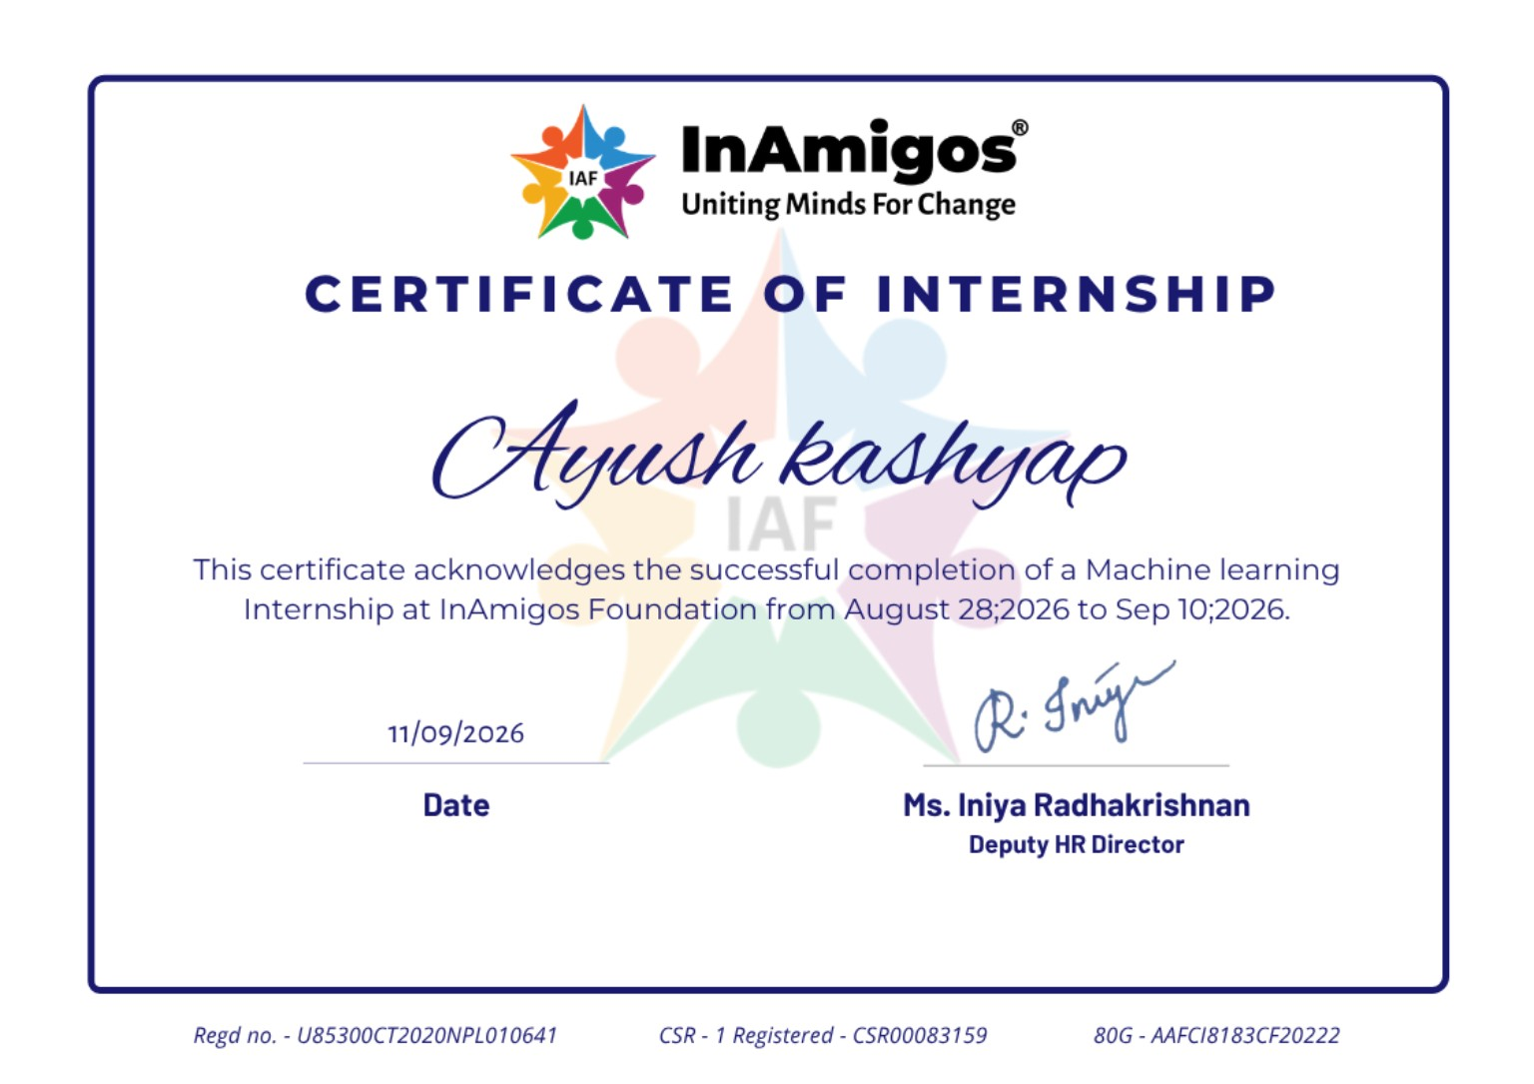
Internship Certification
Certificate issued by InAmigos Foundation
Machine Learning Internship • Ayush Kashyap 13

