Slide 1
INTERNSHIP PRESENTATION
AYUSH KASHYAP
Internship Duration: 01 July 2026 – 30 July 2026
Artificial Intelligence Intern
A presentation on my one-month Artificial Intelligence internship experience, learning outcomes and professional development.
Codec Technologies Pvt. Ltd.
ROLE
DURATION
MODE
AI Intern
1 Month
Virtual
Internship Presentation • Codec Technologies Pvt. Ltd.
1

Slide 2
Internship Overview
02
Official details from my internship offer letter
Organization
Designation
Codec Technologies Pvt. Ltd.
Artificial Intelligence Intern
Duration
Mode
01/07/2026 to 30/07/2026
Pan India, Virtual
Internship Purpose
To gain industry-level exposure through assigned projects and training activities.
To strengthen practical understanding and develop valuable technical skills.
To experience a structured project environment with guidance and performance review.
Internship Presentation • Codec Technologies Pvt. Ltd.
2

Slide 3
Objectives of the Internship
03
My key learning and development goals
Practical Learning
Technical Development
01
02
Apply academic knowledge in a project-oriented environment.
Strengthen my understanding of Artificial Intelligence concepts.
Problem Solving
Professional Growth
03
04
Develop a structured approach to analysing tasks and finding solutions.
Improve communication, responsibility and consistency.
Internship Presentation • Codec Technologies Pvt. Ltd.
3

Slide 4
Learning Experience
04
Key areas of learning during the internship
Strengthened my foundation in Artificial Intelligence and its practical applications.
Worked through assigned internship activities in a structured learning environment.
Improved my ability to understand requirements and organise work systematically.
Developed independent learning and research habits while exploring new concepts.
Gained greater awareness of professional expectations, consistency and deadlines.
1
LEARN
Understand concepts
2
APPLY
Complete assigned work
3
REVIEW
Identify improvements
4
GROW
Build stronger skills
Internship Presentation • Codec Technologies Pvt. Ltd.
4

Slide 5
Skills Developed
05
Technical, analytical and professional skills strengthened
Artificial Intelligence Awareness
Analytical Thinking
Research & Self-Learning
Better understanding of AI concepts and applications.
Breaking tasks into smaller, manageable steps.
Exploring and understanding unfamiliar concepts independently.
Project Discipline
Communication
Adaptability
Working consistently towards assigned goals and timelines.
Presenting work and learning outcomes more clearly.
Adjusting to new requirements and continuous learning.
Internship Presentation • Codec Technologies Pvt. Ltd.
5

Slide 6
Professional Takeaways
06
What I gained beyond technical learning
The internship helped me connect academic learning with a practical and professional way of working.
I understood the importance of consistency, deadlines and taking responsibility for assigned work.
The experience encouraged me to continue improving my technical skills in Artificial Intelligence.
It increased my confidence to take part in future projects and industry-oriented opportunities.
“Knowledge becomes more valuable when it is applied to solve practical problems.”
INTERNSHIP REFLECTION
Internship Presentation • Codec Technologies Pvt. Ltd.
6

Slide 7
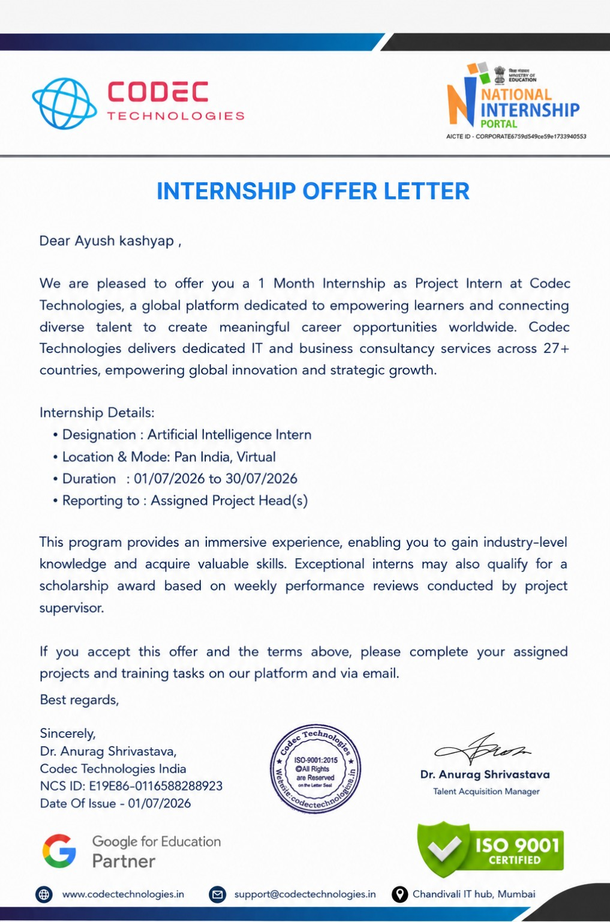
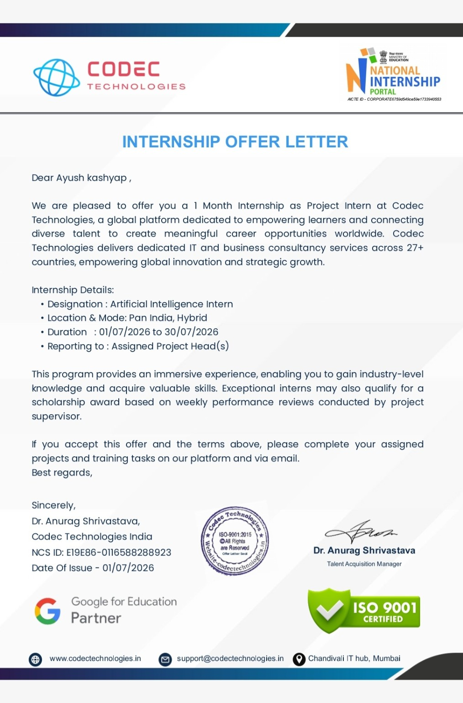
Official Offer Letter
07
Internship offer issued by Codec Technologies
Evidence of internship selection and role confirmation
Internship Presentation • Codec Technologies Pvt. Ltd.
7

Slide 8
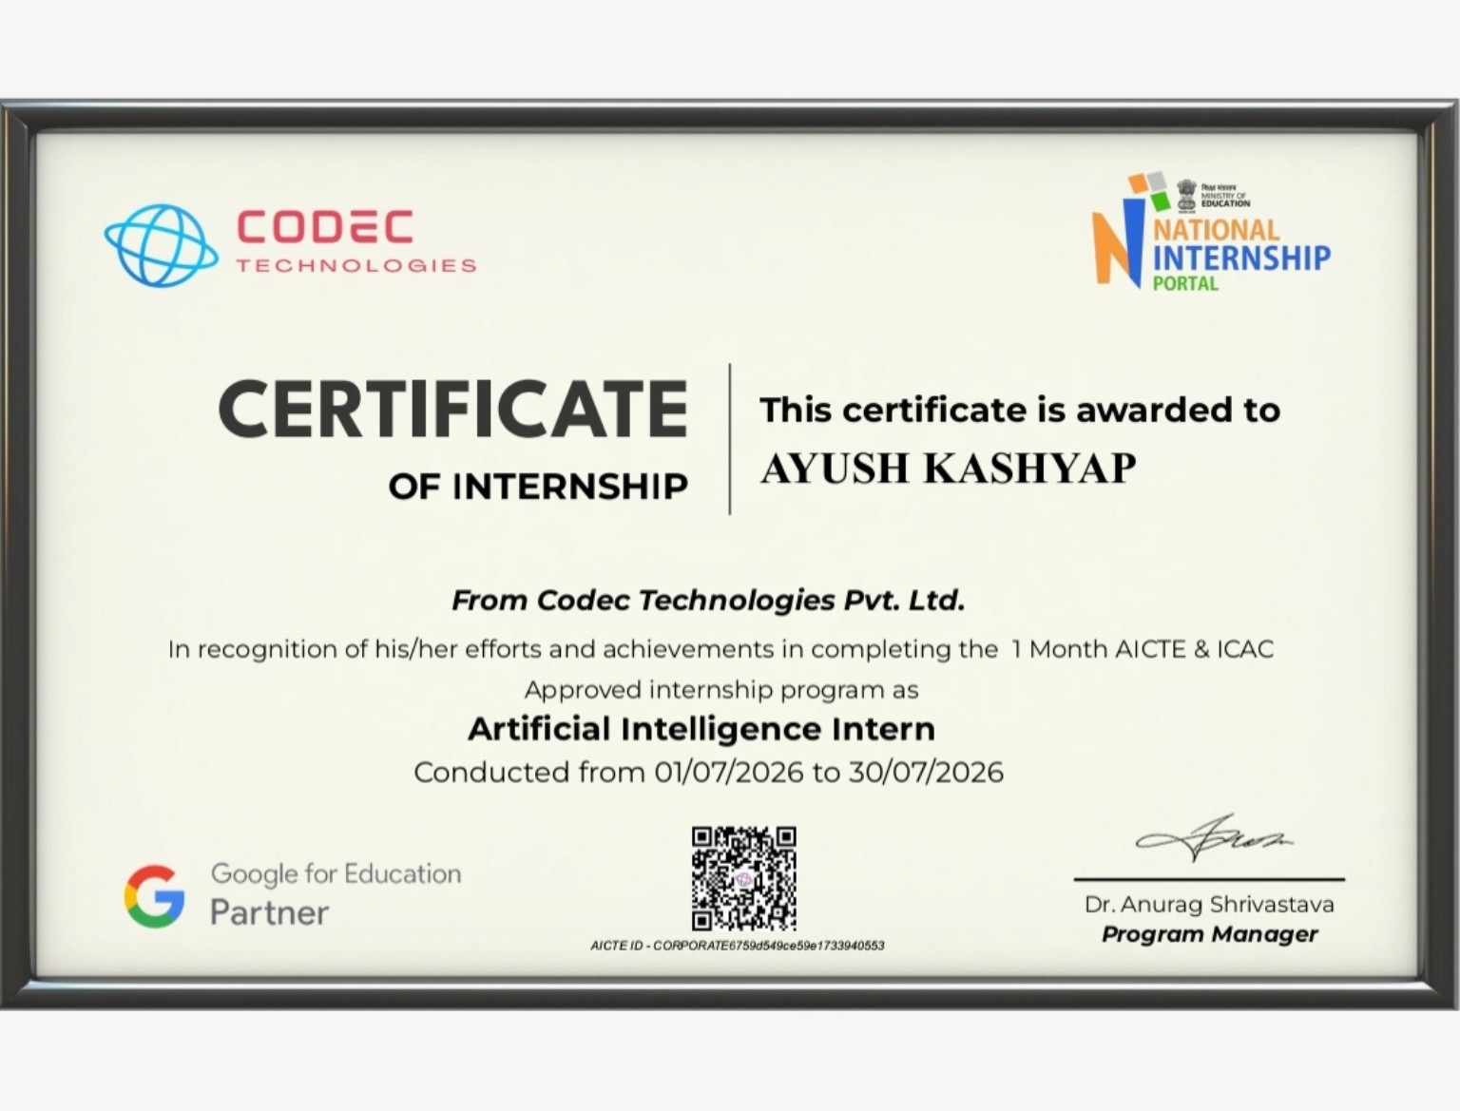
Internship Completion Certificate
08
Certificate awarded after completion of the one-month internship
Internship Presentation • Codec Technologies Pvt. Ltd.
8

Slide 9
Conclusion
09
Summary of my internship journey
The one-month internship at Codec Technologies was a valuable learning experience that helped me strengthen my understanding of Artificial Intelligence, improve my analytical and professional skills, and develop a stronger project-oriented mindset.
This experience has motivated me to continue learning, build stronger technical expertise, and take on more challenging opportunities in the future.
THANK YOU
Questions & Discussion
Internship Presentation • Codec Technologies Pvt. Ltd.
9

