Slide 1

B.TECH MAJOR PROJECT · PROPOSAL PRESENTATION
Uncertainty-Aware Decentralized Multi-Agent Reinforcement Learning for Carbon-Aware Workload Scheduling Across Geo-Distributed Data Centers
Everything in this proposal is built on real, free, licence-clean data - downloaded, parsed and verified before this meeting.
Ayushmaan Krishna (RA2311026010570) · Kunwar Abhyansh Visen (RA2311026010576)
Guide: Dr. B. Hariharan November 2026
16.8M real LLM requests parsed
forecast error MAE 9.05 gCO₂/kWh
348 gCO₂/kWh regional CI spread
Notes:
Opening line: we propose to schedule real production workloads across UK grid regions so jobs run where and when the grid is greenest - while hedging against the carbon forecast's own error. Everything is built on data we already downloaded and verified, so feasibility is not a promise, it is done.

Slide 2




OVERVIEW
The proposal at a glance
Schedule cloud workloads across UK grid regions - each job runs where and when the grid is greenest, while hedging the carbon forecast's own error.
The problem
The gap
Data centres are a fast-growing carbon source. Workloads can run at other times and other places, but the steering signal - grid carbon intensity - shifts every 30 minutes and its forecast is never perfect.
Across 30 papers (2024-26, all DOIs resolved): none combines decentralised agents, limited communication, real measured forecast uncertainty, region-matched data and a risk-aware (CVaR) objective at once.
Our approach
Final outcome
Extend the MIT-licensed SustainCluster simulator with 3-5 real UK grid regions; train MAPPO agents that hedge with uncertainty bands measured from NESO forecast errors, plus a CVaR penalty on SLA risk.
A working scheduler validated end-to-end on real data - carbon saved vs 6 baselines under identical demand, robustness curves under 2x forecast error, thesis and paper-ready figures.
Notes:
One-slide summary. Problem: carbon intensity moves every 30 minutes and forecasts are imperfect. Gap: nobody has combined the four ingredients. Approach: extend SustainCluster with real UK regions and train uncertainty-aware MAPPO. Outcome: relative carbon savings plus robustness - a defensible thesis.

Slide 3

FEASIBILITY
Feasibility check - verdict: yes, on real data
VERDICT: feasible today - every layer below is already downloaded, parsed and licence-cleared (CC BY 4.0 / MIT / CC0). Data cost: £0.
One impossible requirement, honestly dropped
16.8M
real production LLM traffic - the full Azure trace parsed: 0 nulls, 0 duplicates
No public workload trace on Earth is officially tied to a real region - verified across 29 trace families; Azure, Alibaba and Google all anonymise geography. So we fix the grid (UK), disclose the demand-source assumption as the field does, and match trace jobs to sites where energy is computed.
requests
Why the UK - and not India, the US or Japan
9.05
measured 30-min forecast error (Jan 2025, 1,463 pairs) - the uncertainty signal nobody else has
Only source worldwide that ships historical forecast-vs-actual carbon pairs natively - NESO, since 2017, free, no API key, CC BY 4.0
14 grid regions inside one country - genuine multi-site structure with a verified 348 gCO₂/kWh spread
India and Japan lack the full stack (no hourly carbon / no measured power); the US has no CO₂ forecast - EIA-930 stays as fallback
gCO₂/kWh
348
verified regional carbon spread across 14 UK regions - inside a single half-hour
gCO₂/kWh
28 datasets ranked in one comparison - typical rejects: Electricity Maps (€6,000/yr, paid), Fingrid (key-gated), ENTSO-E (no CO₂ values), Meta / Tencent traces (not found).
Notes:
The answer to 'is this feasible' is yes, with one disclosed assumption. No trace anywhere is officially geo-mapped - that is the industry's doing, not our limitation. The UK is the only complete stack: the NESO API is the only source on Earth with forecast+actual carbon pairs, which is exactly the uncertainty signal our title needs.

Slide 4
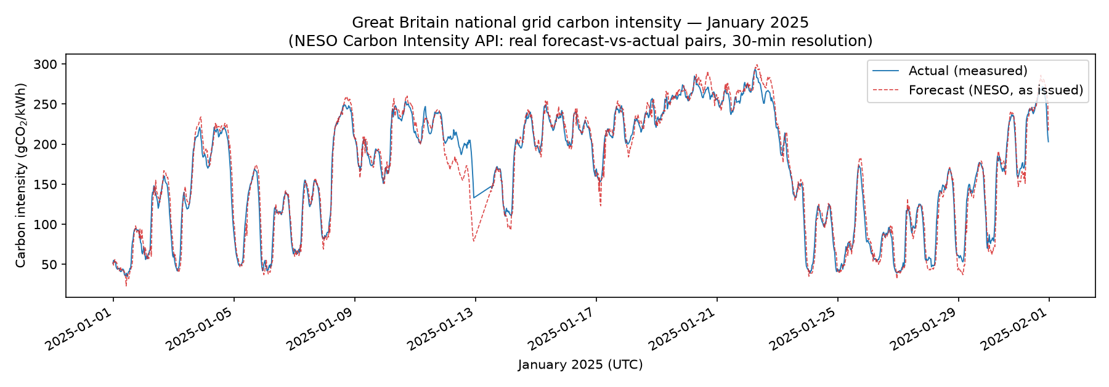
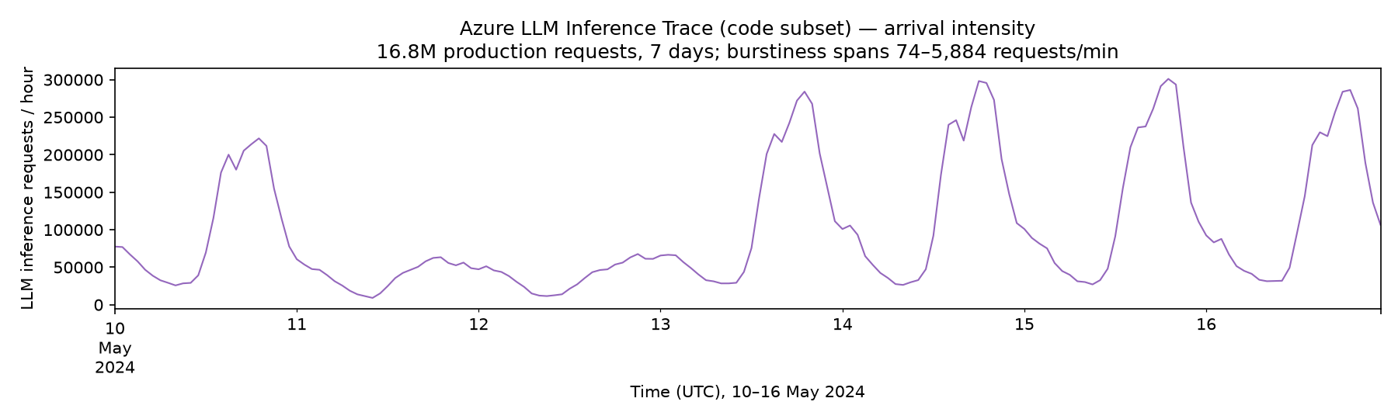
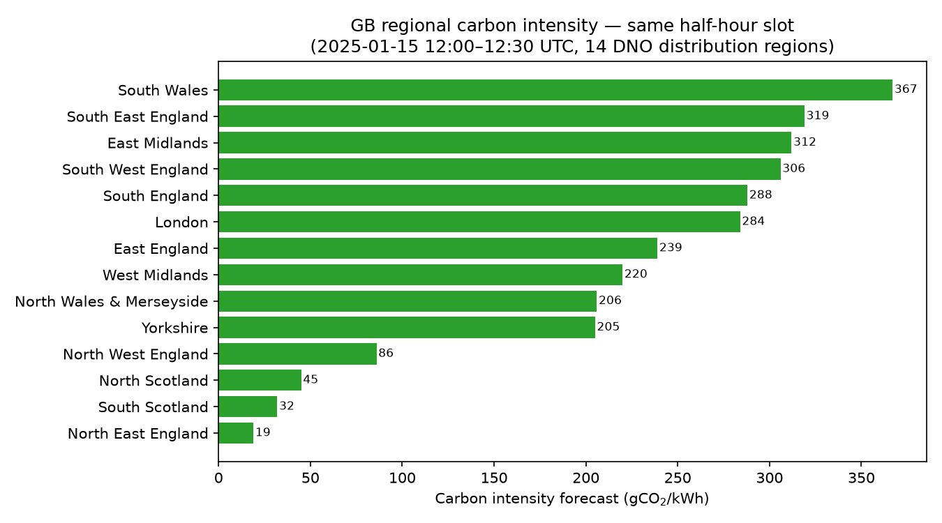
EVIDENCE
The evidence - from our own downloads
Measured uncertainty: real NESO forecast-vs-actual pairs, Jan 2025. The gap between the curves - MAE 9.05 gCO₂/kWh - is precisely what our uncertainty bands learn to hedge.
Real demand: 16.8M Azure LLM requests over 7 days; arrivals swing 74 to 5,884 per minute (80x burstiness). Agents buffer these waves across sites.
One half-hour, one country - a 19x carbon gap
15 Jan 2025, 12:00Z - North East England at 19, South Wales at 367 gCO₂/kWh, under the same grid operator
Place-shifting and time-shifting are the two levers; our agents decide both, under uncertainty
All three figures are computed by our own scripts from these exact datasets - reproducible evidence, not clipped from papers
Notes:
Three figures generated from our own downloads. Left top: the forecast-actual gap over a month - MAE 9.05 - that becomes training data for the uncertainty bands. Right top: the demand wave we replay, 80x burstiness. Bottom: in a single half-hour, carbon varies 19x across 14 UK regions - that spread is the scheduling opportunity.

Slide 5

CLAIM DISCIPLINE
What we can and cannot claim
The one disclosed assumption
+ Can claim
X% lower operational carbon vs 6 baselines under identical real demand
Uncertainty measured from real NESO forecast errors - not simulated
348 gCO₂/kWh regional spread verified in real data
Savings reported inside the EuroSys-2024 shifting envelope
Every publisher cuts geography first: workload traces are quasi-identifying (timestamps + hashed IDs re-identify users - the Netflix-Prize lesson), commercially sensitive (requests per region approximates revenue per region), and GDPR / PIPL-constrained. We therefore treat the trace as a demand pattern and assign jobs to UK sites; carbon is computed where the job runs - measured power curves x real UK grid intensity. All policies face identical demand, so the scheduler ranking we defend is relative and robust to the trace's origin.
− Cannot claim
That these requests were served from UK data centres
Any absolute national carbon figure as a measurement
That the workload mix equals UK demand exactly
Savings beyond spatio-temporal shifting-limits bounds
Same disclosure as SustainCluster (NeurIPS 2025), the field's benchmark - stated up front, never buried in a footnote.
Every experiment reports the relative saving plus one absolute figure, labelled illustrative - the guide sees both, always.
Why the comparison still stands if the requests are not UK-only:
Every scheduler consumes the identical demand replay, so the X% saving is a property of the policy - not of request origin
We supply the UK geography ourselves: each request is assigned to a real UK site, carbon accrued there from NESO region actuals
No origin-labelled trace exists anywhere (verified); SustainCluster, the field's NeurIPS 2025 benchmark, makes the same disclosure
Notes:
This slide answers the question we expect from the panel: 'the trace has no UK location - is that acceptable?' Yes, if disclosed: it is exactly what the NeurIPS 2025 benchmark does, because no alternative exists anywhere. Three-part defence on the bottom strip: (1) equal-footing - identical demand replay for every policy makes the saving a policy property, origin-independent; (2) we add the UK geography - the scheduler places each request on a real UK site and carbon accrues there from NESO actuals, so origin changes magnitude, not mechanism; (3) the demand's statistical shape (diurnal cycle, 80x burstiness, token mix) is what stresses a scheduler, and that shape is server-side, not tied to where users sat. Absolutes are labelled illustrative.

Slide 6






DATASETS
The data stack - six verified layers
NESO Carbon Intensity API - UK, national + regional
VERIFIED · CC BY 4.0
30-min slots; forecast + actual; since Sep 2017; free, no API key
Azure LLM Inference Trace 2024 - demand
VERIFIED · FULL DOWNLOAD
692 MB, 16.8M requests (May 2024); 0 nulls, 0 duplicates; 80x burstiness
Alibaba GPU cluster trace 2020 - job shapes
VERIFIED · FULL DOWNLOAD
~350 MB: 707k jobs / 1.26M tasks; plan_gpu, gpu_type (V100/A100-class, T4)
Alibaba job_execution_summary 2026 - validation
PARTIAL · TOO BIG TRACE
1.19 GB summary of a 352 GB trace (too big to download); durations, delays, job & model types
NLR GenAI power profiles - measured power
VERIFIED · FULL DOWNLOAD
1.0 GB, 10 Hz RAPL + NVML; CPU 100.8-355.5 W; 4-GPU 289-2,851 W
SustainCluster (HPE Labs) - simulator base
VERIFIED · MIT · NeurIPS'25
MIT Gymnasium env; physics IT + HVAC + water models; GB carbon 2021-24 bundled
Cross-checks - Elexon BMRS generation mix · Google PUE 1.09 fleet prior · Azure inter-region RTT table · AWS / Azure / GCP egress pricing · EIA-930 US fallback (no CO₂ forecast).
Notes:
Six layers, each with a status chip: everything marked VERIFIED was downloaded and programmatically inspected during the audit - 715 MB of raw samples stay in the repo as proof. The only amber item is the Alibaba 2026 summary, which plays a validation-only role and is replaceable, so it cannot block the project.

Slide 7
SIZE AUDIT
Sizes & download feasibility
Every size below was checked by downloading or HTTP-probing during the study audit - none is quoted from a paper.
Dataset | Size | Download evidence | Verdict
NESO Carbon Intensity API (UK) | KB-MB per call | Free, no key, live since Sep 2017; single long-window calls hit an HTTP 400 cap - weekly chunks used | FEASIBLE - chunked pulls
Azure LLM Inference Trace 2024 | 692 MB | Weekly production file (May 2024) pulled in full - 16.8M requests, µs timestamps; CC BY 4.0 | FEASIBLE - downloaded
Alibaba GPU cluster trace 2020 | ~350 MB | Full file set downloaded - 707k jobs / 1.26M tasks (GPU plan + utilisation sensors) | FEASIBLE - downloaded
Alibaba pod-level trace 2026 | 352 GB | Pod-table fetch times out; hourly grain also too coarse for 15-min decisions - the 1.19 GB job summary (downloaded) does validation instead | PARTIAL - full trace NOT feasible
NLR GenAI power profiles | 1.0 GB | Full zip downloaded - 504,570 RAPL rows @ ≈10 Hz (Llama-3.1-70B); open DOI | FEASIBLE - downloaded
EIA-930 (US fallback) | 42 MB / 6-mo file | Six-month files, sliceable by Balancing Authority; demand + fuel mix but no CO₂ forecast | FEASIBLE - fallback
Electricity Maps | paid API | €6,000/yr licence per country; only a 14-day trial is free - historical zones stay paywalled | NOT FEASIBLE - paid wall
Meta / Tencent DC traces | unpublished | Exhaustive search found no public release - the traces were never published | NOT FEASIBLE - no access
Already in hand as spares: Bitbrains GWA-T-12 VM traces (128 MB) and Harvard GPU power metrics (0.4 MB) - both downloaded in full.
Notes:
The download-feasibility audit. Green rows are fully downloaded: NESO, Azure 692 MB, Alibaba 2020 ~350 MB, NLR 1.0 GB. The too-big case: the Alibaba 2026 pod table is 352 GB - the fetch times out, and its hourly grain is coarser than our 15-minute decision interval - so the full trace is marked NOT FEASIBLE; its 1.19 GB job summary is downloadable and covers validation, hence PARTIAL. EIA-930 is the sliceable US fallback (no CO2 forecast, so uncertainty would need self-training). Electricity Maps fails on cost (EUR 6,000/yr per country, 14-day trial only); Meta and Tencent scheduling traces were never published. Bitbrains (128 MB) and Harvard (0.4 MB) sit in hand as spares.

Slide 8
FIELD ANALYSIS
The fields that matter most
Dataset | Fields we will use | Why they matter
NESO Carbon Intensity API | intensity.forecast · intensity.actual · intensity.index · generationmix[] · from / to · regionid | forecast = the agent's observation; forecast-vs-actual = training pairs for uncertainty bands; actual = ground-truth carbon accounting; generation mix = cross-check
Azure LLM Trace 2024 | TIMESTAMP (µs precision) · ContextTokens · GeneratedTokens | µs arrivals build the 15-min demand process and diurnal replay (80x burstiness); token counts set per-request compute, energy and p95 x slack deadlines
Alibaba GPU 2020 | plan_gpu · gpu_type (V100 / A100-class, T4) · task / instance tables (start, end) · utilisation sensors | job shapes, hardware mix and durations - calibrate the deadline policy (p95 service time x slack)
Alibaba 2026 summary | duration_hours · schedule_delay_sec · job_type_public (training / inference) · model_type_public (genai / rec / cv) · priority_class (HP / LP) | modern-fleet validation only - anchors duration and schedule-delay distributions
NLR GenAI power profiles | per-CPU RAPL power @ 10 Hz · per-GPU NVML array power (min / mean / max) | idle-to-peak power curves (Llama-3.1-70B) feed energy = ∫ P dt x PUE - the only geo-identified measured-power set
Notes:
This is the data-to-model bridge. NESO forecast becomes the agents' observation; the forecast-actual gap trains the conformal bands; actual is ground truth for accounting. Azure timestamps and tokens define demand and deadlines. Alibaba supplies job shapes and GPU hardware, with 2026 as a modern-fleet cross-check; NLR gives measured watts so energy is real, not invented.

Slide 9
LITERATURE
Why this is novel - the gap the survey found
Survey: 30 papers (2024-2026, every DOI resolved; three 2026 works in the table) + 28 datasets - no published work combines all four:
decentralised agents
+
measured forecast uncertainty
+
region-matched real data
+
risk-aware deadlines (CVaR)
Closest works | What they have | What they miss
SustainCluster - NeurIPS 2025 D&B, HPE Labs | Real workload + real carbon, physics env, RL agents | One centralised agent; no forecast uncertainty - lists MARL + advanced forecasting as its future work
DRO scheduling - JCC 2026 | CVaR / distributionally robust control | Single central controller - journal simulation
TACOS - IEEE TII 2026 | Cooperative multi-agent power-computing co-scheduling | Microgrid power focus; not geo-distributed carbon-aware placement
CA-MARL AIDC - arXiv 2026 | Multi-agent + carbon + forecast uncertainty | Grid co-optimisation, preprint; no workload traces, no limited-comm design
Green-DCC - AAAI 2025 | Carbon-aware deep RL for data centres | Hierarchical but central; uncertainty-free
UAD / SIGENERGY - 2024 | Conformal forecast uncertainty | No control agents - analysis only
Jayanetti - IEEE TPDS 2024 | Decentralised RL workload scheduling | Deterministic signals; no uncertainty, no risk
SustainCluster's own future-work list names MARL extensions and advanced forecasting - this project is, almost verbatim, that item.
Notes:
The novelty check: each nearest neighbour is missing exactly one of the four pillars. Newest works are tracked: DRO (JCC 2026) is risk-aware but centralised; TACOS (IEEE TII 2026) is cooperative multiagent but microgrid/power-side; CA-MARL (arXiv 2026) has agents + carbon + uncertainty but on grid co-optimisation with no workload traces - the closest 2026 competitor, and it confirms the scarcity on our side. SustainCluster has the best data but one central agent and zero uncertainty - and its own paper lists our idea as future work. That makes the novelty easy to defend and hard to dispute.

Slide 10
PLAN · BUILD
What we will build - five gated components
1
Uncertainty layer
Conformal / quantile bands per horizon, calibrated on real NESO forecast-vs-actual pairs (MAE 9.05 / RMSE 12.97 anchor).
Exit test - bands hit ~90% empirical coverage on held-out months
2
Demand model
Azure arrivals aggregated to a 15-min demand process + token-size distributions; seasonal-naive + gradient-boosted forecaster.
Exit test - forecast skill beats seasonal-naive; replay keeps the 80x burstiness
3
Job mix & deadlines
Azure requests + Alibaba job shapes; deadlines set by p95 service time x a disclosed slack factor.
Exit test - duration / delay distributions match Alibaba 2026 within tolerance
4
Power & energy model
NLR idle-to-peak curves (counter-rollover filtered) give energy = ∫ P dt x PUE with Google's 1.09 fleet prior.
Exit test - per-request energy lands inside DynamoLLM / TAPAS reported ranges
5
Carbon-aware simulator
SustainCluster extended: 3-5 real UK sites, NESO regional CI per site, forecast bands in every observation.
Exit test - SustainCluster baseline reproduced; carbon accounting matches GB actuals
Notes:
Five build components, in dependency order, and every one has a concrete exit test instead of 'it looks done'. The uncertainty layer is the differentiator and comes first because everything downstream consumes its bands. If any exit test fails, we fix or descope before moving on - that is the discipline.

Slide 11
PLAN · EVALUATION
How we will prove it
Policy ladder - seven schedulers, one identical demand stream
0 · Round Robin - sanity floor
Ablations & stress tests
1 · Earliest Deadline First - carbon-blind SLA baseline
Uncertainty bands on / off
Communication: full, summaries, none
CVaR level α sweep
Double the forecast error - which policy degrades least?
How often jobs chase low-carbon regions
2 · Carbon-greedy - greenest site now, ignores the future
3 · Centralised PPO - upper bound (SustainCluster's own)
4 · IPPO - decentralised, zero communication
Metrics
5 · MAPPO - decentralised, limited communication
Total operational CO₂ (kg) & energy (kWh)
SLA violation rate & p95 latency
Transfer volume & egress cost
Robustness curves under 2x forecast error
Band coverage vs nominal level
6 · Uncertainty-aware MAPPO + CVaR - ours
Gate: each rung must beat or match the previous one before the next is added - no result-shopping.
Notes:
The ladder starts dumb and gets smart: Round Robin as the floor, EDF for SLA realism, carbon-greedy as the naive green policy, then centralised PPO as the upper bound, before the decentralised rungs. Our contribution sits at rung 6. Every experiment reports the full metric set, and the gate rule keeps the comparison honest.

Slide 12
CARBON ACCOUNTING
How we know the footprint actually falls
CO₂ = energy × PUE × grid CI - computed per job, per site, per half-hour slot, by our own scripts
energy = ∫ measured watts (NLR idle-to-peak curves) · PUE = disclosed fleet prior (Google 1.09, sensitivity-tested) · CI = NESO region ACTUAL, measured not modelled
Study layer | Where it comes from | Why it is real
Demand stream | Azure's 16.8M production LLM requests + 707k real Alibaba job shapes (GPU types, durations) | Real production data; only user location is absent - fleets worldwide share this demand shape
Server power | Idle-to-peak watts measured at 10 Hz while serving Llama-3.1-70B (NLR, open DOI) | Measured hardware behaviour, not assumed
UK grid carbon | NESO ACTUAL regional carbon intensity every half-hour (14 UK regions) | Measured UK metric at the site's region - the same signal operators act on
Data centre physics | IT + HVAC + water models bundled with the SustainCluster benchmark | Validated engineering models, published at NeurIPS 2025
In simple terms - what is real, what is borrowed:
Every physical ingredient is real: measured watts, real GPU hardware, published physics, measured UK grid carbon
Only the arrival timing is borrowed - a request is just a type, a size and a deadline; fleets worldwide share this shape
We validate the scheduler, not the demand: an operator could replay their own feed and the policy runs unchanged
The saving is measured by a same-demand A/B, after reproducing the published baseline first - not argued from assumptions
This is the field's own standard: SustainCluster (NeurIPS 2025), Green-DCC, DynamoLLM, DRO 2026, TACOS 2026 - all trace-driven simulation
Notes:
Plain-language answer for the guide: nothing physical is invented. Power is measured watt curves from serving the same model class; grid carbon is a measured UK actual per region per slot; the physics wrapper (IT + HVAC + water) is the benchmark's published engineering. What is borrowed is only the arrival timing - and a request is just a type, size and deadline, which behave the same in any LLM fleet; the grid is what differs country to country, and that we take real. How the field tested: SustainCluster, the NeurIPS 2025 Datasets & Benchmarks paper, IS a simulator - real Alibaba GPU trace + real Electricity Maps carbon + real prices replayed through physics, schedulers compared head-to-head on identical demand; Green-DCC (AAAI 2025), DynamoLLM (HPCA 2025), TAPAS (ASPLOS 2025), DRO (JCC 2026) and TACOS (TII 2026) all validate the same way. Nobody trials an unproven RL policy on a live fleet - replay-on-real-signals is the accepted stage between theory and deployment. Our study inherits that standard and adds what none of them has: measured UK forecast-uncertainty data inside the loop. The transfer path: trained policy + simulator + carbon accounting are exactly the artifacts an operator needs to shadow-test on their own feed We validate the scheduler, not the demand.

Slide 13
Q&A
Three questions we expect - straight answers
1
The request trace has no UK origin - and the data centre is configured, not a named UK building. Why does the research still hold?
We validate the scheduler, not the demand: all seven policies replay the identical demand stream, so the ranking cannot be biased by origin
The UK-ness is ours to supply: real sites, measured NESO regional carbon, measured power - the grid is exactly what a scheduler exploits
Same disclosure as SustainCluster, the field's NeurIPS 2025 benchmark - no origin-labelled trace exists anywhere (verified by the audit)
2
Without the site's metered electricity, GPU logs or fixed capacity, how can we schedule - and know the carbon really falls?
CO₂ is a ledger we compute per job, per site, per slot: measured watts x disclosed PUE x NESO ACTUAL grid carbon - reductions are read off, not estimated
Scheduling needs signals, not blueprints: carbon forecast + uncertainty band, queue depth, power headroom - the benchmark's own observation space
Capacity is our disclosed configuration, held identical for every policy - it cannot advantage any rung of the ladder
3
If it is simulation on replayed demand, how does any of it apply to a real data centre?
This is the field's own standard: SustainCluster (NeurIPS 2025), Green-DCC, DynamoLLM, DRO 2026 and TACOS 2026 are all trace-driven simulation
Step two is shadow-testing on the operator's own feed, then a staged rollout - our trained policy, simulator and ledger are exactly what that step needs
Robustness is measured, not promised: 2x forecast-error stress, PUE sensitivity band, savings inside the EuroSys-2024 shifting envelope
Each answer is quantified in this deck: slide 5 (claim discipline), slide 11 (validation gates), slide 12 (the CO₂ ledger).
Notes:
Walk-through of the three expected questions. Q1 origin: the demand replay is identical for every policy, so the ranking cannot be biased by origin; the UK-ness (sites, grid carbon, power) is measured and real; SustainCluster's benchmark makes the same disclosure, and the audit verified no origin-labelled trace exists. Q2 internals: the carbon ledger uses measured watts x disclosed PUE x NESO actuals; schedulers act on bounded signals - the benchmark's own observation space; capacity is disclosed and identical across all rungs. Q3 application: trace-driven simulation is the field's validation standard - SustainCluster at NeurIPS D&B, Green-DCC, DynamoLLM, TACOS 2026, DRO 2026; the path to production is replay, then shadow-test on the operator's feed, then staged rollout, and our artifacts (trained policy, simulator, ledger) are what the shadow stage needs; robustness is stress-tested, not promised.

Slide 14


OUTCOMES
Final outcome - what exists at week 24
Success gates:
bands ~90% coverage
baseline reproduced
each rung ≥ previous
inside EuroSys-2024 envelope
Working simulator
Trained scheduler suite
SustainCluster extended with 3-5 real UK grid regions, NESO 14-region carbon and forecast-band observations - MIT-licensed, reusable by the next student.
The full seven-policy ladder ending in uncertainty-aware MAPPO + CVaR, plus a complete ablation and stress-test study.
The headline number
Thesis & paper-ready study
Percent of operational carbon saved vs the strongest carbon-blind baseline under identical real demand - and how little the edge degrades under 2x forecast error.
This 24-week study - 79 DOIs, 10-chapter report, audited 715 MB of data - becomes the B.Tech thesis; every figure and claim is already reproducible.
Notes:
What exists at the end: a reusable simulator extension, a trained policy ladder with a full ablation study, one defensible headline number - percent of carbon saved versus the best baseline under identical demand - and a thesis whose every figure regenerates from scripts. The headline number is relative, which is exactly what survives review.

Slide 15
TIMELINE
24 weeks - four phases, four gates
W0 · guide sign-off
W1
W5
W9
W13
W17
W21
W24 - thesis due
1 · Data freeze
Data freeze
Wk 1-4
Exit: bands hit ~90% coverage on a held-out month
2 · Simulator
Simulator
Wk 5-10
Exit: baseline reproduced; carbon matches GB actuals
3 · Agents
Agents
Wk 11-18
Exit: every rung beats or matches the previous
4 · Evaluate & write
Evaluate & write
Wk 19-24
Exit: ablations, robustness, thesis
Weekly 15-minute guide checkpoint · written log entry per week · go / no-go on each gate before the next phase starts. This proposal's survey and data audit are already banked - Phase 1 starts from downloaded data, not from a plan to get data.
Notes:
Four phases in 24 weeks. Phase 1 banks the uncertainty layer and demand model; Phase 2 ports the simulator to real UK regions; Phase 3 climbs the policy ladder rung by rung; Phase 4 is evaluation and writing. Each phase ends at a gate - we stop and show you the exit test result before starting the next.

Slide 16
RISK
What can go wrong - fallbacks priced in
Risk | Fallback / mitigation
Panel rejects the region assumption | It is field practice - SustainCluster (NeurIPS 2025) discloses the same; stated in the abstract, never buried in a footnote
NESO regional slots lack 'actual' intensity | Scale national actuals by the regional forecast ratio; disclose the derivation - anchored on national actuals
MAPPO training proves unstable | Fall back to IPPO - novelty survives via uncertainty + CVaR; centralised PPO is the guaranteed floor
Alibaba 2026 licence turns restrictive | Its role is validation-only; Bitbrains utilisation cross-checks are the drop-in replacement
Measured carbon savings look small | That is the honest EuroSys-2024 envelope - the value claim is robustness under uncertainty, not a headline percentage
Every fallback is already integrated into the build and evaluation plan - nothing needs renegotiating mid-way.
Notes:
Five risks we take seriously. The structural one is the region assumption - and its defence is that no alternative exists anywhere and the NeurIPS 2025 benchmark discloses the identical assumption. Technical risks (MAPPO stability, regional actuals) each have a fallback that does not reduce the contribution below novelty.

Slide 17
NEXT STEPS · DISCUSSION
The ask
1
Approve the scope - and the one disclosed assumption - today
2
Approve the metric set and the 24-week plan on the previous slides
3
A weekly 15-minute checkpoint slot through the semester
4
Go / no-go sign-off on each phase's exit test
Everything in this proposal is already downloaded, parsed and verified - we start from evidence, not promises.
Ayushmaan Krishna (RA2311026010570) · Kunwar Abhyansh Visen (RA2311026010576)
Guide: Dr. B. Hariharan · November 2026
Notes:
Close with four concrete asks: scope approval including the disclosed assumption, approval of metrics and the timeline, a weekly checkpoint slot, and gate sign-offs. End on the differentiator: the survey, the datasets and the audit are already done - the plan starts from evidence.

