Slide 1

Department of Electrical, Electronics and Communication Engineering
Course Code: BECE9997 Course Name :Capstone Design-2
Interrogators Identification System
Ayush Kumar (19SECE1030008)
Ashutosh Gaurav (19SECE1030020)
Faculty Name: D Gnana Jeba Das Program Name: B.Tech

Slide 2
Contents
Literature Survey
Merits and Demerits
Problem statement
Introduction
Timeline
Methodology
Simulation video
Conclusions
References

Slide 3
Literature Survey
Real-time face recognition and RFID (Radio Frequency Identification) tags are widely used in attendance systems to improve accuracy and efficiency. Here is a literature survey on the topic:
"Real-time face recognition-based attendance system using IoT" by Ravishankar et al. (2019): The paper presents a real-time attendance system that uses face recognition and RFID technology. The proposed system is based on IoT (Internet of Things) architecture and can be used in educational institutions and companies.
"Development of an RFID-based attendance system with face recognition" by Boonkham et al. (2014): The paper proposes an attendance system that combines RFID and face recognition technologies. The system is designed for educational institutions and can automatically record attendance using RFID tags and facial recognition.
"Design and implementation of a real-time face recognition and RFID-based attendance management system" by Adegbiji et al. (2020): The paper presents a real-time attendance management system that uses face recognition and RFID technology. The proposed system can automatically record attendance and generate reports for educational institutions and companies.

Slide 4
Literature Survey
4. "Real-time attendance system using RFID and face recognition" by Singh et al. (2018): The paper proposes an attendance system that combines RFID and face recognition technologies. The system is designed for educational institutions and can automatically record attendance using RFID tags and facial recognition.
5. "Smart attendance system using RFID and face recognition" by Sutar et al. (2017): The paper presents a smart attendance system that uses RFID and face recognition technologies. The proposed system can automatically record attendance and generate reports for educational institutions and companies.
Overall, the literature suggests that real-time face recognition and RFID technology can be used together to create efficient attendance systems. These technologies can automate the attendance process and eliminate manual entry errors, which can save time and reduce costs. The proposed systems can also generate attendance reports and provide real-time data to help educational institutions and companies manage attendance more effectively.

Slide 5
Problem Statement
“The problem statement is to reduce the manual attendance by using this devices”
Basically, recording of student attendance can be tedious and time consuming if done manually, especially for large classes. There are a few latest technologies that also involve in recording students’ attendance such as bar code system and fingerprint system but all of them are very high maintenance and costly. If a portable computer assisted system with affordable cost is used, data can be recorded and stored accurately, so that time consuming problem can be avoided.
Future Scope:- We can connect the system to a server and link it with the parent email id thereafter we can give the monthly attendance report of the student to their parents via email for the student’s progress.

Slide 6
Merits and demerits
Merits:-
RFID tag and reader should not be in LOS to make the system work.
Unlike barcodes, tags can store more information.
It provides location to the reader along with its ID.
RFID tags are used for tracking luggage as well as for monitoring health history of patients in the hospitals.
RFID technology is versatile in nature and hence smaller and larger RFID devices are available as per application.
Tags can be read only as well as read/write unlike barcodes.
The technology is used for security and attendance purpose in schools, colleges as well as office establishments. The time-in and time-out is recorded it the database of the server.
No privacy concern with 2- way verification.

Slide 7
Merits and demerits
Demerits:-
Active RFID is costly due to use of batteries.
RFID devices need to be programmed which requires enough amount of time.
Use of RFID technology at inventory control and for other such applications lead to loss of jobs for unskilled laborer.
The external electromagnetic interference can limit the RFID remote reading.

Slide 8
Introduction
Identification or Attendance management is one of the most crucial tasks in an educational institution- school, college, or university. Daily student attendance allows teachers to keep a tab on students’ activities.
It also enables parents to understand whether their children are attentive towards studies & attend their class regularly.
An Active RFID based and Face recognition attendance system can be a great solution to overcome such challenges as it automates the students’ attendance process & enables teachers and parents to track & monitor students’ activities effortlessly.
The RFID attendance system can also be used to track the attendance of faculty or staff to simplify the payroll management procedure. Patients at hospital can be tracked with active RFID tags and can be cared with more efficiency.

Slide 9
Recording the attendance of students using RFID cards requires a portable recording device to be designed and built. Several components need to be integrated into a robust portable device that can read the RFID cards and store key data on board which can be transferred to a personal computer later.
This portable device have a storage part which is Secure Digital (SD) card to store the data that can be prevent the data from damage. Attendance can be recorded by swiping student identification card onto a portable device that contain a microcontroller equipped with Radio Frequency Identification (RFID) reader and recorded into on-board memory. Then, the data will be transferred to a personal computer either using a memory card or through Universal Serial Bus (USB) cable.

Slide 10
Comparisons
 | Active RFID | Passive RFID
Tag Power Source | Internal to tag | Energy transferred from the reader via RF
Tag Battery | Yes | NO
Availability of Tag Power | Continuous | Only within field of reader
Required Strength | Low | High (must power the tag)
Communication Range | Long range | Short
Signal strength from Tag to Reader | High | Low

Slide 11
Face recognition
Facial recognition has become a very important. Face recognition is effectively applied in various applications like security systems, authentication, entrance control, surveillance system, unlocking of smartphones and social networking systems. Most of the devices do not use facial recognition as the main form of conceding entry. However, with advancement in technology and algorithm, facial recognition system has the potential to replace the standard passwords and fingerprint scanners.
Face detection:-The primary function of this step is to conclude whether the human faces emerge in each image, and what is the location of these faces. The expected outputs of this step are patches which contain each face in the input image.
Face extraction:- Face detection step the extraction of human face patches from images is done. After this step, the conversion of face patch is done into vector with fixed coordinates or a set of landmark points.
Face recognition:- The last step after the representation of faces is to identify them. For automatic recognition we need to build a face database. Various images are taken of each person and their features are extracted and stored in the database. Then when an input image is fed the face detection and feature extraction is performed and its feature to each face class is compared and stored in the database.

Slide 12
Timeline(Progress done)
Problem Statement
Circuit Designing
Code
Soldering
Simulation
Research Paper

Slide 13
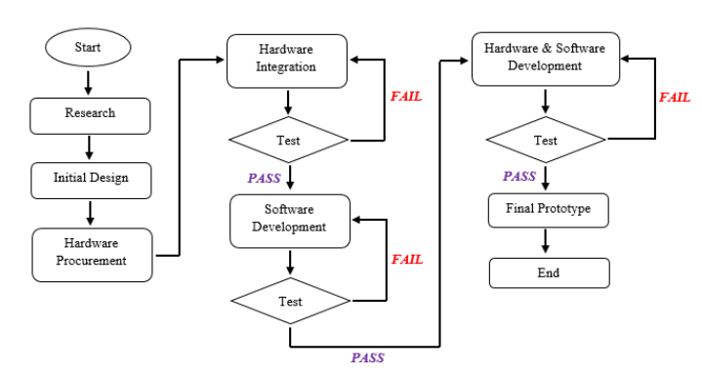
Methodology
A specific approach of executing is required in this project like any other software hardware integrated project. This approach emphasizes on step-by-step development by finishing one step before advancing to the other until it reaches the final stages of prototyping.
Figure :- Flow chart

Slide 14

Simulation Video

Slide 15
Conclusions
The Student Attendance System Using RFID is developed with the purpose to automate and improve the current processes and procedure of manual attendance recording. In developing the system, the student had to prepare 3 major scopes of functions which include the Arduino microcontroller, RFID module and microSD Card module. The system is developed using Arduino Integrated Development Environment (IDE) software as its main platform. IDE is used because of its open source and a very easy to program user interface.
The two way verification will be a boon and bane for attendance system as we know that a person entering a class room will be verified through real time face recognition and the active RFID will start working as soon as the person enter the class rooms, and the range will be decided by the dimensions of the room and the real time movement of the person will be recorded i.e. entry time and exit time.

Slide 16
References
[1]Sudhir Bussa,Shruti Bharuka, Ananya mani, Sakshi Kaushik, Smart attendance system using OPENCV based on facial recognition, vol. 9.IJERT, 03March -2020.
[2]Hao Yang,Xiaofeng han, Face recognition attendance system based on real-time video Processing, IEEE.
[3]Nirmalya Kar, Mrinal Kanti Debbarama,Ashim saha,Dwijen Rudra pal, Study of implementing automated attendance system using face recognition technique, vol 01. IJCCE, July 2012.
[4]Shreyaksawhney,Karan Kacker,Samyak Jain,Shailendra Narayan Singh,Rakesh Garg,Real-time Smart attendance system using face recognition techniques, ICCDSE,2019.

Slide 17
Thank You

