Slide 1

Department of Electrical, Electronics and Communication Engineering
Course Code: BECE4001 Course Name :Capstone Design-1
Interrogators Identification System
Ayush Kumar (19SECE1030008)
Ashutosh Gaurav (19SECE1030020)
Faculty Name: D Gnana Jeba Das Program Name: B.Tech

Slide 2
Literature Review
Identification or Attendance management is one of the most crucial tasks in an educational institution- school, college, or university. Daily student attendance allows teachers to keep a tab on students’ activities.
It also enables parents to understand whether their children are attentive towards studies & attend their class regularly.
An Active RFID based and Face recognition attendance system can be a great solution to overcome such challenges as it automates the students’ attendance process & enables teachers and parents to track & monitor students’ activities effortlessly.
The RFID attendance system can also be used to track the attendance of faculty or staff to simplify the payroll management procedure. These can also be used in alternative of Fast Tag system which will be internally fitted in the car and at Highway toll can be collected and if a theft case is registered the car my be stopped at a gate/parking/toll tax when scanned. Patients at hospital can be tracked with active RFID tags and can be cared with more efficiency.

Slide 3
Literature Review
Recording the attendance of students using RFID cards requires a portable recording device to be designed and built. Several components need to be integrated into a robust portable device that can read the RFID cards and store key data on board which can be transferred to a personal computer later.
This portable device have a storage part which is Secure Digital (SD) card to store the data that can be prevent the data from damage. Attendance can be recorded by swiping student identification card onto a portable device that contain a microcontroller equipped with Radio Frequency Identification (RFID) reader and recorded into on-board memory. Then, the data will be transferred to a personal computer either using a memory card or through Universal Serial Bus (USB) cable.

Slide 4
Merits and demerits
Merits:-
Its is a cost-effective.
RFID tag and reader should not be in LOS to make the system work.
Unlike barcodes, tags can store more information. Moreover it follows instructions/commands of reader.
It provides location to the reader along with its ID.
RFID tags are used for tracking luggage as well as for monitoring health history of patients in the hospitals.
RFID technology is versatile in nature and hence smaller and larger RFID devices are available as per application.
Tags can be read only as well as read/write unlike barcodes.
The technology is used for security and attendance purpose in schools, colleges as well as office establishments. The time-in and time-out is recorded it the database of the server.

Slide 5
Merits and demerits
Demerits:-
Active RFID is costly due to use of batteries.
Privacy is a concern with the use of RFID on products as it can be easily tapped or intercepted.
RFID devices need to be programmed which requires enough amount of time.
Use of RFID technology at inventory control and for other such applications lead to loss of jobs for unskilled laborer.
The external electromagnetic interference can limit the RFID remote reading.
The coverage range of RFID is limited which is about 3 meters.

Slide 6
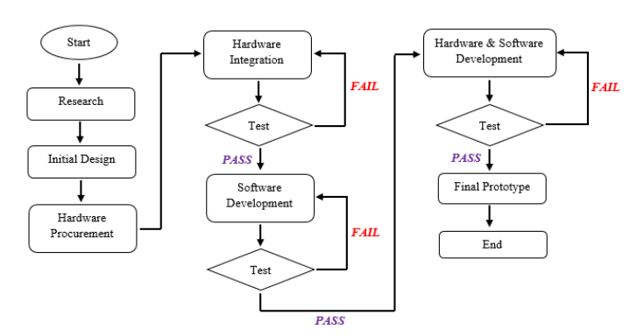
Methodology
A specific approach of executing is required in this project like any other software hardware integrated project. This approach emphasizes on step-by-step development by finishing one step before advancing to the other until it reaches the final stages of prototyping.
Figure :- Flow chart

Slide 7
Problem Statement
“The problem statement is to reduce the manual attendance by using this devices”
Basically, recording of student attendance can be tedious and time consuming if done manually, especially for large classes. There are a few latest technologies that also involve in recording students’ attendance such as bar code system and fingerprint system but all of them are very high maintenance and costly. If a portable computer assisted system with affordable cost is used, data can be recorded and stored accurately, so that time consuming problem can be avoided.

Slide 8
Timeline(Progress done)
Problem Statement
Circuit Designing
Code
Soldering
Simulation
Review paper

Slide 9

Simulation Video

Slide 10
Conclusions
The Student Attendance System Using RFID is developed with the purpose to automate and improve the current processes and procedure of manual attendance recording. In developing the system, the student had to prepare 3 major scopes of functions which include the Arduino microcontroller, RFID module and microSD Card module. The system is developed using Arduino Integrated Development Environment (IDE) software as its main platform. IDE is used because of its open source and a very easy to program user interface.

