Slide 1
Face Recognition Attendance System
Automating Attendance with AI for Efficiency and Security
Group Members and Contribution
Group Members | Contribution
Arshad Reza | Planning The Project & Field Research
Celestine Joseph | Make the Flow Charts
Dyanraj Rathod | Implementation of Add Data
Gyan Gupta | Implementation oF unique Features & GUI
Pratik Pandarkar | Implementation of Mark Attendance

Slide 2
Problem and Solution
What was the Problem in Real scenario and what solution did we offer.
Problem:
Traditional attendance systems rely on manual processes, which are time-consuming and prone to errors. There is also the risk of tampering and inaccuracies in attendance records.
Our solution:
An advanced attendance system that marks student attendance instantly by recognizing their faces, eliminating time wastage and effort.

Slide 3
Core Highlights:
What Makes This Attendance System Truly Exceptional!
Wi-Fi Check for Security: Makes sure attendance can only be marked on the right network, stopping any cheating.
Real vs. Fake Face Detection: Uses eye blinking to confirm it’s a real person, not a fake image.
Easy to Access: Works on any device through a web browser, making it simple for everyone to use.
Quick and Hassle-Free: No forms or typing needed—just show your face, and attendance is marked in seconds.
Scheduled Attendance: Only allows attendance to be marked during the set time, ensuring accuracy.

Slide 4
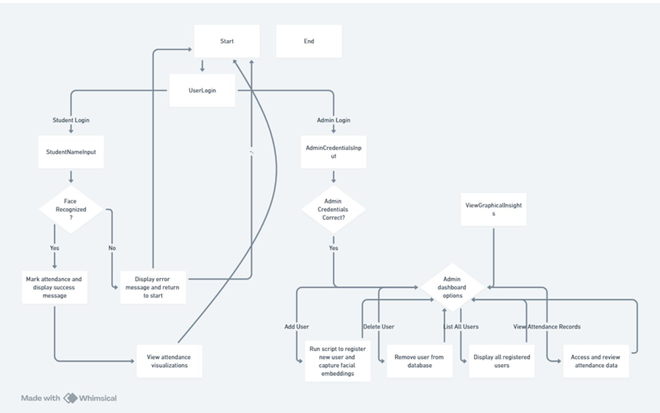
How It Works:
The work-flow and how this project works?

Slide 5
Innovative Technology:
This system uses advanced libraries to deliver a smooth and efficient attendance management experience.
OpenCV (Computer Vision Library): Used for face detection and recognition, allowing the system to identify students quickly and accurately.
dlib (Machine Learning Library): Helps with face landmark detection and verifying the authenticity of the face through eye blink detection, ensuring the attendance is recorded by a real person.
SQLite / pandas (Data Handling): Stores and processes attendance data in an organized format. pandas is used to handle attendance records and generate reports.
Flask (Web Framework): Provides a lightweight web interface that allows easy access through any browser, making the system simple and flexible to use.
Matplotlib (Data Visualization): Used for generating attendance graphs and visual reports, helping admins track attendance trends.
Tabulate (Table Display): Provides a neat and readable format for displaying user data and attendance records, making the system user-friendly.
Python smtplib (Email Notifications): Future plans include sending notifications, allowing users to stay updated with their attendance status via email.

Slide 6
Demonstration:

Slide 7
Market Potential:
This Face Recognition Attendance System has significant potential in various sectors:
Educational Institutions: Reduces administrative workload, ensures accurate attendance, and prevents proxy attendance.
Corporate Offices: Streamlines employee attendance tracking, enhances security, and reduces fraud.
Event Management: Provides a quick and secure check-in process for large events and conferences.
Multi-Platform Access: Can be accessed through any device on a browser, ensuring convenience and accessibility.
Data-Driven Insights: Generates reports and visualizations to track trends and make informed decisions.
Flexible Scheduling: Attendance is marked only within scheduled hours, preventing misuse.

Slide 8



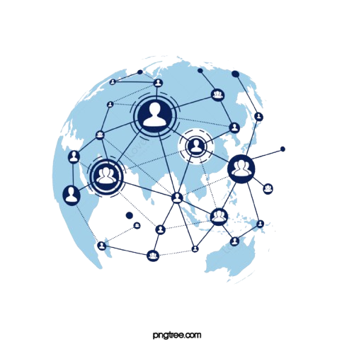

Limitations:
What are the drawbacks of the project ?
No Database Integration:
Camera Quality Dependency:
No Attendance Editing:
The system does not integrate with a centralized database, limiting scalability for larger organizations or institutions.
The performance of the face recognition system is highly dependent on the quality of the camera, and lower-quality cameras may affect accuracy.
Once attendance is marked, it cannot be edited or corrected, which could cause issues if mistakes are made.
Requires Stable Internet Connection:
Limited User Management:
Once attendance is marked, it cannot be edited or corrected, which could cause issues if mistakes are made.
User addition and deletion are manual processes, which could be time-consuming when dealing with a large number of users.

Slide 9
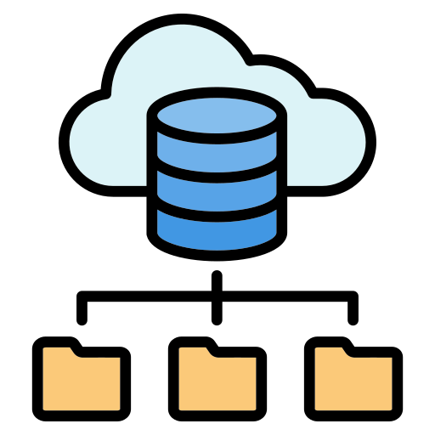


Future Enhancement:
What enhancement could be made in Future ?
Database Integration:
Real-Time Notifications:
Enhanced Security Features:
Integrate with relational or NoSQL databases like MySQL or MongoDB for scalable, efficient data storage and management, allowing the system to handle larger user bases.
Implement more sophisticated machine learning or deep learning models to improve accuracy, even in challenging conditions like poor lighting or obstructions.
Introduce security measures like data encryption, multi-factor authentication, and audit logs to ensure privacy and safeguard sensitive user data.

Slide 10


Call to Action:
For inquiries, contact:
Teamail@gmail.com | Customer Support: +91 12345 67890

