Slide 1
INSIGHTVISTA 2026
Retail Sales
Analysis & Visualization
Group Name
Subject Code
Syntax Squad
1IT508
Subject
Enrollment No.
Data Analysis and Visualization
240840116004
240840116008
240840116056
250843116010
Retail transactions • 2023–2024

Slide 2
What we observe in the dataset
A one-year retail snapshot with three closely sized product categories
456,000
1,000
2,514
1,000
Total sales
Transactions
Units sold
Unique customers
Key observations
Electronics leads sales at 156,905; Clothing is close at 155,580.
Beauty contributes 143,515, so category revenue is relatively balanced.
Monthly sales vary from 23,620 in September to 53,150 in May 2023.
The file covers Jan 1, 2023–Jan 1, 2024; the last date has only two transactions.
Source: supplied competition dataset • currency not specified
02

Slide 3
Steps performed
A compact workflow from source file to interactive Power BI pages
01
02
03
04
05
Inspect
›
Validate
›
Prepare
›
Derive
›
Visualize
Reviewed columns, row count, date range, and field roles.
Checked missing values, duplicate rows/IDs, and sales arithmetic.
Confirmed dates and numeric fields; retained all valid records.
Created age bands for comparing average transaction value.
Built category, monthly, age, and KPI views with cross-filtering.
Validation outcome
1,000 rows retained • no blanks or duplicate rows • Total Amount = Quantity × Price per Unit in every row
Source: competition retail sales dataset
03

Slide 4
Final dataset and preparation
The source data was already complete; preparation focused on validation and analysis fields
Source fields and roles
Transaction ID
Date
Customer ID
Unique transaction key
Transaction date
Customer key
Gender
Age
Product Category
Category
Integer
Category
Quantity
Price per Unit
Total Amount
Integer
Numeric
Numeric measure
Preparation and quality checks
All 1,000 rows have values; no duplicate rows or transaction IDs were found.
Recalculated Quantity × Price per Unit and confirmed it matches Total Amount for all rows.
Added age groups: 18–24, 25–34, 35–44, 45–54, and 55–64; no source rows were removed.
Source: supplied dataset • original rows retained
04

Slide 5
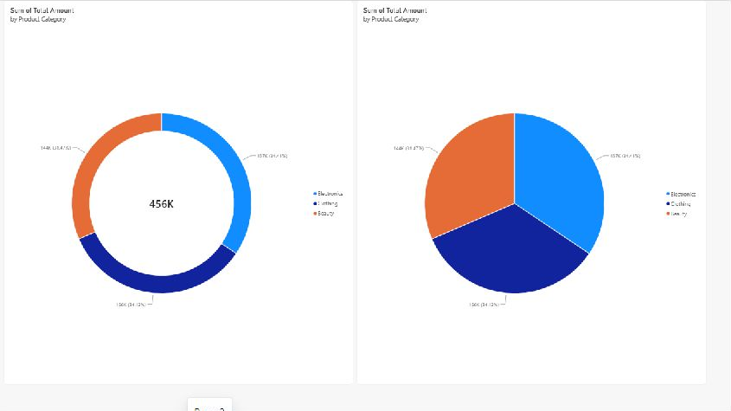
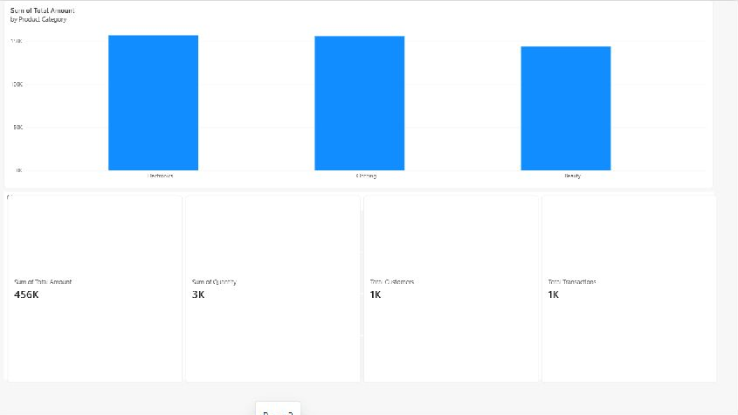
Dashboard views and first observations
Power BI pages 2 and 3 show category mix, category sales, and headline KPIs
Category composition
Sales by category and four KPIs
Revenue is concentrated fairly evenly across Electronics, Clothing, and Beauty.
The category chart filters the KPI cards; the report’s chart selections cross-filter related visuals.
Dashboard screenshots from the Power BI report • values rounded for display
05

Slide 6
Sales trends and category performance
Monthly sales are uneven; category totals remain close
May was the strongest month; September was the lowest in 2023.
Electronics generated the most revenue (34.4%); Clothing had the most transactions (351).
Jan 2024 excluded from the monthly trend: only two transactions are present for that date
06

Slide 7
Category mix
Two views of the same revenue split
Electronics 34.4% • Clothing 34.1% • Beauty 31.5%
Share of total sales 456,000 • currency not specified
07

Slide 8
Customer profile
Average transaction value trends lower across older age bands; sales split by gender is close
18–24 has the highest observed average (501); 55–64 has the lowest (417.5).
Female sales are 232,840 (51.1%); Male sales are 223,160 (48.9%).
Descriptive differences only; age and gender patterns do not establish cause
08

Slide 9
Business recommendations
Use the patterns as hypotheses to test, then measure profit and repeat behavior.
1
Plan around monthly variation
Review what drove the May high and September low; test calendar offers before changing budgets.
2
Protect category availability
Electronics led revenue while Clothing led transaction count. Track stockouts, margin, and conversion before shifting inventory.
3
Test customer-specific offers
Compare age-band response with controlled campaigns; do not treat the observed age pattern as a cause.
4
Improve the next data capture
Add unit cost, promotion, product/SKU, channel, inventory, and repeat-customer fields to measure profit and retention.
Analysis scope: sales and transaction value only • cost, profit, promotion, inventory, and repeat behavior are not in the source file
09

