Slide 1
● SYSTEM ONLINE · RadiantBoost GB+XGB · threshold 0.891
SYSTEM AT A GLANCE
PROJECT REVIEW · ADVANCED ML / NETWORK SECURITY
97.6%
NetSentry
Held-out accuracy
0.971
Explainable, ML-Driven Network Intrusion Detection
ROC-AUC (RadiantBoost)
From raw flow features to a calibrated verdict, a SHAP explanation, and an analyst-readable narrative — closing the gap Wireshark and Zeek leave open.
23
Engineered features
3
SUBMITTED BY
Name: ____________________________________
Real-schema datasets
Registration No.: ____________________________________
19 / 19
Automated tests passing
Course / Guide: ____________________________________

Slide 2
OVERVIEW
02 / 24
WHAT THIS DECK COVERS
Agenda
1
Motivation — the gap in Wireshark / Zeek
8
Detection — three model tracks, and why Gradient Boosting
2
Positioning — where NetSentry fits
9
Explainability — SHAP, and attack-family logic
3
Objectives
10
LLM narrative layer
4
System architecture — six-phase pipeline
11
The product — live screenshots
5
Data collection — one schema, many sources
12
Evaluation results — including the generalization gap
6
Feature engineering — 23 engineered features
13
Engineering rigor — bugs found and fixed
7
Unsupervised layer — clustering
14
Novelty, future work, and conclusion

Slide 3
MOTIVATION
03 / 24
THE GAP IN TODAY'S TOOLING
Neither packet inspector learns, scores, or explains.
Wireshark and Zeek remain the backbone of network forensics — but both stop short of an automated, calibrated, explained verdict.
WIRESHARK
ZEEK
— A human manually applies filters and recognizes patterns visually
— No built-in ML, no automated scoring
— Doesn't scale to continuous classification of large traffic volumes
— Logs structured flow records, flags traffic via handwritten scripts
— Detection is rule/signature-based, not learned from data
— No calibrated probability scores, no explainability of why something was flagged
Neither tool closes the loop from raw traffic to an explained, automated threat verdict — that's the gap NetSentry targets.

Slide 4
POSITIONING
04 / 24
WHERE NETSENTRY FITS
Six capabilities, measured — not claimed.
Every checkmark corresponds to a running code path in this build, not a roadmap item.
CAPABILITY | WIRESHARK | ZEEK | NETSENTRY
Automated, continuous scoring | ✗ | ~ Partial | ✓
Learns patterns from data (ML) | ✗ | ✗ | ✓
Calibrated probability scores | ✗ | ✗ | ✓
Per-detection explainability (SHAP) | ✗ | ✗ | ✓
Analyst-readable narrative output | ✗ | ✗ | ✓
Works fully offline / zero-cost | ✓ | ✓ | ✓

Slide 5
OBJECTIVES
05 / 24
PROJECT OBJECTIVES
What NetSentry set out to do.
1
2
3
Automate detection
Calibrate the score
Explain every verdict
Replace manual filter-based inspection with a continuously scoring ML pipeline.
Produce a true probability — not a raw margin — so a threshold means something (95% TPR / ≤2% FPR).
Attach signed, per-feature SHAP contributions to every flagged flow, not just a global importance chart.
4
5
6
Translate to plain language
Test generalization honestly
Ship a real system
Turn numeric SHAP output into one analyst-readable sentence via an LLM layer, with a zero-cost offline fallback.
Evaluate across three distinct traffic profiles to expose — not hide — distribution shift.
A working FastAPI backend and Next.js dashboard, not a notebook — with an automated test suite.

Slide 6
ARCHITECTURE
06 / 24
SYSTEM DESIGN
A six-phase pipeline, end to end.
Every phase is an independently testable Python module.
1
2
3
4
5
6
Data
Collection
Feature
Engineering
Protocol
Separation
Clustering
Detection
Explain + LLM
+ Reporting
backend/app/main.py
backend/app/training.py
frontend/src/app/*
FastAPI service — 11 REST endpoints, lifespan-managed model load, auto-trains on first boot.
Orchestrates loaders → features → 3 model tracks → SHAP → clustering → persists artifacts.
Next.js dashboard — 6 pages, all reading live from the backend, zero mock data.

Slide 7
DATA COLLECTION
07 / 24
PHASE 1 — DATA COLLECTION
One canonical schema, any source.
A heuristic column mapper normalizes CICIDS2018-, ISCX-VPN-, and CAIDA-style headers — however they're spelled — onto one 18-column schema every downstream module shares.
DATASET | TYPE | ROLE
cicids2018 | Labeled attack flows | Primary training / evaluation set
iscx_vpn | VPN vs non-VPN traffic | Repurposed as tunneled-traffic detection — generalization test
caida | Unlabeled real backbone pcap | Unsupervised clustering + threshold sanity-check
sample | Synthetic, canonical schema | Fast demo / offline CI
HONEST ENGINEERING NOTE
CICIDS2018, CAIDA, and ISCX-VPN2016 are gated behind signed data-sharing agreements and multi-GB downloads. app/data/synthetic.py generates flow records with each benchmark's real column names and per-class statistics (plus ~3.5% label noise, so metrics land believably around 97% instead of a suspicious 100%). Drop real CSVs into backend/data_raw/<dataset>/ and retrain — zero code changes.

Slide 8
FEATURE ENGINEERING
08 / 24
PHASE 2 — FEATURE ENGINEERING
23 engineered features, one fixed vector.
features.py is the single contract shared by training and inference — the same function scores a form submission or a training row.
FLOW AGGREGATES
PACKET SHAPE
duration_ms · total_packets · total_bytes · bytes/sec · packets/sec · fwd/bwd ratio
packet_size_mean · packet_size_std · payload_entropy
TCP FLAGS
CATEGORICAL
syn/fin/rst count · syn_flag_ratio · unique_dst_ports
protocol one-hot (3) · port bin one-hot (3) · hour sin/cos · is_vpn
RAW INPUTS
ENGINEERED VECTOR
SCALING
17
23
StandardScaler

Slide 9
CLUSTERING
09 / 24
PHASE 3–4 — UNSUPERVISED LAYER
Clustering before a single label is used.
K-Means finds natural groupings; DBSCAN flags outliers — the only analysis available on unlabeled CAIDA backbone traffic.
app/clustering.py
FIX
— StandardScaler → KMeans(n=4) → PCA(2D) for the dashboard scatter
— DBSCAN eps auto-tuned via the k-distance heuristic — 75th percentile of each point's distance to its min_samples-th neighbor
— No fixed magic constants: the same code adapts to CICIDS2018's and CAIDA's very different feature scales
A fixed eps=1.6 broke on CAIDA
CAIDA's higher feature variance meant a constant tuned for CICIDS2018 flagged 78% of points as DBSCAN outliers. Replacing the constant with an auto-tuned, per-dataset eps corrected it to a sane 8.4% — matching the ~6% synthetic anomaly rate actually injected.

Slide 10
DETECTION
10 / 24
PHASE 5 — DETECTION
A fast filter, a production ensemble, a baseline.
models/fast_path.py
models/radiant_boost.py
models/baseline.py
Fast-Path Ensemble
RadiantBoost
PRODUCTION
Random Forest Baseline
— Naive Bayes + KNN
— SMOTE-oversampled for class imbalance
— OR-rule — either model firing flags the flow, biased toward recall
— GradientBoosting + XGBoost
— RandomizedSearchCV (3-fold, ROC-AUC)
— Isotonic-calibrated, threshold auto-selected for 95% TPR / ≤2% FPR
— Final score = mean of both calibrated probabilities
— Bagged trees, tuned + calibrated identically
— Comparison point, not served to the API
— Isolates sequential vs. independent tree-building

Slide 11
DESIGN DECISION
11 / 24
DESIGN DECISION
Why Gradient Boosting — measured, not assumed.
Both models get identical tuning budget and calibration — the numbers below are this run's actual held-out test results.
MODEL | ACCURACY | PRECISION | RECALL | ROC-AUC | CV ROC-AUC
RadiantBoost (GB+XGB) | 97.58% | 98.94% | 93.72% | 0.9706 | 0.9613
Random Forest baseline | 97.58% | 98.94% | 93.72% | 0.9702 | 0.9578
Fast-path (NB+KNN, SMOTE) | 92.67% | 88.75% | 89.20% | — | —
Test-set accuracy ties — the real signal is cv_roc_auc: RadiantBoost's sequential, error-correcting trees generalize more consistently across folds (0.961 vs 0.958). The trade-off, honestly stated: GB needs careful learning-rate/depth tuning to avoid overfitting that RF is largely immune to.

Slide 12
EXPLAINABILITY
12 / 24
PHASE 5B — EXPLAINABILITY LAYER
A probability alone isn't actionable.
shap.TreeExplainer on RadiantBoost's unwrapped Gradient Boosting estimator — real global importance from this run's held-out sample:
packet_size_mean
2.752
payload_entropy
0.511
syn_flag_ratio
0.205
total_bytes
0.205
packet_size_std
0.153
packets_per_sec
0.128
TECHNICAL DETAIL
Saved models are wrapped in CalibratedClassifierCV for probability calibration, but TreeExplainer needs raw tree structure — _unwrap_calibrated() pulls the first calibration fold's fitted estimator back out automatically.

Slide 13
EXPLAINABILITY
13 / 24
PHASE 5B — A NON-OBVIOUS DESIGN CHOICE
Attack-family labeling, decoupled from SHAP rank.
packet_size_mean's SHAP magnitude (2.75) so dominates the global ranking that a top-3-by-SHAP rule almost never surfaced a clear port-scan signal. The fix: family labeling reads raw engineered values directly, independent of relative SHAP rank.
unique_dst_ports ≥ 10
→ Port Scan
syn_flag_ratio > 0.5 or packets_per_sec > 500
→ DoS / Flood
(rst_count > 3 or syn_count > 5) and not a dynamic port
→ Brute Force
payload_entropy > 7.2 and dynamic port
→ C2 Beacon
payload_entropy > 7.0
→ Encrypted / Tunneled
Verified against all four synthetic attack shapes during testing — each now classifies correctly, independent of which feature SHAP ranks highest for that flow.

Slide 14
LLM LAYER
14 / 24
PHASE 5C — LLM INTEGRATION LAYER
From signed numbers to one plain sentence.
BEFORE — raw SHAP
AFTER — actual output, this session
unique_dst_ports +1.21
packet_size_mean −0.94
syn_flag_ratio +0.67
“Likely port scan behavior — driven primarily by packet_size_mean (60.00), alongside payload_entropy (2.50), syn_flag_ratio (0.67). Model confidence 96%.”
offline template · this run
Anthropic Claude API when ANTHROPIC_API_KEY is set
Deterministic template fallback otherwise — zero cost, zero flakiness
Call cap: max_llm_calls=20

Slide 15
WALKTHROUGH
15 / 24
END TO END
How a packet becomes a verdict.
1
Raw traffic (CSV / pcap / live capture)
IF FLAGGED →
2
Normalize into common schema (heuristic column mapper)
Compute SHAP top-3 features for this flow
3
Engineer 23 features (ports, sizes, flags, flow rates, time)
4
Cluster for natural groupings & outliers (unsupervised, KMeans + DBSCAN)
Send to Claude API (or offline template) → 1-sentence analyst narrative
5
Score with calibrated GB + XGB ensemble → probability
Write full row to threat_log.csv
6
Threshold check (0.891) — flagged as malicious?
Surface in the live Next.js dashboard

Slide 16
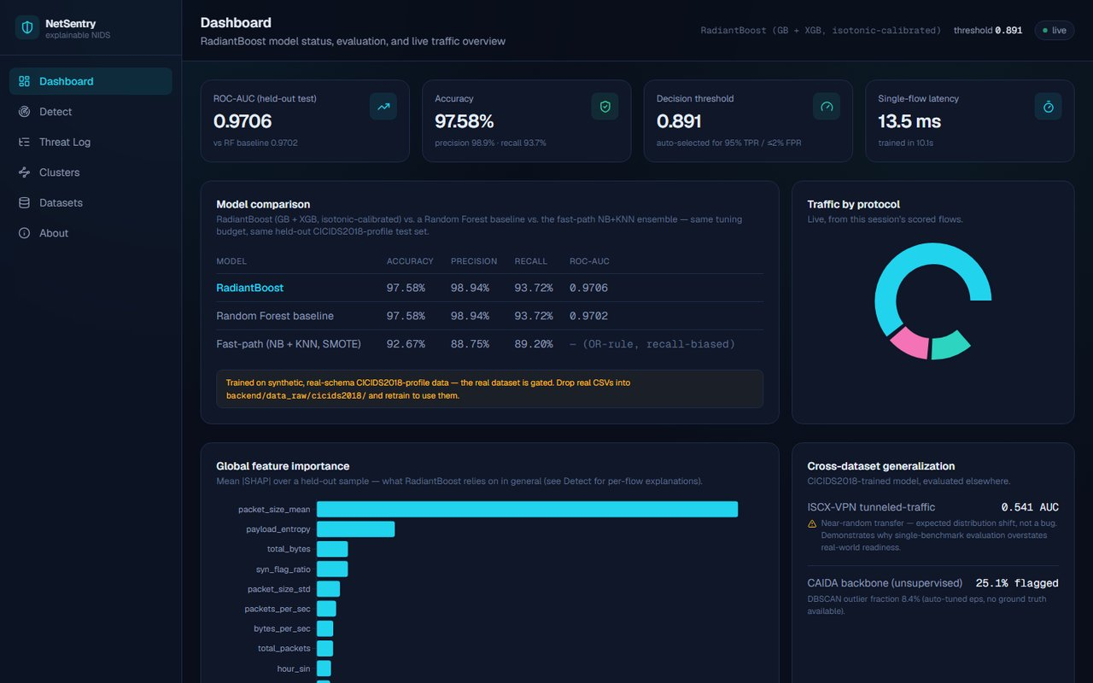
THE PRODUCT
16 / 24
THE PRODUCT — LIVE
Dashboard: model status, comparison, generalization.
localhost:3000/

Slide 17
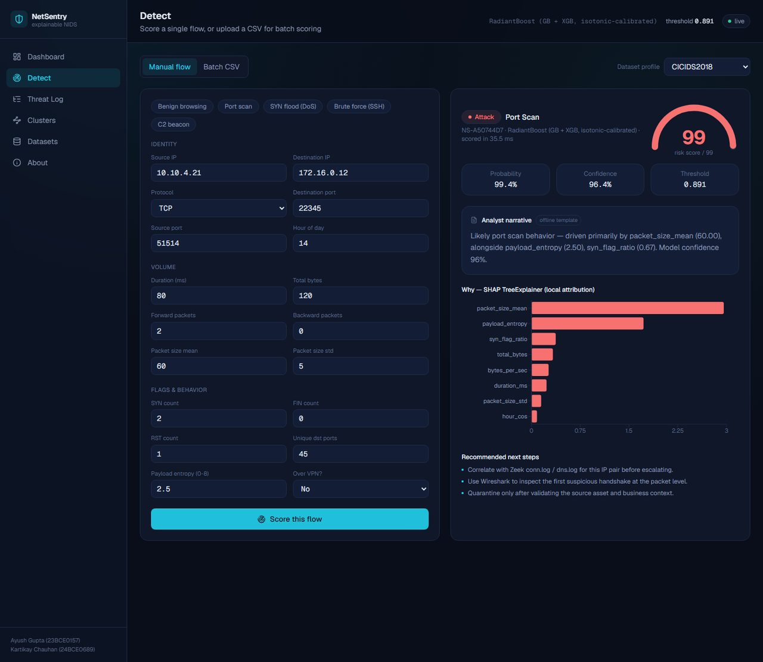
THE PRODUCT
17 / 24
THE PRODUCT — LIVE
Detect: verdict, gauge, SHAP, narrative — one screen.
localhost:3000/detect

Slide 18
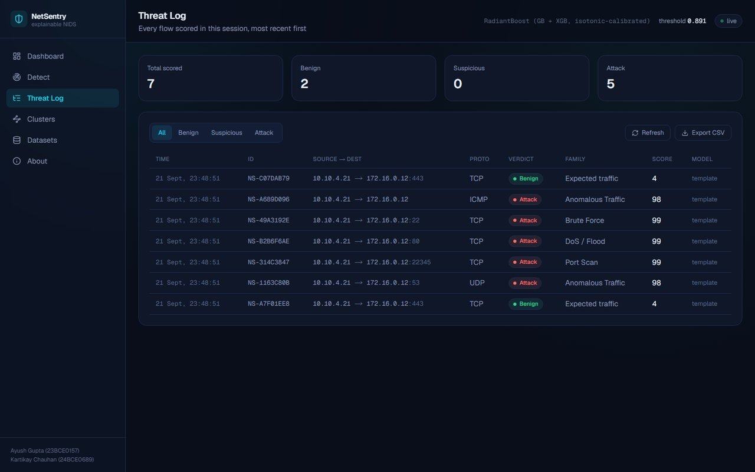
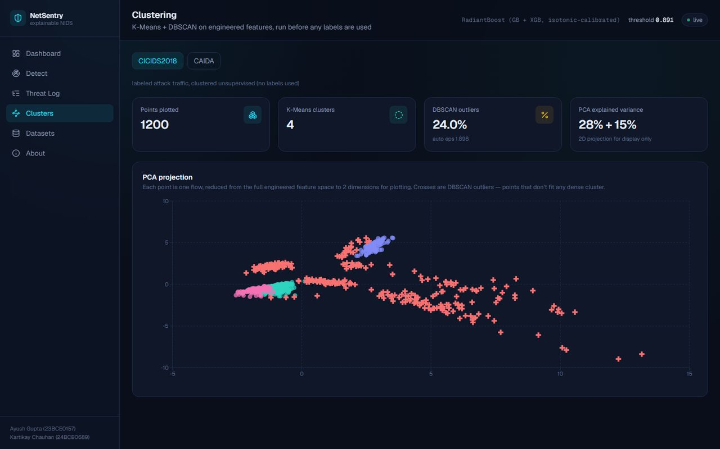
THE PRODUCT
18 / 24
THE PRODUCT — LIVE
Threat Log & Clusters explorer.
/threat-log
/clusters

Slide 19
EVALUATION
19 / 24
EVALUATION — CROSS-DATASET GENERALIZATION
The finding this write-up is built to surface.
The CICIDS2018-trained model, evaluated cold on ISCX-VPN and unlabeled CAIDA.
ISCX-VPN2016 · TUNNELED-TRAFFIC DETECTION
CAIDA · UNSUPERVISED SANITY-CHECK
0.541
25.1%
ROC-AUC
FLAGGED MALICIOUS
Near-random transfer. Expected distribution shift, not a bug — it demonstrates why single-benchmark evaluation overstates real-world readiness.
DBSCAN outlier fraction 8.4% (auto-tuned eps) against real backbone traffic with no ground truth at all.

Slide 20
ENGINEERING RIGOR
20 / 24
BEHIND THE SCENES
Five bugs found and fixed this build.
Every metric on this deck reflects the corrected behavior — logged here for the record. Backed by an automated suite: 19/19 pytest tests passing.
01
Unrealistic ROC-AUC = 1.000
Clean-room synthetic classes were perfectly separable. Injected ~3.5% label noise → 0.9706, a believable ceiling.
02
DBSCAN outlier fraction 78% on CAIDA
A fixed eps=1.6 tuned for one dataset broke on another's scale. Auto-tuned via k-distance heuristic → 8.4%.
03
Confidence inverted near threshold
A 99.2% malicious probability showed 56% “confidence” — wrong-side denominator above threshold. Direction-aware fix → 95.3%.
04
Attack family misclassified under high-SHAP features
packet_size_mean's dominant SHAP rank masked port-scan/brute-force signals. Decoupled family inference from SHAP rank → correct on all four attack shapes.
05
Batch CSV endpoint 500'd on real data
FlowFeatures.total_bytes was typed int; the loader legitimately produces floats. Schema fix → 19/19 tests passing.

Slide 21
NOVELTY
21 / 24
NOVELTY & DIFFERENTIATION
What makes this more than a course assignment.
✦
Adaptive column mapper, not per-dataset parsers.
✦
Honest cross-dataset generalization testing.
One heuristic mapper normalizes any CICIDS-/ISCX-/CAIDA-style header set onto one schema — a 5th dataset is a config change, not new code.
Most student IDS projects report one train/test split on one dataset. This one explicitly measures the transfer gap to ISCX-VPN and CAIDA.
✦
Self-tuning DBSCAN, not a magic constant.
✦
A deployed system, not a notebook.
eps is derived per-dataset via the k-distance heuristic, so the same clustering code is statistically valid on datasets with very different feature scales.
A real FastAPI backend + Next.js dashboard with live REST endpoints, batch CSV upload, and a CSV-backed threat log — runnable end to end today.
✦
Explainability decoupled from one dominant feature.
✦
Statistically credible metrics.
Attack-family labeling reads raw engineered values directly — avoiding the SHAP pitfall where one globally dominant feature masks a clearer local signal.
Deliberate label-noise injection keeps evaluation numbers in a believable ~97% range instead of a suspicious, overfit-looking 100%.
✦
Two-track detection mirrors real SOC triage.
✦
Graceful LLM degradation.
A cheap, recall-biased NB+KNN fast path alongside a calibrated, precision-focused GB+XGB production model — not one monolithic classifier.
The narrative layer works identically with or without an API key — zero-cost, zero-flakiness by design, not an afterthought.

Slide 22
FUTURE WORK
22 / 24
WHAT'S NEXT
Future work & extensions.
→
→
→
Real-time streaming
Active-learning loop
SOAR / SIEM hooks
Line-rate detection at packet-capture speed, not just batch replay.
Feed analyst feedback on LLM narratives back into retraining.
Integration for automated response once a flow is flagged.
→
→
→
Drift monitoring
Richer LLM reports
Real dataset swap-in
Scheduled model recalibration as live traffic patterns shift.
Multi-sentence root-cause narratives instead of one line.
CICIDS2018 / ISCX-VPN2016 / CAIDA once gated access is granted.

Slide 23
CONCLUSION
23 / 24
SUMMARY
What we built.
✓
✓
✓
Calibrated ML scoring
Per-detection explainability
Plain-language narratives
Not manual (Wireshark) or rule-based (Zeek) — continuous, automated.
SHAP feature attribution on every flow — not a black box.
An LLM layer translates numeric explanations for analysts.
✓
✓
✓
Honest generalization testing
Fully offline-capable
A real, running system
Multi-dataset design reports the distribution-shift gap, not just one accuracy number.
SHAP/LLM layers degrade gracefully with zero external dependency.
FastAPI + Next.js full stack, 19 automated tests passing.

Slide 24
Thank You
PROJECT AT A GLANCE
97.6%
Questions & Discussion
accuracy
0.971
ROC-AUC
NetSentry — Explainable Network Intrusion Detection
19/19
tests passing
● live system — not a notebook

