Slide 1
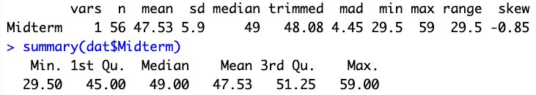
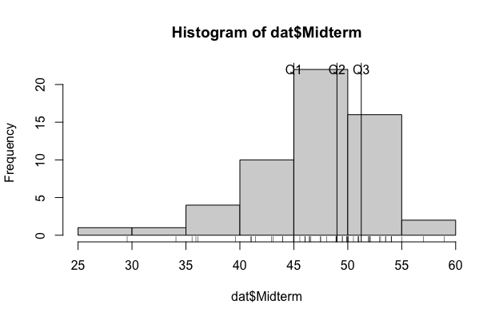
Midterm
51-59 = A
49-51 = A-
46-49 = B+
40-46 = B
<40 B-
A
B

