Slide 1
Nonparametric/Blackbox Regression and Classification Continued
See Syllabus for reference reading

Slide 2
K-Nearest Neighbors
A generic nonlinear modeling tool that is extremely flexible
Perhaps the simplest modeling idea of all
Can be effective for data sets with large n, small k (or large k but with predictors on a low-dimensional manifold), high SNR, and no categorical predictors with > 2 categories
Based on the name, can you guess how K-nearest neighbors works?

Slide 3
Structure of 1-Nearest Neighbors (for regression)
You need a set of training data {y_{i}, x_{i}: i = 1, 2, . . ., n}, but you do not fit a model.
For 1-Nearest Neighbors, to predict Y for a new case with predictors x:
find the x_{i} in your training set that is the closest neighbor to x
then take the predicted Y to be the response value for that training observation

Slide 4
Illustration of K-NN for Gas Mileage data
library(scatterplot3d)
library(rgl)
GAS<-read.csv("Gas_Mileage.csv",header=TRUE)
GAS1<-GAS
GAS1[,2:12]<-sapply(GAS1[,2:12], function(x) (x-mean(x[!is.na(x)]))/sd(x[!is.na(x)]))
GAS[1:10,]
attach(GAS1)
GAS1[c(1,2,6)]
plot3d(Displacement,Rear_axle_ratio,Mpg)
###
plot(Displacement,Rear_axle_ratio,type="p")
###
identify(Displacement,Rear_axle_ratio)

Slide 5
Nearest Neighbors Example: Gas_Mileage.csv

Slide 6
Calculating Distances to find Nearest Neighbors
If we want to predict Y(x) for a new case with predictors x, the distance between x and the predictors x_{i} for the ith training case (i = 1, 2, . . ., n) is measured via
For 1-nearest neighbor, the prediction of Y(x) is
where i₁(x) = row index of closest neighbor of x

Slide 7
> GAS1[c(1,2,6)]
Mpg Displacement Rear_axle_ratio
1 18.90 0.5540441 -0.96676902
2 17.00 0.5540441 -0.96676902
3 20.00 -0.2989055 -0.63495681
4 18.25 0.5625736 -0.10796096
5 20.07 -0.5121430 -0.57640172
6 11.20 1.3216988 -0.34218134
7 22.12 -0.4609660 -0.96676902
8 21.47 -0.1965516 -0.96676902
9 34.70 -1.6661838 1.64869189
10 30.40 -1.6047715 2.42942649
11 16.50 0.5540441 0.04818596
12 36.50 -1.7037136 1.62917353
13 21.50 -0.9727358 0.32144307
14 19.70 -0.2306696 0.04818596
15 20.30 -1.2371502 0.67277364
16 17.80 0.1446283 -0.10796096
17 14.39 1.8334686 -0.63495681
18 14.89 1.3216988 -0.67399354
19 17.80 0.5540441 0.04818596
20 16.41 0.2811002 -1.18147103
21 23.54 -0.4609660 -0.96676902
22 21.47 0.6393391 -1.18147103
23 16.59 0.9805189 0.04818596
24 31.90 -1.6047715 2.42942649
25 29.40 -1.2371502 -0.26410788
26 13.27 1.4922887 -0.10796096
27 23.90 -1.2917389 1.66821026
28 19.73 0.2811002 -0.67399354
29 13.90 0.5625736 0.37999817
30 13.27 0.5625736 0.39951653
31 13.77 0.6393391 0.18481452
32 16.50 0.6393391 -0.63495681
What is the predicted mpg for a car with Displacement = -1.0 and Rear_axle_ratio = 0.0 (in standardized units) using 1-nearest neighbor?
i.e., what is for x = [−1.0, 0]^{T}?
Row 13 is the nearest neighbor with x₁₃ = [−0.97, 0.32]^{T} and distance
So i₁(x) = 13, and

Slide 8
Discussion Points and Questions
You should always standardize your predictors as a first step – why?
How do you handle categorical predictors?
For 1-nearest neighbor, what would a plot of versus x look for the gas mileage example with only Displacement as a predictor?

Slide 9
Structure of K-Nearest Neighbors (for regression)
More generally, for K-nearest neighbors, you use exactly the same procedure, except you:
find the K closest training x_{i}'s to x, and
then take the predicted Y to be the average response value for these K training observations:
where {i₁(x), i₂(x), . . ., i_{K}(x)} = indices of K closest neighbors of x
The tradeoff of using large vs. small K is exactly the classic bias/variance tradeoff

Slide 10
Large Versus Small K (single predictor example)
K=1
K=20
Why is the predictor in the left plot high variance and low bias?
Why is the predictor in the right plot low variance and high bias?

Slide 11
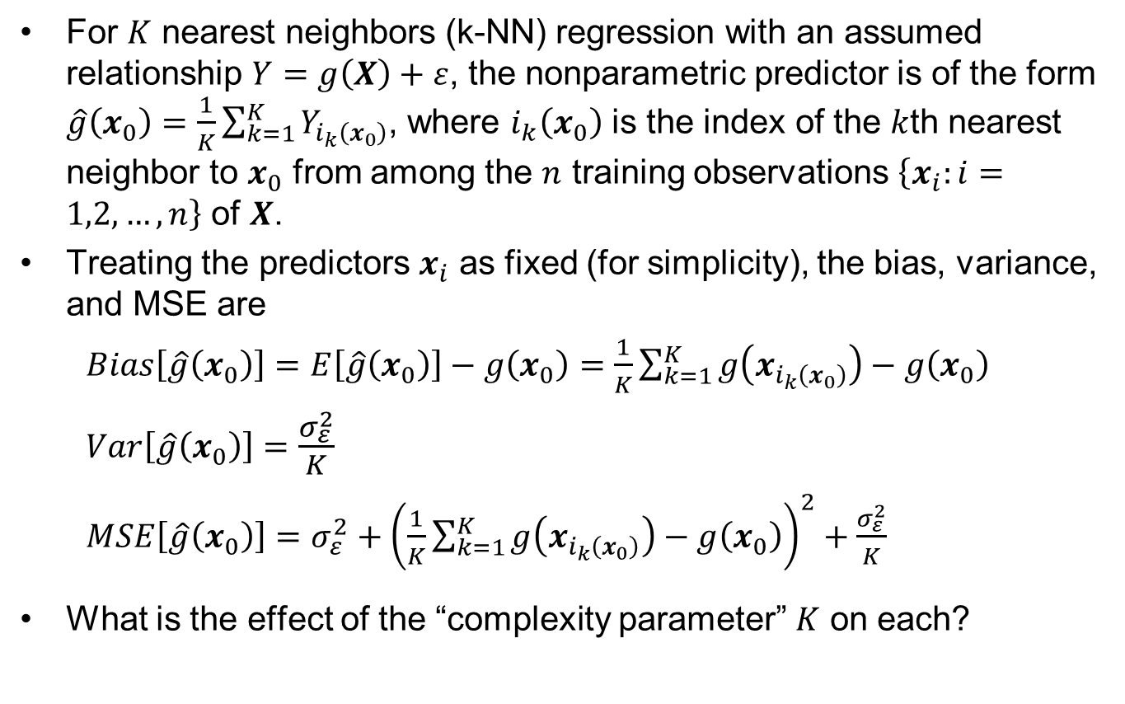
Bias and Variance in Nearest Neighbors
For $K$ nearest neighbors (k-NN) regression with an assumed relationship $Y=g\left(X\right)+ε$, the nonparametric predictor is of the form $\hat{g}\left(x_{0}\right)=\frac{1}{K}\sum_{k=1}^{K}{Y_{i_{k}\left(x_{0}\right)}}$, where $i_{k}\left(x_{0}\right)$ is the index of the $k$th nearest neighbor to $x_{0}$ from among the $n$ training observations $\left\{x_{i}:i=1,2,…,n\right\}$ of $X$.
Treating the predictors $x_{i}$ as fixed (for simplicity), the bias, variance, and MSE are
$Bias\left[\hat{g}\left(x_{0}\right)\right]=E\left[\hat{g}\left(x_{0}\right)\right]−g\left(x_{0}\right)=\frac{1}{K}\sum_{k=1}^{K}{g\left(x_{i_{k}\left(x_{0}\right)}\right)}−g\left(x_{0}\right)$
$Var\left[\hat{g}\left(x_{0}\right)\right]=\frac{σ_{ε}^{2}}{K}$
$MSE\left[\hat{g}\left(x_{0}\right)\right]=σ_{ε}^{2}+{\left(\frac{1}{K}\sum_{k=1}^{K}{g\left(x_{i_{k}\left(x_{0}\right)}\right)}−g\left(x_{0}\right)\right)}^{2}+\frac{σ_{ε}^{2}}{K}$
What is the effect of the “complexity parameter” $K$ on each?

Slide 12
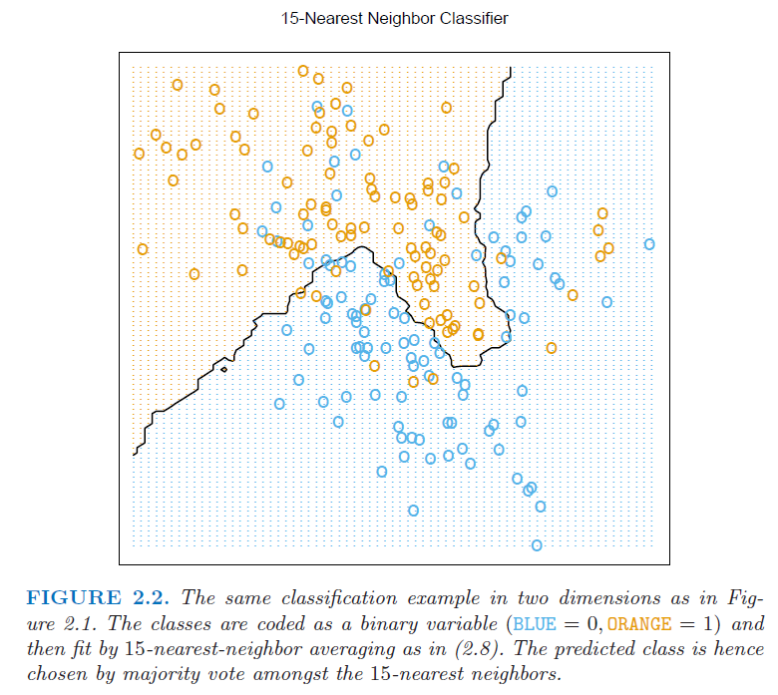
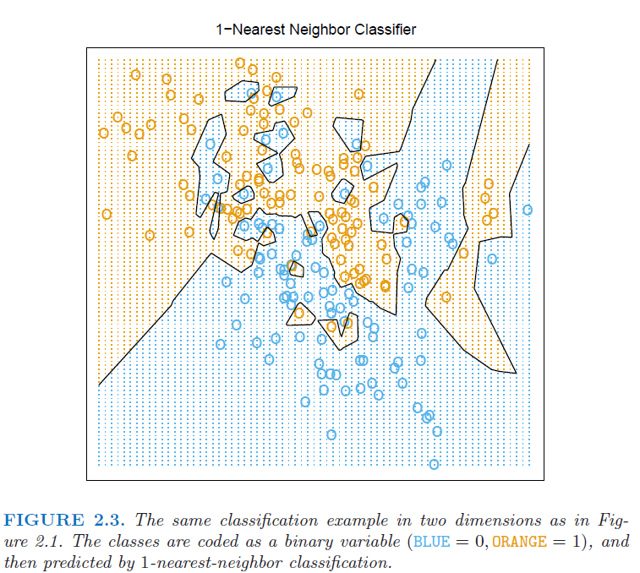
Another Example of Large Vs. Small K
This is a classification example from HTF with two response categories (blue or orange in the figures) and two predictors. The following scatterplots are x₁ vs. x₂ also showing the decision boundaries for the K-nearest neighbors classifiers with K = 15 and K = 1

Slide 13
K-NN for Concrete data
library(yaImpute)
CRT<-read.csv("concrete.csv", header=TRUE)
CRT1<-CRT
CRT1[1:8]<-sapply(CRT1[1:8], function(x) (x-mean(x))/sd(x)) #standardize predictors
CRT1[9]<-(CRT1[9]-min(CRT1[9]))/(max(CRT1[9])-min(CRT1[9]))
train<-as.matrix(CRT1[,1:8])
test<-as.matrix(CRT1[,1:8])
ytrain<-CRT1[,9]
ytest<-CRT1[,9]
K=3
out<-ann(train,test,K)
ind<-as.matrix(out$knnIndexDist[,1:K])
D<-as.matrix(out$knnIndexDist[,(1+K):(2*K)])
fit<-apply(ind,1,function(x) mean(ytrain[x]))
plot(fit,ytest)
1-var(ytest-fit)/var(ytest)

Slide 14
y versus yhat for training data with different K
K=2, training fit
K=3, training fit

Slide 15
CV to Choose the Best K
Nrep<-50 #number of replicates of CV
K<-10 #K-fold CV on each replicate
n.models = 2 #number of different models to fit
n=nrow(CRT1)
y<-CRT1$Strength
yhat=matrix(0,n,n.models)
MSE<-matrix(0,Nrep,n.models)
for (j in 1:Nrep) {
Ind<-CVInd(n,K)
for (k in 1:K) {
train<-as.matrix(CRT1[-Ind[[k]],1:8])
test<-as.matrix(CRT1[Ind[[k]],1:8])
ytrain<-CRT1[-Ind[[k]],9]
K1=3;K2=2
out<-ann(train,test,K1,verbose=F)
ind<-as.matrix(out$knnIndexDist[,1:K1])
yhat[Ind[[k]],1]<-apply(ind,1,function(x) mean(ytrain[x]))
out<-ann(train,test,K2,verbose=F)
ind<-as.matrix(out$knnIndexDist[,1:K2])
yhat[Ind[[k]],2]<-apply(ind,1,function(x) mean(ytrain[x]))
} #end of k loop
MSE[j,]=apply(yhat,2,function(x) sum((y-x)^2))/n
} #end of j loop
MSEAve<- apply(MSE,2,mean); MSEAve #averaged mean square CV error
MSEsd <- apply(MSE,2,sd); MSEsd #SD of mean square CV error
r2<-1-MSEAve/var(y); r2 #CV r^2
plot(yhat[,2],y)

Slide 16
y versus yhat for CV with different K
K=2, 10-fold CV
K=3, 10-fold CV

Slide 17
Discussion Points and Questions
Did the 3-nearest neighbors method do better than the best neural network model or the linear regression model?
How can you tell which predictors have the largest effect on the response in the K-nearest neighbors model?
What are the parameters of the fitted model?

Slide 18
K-NN for CPUS data
library(yaImpute)
CPUS<-read.table("cpus.txt",sep="\t")
CPUS1<-CPUS[2:8]
CPUS1[c(1:3,7)]<-sapply(CPUS1[c(1:3,7)], log10) #take log of first three predictors and response
CPUS1[1:6]<-sapply(CPUS1[1:6], function(x) (x-mean(x))/sd(x)) #standardize predictors
CPUS1[7]<-(CPUS1[7]-min(CPUS1[7]))/(max(CPUS1[7])-min(CPUS1[7]))
train<-as.matrix(CPUS1[,1:6])
test<-as.matrix(CPUS1[,1:6])
ytrain<-CPUS1[,7]
ytest<-CPUS1[,7]
K=6
out<-ann(train,test,K)
ind<-as.matrix(out$knnIndexDist[,1:K])
D<-as.matrix(out$knnIndexDist[,(1+K):(2*K)])
fit<-apply(ind,1,function(x) mean(ytrain[x]))
plot(fit,ytest)
1-var(ytest-fit)/var(ytest)

Slide 19
y versus yhat for training data with different K
K=2, training fit
K=6, training fit

Slide 20
CV to Choose the Best K
Nrep<-10 #number of replicates of CV
K<-10 #K-fold CV on each replicate
n=nrow(CPUS1)
y<-CPUS1$perf
SSE<-matrix(0,Nrep,2)
for (j in 1:Nrep) {
Ind<-CVInd(n,K)
yhat1<-y;
yhat2<-y;
for (k in 1:K) {
train<-as.matrix(CPUS1[-Ind[[k]],1:6])
test<-as.matrix(CPUS1[Ind[[k]],1:6])
ytrain<-CPUS1[-Ind[[k]],7]
K1=2;K2=6
out<-ann(train,test,K1,verbose=F)
ind<-as.matrix(out$knnIndexDist[,1:K1])
yhat1[Ind[[k]]]<-apply(ind,1,function(x) mean(ytrain[x]))
out<-ann(train,test,K2,verbose=F)
ind<-as.matrix(out$knnIndexDist[,1:K2])
yhat2[Ind[[k]]]<-apply(ind,1,function(x) mean(ytrain[x]))
} #end of k loop
SSE[j,]=c(sum((y-yhat1)^2),sum((y-yhat2)^2))
} #end of j loop
SSE
SSEAve<-apply(SSE,2,mean);SSEAve
plot(yhat2,y)
1-SSEAve/n/var(y)

Slide 21
y versus yhat for CV with different K
K=2, n-fold CV
K=6, n-fold CV

Slide 22
Discussion Points and Questions
Did the 6-nearest neighbors method do better than the best neural network model or the linear regression model?
How can you tell which predictors have the largest effect on the response in the K-nearest neighbors model?
What are the parameters of the fitted model?

Slide 23
K-Nearest Neighbors for Classification
Like CART models, it is straightforward to use nearest neighbors for classification.
For binary classification, to predict Pr{Y=1 | x} for a new case, find the K nearest neighbors as before, and take the predicted Pr{Y=1 | x} to be the fraction of the K nearest neighbors having y = 1 responses
If we have more than two response categories, we take the predicted probability for each category to be the fraction of nearest neighbors with response values belonging to that category.

Slide 24
K-NN for FGL data
FGL<-read.table("fgl.txt",sep="\t")
z<-(FGL$type == "WinF") | (FGL$type == "WinNF")
y<-as.character(FGL$type)
y[z]<-"Win"; y[!z]<-"Other"
FGL<-data.frame(FGL,"type_bin"=as.factor(y)) #add a binary factor response column
y[y == "Win"]<-1;y[y == "Other"]<-0;
FGL<-data.frame(FGL,"type01"=as.numeric(y)) #also add a binary numeric response column
FGL1<-FGL
FGL1[1:9]<-sapply(FGL1[1:9], function(x) (x-mean(x))/sd(x)) #standardize predictors
train<-as.matrix(FGL1[,1:9]); test<-as.matrix(FGL1[,1:9])
ytrain<-FGL1[,11]; ytest<-FGL1[,11]
K=5
out<-ann(train,test,K)
ind<-as.matrix(out$knnIndexDist[,1:K])
phat<-apply(ind,1,function(x) sum(ytrain[x]=="Win")/length(ytrain[x]))
plot(phat,jitter(as.numeric(ytest=="Win"),amount=.05))
####can alternatively use the following
library(class)
out<-knn(train, test, ytrain, k = 10, prob = T)

Slide 25
y (with jitter) versus phat for FGL training data
K=10, training fit

Slide 26
Discussion Points and Questions
In the preceding, what was the training misclassification rate? What would happen to the training misclassification rate if we decreased K? What would it be for K = 1?
To find the best K for K-nearest neighbors for classification problems, you must use CV, just like for any other method.
What CV measure would you use to find the best K for the FGL data?
Is finding the CV errors for K-nearest neighbors substantially more computationally expensive than finding the training errors, like it is for all of the other methods we have covered?

Slide 27
Pros and Cons of Nearest Neighbors
Pros:
The most flexible of all – can represent any nonlinear relationship (as long as you have sufficiently large n).
Easy to use. No model fitting required
Cons:
There is no real fitted model (nor even any indication of which predictors are most important), so not suitable for interpretation or explanatory purposes.
Because there is no fitted model, you need to retain all the training data to predict.
With large k (the number of predictors), you need very large n, because neighbors get further away in higher dimensions.
For most supervised learning methods, large n increases the computational expense for training, but not for new case prediction. Large n is more problematic for nearest neighbors, because the "training" occurs for every new case prediction
With very large n, we need computational tricks (e.g. tree-based methods) to efficiently search for nearest neighbors.
Not well suited for categorical predictors

Slide 28
Effect of dimension (k) on distance between neighbors
k = 1
k = 2
k = 3

Slide 29
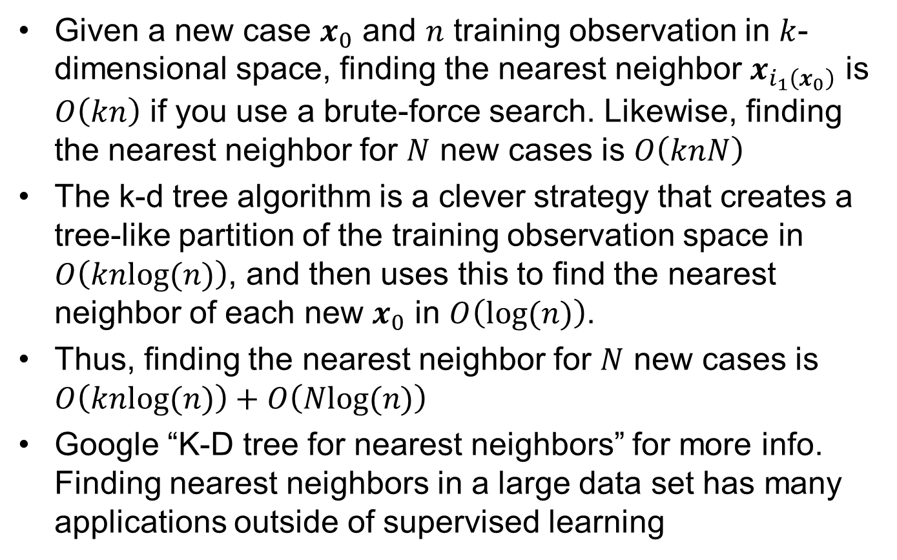
K-D Tree Algorithm
Given a new case $x_{0}$ and $n$ training observation in $k$-dimensional space, finding the nearest neighbor $x_{i_{1}\left(x_{0}\right)}$ is $O\left(kn\right)$ if you use a brute-force search. Likewise, finding the nearest neighbor for $N$ new cases is $O\left(knN\right)$
The k-d tree algorithm is a clever strategy that creates a tree-like partition of the training observation space in $O\left(knlog(n)\right)$, and then uses this to find the nearest neighbor of each new $x_{0}$ in $O\left(log(n)\right)$.
Thus, finding the nearest neighbor for $N$ new cases is $O\left(knlog(n)\right)+O\left(Nlog(n)\right)$
Google “K-D tree for nearest neighbors” for more info. Finding nearest neighbors in a large data set has many applications outside of supervised learning

Slide 30
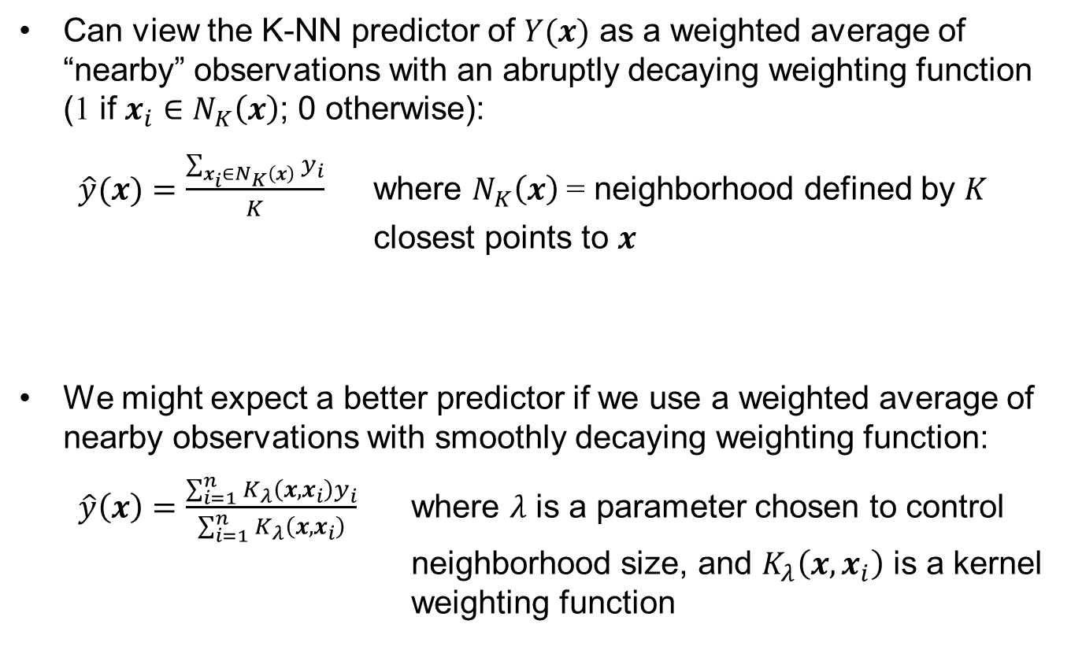
Local Weighting and Kernel Smoothing
Can view the K-NN predictor of $Y(x)$ as a weighted average of “nearby” observations with an abruptly decaying weighting function (1 if $x_{i}∈N_{K}\left(x\right)$; 0 otherwise):
$\hat{y}(x)=\frac{\sum_{x_{i}∈N_{K}\left(x\right)}{y_{i}}}{K}$ where $N_{K}\left(x\right)$ = neighborhood defined by $K$ closest points to $x$
We might expect a better predictor if we use a weighted average of nearby observations with smoothly decaying weighting function:
$\hat{y}\left(x\right)=\frac{\sum_{i=1}^{n}{K_{λ}\left(x,x_{i}\right)y_{i}}}{\sum_{i=1}^{n}{K_{λ}\left(x,x_{i}\right)}}$ where $λ$ is a parameter chosen to control neighborhood size, and $K_{λ}\left(x,x_{i}\right)$ is a kernel weighting function

Slide 31
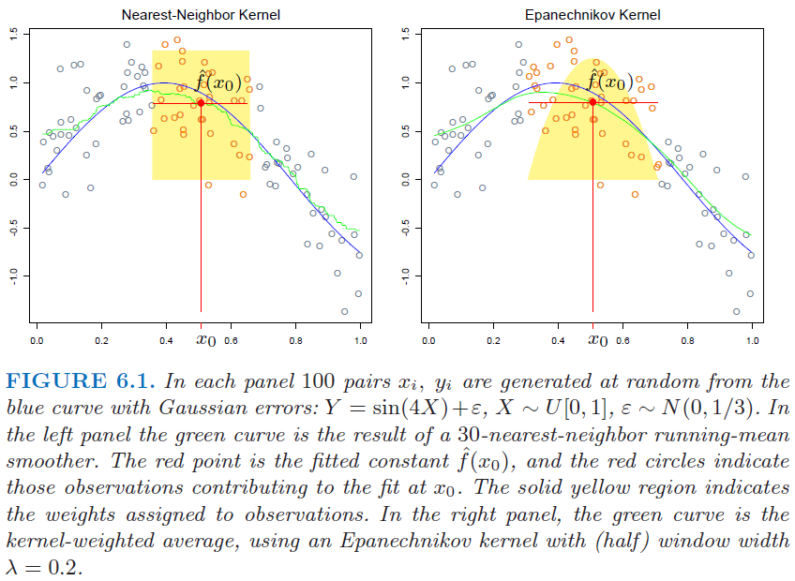
Abrupt (K-NN) Vs. Smooth Weighting

Slide 32
Three Common Kernel Weighting Functions
Gaussian kernel:
Epanechnikov quadratic kernel:
Tri-cube kernel:

Slide 33
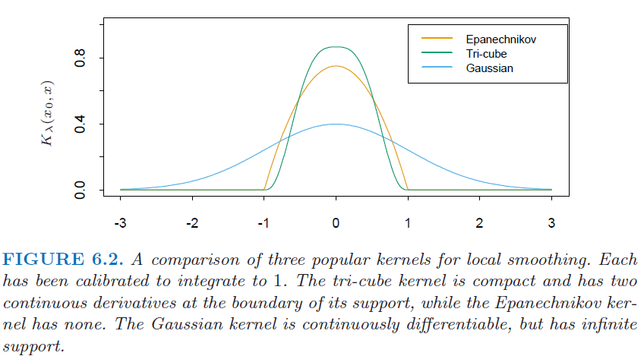
Plot of Three Common Kernel Functions
In the above plot, the vertical axis is K_{λ}(x,x_{i}), and the horizontal axis is ±||x−x_{i}||/λ as x_{i} deviates from x

Slide 34
Discussion Points and Questions
The Gaussian kernel weights decay more smoothly, but the other two “compact support” kernels have computational advantages. Why?
How would increasing λ change the predictor plotted three slides earlier?
Regarding the omnipresent bias/variance tradeoff, would increasing λ
increase or decrease the variance of the predictor?
increase or decrease the bias of the predictor?
λ is a tuning parameter that you choose. How would you choose it?

Slide 35
Comparison of Adaptive Neighborhood Sizes
In addition to having a more smoothly decaying weighting function relative to K-NN, another difference with kernel weighting is that in regions of sparser data:
the K-NN neighborhood size grows larger (giving larger potential bias but roughly constant variance)
the kernel neighborhood size remains the same (giving roughly constant bias but larger variance)
for the data set shown in the following
scatterplot of y vs x, which seems
more appropriate?
This boils down to the familiar
bias-variance tradeoff?

Slide 36
A Problem with N-W Kernel-Weighted Average (and also with Nearest Neighbors)
The kernel-weighted average can have severe bias at the boundaries of the x-domain
In high dimensional space (large k), points are inherently closer to the boundaries.
In one dimension, 2 out of 9
points are on the boundary
But in two dimensions, 8 out
of 9 are on the boundary

Slide 37
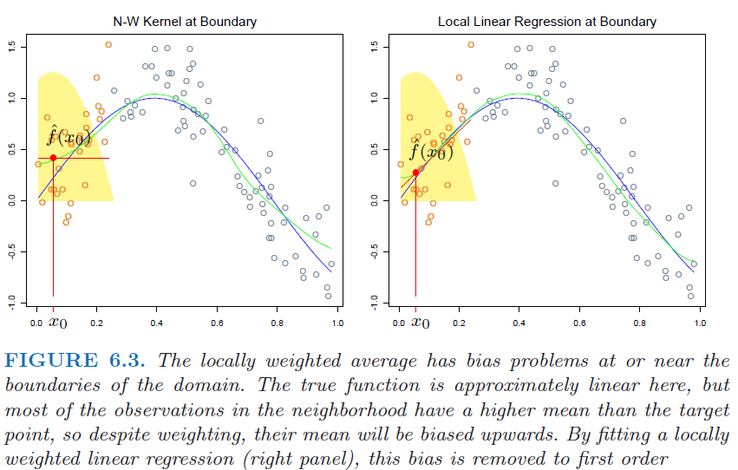
Illustration of Boundary Bias for Kernel Average

Slide 38
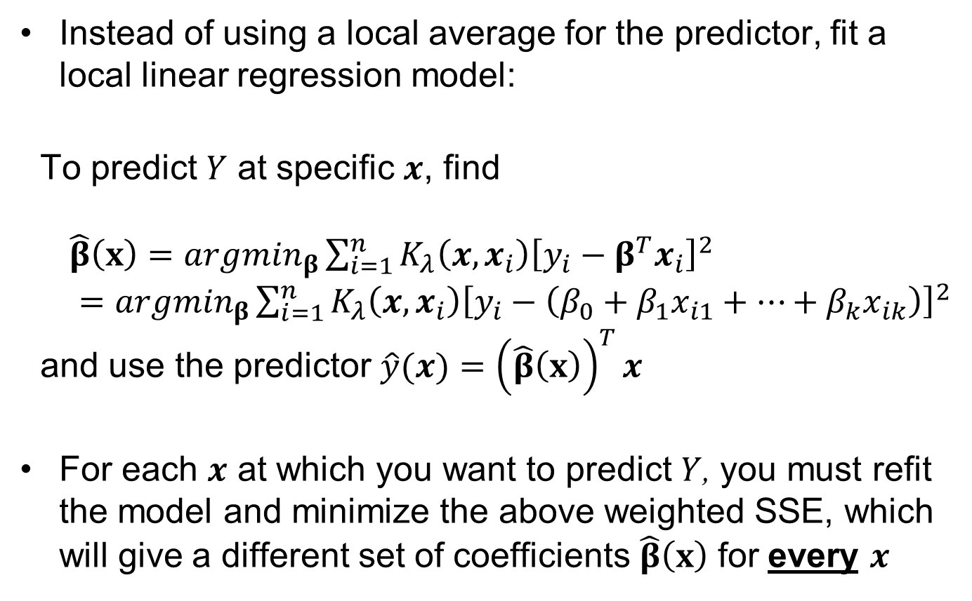
Solution: Local Linear Regression
Instead of using a local average for the predictor, fit a local linear regression model:
To predict $Y$ at specific $x$, find
$\hat{β}\left(x\right)={argmin}_{β}\sum_{i=1}^{n}{K_{λ}\left(x,x_{i}\right){\left[y_{i}−β^{T}x_{i}\right]}^{2}}$
$={argmin}_{β}\sum_{i=1}^{n}{K_{λ}\left(x,x_{i}\right){\left[y_{i}−\left(β_{0}+β_{1}x_{i1}+…+β_{k}x_{ik}\right)\right]}^{2}}$
and use the predictor $\hat{y}(x)={\left(\hat{β}\left(x\right)\right)}^{T}x$
For each $x$ at which you want to predict $Y$, you must refit the model and minimize the above weighted SSE, which will give a different set of coefficients $\hat{β}\left(x\right)$ for every $x$

Slide 39
Discussion Points and Questions
A local linear regression model is nonparametric, just like kernel-weighted average and nearest neighbors. There is no single fitted model – the coefficients are different for each x at which you want to predict Y
What is the relationship between a local linear regression model and a linear regression model? Is a local linear regression model "almost" linear?
Where is a local linear regression predictor most likely to be biased?

Slide 40
Local Linear Vs. Local Quadratic Regression
Local linear regression effectively removes linear boundary bias, but is still subject to bias in regions of high curvature
Local quadratic regression will remove much of the bias in regions of high curvature, but also increases the variance of the predictor
Local polynomials of higher order than 2 will remove even more of the bias, but are almost never used

Slide 41
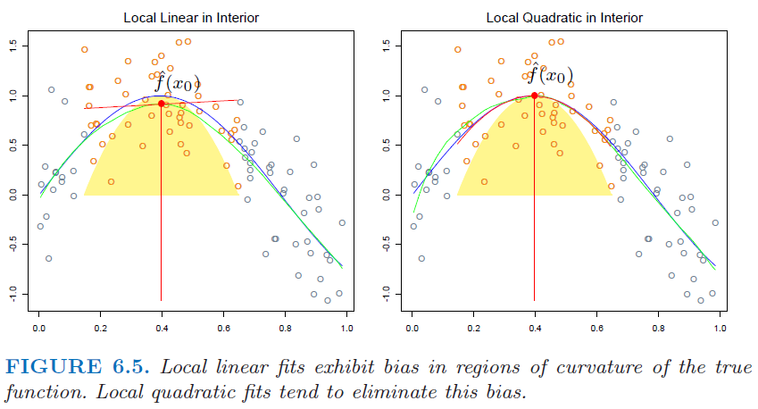
Local Linear Vs. Local Quadratic Regression
What are the pros and cons of using a local linear, versus local quadratic, model for the above data?

Slide 42
Local Regression for Concrete data
CRT<-read.csv("concrete.csv", header=TRUE)
CRT1<-CRT
CRT1[1:8]<-sapply(CRT1[1:8], function(x) (x-mean(x))/sd(x)) #standardize predictors
CRT1[9]<-(CRT1[9]-min(CRT1[9]))/(max(CRT1[9])-min(CRT1[9]))
out<-loess(Strength~., CRT1[,c(1,2,4,8,9)],degree=1,span=.3)
summary(out)
names(out)
y<-CRT1[[9]]
yhat<-predict(out)
SSE<-sum((y-yhat)^2);SSE
1-var(y-yhat)/var(y)
plot(yhat,y)

Slide 43
> summary(out)
Call:
loess(formula = Strength ~ ., data = CRT1[, c(1, 2, 4, 8, 9)],
span = 0.3, degree = 1)
Number of Observations: 1030
Equivalent Number of Parameters: 21.54
Residual Standard Error: 0.089
Trace of smoother matrix: 32.38
Control settings:
normalize: TRUE
span : 0.3
degree : 1
family : gaussian
surface : interpolate cell = 0.2
> 1-var(y-yhat)/var(y)
[1] 0.8285685

Slide 44
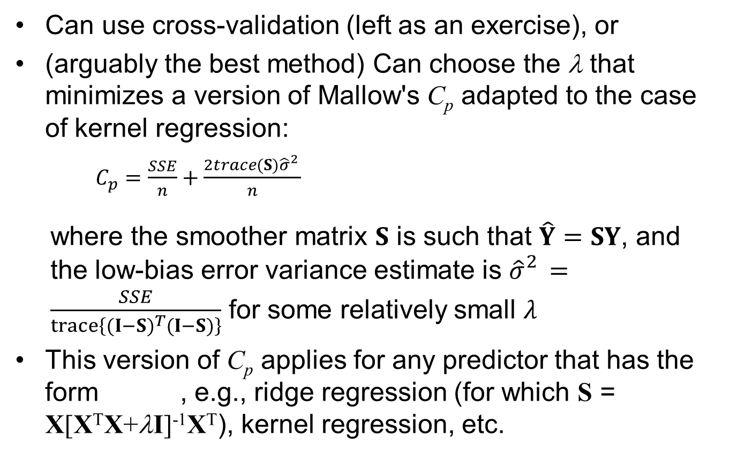
Choosing the best λ
Can use cross-validation (left as an exercise), or
(arguably the best method) Can choose the λ that minimizes a version of Mallow's C_{p} adapted to the case of kernel regression:
$C_{p}=\frac{SSE}{n}+\frac{2trace(S){\hat{σ}}_{}^{2}}{n}$
where the smoother matrix $S$ is such that $\hat{Y}=SY$, and the low-bias error variance estimate is ${\hat{σ}}_{}^{2}=\frac{SSE}{trace\left\{{(I−S)}^{T}(I−S)\right\}}$ for some relatively small $λ$
This version of C_{p} applies for any predictor that has the form , e.g., ridge regression (for which S = X[X^{T}X+λI]⁻¹X^{T}), kernel regression, etc.

Slide 45
Using C_{p} to choose λ for Concrete example
##first find sigma_hat for a low-bias model###
for (lambda in seq(.02,.2,.02)) {out<-loess(Strength ~., CRT1[, c(1,2,4,8,9)],degree=1, span=lambda); print(c(lambda,out$s))}
[1] 0.0200000 0.5845109
[1] 0.0400000 0.1251313
[1] 0.06000000 0.09536982 Choose about this as the low-bias estimate of sigma
[1] 0.0800000 0.1023739
[1] 0.10000000 0.08853284
[1] 0.12000000 0.08879249
[1] 0.1400000 0.1034087
[1] 0.16000000 0.09696377
[1] 0.18000000 0.09403151
[1] 0.20000000 0.09007899
sig_hat<-0.1

Slide 46
Using C_{p} to choose λ for Concrete example
##now find Cp for various lambda###
for (lambda in c(seq(.01,.05,.01), seq(.1,1,.2))) {out<-loess(Strength ~., CRT1[, c(1,2,4,8,9)],degree=1, span=lambda); SSE<-sum((CRT1[,9]-out$fitted)^2); Cp <- (SSE+2*out$trace.hat*sig_hat^2)/nrow(CRT1); print(c(lambda,Cp))}
[1] 0.01000 71.52311
[1] 0.0200000 0.2694297
[1] 0.0300000 0.0978872
[1] 0.04000000 0.01558056
[1] 0.05000000 0.01136318
[1] 0.100000000 0.008515458
[1] 0.300000000 0.008216944 lambda = 0.3 is about the best
[1] 0.500000000 0.009435424
[1] 0.70000000 0.01025778
[1] 0.90000000 0.01112647
An estimate of the corresponding test error SD is sqrt(Cp) = sqrt(0.00822) = 0.0906
Exercise: Compare this λ and error SD with those from CV

Slide 47
Local Regression for CPUS data
CPUS<-read.table("cpus.txt",sep="\t")
CPUS1<-CPUS[2:8]
CPUS1[c(1:3,7)]<-sapply(CPUS1[c(1:3,7)], log10) #take log of first three predictors and response
CPUS1[1:6]<-sapply(CPUS1[1:6], function(x) (x-mean(x))/sd(x)) #standardize predictors
CPUS1[7]<-(CPUS1[7]-min(CPUS1[7]))/(max(CPUS1[7])-min(CPUS1[7]))
out<-loess(perf~.,CPUS1[,c(1:4,7)],degree=1,span=.6)
summary(out)
names(out)
y<-CPUS1[[7]]
yhat<-predict(out)
SSE<-sum((y-yhat)^2);SSE
1-var(y-yhat)/var(y)
plot(yhat,y)

Slide 48
> summary(out)
Call: loess(formula = perf ~ ., data = CPUS1[, c(1:4, 7)], span = 0.6,
degree = 1)
Number of Observations: 209
Equivalent Number of Parameters: 9.89
Residual Standard Error: 0.07711
Trace of smoother matrix: 14.31
Control settings:
normalize: TRUE
span : 0.6
degree : 1
family : gaussian
surface : interpolate cell = 0.2
> 1-var(y-yhat)/var(y)
[1] 0.8634346

Slide 49
Using C_{p} to choose λ for CPUS example
##first find sigma_hat for a low-bias model###
for (lambda in seq(.1,1,.1)) {out<-loess(perf~.,CPUS1[,c(1:4,7)],degree=1, span=lambda); print(c(lambda,out$s))}
[1] 0.1000000 0.1281004
[1] 0.20000000 0.08491299
[1] 0.30000000 0.07729764 chose this as the estimate of sigma for a low-bias model
[1] 0.40000000 0.07617725
[1] 0.50000000 0.07632685
[1] 0.60000000 0.07711136
[1] 0.70000000 0.07889357
[1] 0.80000000 0.07855612
[1] 0.90000000 0.07884745
[1] 1.00000000 0.08208199
sig_hat<-0.0773

Slide 50
Using C_{p} to choose λ for CPUS example
##now find Cp for various lambda###
for (lambda in seq(.1,1,.1)) {out<-loess(perf~.,CPUS1[,c(1:4,7)],degree=1, span=lambda); SSE<-sum((CPUS1[,7]-out$fitted)^2); Cp <- (SSE+2*out$trace.hat*sig_hat^2)/nrow(CPUS1); print(c(lambda,Cp))}
[1] 0.10000000 0.01467463
[1] 0.200000000 0.007535495
[1] 0.300000000 0.006428755
[1] 0.400000000 0.006216846
[1] 0.500000000 0.006165853 the best lambda is 0.5
[1] 0.60000000 0.00623147
[1] 0.700000000 0.006453386
[1] 0.800000000 0.006383156
[1] 0.900000000 0.006405543
[1] 1.000000000 0.006864742
An estimate of the corresponding test error SD is sqrt(Cp) = sqrt(.00617) = 0.0785
Exercise: Compare this λ and error SD with those from CV

Slide 51
Local Kernel Weighting For Classification
Very similar to local regression, except that instead of fitting a local model to minimize the locally weighted SSE, maximize the locally weighted log-likelihood for some local probabilistic class model with parameters β(x):
To classify Y at a specific x, estimate the class probabilities based on the assumed local model structure with parameters

Slide 52
What to Use for Locally Constant Class Probabilities
For locally constant class probabilities, the local likelihood to use in the previous slide is obtained from the simple model Pr[Y_{i} ∈ Class j] = p_{j} (constant for x_{i} in neighborhood of x), i.e., a local intercept-only logistic regression model
Plugging this local likelihood into the equation on the previous slide and minimizing to estimate β(x) is equivalent to taking the predicted class probabilities to be the locally weighted fraction of observations in each class:

Slide 53
Locally Constant Vs. Locally Logistic Pr[Y ∈ Class j]
scatterplot of binary y vs a single predictor x
y
kernel weighting function
locally logistic Pr[Y = 1]
locally constant Pr[Y = 1]
x
x₀

Slide 54
What to Use for Local Binary Logistic Regression Class Probabilities
With assumed local binary logistic regression class probabilities:
(β constant for x_{i} in neighborhood of x)
The estimated class probabilities are obtained by plugging x into a logistic regression model with coefficients from a locally weighted logistic regression fit:

Slide 55
Summary of Local Methods (K-NN or Kernel)
No assumed structure and completely nonparametric, so very flexible and avoids specifying the “wrong” model structure (pro), but poorer bias/variance tradeoff (con)
Computational/Memory: No training step (pro), but must fit a new local model for each case to predict (con) and retain all of the original “training” data in memory (con)
Comp. expense of K-fold CV independent of K (pro) and can be fast using the same K-NN computational tricks
No good way to handle categorical predictors, especially for kernel methods
Not well suited for high dimensions
Points are inherently sparser in high dimensions
Originally intended as a scatterplot smoother for visualization [which accounts for the ss in loess(), which allows at most 4 predictors]
Additive nonparametric models [ppr() and gam() in mgcv package in R] borrow ideas from local kernel regression, but are better suited for high dimensions

Slide 56
lowess (similar to loess) as a Scatterplot Smoother
plot(CRT$Age, CRT$Strength)
lines(lowess(CRT$Age, CRT$Strength))
It is easier to visualize a trend in a scatter plot if a loess curve is superimposed

Slide 57
Generalized Additive Models (GAMs)
Local methods work well in relatively low dimensions, but break down in higher dimension (sparser neighbors)
For higher dimensional data, generalized additive models model the response as the sum of functions of one or two predictors at a time, e.g. (for k predictors):
GAM: Y(x) = α + f₁(x₁)+ f₂(x₂)+ . . . + f_{k}(x_{k}) + ε
or sometimes +
Each f_{j}(•) or f_{j,l}(•) function is estimated nonparametrically, typically using an iterative backfitting algorithm, until convergence

Slide 58
Backfitting Algorithm (without interactions f_{j,l}(•))
0) Initialize
1) For j = 1, 2, . . ., k,
i) Calculate errors (i = 1, 2, . . ., n)
ii) Fit nonparametric to {e_{i} vs. x_{ij}: i = 1, 2, . . ., n}
iii) Center
Repeat Step 1 until convergence, i.e., no further changes in the
The function in Step 1-ii can be any nonparametric smoother (e.g., local regression, smoothing spline, etc)

Slide 59
Illustration of Backfitting Step 1 on the First Iteration
Step 1 for j = 1
Step 1 for j =2
-2.5 -1.5 -0.5 0.5 1.5 2
x₁
x₂

Slide 60
Discussion Points and Questions
With no interactions, what are the implications of the GAM model structure Y(x) = α + f₁(x₁)+ f₂(x₂)+ . . . + f_{k}(x_{k}) + ε, in terms of the type of predictive relationships it can capture?
What types of relationships is it incapable of capturing?
How would you handle categorical predictors in a GAM model?

Slide 61
Projection Pursuit Regression (PPR)
If the relationship is not truly additive in the predictors, including interaction terms in a GAM can capture this, but this is inefficient for large k (~ k²/2 interaction terms)
PPR is similar to GAMs, but instead of each function being a 1-D function of one predictor, allow it to be a 1-D function of some linear combination of all predictors:
PPR model: Y(x) = α + f₁(β₁^{T}x)+ f₂(β₂^{T}x)+ . . . + f_{M}(β_{M}^{T}x) + ε
= α + f₁(v₁)+ f₂(v₂)+ . . . + f_{M}(v_{M}) + ε
where v_{j} = β_{j}^{T}x = β_{j1}x₁ + β_{j2}x₂ + . . . + β_{jk}x_{k} (linear combo of x’s)
You specify M (or determine it via CV), and the fitting algorithm estimates the functions f_{j}(•) nonparametrically and also estimates the direction vectors β_{j}

Slide 62
Discussion Points and Questions
Neural networks with a linear output activation function and one hidden layer are very similar to PPR, but with the neural network logistic H_{j}(•) replaced by the completely nonparametric PPR f_{j}(•)
More generally, what is the relationship between GAMs, PPR, and neural networks?
Which model (GAM, PPR, or neural net) is easiest to interpret and to visualize, in terms of the nature of the predictive response surface and the effects of the predictors?

Slide 63
Individual Constituent Functions for GAM vs. PPR vs. Neural Network
GAM f₁(x) = f₁(x₁)
PPR f₁(β₁^{T}x)
Neural Net H₁(x)

Slide 64
GAM Fit for Concrete data
CRT<-read.csv("concrete.csv", header=TRUE); CRT1<-CRT
CRT1[1:8]<-sapply(CRT1[1:8], function(x) (x-mean(x))/sd(x)) #standardize predictors
CRT1[9]<-(CRT1[9]-min(CRT1[9]))/(max(CRT1[9])-min(CRT1[9]))
library(mgcv) #stands for “Mixed GAM Computation Vehicle”
out<-gam(Strength~s(Cement)+s(Slag)+s(FlyAsh)+s(Water)+ s(SPlast) + s(CAgg) + s(FAgg) + s(Age), data=CRT1, family=gaussian(), sp=c(-1,-1,-1,-1,-1,-1,-1,-1))
summary(out)
out$sp ##estimated smoothing parameters for each constituent function
yhat<-predict(out)
plot(yhat,CRT1$Strength) #probably quite a bit of overitting
##
par(mfrow=c(2,4))
plot(out) #plot component functions
If you want to control the degree of smoothing in each constituent function, you can use the k parameter within the s() argument, where k is the d.f. of the smoother. E.g., replacing s(Age) by s(Age, k = 2) in the above would force a smoother f₄(x₄), and using s(Age, k = 20) would be rougher
You can also control the degree of smoothing use the sp parameter in gam(). sp=c(-1,-1,-1,-1,-1,-1,-1,-1) (or omitting sp, I think) will result in all smoothing parameters being estimated using GCV or something similar. Using sp=c(-1,-1,-1,.1,-1,-1,-1,-1) gives a smoother f₄(x₄), and using Using sp=c(-1,-1,-1,0.000001,-1,-1,-1,-1) is rougher.
For binary response, use family = “binomial”; for multi-category response, use family = "poisson"

Slide 65
> summary(out)
Parametric coefficients:
Estimate Std. Error t value Pr(>|t|)
(Intercept) 0.417191 0.002082 200.4 <2e-16 ***
---
Signif. codes: 0 ‘***’ 0.001 ‘**’ 0.01 ‘*’ 0.05 ‘.’ 0.1 ‘ ’ 1
Approximate significance of smooth terms:
edf Ref.df F p-value
s(Cement) 8.228 8.833 48.281 < 2e-16 ***
s(Slag) 8.387 8.874 24.605 < 2e-16 ***
s(FlyAsh) 8.331 8.851 9.714 4.67e-14 ***
s(Water) 8.742 8.974 25.925 < 2e-16 ***
s(SPlast) 7.986 8.713 11.127 4.41e-16 ***
s(CAgg) 7.956 8.702 3.592 0.000266 ***
s(FAgg) 8.614 8.950 18.297 < 2e-16 ***
s(Age) 8.561 8.901 367.214 < 2e-16 ***
---
Signif. codes: 0 ‘***’ 0.001 ‘**’ 0.01 ‘*’ 0.05 ‘.’ 0.1 ‘ ’ 1
R-sq.(adj) = 0.897 Deviance explained = 90.4%
GCV score = 0.004778 Scale est. = 0.0044634 n = 1030

Slide 66
Visualizing a GAM by Plotting Component f()’s

Slide 67
GAM Fit for CPUS data
library(mgcv) #stands for “Mixed GAM Computation Vehicle”
out<-gam(perf~s(syct)+s(mmin)+s(mmax)+s(cach)+s(chmin)+s(chmax), data=CPUS1, family=gaussian(), sp=c(-1,-1,-1,-1,-1,-1))
summary(out)
out$sp ##estimated smoothing parameters for each constituent function
yhat<-predict(out)
plot(yhat,CPUS1$perf) #probably quite a bit of overitting
##
par(mfrow=c(2,3))
plot(out) #plot component functions
If you want to control the degree of smoothing in each constituent function, you can use the k parameter within the s() argument, where k is the d.f. of the smoother. E.g., replacing s(cach) by s(cach, k = 2) in the above would force a smoother f₄(x₄), and using s(cach, k = 20) would be rougher
You can also control the degree of smoothing use the sp parameter in gam(). sp=c(-1,-1,-1,-1,-1,-1) (or omitting sp, I think) will result in all smoothing parameters being estimated using GCV or something similar. Using sp=c(-1,-1,-1,.1,-1,-1) gives a smoother f₄(x₄), and using Using sp=c(-1,-1,-1,.000001,-1,-1) is rougher.
For binary response, use family = “binomial”; for multi-category response, use family = "poisson"

Slide 68
> summary(out)
Parametric coefficients:
Estimate Std. Error t value Pr(>|t|)
(Intercept) 0.427234 0.004858 87.95 <2e-16 ***
---
Signif. codes: 0 ‘***’ 0.001 ‘**’ 0.01 ‘*’ 0.05 ‘.’ 0.1 ‘ ’ 1
Approximate significance of smooth terms:
edf Ref.df F p-value
s(syct) 4.089 5.055 3.856 0.002298 **
s(mmin) 1.000 1.000 12.060 0.000637 ***
s(mmax) 2.368 3.032 23.123 3.66e-13 ***
s(cach) 6.351 7.163 11.762 5.68e-13 ***
s(chmin) 5.399 6.355 1.547 0.160295
s(chmax) 2.605 3.173 1.804 0.143871
---
Signif. codes: 0 ‘***’ 0.001 ‘**’ 0.01 ‘*’ 0.05 ‘.’ 0.1 ‘ ’ 1
R-sq.(adj) = 0.876 Deviance explained = 88.9%
GCV score = 0.0055362 Scale est. = 0.0049319 n = 209

Slide 69
Visualizing a GAM by Plotting Component f()’s

Slide 70
Visualizing Additive Models in General
By definition, a model is additive if there are no interactions, in which case you can always write it as
Y(x) = α + f₁(x₁)+ f₂(x₂)+ . . . + f_{k}(x_{k}) + ε
For visualizing the effect of x_{j} on Y, you can simply plot vs. x_{j}, or equivalently vs. x_{j} using any set of fixed values for the other predictors
The effect of x_{j} on Y is the same regardless of the levels of the other predictors because of the model additivity:

Slide 71
Another Convenient Use of GAMs
Plotting the component f_{j}()’s can be useful for getting a rough idea of the effects of individual predictors and selecting a subset of relevant predictors with which to fit some other nonlinear model that performs poorly in high dimensions (e.g., nearest neighbors, local linear regression, etc) – choose the predictors with the largest f_{j}()’s
Trees are also good for this purpose, since they automatically omit irrelevant predictors – you can overgrow and choose the predictors to include based on order of importance
What are the relative advantages and disadvantages of GAMs versus trees for selecting a subset of important predictors?

Slide 72
PPR Fit for Concrete data
out<-ppr(Strength~., data=CRT1, nterms=6)
summary(out)
yhat<-predict(out)
plot(yhat,CRT1$Strength)
##
par(mfrow=c(2,3)); plot(out) #plot component functions
Projection direction vectors:
term 1 term 2 term 3 term 4 term 5 term 6
Cement 0.56038180 0.14875663 -0.51181859 0.19253651 0.32375148 -0.18080845
Slag 0.36971039 0.02906004 -0.42377081 0.30425184 0.60764538 -0.35929921
FlyAsh 0.24818052 -0.05312206 -0.40260714 -0.61037330 0.54251333 -0.12058484
Water -0.02835874 0.04016617 -0.03668892 0.25889810 0.19846385 -0.68332281
SPlast 0.04247494 0.74361516 0.36594101 0.10989266 -0.05797348 -0.33548973
CAgg 0.13441209 -0.01507782 -0.29928555 0.24351108 0.25379468 -0.33372838
FAgg 0.14182243 0.02512404 -0.30127236 0.24231468 0.30552913 -0.36370375
Age 0.66850905 -0.64712413 0.28420371 -0.54834867 0.17641641 0.02309131
Coefficients of ridge terms:
term 1 term 2 term 3 term 4 term 5 term 6
0.20686296 0.10395489 0.05538284 0.06171454 0.03707326 0.03622624

Slide 73
Plots of the PPR Component Functions

Slide 74
Discussion Points and Questions
How can you interpret the PPR response surface and component functions?
Which of the six component PPR functions is the most important?
Which predictors appear the most important, and what are their effects?
Does nterms = 6 seem like a reasonable choice?

Slide 75
CV to Find Best nterms in PPR on Concrete Data
Nrep<-5 #number of replicates of CV
K<-10 #K-fold CV on each replicate
n.models = 2 #number of different models to fit
n=nrow(CRT1)
y<-CRT1$Strength
yhat=matrix(0,n,n.models)
MSE<-matrix(0,Nrep,n.models)
for (j in 1:Nrep) {
Ind<-CVInd(n,K)
for (k in 1:K) {
out<- ppr(Strength~., data=CRT1[-Ind[[k]],], nterms=10)
yhat[Ind[[k]],1]<-as.numeric(predict(out,CRT1[Ind[[k]],]))
out<- ppr(Strength~., data=CRT1[-Ind[[k]],], nterms=20)
yhat[Ind[[k]],2]<-as.numeric(predict(out,CRT1[Ind[[k]],]))
} #end of k loop
MSE[j,]=apply(yhat,2,function(x) sum((y-x)^2))/n
} #end of j loop
MSEAve<- apply(MSE,2,mean); MSEAve #averaged mean square CV error
MSEsd <- apply(MSE,2,sd); MSEsd #SD of mean square CV error
r2<-1-MSEAve/var(y); r2 #CV r^2
MSE

Slide 76
PPR Fit for CPUS data
out<-ppr(perf~., data=CPUS1, nterms=3)
summary(out)
yhat<-predict(out)
plot(yhat,CPUS1$perf)
##
par(mfrow=c(1,3))
plot(out) #plot component functions
Projection direction vectors:
term 1 term 2 term 3
syct -0.25632765 -0.02650517 0.38934668
mmin 0.34270188 -0.25311005 -0.11243881
mmax 0.64436620 0.80500176 -0.38123957
cach 0.58713347 -0.45158231 0.80839663
chmin 0.12233875 -0.28025561 0.18320722
chmax 0.20482010 0.06881243 0.05790573
Coefficients of ridge terms:
term 1 term 2 term 3
0.19074005 0.05432089 0.05744858

Slide 77
Plots of the PPR Component Functions

Slide 78
Discussion Points and Questions
How can you interpret the PPR response surface and component functions?
Which of the three component PPR functions is the most important?
Which predictors appear the most important, and what are their effects?
Does nterms = 3 seem like a reasonable choice?

Slide 79
CV to Find Best nterms in PPR on CPUS Data
Nrep<-10 #number of replicates of CV
K<-10 #K-fold CV on each replicate
n=nrow(CPUS1)
y<-CPUS1$perf
SSE<-matrix(0,Nrep,2)
for (j in 1:Nrep) {
Ind<-CVInd(n,K)
yhat1<-y;
yhat2<-y;
for (k in 1:K) {
out<- ppr(perf~., data=CPUS1[-Ind[[k]],], nterms=1)
yhat1[Ind[[k]]]<-as.numeric(predict(out,CPUS1[Ind[[k]],]))
out<- ppr(perf~., data=CPUS1[-Ind[[k]],], nterms=2)
yhat2[Ind[[k]]]<-as.numeric(predict(out,CPUS1[Ind[[k]],]))
} #end of k loop
SSE[j,]=c(sum((y-yhat1)^2),sum((y-yhat2)^2))
} #end of j loop
SSE
apply(SSE,2,mean)

Slide 80
Basis Functions
Many supervised learning methods can be viewed as modeling the response as a linear combination of a set of nonlinear functions of x, each of specified form
Y = β₁f₁(x)+ β₂f₂(x)+ . . . + β_{M}f_{M}(x) + ε
where f_{j}(•) are specified functions of x, e.g.:
polynomial: f₁(x) = x₁, f₂(x) = x₁², f₃(x) = x₁x₂, etc
Gaussian RBF:
Fitting such a model involves estimating:
the coefficients (β_{j}’s) in the linear combination, usually under some regularization/shrinkage penalty
some complexity or other parameters on which the f_{j}(•)’s depend

Slide 81
Example of Gaussian RBF Basis Function

Slide 82
Basis Functions continued
Almost all methods can be cast as fitting basis functions if the f_{j}(•)’s are allowed to depend on the training x’s (and sometimes the training y’s): polynomial regression, Gaussian RBFs, neural networks, trees, smoothing splines, local regression, wavelets, etc.
To understand any method, it is helpful to think about what the basis functions associated with it look like
Basis functions are really more of a way to interpret supervised learning methods, rather than a distinct method of their own

Slide 83
Ensemble/Committee Methods
Ensemble methods combine a number of (what are usually) “weak learners” to form a single more powerful learner
Summary of most common ensemble methods:
Bootstrap aggregation (bagging), for averaging a similar set of learners, not necessarily weak, each learner fit to a different bootstrapped training sample
Stacking, for linearly combining any set of learners, not necessarily weak, with coefficients determined by regression
Boosting, for a weighted average of weak learners, usually simple trees, each fitted sequentially to the errors from the previous fit, with weights based on the errors
Random forests, for averaging trees, each fit to a different bootstrapped training sample, with some tricks for giving less correlated learners

Slide 84
Bagging
Straightforward idea: Generate many different bootstrap samples, fit a model to each, and take the predicted response (predicted probabilities if classification) at any x to be the average of the predicted responses at x for the individual models, i.e.:
for b = 1, 2, . . ., B:
generate bootstrap sample of size n
fit model (any type of model you like)
Take

Slide 85
When Bagging Might Be Useful
For predictors that are linear ( a linear function of training y), bagging has no effect on the predictor
The types of predictors that have potential to be most improved by bagging are ones for which:
fitting is unstable (i.e., a small change in the data gives a very different fitted model) and/or
the structure is such that the sum of multiple predictors no longer has the same structure
Trees are the most important type of predictor that can be improved by bagging
Random forests are bagging with trees, but with a few whistles and bells added (boosted trees are related to random forests, but not quite bagging)
Bagging is not commonly used with predictors other than trees, so we will not cover bagging in its generality here

Slide 86
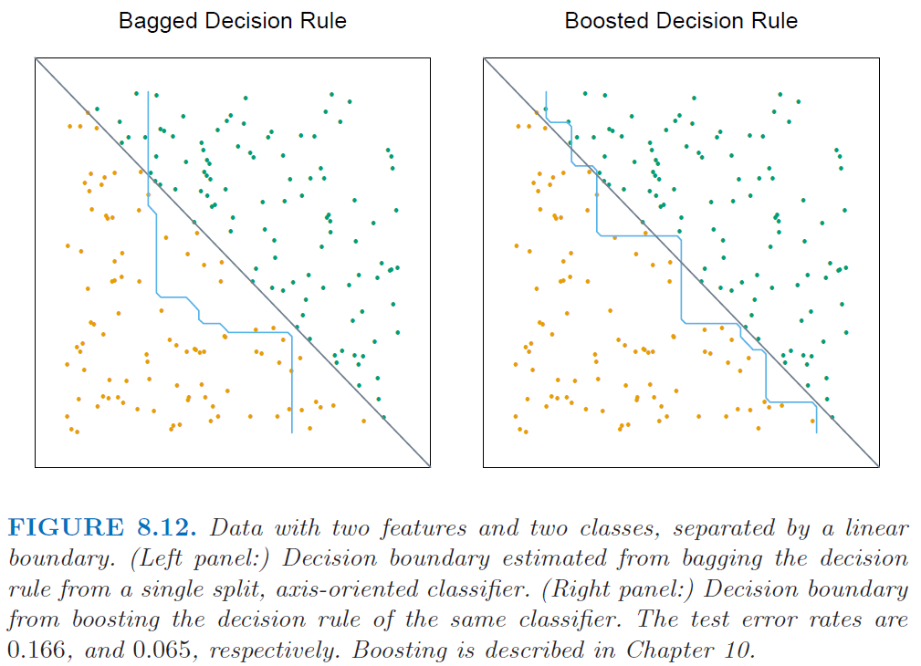
Illustration of How Bagging/Boosting Trees Changes Their Structure (HTF, Fig 8.12)

Slide 87
Stacking
Whereas in bagging you usually average an ensemble of similarly structured models, each fit to a different bootstrapped sample, in stacking you usually average differently structured models, each fit to the entire training data
Straightforward idea: Fit a number of different models, each possibly with entirely different structure. Then take a linear combination (i.e., a weighted average) of the constituent models as the predictor, using linear regression to determine the coefficients (i.e., the weights), with the constituent models as basis functions
The only subtlety is that when conducting regression to find the β’s, a leave-one-out CV SSE must be used

Slide 88
Stacking Algorithm (almost but not quite)
For each m = 1, 2, . . ., M:
fit model (any set of M models that you like)
Then take
with found by minimizing
Question: What is the problem with using this approach exactly?

Slide 89
Stacking Algorithm (exactly)
For each m = 1, 2, . . ., M:
fit n separate models
where coefficients for mth model, fitted with ith row {y_{i},x_{i}} left out (as in leave-one-out CV)
Then take
with found by minimizing

Slide 90
Discussion Points and Questions
What is the computational expense associated with stacking? Which part of the stacking algorithm is the most computationally expensive?
Would the computational expense be better or worse if you used K-fold, instead of n-fold CV
How does stacking relate to model selection using CV?
Stacking has not been extensively investigated and the jury is still out regarding whether it is worth the effort
very computationally expensive if the constituent models are expensive to fit
same issue as in bagging (not necessary for model classes that are closed under summation)
there are much less expensive ensemble methods like boosting

Slide 91
Boosting
Bagging and stacking fit a set of models in parallel and take a weighted or unweighted average for the final model
(Gradient) boosting sequentially fits weak models (almost always simple trees) to the residuals from the previous iteration, taking the final model to be the sum of the individual models from each iteration
Notation:
M = # of trees/iterations to fit
f(x) = predictor of y(x)
L(y_{i},f(x_{i})) = loss function to be minimized when fitting
r_{im} = psuedo-residual of {y_{i}, x_{i}} at iteration m
J_{m} = # nodes for mth tree

Slide 92
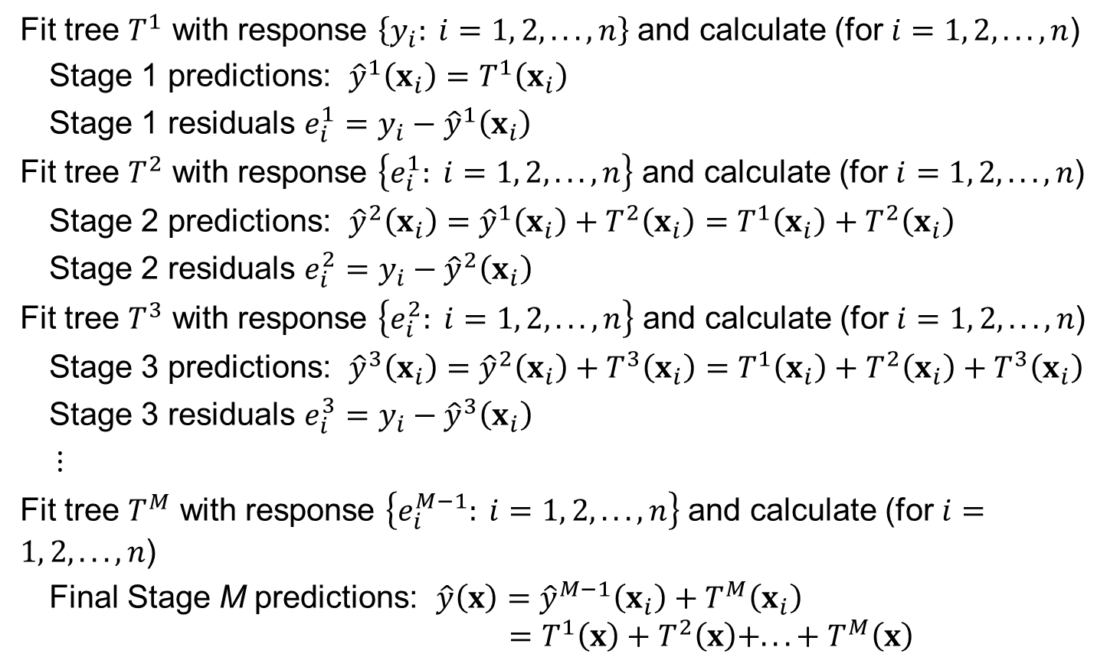
Rough Idea Behind Boosting with Trees
Fit tree $T^{1}$ with response $\left\{y_{i}: i=1, 2, . . ., n\right\}$ and calculate (for $i=1, 2, . . ., n$)
Stage 1 predictions: ${\hat{y}}^{1}\left(x_{i}\right)=T^{1}\left(x_{i}\right)$
Stage 1 residuals $e_{i}^{1}=y_{i}−{\hat{y}}^{1}\left(x_{i}\right)$
Fit tree $T^{2}$ with response $\left\{e_{i}^{1}: i=1, 2, . . ., n\right\}$ and calculate (for $i=1, 2, . . ., n$)
Stage 2 predictions: ${\hat{y}}^{2}\left(x_{i}\right)={\hat{y}}^{1}\left(x_{i}\right)+T^{2}\left(x_{i}\right)=T^{1}\left(x_{i}\right)+T^{2}\left(x_{i}\right)$
Stage 2 residuals $e_{i}^{2}=y_{i}−{\hat{y}}^{2}\left(x_{i}\right)$
Fit tree $T^{3}$ with response $\left\{e_{i}^{2}: i=1, 2, . . ., n\right\}$ and calculate (for $i=1, 2, . . ., n$)
Stage 3 predictions: ${\hat{y}}^{3}\left(x_{i}\right)={\hat{y}}^{2}\left(x_{i}\right)+T^{3}\left(x_{i}\right)=T^{1}\left(x_{i}\right)+T^{2}\left(x_{i}\right)+T^{3}\left(x_{i}\right)$
Stage 3 residuals $e_{i}^{3}=y_{i}−{\hat{y}}^{3}\left(x_{i}\right)$
$⋮$
Fit tree $T^{M}$ with response $\left\{e_{i}^{M−1}: i=1, 2, . . ., n\right\}$ and calculate (for $i=1, 2, . . ., n$)
Final Stage M predictions: $\hat{y}\left(x\right)={\hat{y}}^{M−1}\left(x_{i}\right)+T^{M}\left(x_{i}\right)$ $$=T^{1}\left(x\right)+T^{2}\left(x\right)+. . . + T^{M}\left(x\right)$$

Slide 93
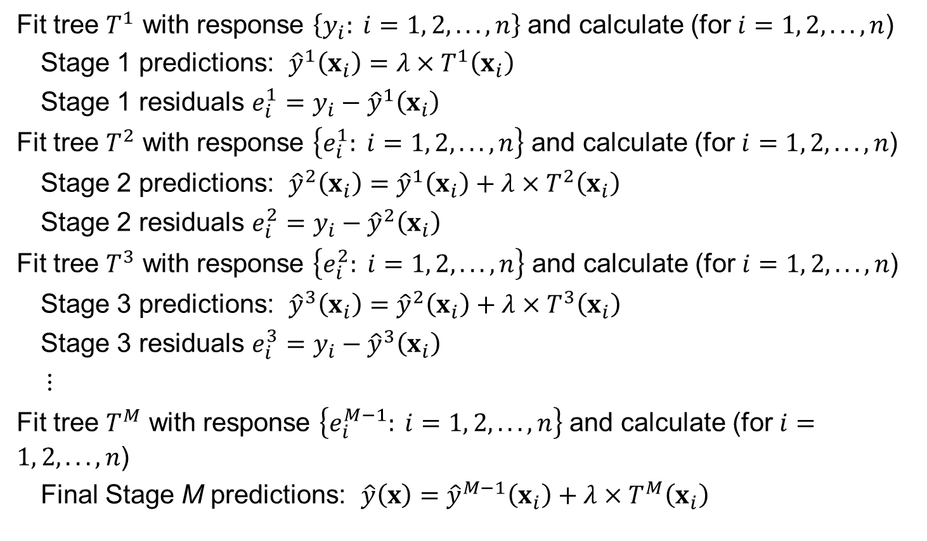

A Modification (Slow Learning) with Shrinkage Parameter $λ∈(0,1]$
Fit tree $T^{1}$ with response $\left\{y_{i}: i=1, 2, . . ., n\right\}$ and calculate (for $i=1, 2, . . ., n$)
Stage 1 predictions: ${\hat{y}}^{1}\left(x_{i}\right)=λ×T^{1}\left(x_{i}\right)$
Stage 1 residuals $e_{i}^{1}=y_{i}−{\hat{y}}^{1}\left(x_{i}\right)$
Fit tree $T^{2}$ with response $\left\{e_{i}^{1}: i=1, 2, . . ., n\right\}$ and calculate (for $i=1, 2, . . ., n$)
Stage 2 predictions: ${\hat{y}}^{2}\left(x_{i}\right)={\hat{y}}^{1}\left(x_{i}\right)+λ×T^{2}\left(x_{i}\right)$
Stage 2 residuals $e_{i}^{2}=y_{i}−{\hat{y}}^{2}\left(x_{i}\right)$
Fit tree $T^{3}$ with response $\left\{e_{i}^{2}: i=1, 2, . . ., n\right\}$ and calculate (for $i=1, 2, . . ., n$)
Stage 3 predictions: ${\hat{y}}^{3}\left(x_{i}\right)={\hat{y}}^{2}\left(x_{i}\right)+λ×T^{3}\left(x_{i}\right)$
Stage 3 residuals $e_{i}^{3}=y_{i}−{\hat{y}}^{3}\left(x_{i}\right)$
$⋮$
Fit tree $T^{M}$ with response $\left\{e_{i}^{M−1}: i=1, 2, . . ., n\right\}$ and calculate (for $i=1, 2, . . ., n$)
Final Stage M predictions: $\hat{y}\left(x\right)={\hat{y}}^{M−1}\left(x_{i}\right)+λ×T^{M}\left(x_{i}\right)$

Slide 94
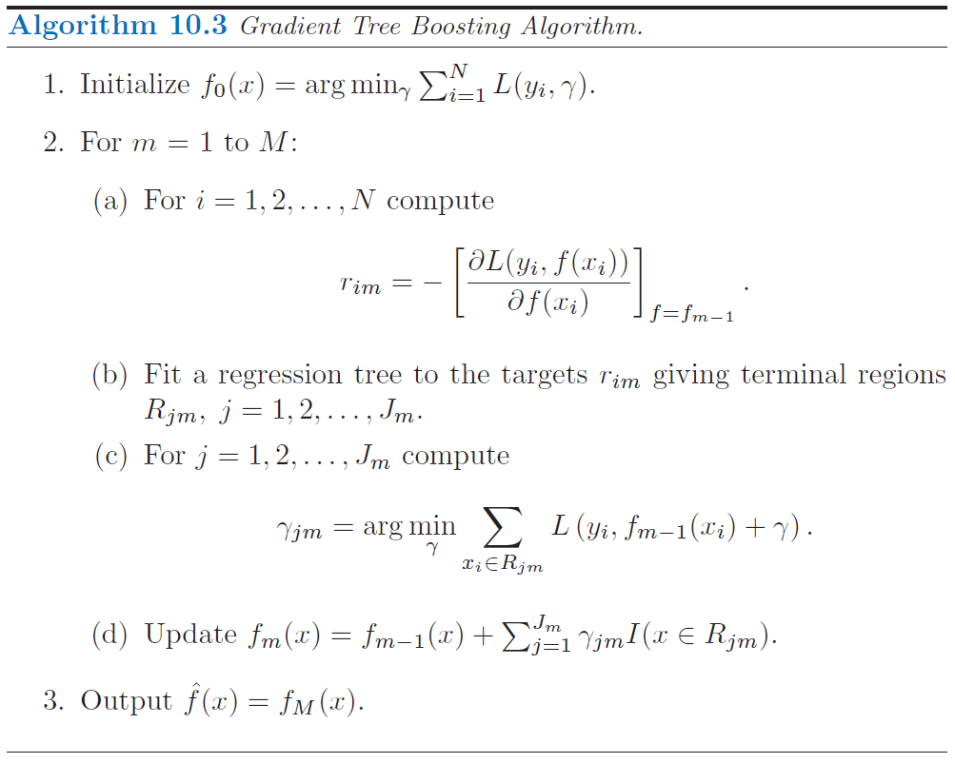

Slide 95
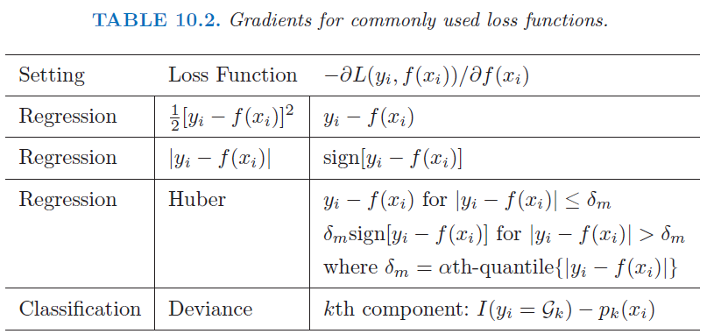

Slide 96
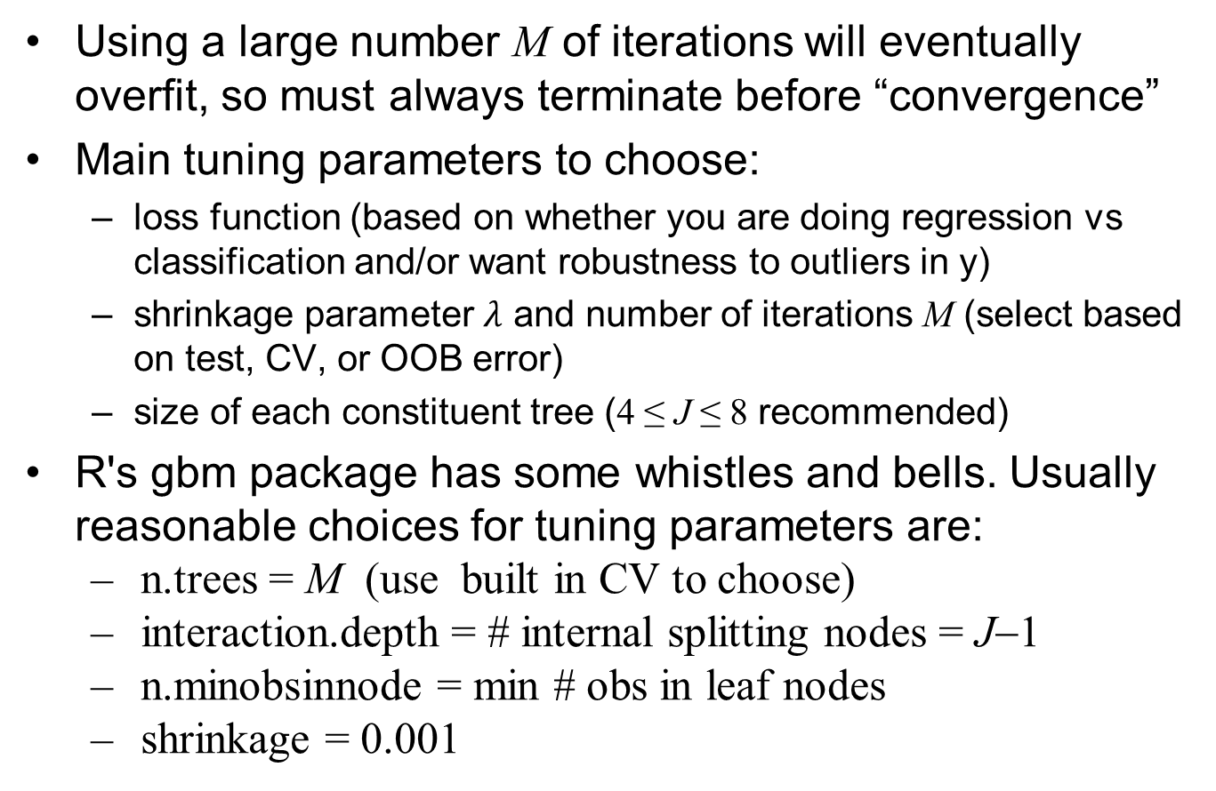
Tuning a Boosting Algorithm
Using a large number M of iterations will eventually overfit, so must always terminate before “convergence”
Main tuning parameters to choose:
loss function (based on whether you are doing regression vs classification and/or want robustness to outliers in y)
shrinkage parameter $λ$ and number of iterations M (select based on test, CV, or OOB error)
size of each constituent tree (4 ≤ J ≤ 8 recommended)
R's gbm package has some whistles and bells. Usually reasonable choices for tuning parameters are:
n.trees = M (use built in CV to choose)
interaction.depth = # internal splitting nodes = J−1
n.minobsinnode = min # obs in leaf nodes
shrinkage = 0.001

Slide 97
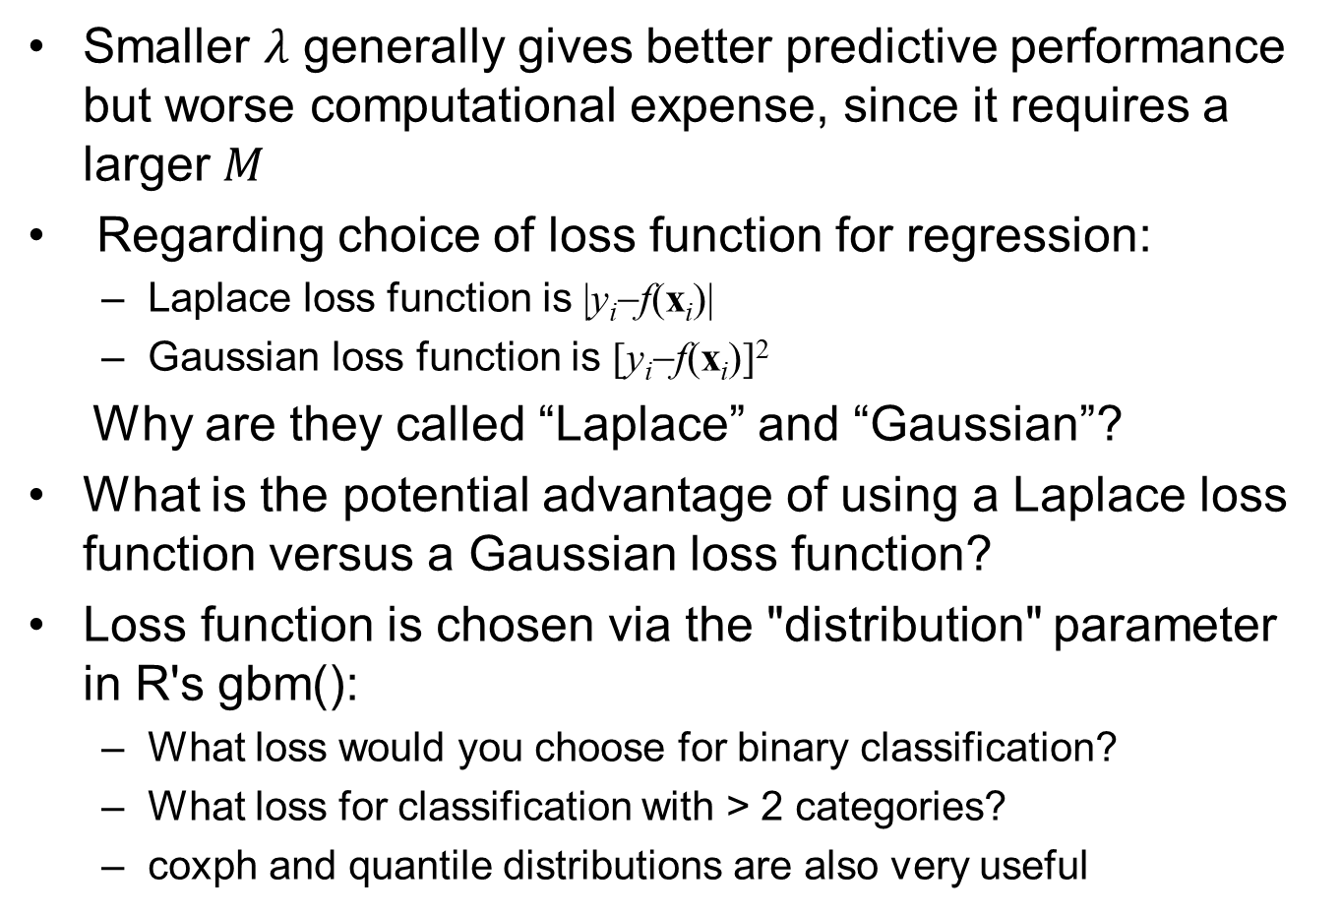
Discussion Points and Questions
Smaller $λ$ generally gives better predictive performance but worse computational expense, since it requires a larger $M$
Regarding choice of loss function for regression:
Laplace loss function is |y_{i}−f(x_{i})|
Gaussian loss function is [y_{i}−f(x_{i})]²
Why are they called “Laplace” and “Gaussian”?
What is the potential advantage of using a Laplace loss function versus a Gaussian loss function?
Loss function is chosen via the "distribution" parameter in R's gbm():
What loss would you choose for binary classification?
What loss for classification with > 2 categories?
coxph and quantile distributions are also very useful

Slide 98
Gradient Boosting Trees for Concrete data
library(gbm)
gbm1 <- gbm(Strength~., data=CRT1, var.monotone=rep(0,8), distribution="gaussian", n.trees=5000, shrinkage=0.1, interaction.depth=3, bag.fraction = .5, train.fraction = 1, n.minobsinnode = 10, cv.folds = 10, keep.data=TRUE, verbose=FALSE)
best.iter <- gbm.perf(gbm1,method="cv");best.iter
sqrt(gbm1$cv.error[best.iter]) #CV error SD
1-gbm1$cv.error[best.iter]/var(CRT1$Strength) #CV r^2
yhat<-predict(gbm1,CRT1, n.trees = best.iter); sd(CRT1$Strength-yhat) #training error SD
##
summary(gbm1,n.trees=best.iter) # based on the optimal number of trees
##
par(mfrow=c(2,4))
for (i in c(8,1,4,2,7,5,6,3)) plot(gbm1, i.var = i, n.trees = best.iter)
par(mfrow=c(1,1))
##
plot(gbm1, i.var = c(8,1), n.trees = best.iter)
##
print(pretty.gbm.tree(gbm1,1)) #show the first tree
##
print(pretty.gbm.tree(gbm1,best.iter)) #show the last tree

Slide 99
Gradient Boosting Trees for Concrete data
library(gbm)
gbm1 <- gbm(Strength~., data=CRT1, var.monotone=rep(0,8), distribution="gaussian", n.trees=5000, shrinkage=0.1, interaction.depth=3, bag.fraction = .5, train.fraction = 1, n.minobsinnode = 10, cv.folds = 10, keep.data=TRUE, verbose=FALSE)
best.iter <- gbm.perf(gbm1,method="cv");best.iter
sqrt(gbm1$cv.error[best.iter]) #CV error SD
1-gbm1$cv.error[best.iter]/var(CRT1$Strength) #CV r^2
yhat<-predict(gbm1,CRT1, n.trees = best.iter); sd(CRT1$Strength-yhat) #training error SD
##
summary(gbm1,n.trees=best.iter) # based on the optimal number of trees
##Construct PD main effect plots for predictors c(8,1,4,2,7,5,6,3)
i=8; plot(gbm1, i.var = i, n.trees = best.iter)
## Construct a PD interaction plot for predictors 8 and 1
plot(gbm1, i.var = c(8,1), n.trees = best.iter)
##
print(pretty.gbm.tree(gbm1,1)) #show the first tree
##
print(pretty.gbm.tree(gbm1,best.iter)) #show the last tree

Slide 100
Boosting Results for Concrete Data
CV and Training Error vs. # Iterations
Variable Importance

Slide 101
Marginal Plots for Concrete Boosted Trees

Slide 102
Pairwise Marginal Plot for Concrete Boosted Trees for Visualizing Interactions

Slide 103
Discussion Points and Questions
The variable importance measure is simply the sum of the variable importance measures for each of the M individual trees
For interpreting the model and the effects of the predictors
Individual marginal plots are very useful but cannot show any interactions (and can be misleading if interactions are strong)
Pairwise marginal plots show interactions between pairs of variables
Printing out the first few trees using print(pretty.gbm.tree(gbm1,i)) (for i = 1, 2, . . .) and attempting to interpret these may also help, but this is usually difficult
Of all the methods we have tried for the Concrete data, which did the best?

Slide 104
Comparison of CV r^2 for Various Methods for Concrete Data
CV error SD CV r^2
Boosted tree 3.91 0.945
PPR 5.25 0.901
NNet 5.46 0.893
GAM 5.60 0.888
Loc. Lin. 7.27 0.811
Tree 0.793
K-NN 8.60 0.735
Lin. Reg. 10.5 0.605

Slide 105
Gradient Boosting Trees for CPUS data
library(gbm)
gbm1 <- gbm(perf~., data=CPUS1, var.monotone=c(0,0,0,0,0,0), distribution="gaussian", n.trees=1000, shrinkage=0.05, interaction.depth=3, bag.fraction = .5, train.fraction = 1, n.minobsinnode = 10, cv.folds = 10, keep.data=TRUE, verbose=FALSE)
best.iter <- gbm.perf(gbm1,method="cv");best.iter
sqrt(gbm1$cv.error[best.iter])
##
summary(gbm1,n.trees=best.iter) # based on the optimal number of trees
##
par(mfrow=c(1,3))
for (i in c(4,3,1)) plot(gbm1, i.var = i, n.trees = best.iter)
##
plot(gbm1, i.var = c(3,4), n.trees = best.iter)
##
print(pretty.gbm.tree(gbm1,1)) #show the first tree
##
print(pretty.gbm.tree(gbm1,best.iter)) #show the last tree

Slide 106
Boosting Results for CPUS Data
CV and Training Error vs. # Iterations
Variable Importance

Slide 107
Marginal Plots for CPUS Boosted Trees

Slide 108
Pairwise Marginal Plot for CPUS Boosted Trees for Visualizing Interactions

Slide 109
Discussion Points and Questions
The variable importance measure is simply the sum of the variable importance measures for each of the M individual trees
For interpreting the model and the effects of the predictors
Individual marginal plots are very useful but cannot show any interactions (and can be misleading if interactions are strong)
Pairwise marginal plots show interactions between pairs of variables
Printing out the first few trees using print(pretty.gbm.tree(gbm1,i)) (for i = 1, 2, . . .) and attempting to interpret these may also help, but this is usually difficult
Of all the methods we have tried for the CPUS data, which did the best?

Slide 110
Comparison of CV r^2 for Various Methods for CPUS Data
CV error SD CV r^2
Boosted tree 0.073 86.6%
Loc. Lin. 0.078 84.7%
NNet 0.079 84.3%
K-NN 0.083 82.7%
PPR 0.085 81.8%
Lin. Reg. 0.086 81.4%
GAM 0.086 81.4%
Tree 0.099 75.2% (this was using tree, not rpart)

Slide 111
Advantages of Boosted Trees
Trees have relatively poor predictive power, but have many nice properties for data mining problems:
handles missing data
robust to outliers in predictor space
insensitive to monotone transformation of predictors
computationally scalable (to large n)
handles mixed and categorical predictors with many categories
automatically discards irrelevant predictors
interpretable (for moderate sized trees)
convenient variable importance measure
Boosting trees can substantially improve predictive power, while retaining almost all the advantages (except interpretability, but this can be improved with individual and pairwise marginal plots)

Slide 112
Return to the Income Data Example
Reconsider the data in adult_train.csv
Previously we tried neural network and tree model for regression (predicting the number of hours per week worked) and classification (predicting the binary income categorization <= 50k vs. > 50k)
Let's try boosted trees now

Slide 113
Try a Boosted Regression Tree
library(gbm)
XX<-read.table("adult_train.csv",sep=",",header=TRUE,strip.white=TRUE,na.strings="?")
XX<-na.omit(XX)
INCOME<-XX #there is no need to standardize the predictors with trees (why not)
Inc.gbm1 <- gbm(hours.per.week ~ ., data=INCOME[,-c(3,4)], distribution="gaussian", n.trees=5000, shrinkage=0.05, interaction.depth=3, bag.fraction = .5, train.fraction = 1, n.minobsinnode = 10, cv.folds = 10, keep.data=TRUE, verbose=FALSE)
best.iter <- gbm.perf(Inc.gbm1,method="cv");best.iter
VarCV<-Inc.gbm1$cv.error[best.iter]; 1-VarCV/var(INCOME$hours.per.week)
summary(Inc.gbm1,n.trees=best.iter)
Inc.gbm1$var.names

Slide 114
> best.iter
[1] 1265
> VarCV<-Inc.gbm1$cv.error[best.iter]; 1-VarCV/var(INCOME$hours.per.week)
[1] 0.2650076
> summary(Inc.gbm1,n.trees=best.iter)
var rel.inf
age age 34.9590262
occupation occupation 18.5648540
native.country native.country 12.6696441
relationship relationship 9.9231513
workclass workclass 6.4316208
sex sex 5.5651013
income income 4.0661108
education.num education.num 3.5632509
marital.status marital.status 2.0806690
capital.loss capital.loss 1.0607433
capital.gain capital.gain 0.8191883
race race 0.2966401

Slide 115
plot(Inc.gbm1, i.var = 1, n.trees = best.iter)
plot(Inc.gbm1, i.var = 5, n.trees = best.iter, cex.axis=.7)
plot(Inc.gbm1, i.var = 6, n.trees = best.iter, cex.axis=1)

Slide 116
plot(Inc.gbm1, i.var = 11, n.trees = best.iter, cex.axis=.5)
plot(Inc.gbm1, i.var = 2, n.trees = best.iter, cex.axis=1)
plot(Inc.gbm1, i.var = 8, n.trees = best.iter, cex.axis=1)

Slide 117
plot(Inc.gbm1, i.var = 12, n.trees = best.iter, cex.axis=1)
plot(Inc.gbm1, i.var = 3, n.trees = best.iter, cex.axis=1)
plot(Inc.gbm1, i.var = 4, n.trees = best.iter, cex.axis=1)

Slide 118
Try a Boosted Classification Tree
Inc.gbm2 <- gbm(income==">50K" ~ ., data=INCOME[,-c(3,4)], distribution="bernoulli", n.trees=5000, shrinkage=0.05, interaction.depth=3, bag.fraction = .5, train.fraction = 1, n.minobsinnode = 10, cv.folds = 10, keep.data=TRUE, verbose=FALSE)
best.iter <- gbm.perf(Inc.gbm2,method="cv");best.iter
Inc.gbm2$cv.error[best.iter]
summary(Inc.gbm2,n.trees=best.iter)
Inc.gbm2$var.names

Slide 119
> best.iter <- gbm.perf(Inc.gbm2,method="cv");best.iter
[1] 1831
> Inc.gbm2$cv.error[best.iter]
[1] 0.5919548
> summary(Inc.gbm2,n.trees=best.iter)
var rel.inf
relationship relationship 27.8029637
capital.gain capital.gain 19.7517894
education.num education.num 12.6580751
occupation occupation 12.0258575
age age 6.1660624
marital.status marital.status 5.8939557
capital.loss capital.loss 5.7317558
native.country native.country 4.3856221
hours.per.week hours.per.week 3.5760496
workclass workclass 1.5492630
sex sex 0.3552002
race race 0.1034056

Slide 120
for (i in c(6,9,3,5,1,4)) {plot(Inc.gbm2, i.var = i, type="response",n.trees = best.iter); readline()}

Slide 122
Discussion Points and Questions
For classification, gbm() calculates the CV deviance, not the misclassification rate. How can we interpret this to assess how good the overall predictive power is?
the best CV deviance was 0.592
deviance = −2×ave{log-f(y_{i})}
= −2×ave{log[p_{i}^{yi}(1−p_{i})^{(1−yi)}]}
= −2×ave{y_{i}log(p_{i}) +(1−y_{i})log(1−p_{i})}
= −2×ave{log(α_{i})}
where = predicted probability for correct class of y_{i}
thus, ave{log(α_{i})} = −deviance/2, so that (very approximately)
ave{α_{i}} ≈ exp{−deviance/2} = exp{−0.592/2} = 0.74

Slide 123
Random Forests
This is an application of bagging, but with some twists that are tailored to the specific case of bagging trees
They share all the desirable characteristics of boosted trees, and also have much better predictive performance than trees by themselves (sometimes better, sometimes worse than boosted trees)
They may (arguably) be somewhat easier to tune than tree boosting, but with good software and CV, it is not difficult to tune (select M, J and shrinkage parameter) a tree boosting algorithm
See randomForest package in R

Slide 124
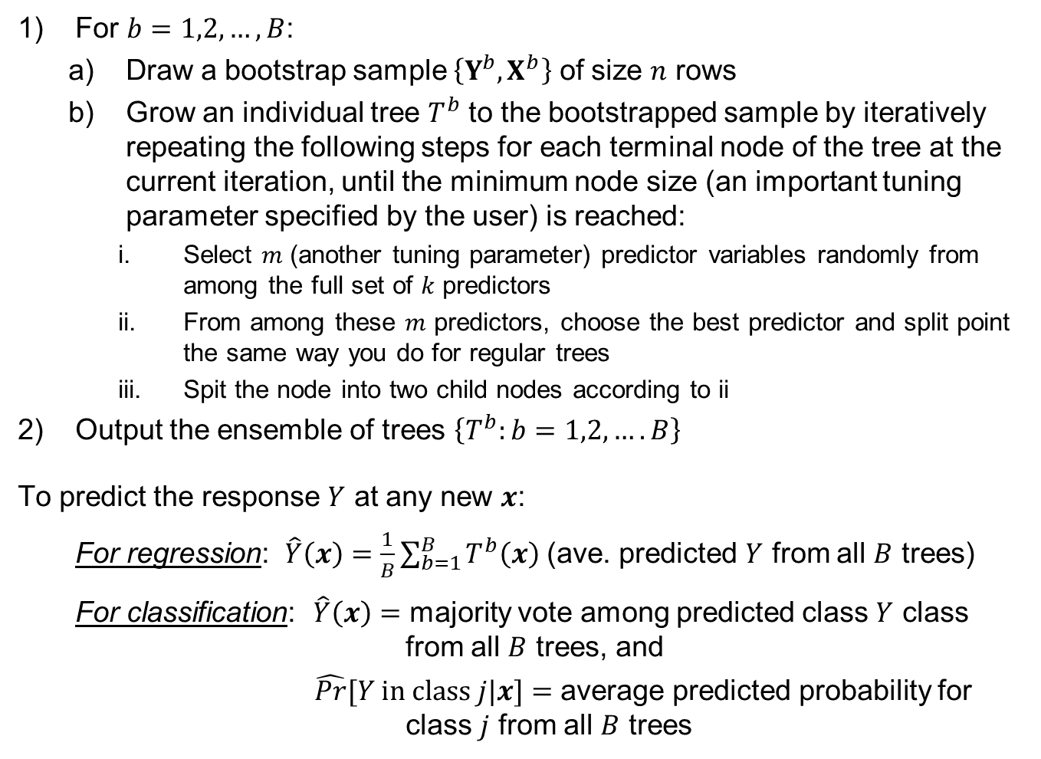
Random Forest Algorithm
For $b=1,2,…,B$:
Draw a bootstrap sample $\left\{Y^{b},X^{b}\right\}$ of size $n$ rows
Grow an individual tree $T^{b}$ to the bootstrapped sample by iteratively repeating the following steps for each terminal node of the tree at the current iteration, until the minimum node size (an important tuning parameter specified by the user) is reached:
Select $m$ (another tuning parameter) predictor variables randomly from among the full set of $k$ predictors
From among these $m$ predictors, choose the best predictor and split point the same way you do for regular trees
Spit the node into two child nodes according to ii
Output the ensemble of trees $\left\{T^{b}:b=1,2,….B\right\}$
To predict the response $Y$ at any new $x$:
For regression: $\hat{Y}\left(x\right)=\frac{1}{B}\sum_{b=1}^{B}{T^{b}\left(x\right)}$ (ave. predicted $Y$ from all $B$ trees)
For classification: $\hat{Y}\left(x\right)=$ majority vote among predicted class $Y$ class from all $B$ trees, and
$\hat{Pr}⁡[Y in class j|x]=$ average predicted probability for class $j$ from all $B$ trees

Slide 125
Random Forest for Concrete data
library(randomForest)
rForest1 <- randomForest(Strength~., data=CRT1, mtry=3, ntree = 500, nodesize = 3, importance = TRUE)
plot(rForest1) #plots OOB mse vs # trees
rForest1 #check the OOB mse and r^2
importance(rForest1); varImpPlot(rForest1)
par(mfrow=c(2,4))
for (i in c(8,1,4,2,7,5,6,3)) partialPlot(rForest1, pred.data=CRT1, x.var = names(CRT1)[i], xlab = names(CRT1)[i], main=NULL) #creates "partial dependence" plots
par(mfrow=c(1,1))
c(rForest1$mse[rForest1$ntree], sum((rForest1$predicted - CRT1$Strength)^2)/nrow(CRT1)) #both give the OOB MSE

Slide 126
Random Forest Results for Concrete Data
OOB MSE vs. # trees
Variable Importance

Slide 127
Partial Dependence (Marginal) Plots for Concrete RF

Slide 128
Discussion Points and Questions
The out-of-bag (OOB) mse plotted vs. # trees replaces the CV mse for evaluating the model and is interpreted similarly.
The individual trees in a random forest are generally much larger (controlled by nodesize and maxnodes) than the individual trees in a boosted tree. Choosing the right size for the individual trees in a random forest is important. You should try different values and use the OOB mse to select the best size.
Random forests can overfit if the individual trees are chosen too large, but as the # trees increases they do not increasingly overfit, unlike boosted trees (why?), so you do not have to worry about choosing ntrees too large
There are two built-in variable importance measures (permutation-based measure and the usual tree-based measure). It's good to look at both
The partial dependence plots are the same as what is called "marginal" plots in the gbm package

Slide 129
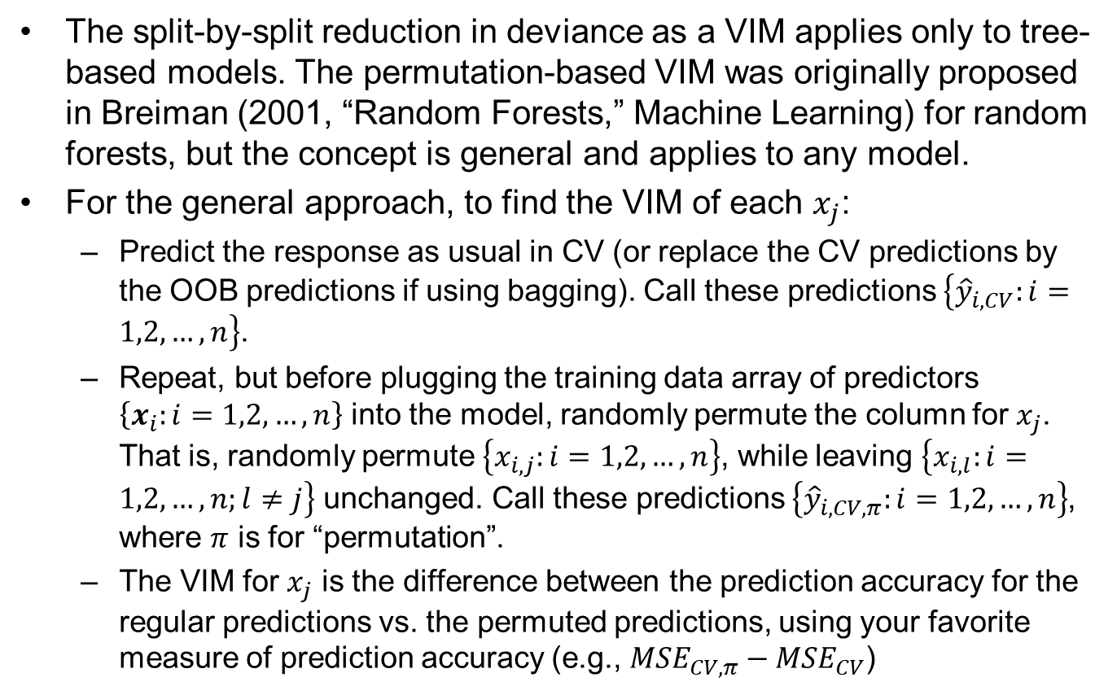
A General Permutation-Based Variable Importance Measure (VIM)
The split-by-split reduction in deviance as a VIM applies only to tree-based models. The permutation-based VIM was originally proposed in Breiman (2001, “Random Forests,” Machine Learning) for random forests, but the concept is general and applies to any model.
For the general approach, to find the VIM of each $x_{j}$:
Predict the response as usual in CV (or replace the CV predictions by the OOB predictions if using bagging). Call these predictions $\left\{{\hat{y}}_{i,CV}:i=1,2,…,n\right\}$.
Repeat, but before plugging the training data array of predictors $\left\{x_{i}:i=1,2,…,n\right\}$ into the model, randomly permute the column for $x_{j}$. That is, randomly permute $\left\{x_{i,j}:i=1,2,…,n\right\}$, while leaving $\left\{x_{i,l}:i=1,2,…,n;l≠j\right\}$ unchanged. Call these predictions $\left\{{\hat{y}}_{i,CV,π}:i=1,2,…,n\right\}$, where $π$ is for “permutation”.
The VIM for $x_{j}$ is the difference between the prediction accuracy for the regular predictions vs. the permuted predictions, using your favorite measure of prediction accuracy (e.g., ${MSE}_{CV,π}−{MSE}_{CV}$)

Slide 130
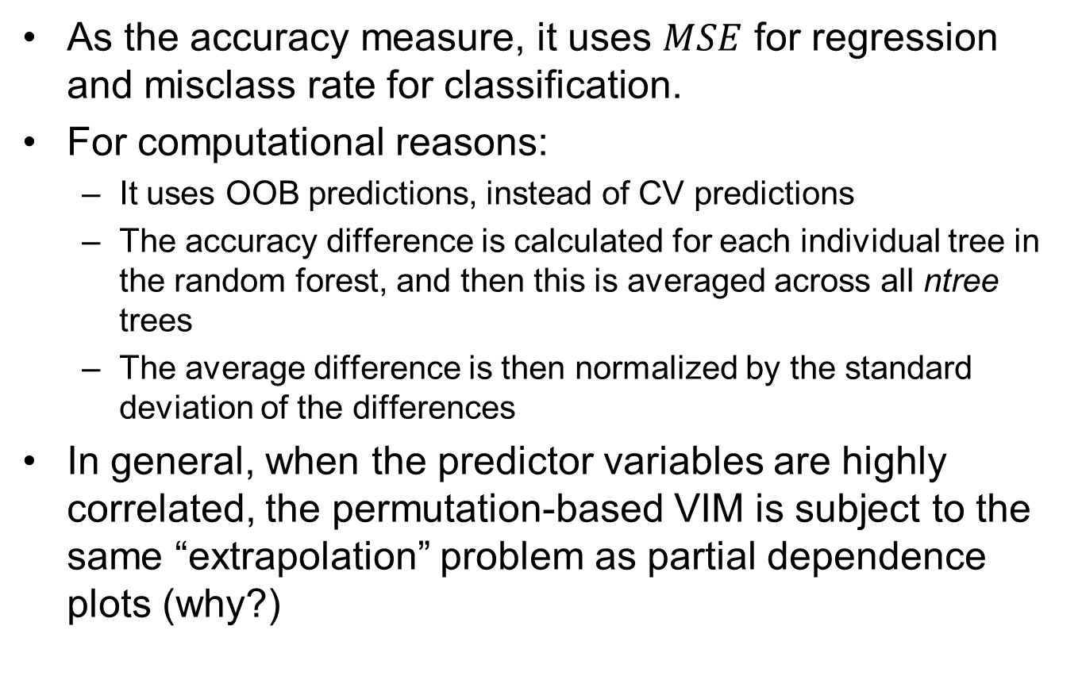
The Permutation-Based VIM in the randomForest Package
As the accuracy measure, it uses $MSE$ for regression and misclass rate for classification.
For computational reasons:
It uses OOB predictions, instead of CV predictions
The accuracy difference is calculated for each individual tree in the random forest, and then this is averaged across all ntree trees
The average difference is then normalized by the standard deviation of the differences
In general, when the predictor variables are highly correlated, the permutation-based VIM is subject to the same “extrapolation” problem as partial dependence plots (why?)

Slide 131
Comparison of CV r^2 for Various Methods for Concrete Data
CV error SD CV r^2
Boosted tree 3.91 0.945
Random Forest 0.921 (OOB r^2)
PPR 5.25 0.901
NNet 5.46 0.893
GAM 5.60 0.888
Loc. Lin. 7.27 0.811
Tree 0.793
K-NN 8.60 0.735
Lin. Reg. 10.5 0.605

Slide 132
Random Forests Vs. Boosted Trees
Random forests have virtually all the same many advantages of boosted trees (see earlier slide on boosted tree advantages)
They inherit almost all the advantages of trees, but, like boosted trees, usually have excellent predictive power
Unlike trees, they lose interpretability. But this can be improved with the built-in partial dependence (aka marginal) plots and the variable importance measures
Overall: random forests may usually give a little smoother model than boosted trees, whereas boosted trees may be a little better at capturing more complex nonlinearities

Slide 133
Random Forest (regression) for the Income Data
library(randomForest)
XX<-read.table("adult_train.csv",sep=",",header=TRUE,strip.white=TRUE,na.strings="?")
XX<-na.omit(XX)
INCOME<-XX #there is no need to standardize the predictors with trees (why not)
rForest <- randomForest(x=INCOME[,-c(3,4,13)], y=INCOME$hours.per.week, data=XX, mtry=4, ntree = 100, nodesize = 50, importance = TRUE)
plot(rForest) #plots OOB mse vs # trees
rForest #check the OOB mse and r^2
importance(rForest); varImpPlot(rForest)
i=1; partialPlot(rForest, pred.data=XX, x.var = names(XX)[i], xlab = names(XX)[i], main=NULL) #a partial dependence plot for age
#For the above parameters, the OOB r^2 was about 26.9%, which is about the same as the CV r^2 for the boosted tree
#using smaller nodesize and/or larger ntree in the above will take longer. Specifying the predictors "x =" and response "y = " as random.Forest arguments is a little faster than specifying the formula and data.frame.

Slide 134
Some Other Supervised Learning Methods
Supervised learning models within proportional hazards models
Quantile regression
Support vector machines (SVM)
Multivariate adaptive regression splines (MARS)
Naive Bayes
Gaussian process regression
In light of the supervised learning methods that you have already learned, it should be relatively easy for you to learn any additional methods on your own (HTF discusses a number of such)

Slide 135
Proportional Hazards (PH) Survival Models
Survival models are used to model time-to-event data in reliability (event = failure of a product), credit risk scoring (event = default on loan), healthcare (event = mortality), etc.
The simplest case is where you just have a single variable $Y=T=$ time-to-failure, in which case you just use some appropriate failure time distribution like exponential, gamma, Weibull, log-normal.
A “Cox proportional hazards” (PH) survival model is used when you also have a vector of predictor variables $X$ and you want to model the failure-time distribution of $Y(=T)$ as a function of $X$

Slide 136
Main Idea Behind PH Survival Models
For response $Y=T=$ time to failure and $X=$ vector of predictors
pdf of $T$: $f(t)$
cdf of $T$: $F(t)$
survival function: $S\left(t\right)=1−F(t)$
hazard function: $h\left(t\right)=\frac{f(t)}{1−F(t)}$
Cox PH model: $h\left(t\right)=h_{0}(t)exp\{g\left(X;θ\right)\}$ where
$h_{0}(t)$ = some baseline hazard function (e.g., Weibull, gamma, etc)
Classic linear model: $g\left(X;θ\right)=X^{T}θ$
Or can use any nonparametric $g\left(X;θ\right)$ like a boosted tree (in gbm)
In rpart, use "method=exp" with the response a survival object
In gbm, use “distribution=coxph" with the response a survival object
Censored observations are typical in survival data, so most PH survival packages will handle at least right-censored data

Slide 137
Quantile Regression
Regression models predict the conditional mean $E\left[Y|X=x\right]=g\left(x;θ\right)$ as a function of $x$
Under the classic regression assumption that $Y=g\left(X;θ\right)+ε$ with iid $ε$, this essentially gives us the entire conditional distribution $f_{Y|X}\left(y | x\right)$:
Estimate $f_{ε}(ε)$ as the marginal distribution of the regression errors $\{y_{i}−g\left(x_{i};\hat{θ}\right):i=1,2,…,n\}$
Take $f_{Y|X}\left(y | x\right)=f_{ε}(y−g(x;\hat{θ}))$
But what if the distribution of $ε$ depends on $X$?
If we are confident $ε$ is zero-mean (which is always reasonable) and Gaussian with $Var\left[Y|X=x\right]=σ^{2}(x)$ a function of $x$, then we can try to estimate $σ^{2}(x)$ along with $E\left[Y|X=x\right]=g\left(x;θ\right)$ and use $f_{Y|X}\left(y | x\right)=N(g(x;\hat{θ}),{\hat{σ}}^{2}(x))$
Quantile regression is more general

Slide 138
Basic Idea Behind Quantile Regression
If we have a sample of univariate observations $\{y_{i}:i=1,2,…,n\}$, the 0.5 sample quantile $q_{0.5}$ (i.e., the median) satisfies
$q_{0.5}={argmin}_{q}\sum_{i=1}^{n}{|y_{i}−q|}={argmin}_{q}\sum_{i=1}^{n}{ρ_{0.5}(y_{i}−q)}$
where $ρ_{0.5}\left(u\right)=0.5\left|u\right|=u\left[0.5−I(u<0)\right]$ is the absolute value function (scaled by 0.5)
More generally, for $τ∈(0,1)$, the $τ$ sample quantile $q_{τ}$ satisfies
$q_{τ}={argmin}_{q}\sum_{i=1}^{n}{ρ_{τ}(y_{i}−q)}$
where $ρ_{τ}\left(u\right)=u\left[τ−I(u<0)\right]=\left\{\begin{matrix}\left(1−τ\right)\left|u\right|: u<0 \\ τ\left|u\right|: u≥0 \end{matrix}\right.$ is the “tilted absolute value function”
For a specified $τ∈(0,1)$, quantile regression estimates the $τ$ quantile of $f_{Y|X}\left(y | x\right)$ (as a function of $x$) as
$q_{τ}\left(x;\hat{θ}\right)={argmin}_{θ}\sum_{i=1}^{n}{ρ_{τ}(y_{i}−q_{τ}\left(x;θ\right))}$
where $q_{τ}\left(x;θ\right)$ is some parametric (or nonparametric) function of $x$

Slide 139
Basic Support Vector Classifier Concepts

Slide 140
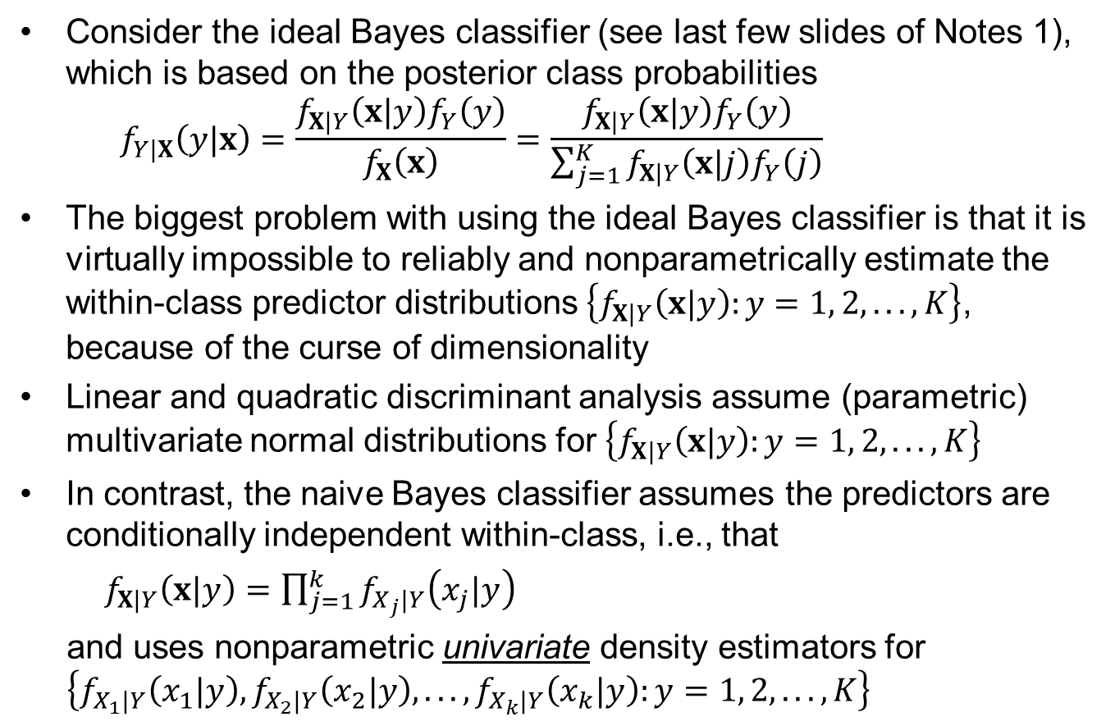
Basic Naive Bayes Concepts
Consider the ideal Bayes classifier (see last few slides of Notes 1), which is based on the posterior class probabilities
$$f_{Y|X}\left(y|x\right)=\frac{f_{X|Y}\left(x|y\right)f_{Y}\left(y\right)}{f_{X}\left(x\right)}=\frac{f_{X|Y}\left(x|y\right)f_{Y}\left(y\right)}{\sum_{j=1}^{K}{f_{X|Y}\left(x|j\right)f_{Y}\left(j\right)}}$$
The biggest problem with using the ideal Bayes classifier is that it is virtually impossible to reliably and nonparametrically estimate the within-class predictor distributions $\left\{f_{X|Y}\left(x|y\right):y=1, 2, . . ., K\right\}$, because of the curse of dimensionality
Linear and quadratic discriminant analysis assume (parametric) multivariate normal distributions for $\left\{f_{X|Y}\left(x|y\right):y=1, 2, . . ., K\right\}$
In contrast, the naive Bayes classifier assumes the predictors are conditionally independent within-class, i.e., that
$f_{X|Y}\left(x|y\right)=\prod_{j=1}^{k}{f_{X_{j}|Y}\left(x_{j}|y\right)}$
and uses nonparametric univariate density estimators for $\left\{f_{X_{1}|Y}\left(x_{1}|y\right), f_{X_{2}|Y}\left(x_{2}|y\right), . . ., f_{X_{k}|Y}\left(x_{k}|y\right):y=1, 2, . . ., K\right\}$

