Slide 1
Random forest and gradient boost tree

Slide 2
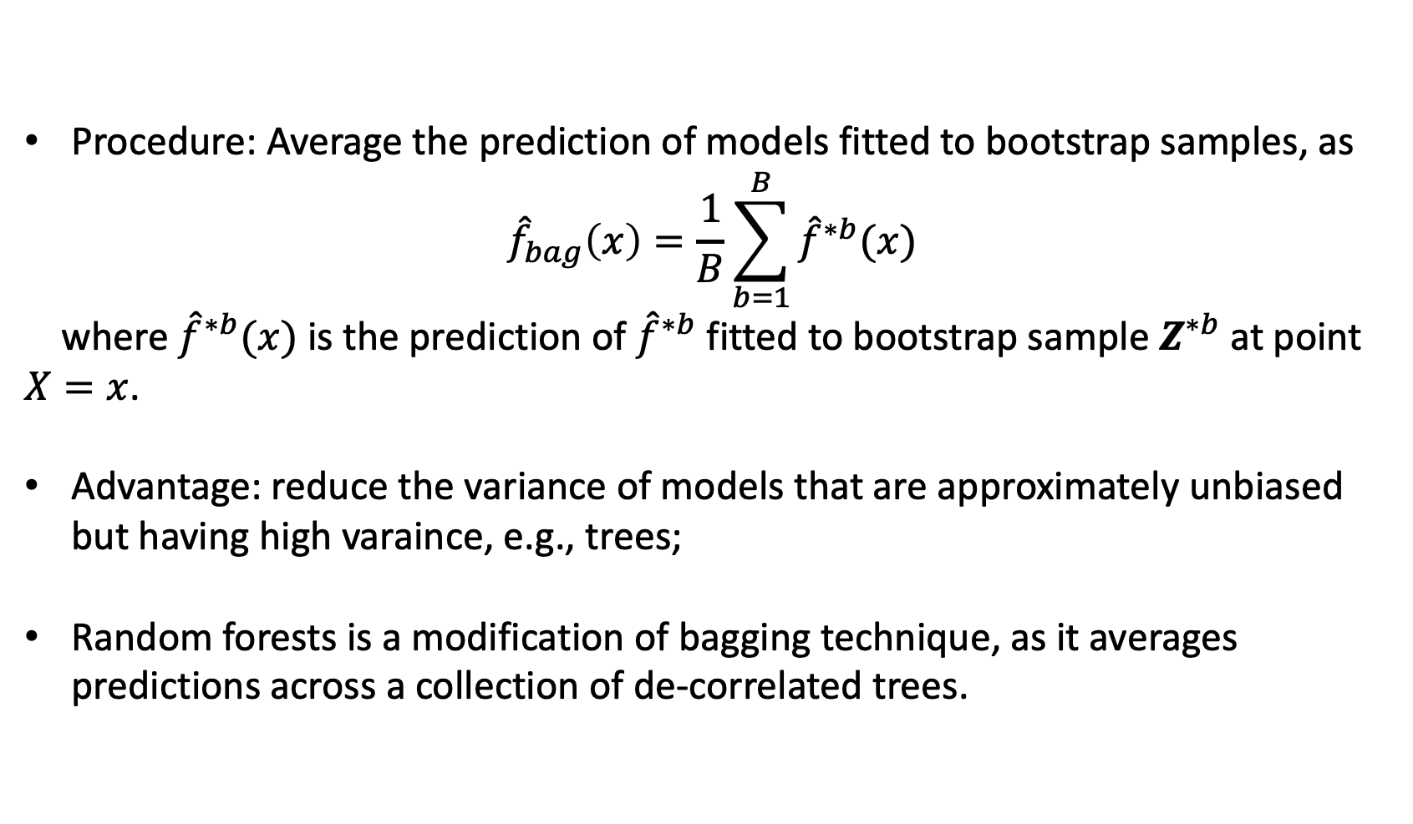
Bagging (bootstrap aggregation)
Procedure: Average the prediction of models fitted to bootstrap samples, as
$${\hat{f}}_{bag}\left(x\right)=\frac{1}{B}\sum_{b=1}^{B}{{\hat{f}}^{∗b}(x)}$$
where ${\hat{f}}^{∗b}(x)$ is the prediction of ${\hat{f}}^{∗b}$ fitted to bootstrap sample $Z^{∗b}$ at point $X=x$.
Advantage: reduce the variance of models that are approximately unbiased but having high varaince, e.g., trees;
Random forests is a modification of bagging technique, as it averages predictions across a collection of de-correlated trees.

Slide 3
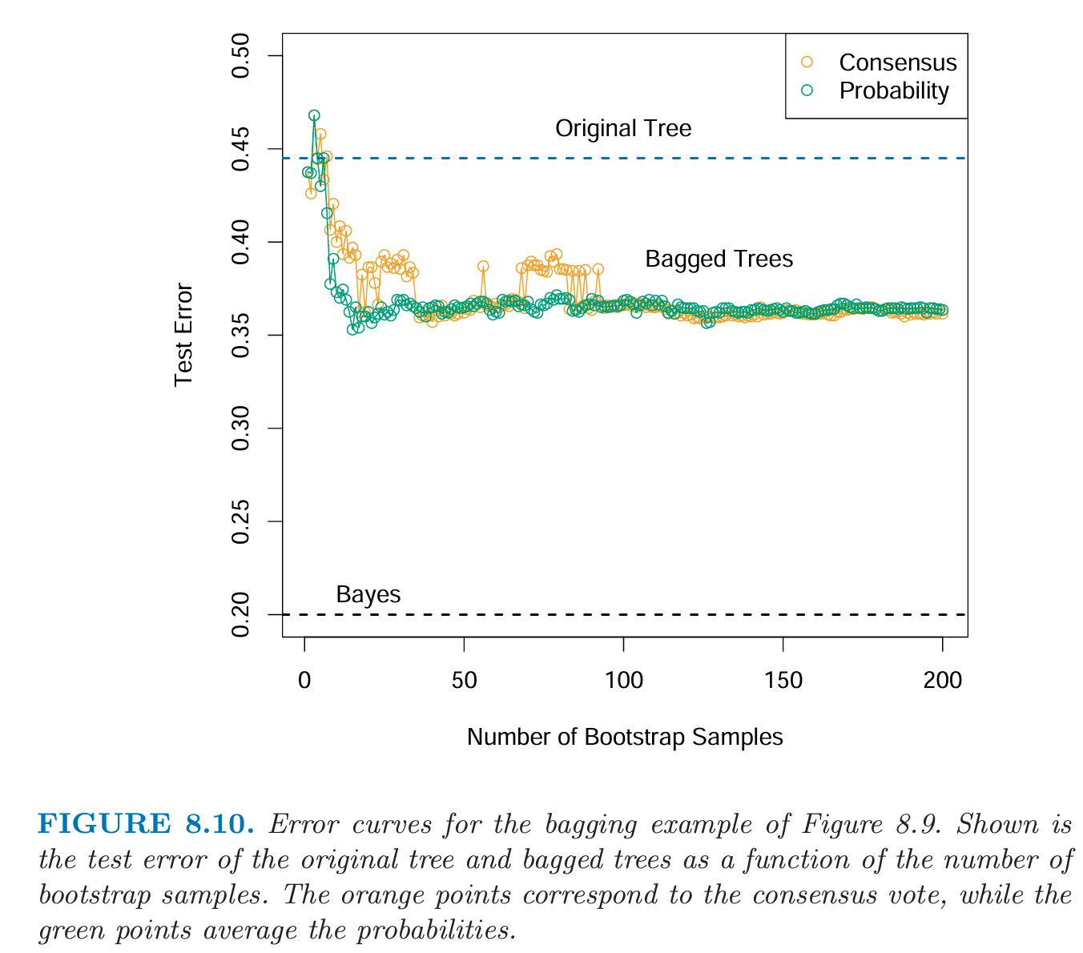
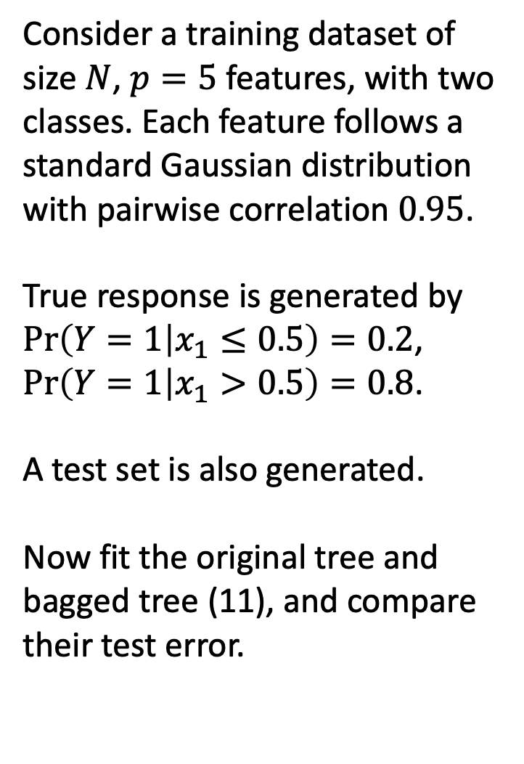
A simulation example (ESL P.283)
Consider a training dataset of size $N$, $p=5$ features, with two classes. Each feature follows a standard Gaussian distribution with pairwise correlation $0.95$.
True response is generated by $\operatorname{Pr}\left(Y=1 | x_{1}≤0.5\right)=0.2$, $\operatorname{Pr}\left(Y=1 | x_{1}>0.5\right)=0.8$.
A test set is also generated.
Now fit the original tree and bagged tree (11), and compare their test error.

Slide 4
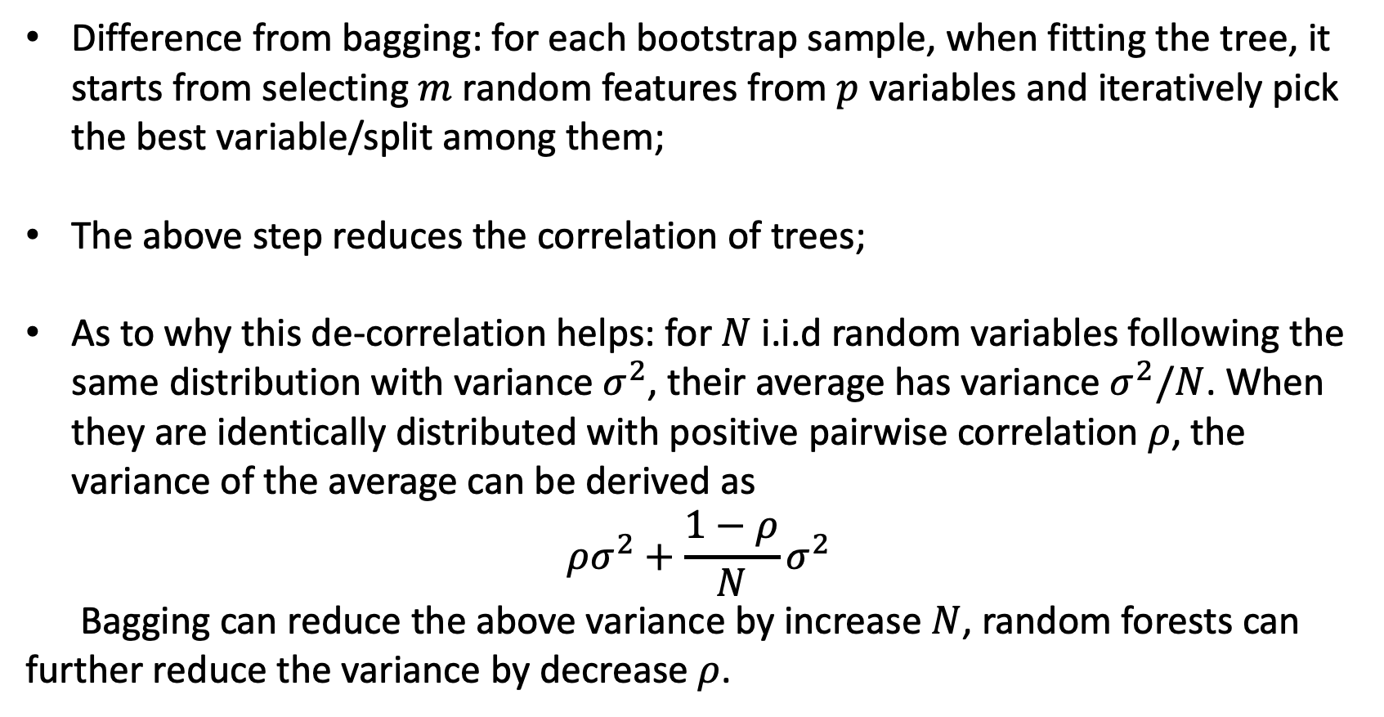
Random forests
Difference from bagging: for each bootstrap sample, when fitting the tree, it starts from selecting $m$ random features from $p$ variables and iteratively pick the best variable/split among them;
The above step reduces the correlation of trees;
As to why this de-correlation helps: for $N$ i.i.d random variables following the same distribution with variance $σ^{2}$, their average has variance $σ^{2}/N$. When they are identically distributed with positive pairwise correlation $ρ$, the variance of the average can be derived as
$$ρσ^{2}+\frac{1−ρ}{N}σ^{2}$$
Bagging can reduce the above variance by increase $N$, random forests can further reduce the variance by decrease $ρ$.

Slide 5
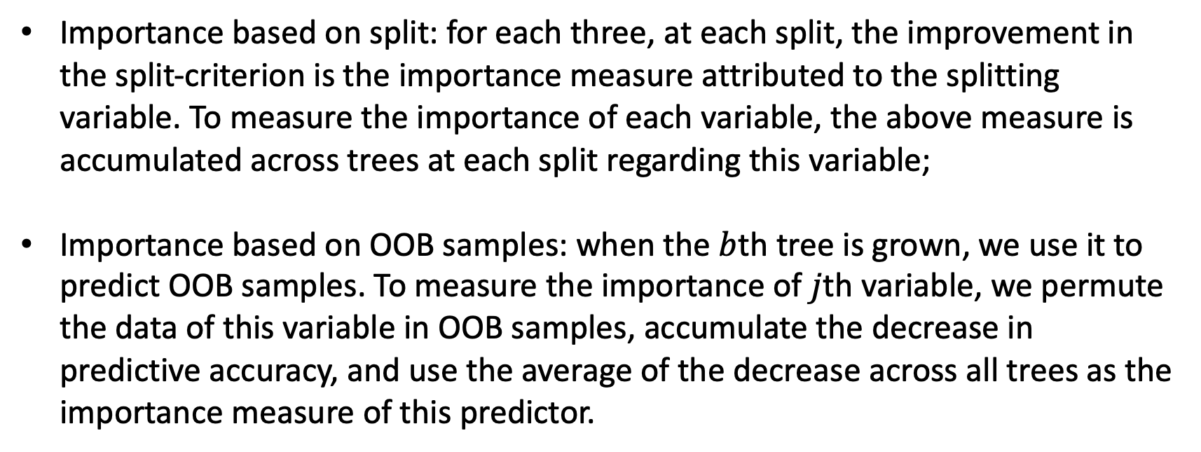
Random forests – feature importance
Importance based on split: for each three, at each split, the improvement in the split-criterion is the importance measure attributed to the splitting variable. To measure the importance of each variable, the above measure is accumulated across trees at each split regarding this variable;
Importance based on OOB samples: when the $b$th tree is grown, we use it to predict OOB samples. To measure the importance of $j$th variable, we permute the data of this variable in OOB samples, accumulate the decrease in predictive accuracy, and use the average of the decrease across all trees as the importance measure of this predictor.

Slide 6
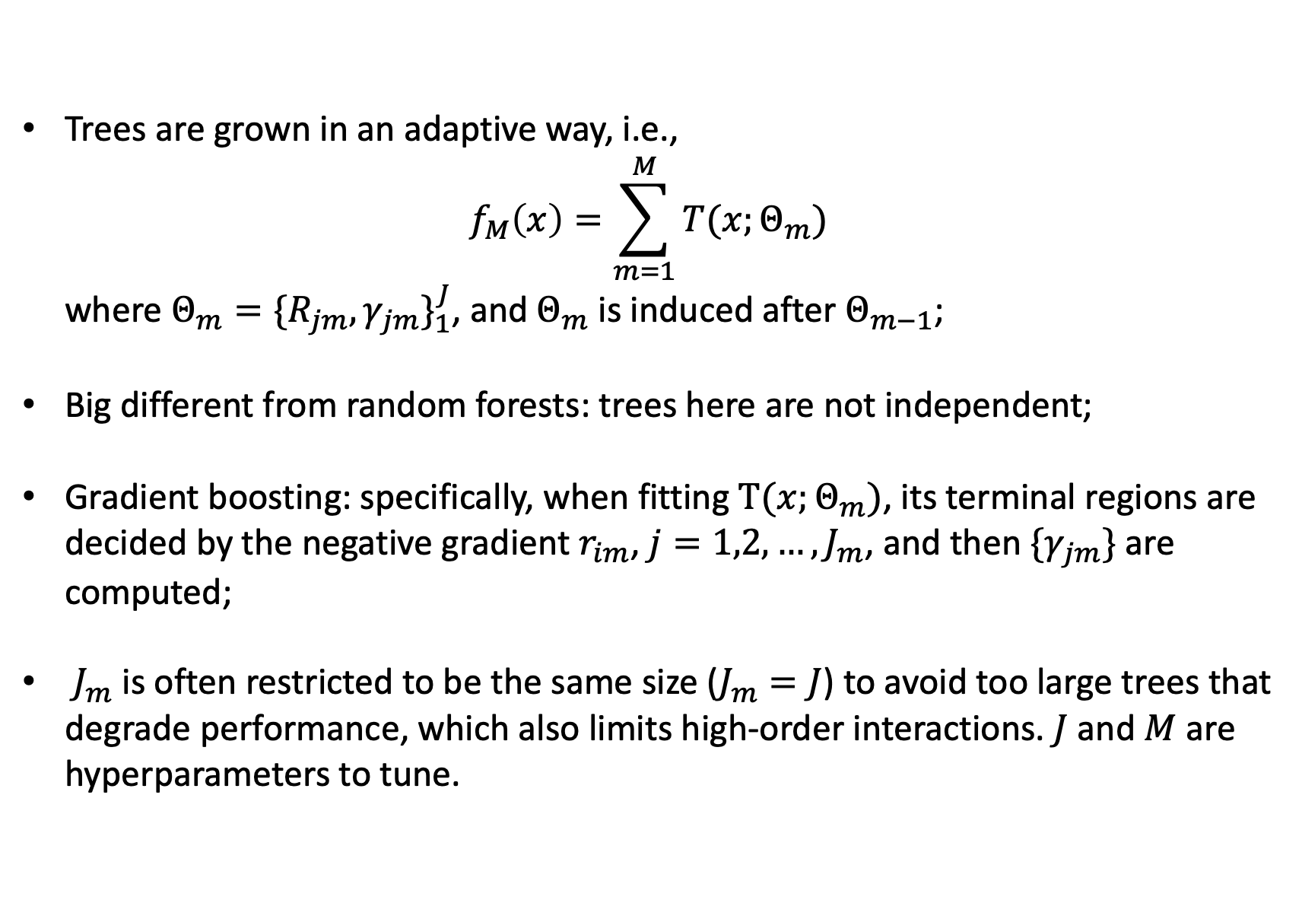
Boosting
Trees are grown in an adaptive way, i.e.,
$$f_{M}\left(x\right)=\sum_{m=1}^{M}{T(x;Θ_{m})}$$
where $Θ_{m}={\{R_{jm},γ_{jm}\}}_{1}^{J}$, and $Θ_{m}$ is induced after $Θ_{m−1}$;
Big different from random forests: trees here are not independent;
Gradient boosting: specifically, when fitting $T(x;Θ_{m})$, its terminal regions are decided by the negative gradient $r_{im}$, $j=1,2,…,J_{m}$, and then $\{γ_{jm}\}$ are computed;
$J_{m}$ is often restricted to be the same size ($J_{m}=J$) to avoid too large trees that degrade performance, which also limits high-order interactions. $J$ and $M$ are hyperparameters to tune.

Slide 7
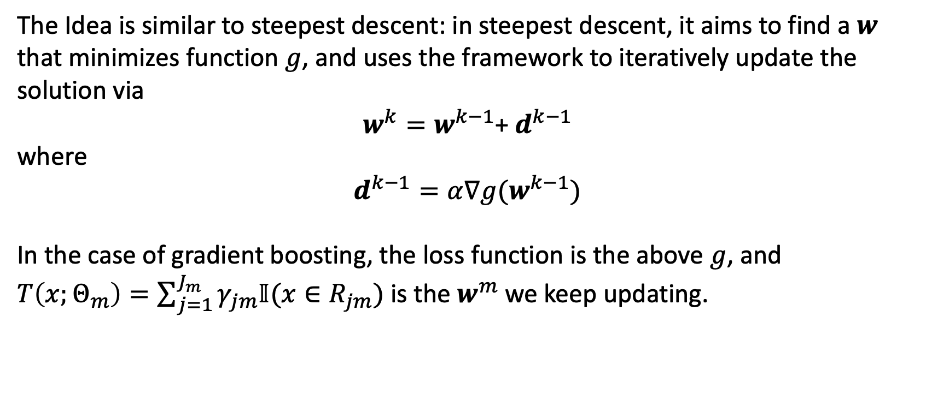
Gradient Boosting
The Idea is similar to steepest descent: in steepest descent, it aims to find a $w$ that minimizes function $g$, and uses the framework to iteratively update the solution via
$w^{k}=w^{k−1}$+ $d^{k−1}$
where
$$d^{k−1}=α∇g(w^{k−1})$$
In the case of gradient boosting, the loss function is the above $g$, and $T\left(x;Θ_{m}\right)=\sum_{j=1}^{J_{m}}{γ_{jm}𝕀(x∈R_{jm})}$ is the $w^{m}$ we keep updating.

