Slide 1
Review

Slide 2
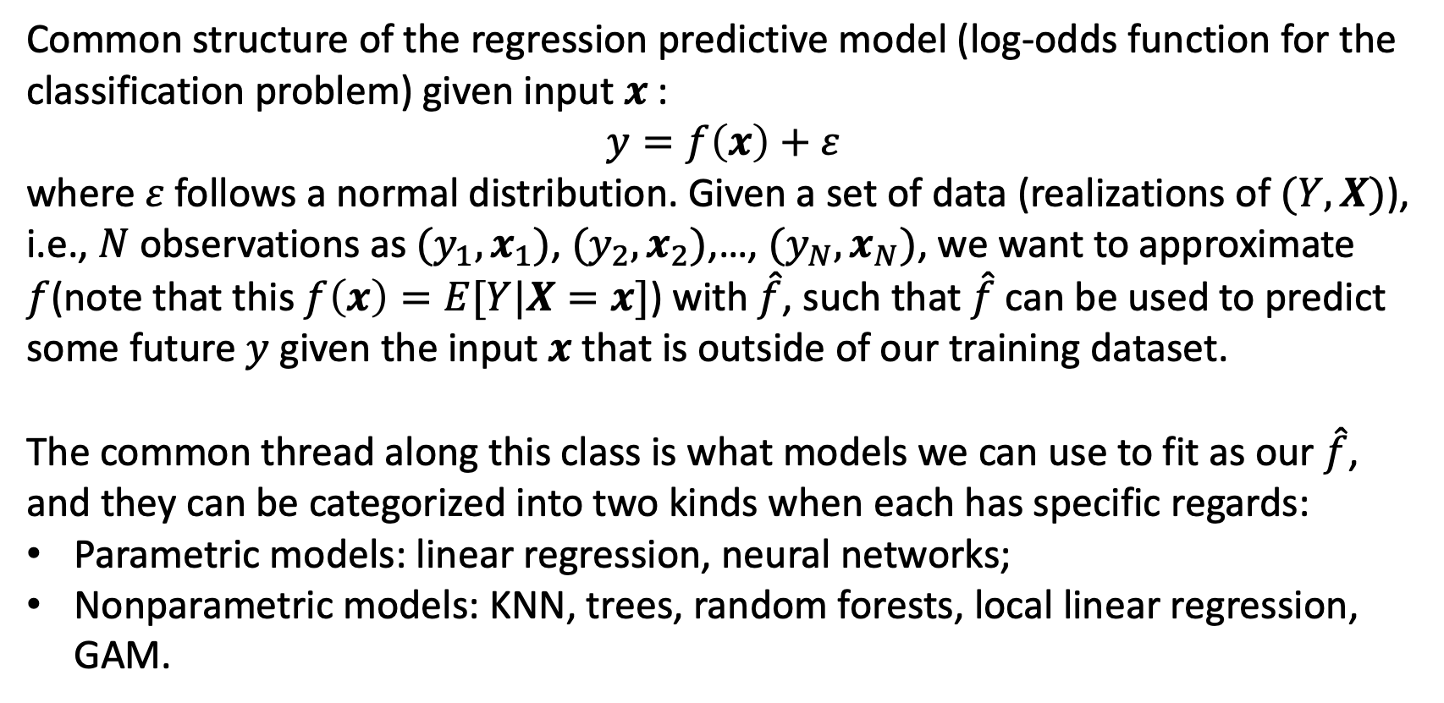
Some high-level reviews
Common structure of the regression predictive model (log-odds function for the classification problem) given input $x$:
$$y=f\left(x\right)+ε$$
where $ε$ follows a normal distribution. Given a set of data (realizations of $(Y,X)$), i.e., $N$ observations as $(y_{1},x_{1})$, $(y_{2},x_{2})$,…, $(y_{N},x_{N})$, we want to approximate $f$(note that this $f\left(x\right)=E[Y|X=x]$) with $\hat{f}$, such that $\hat{f}$ can be used to predict some future $y$ given the input $x$ that is outside of our training dataset.
The common thread along this class is what models we can use to fit as our $\hat{f}$, and they can be categorized into two kinds when each has specific regards:
Parametric models: linear regression, neural networks;
Nonparametric models: KNN, trees, random forests, local linear regression, GAM.

Slide 3
Some high-level reviews
Concepts
Analytical tools for model evaluation
Computational tools
MLE;
Shrinkage/Penalty;
Bias/variance tradeoff;
Mallow’s Cp, AIC, BIC;
Cross-validation: to decide which model is the best (cross-validation MSE is the criterion;
Bootstrap: to estimate SEs and CIs on the parameters;
Visualization tools to understand effects of predictors
ALE/PD plot;

Slide 4
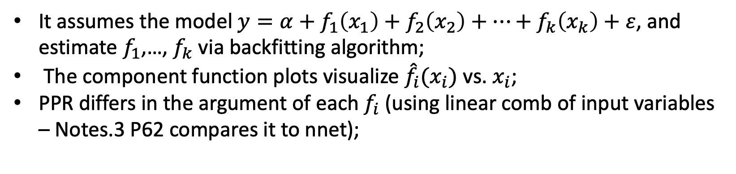
KNN
The complexity of KNN is inversely related to its $K$;
Local weighting
As nonparametric as KNN, but thinks about weighting of neighbors;
GAM
It assumes the model $y=α+f_{1}\left(x_{1}\right)+f_{2}\left(x_{2}\right)+…+f_{k}\left(x_{k}\right)+ε$, and estimate $f_{1}$,…, $f_{k}$ via backfitting algorithm;
The component function plots visualize ${\hat{f}}_{i}(x_{i})$ vs. $x_{i}$;
PPR differs in the argument of each $f_{i}$ (using linear comb of input variables – Notes.3 P62 compares it to nnet);

Slide 5
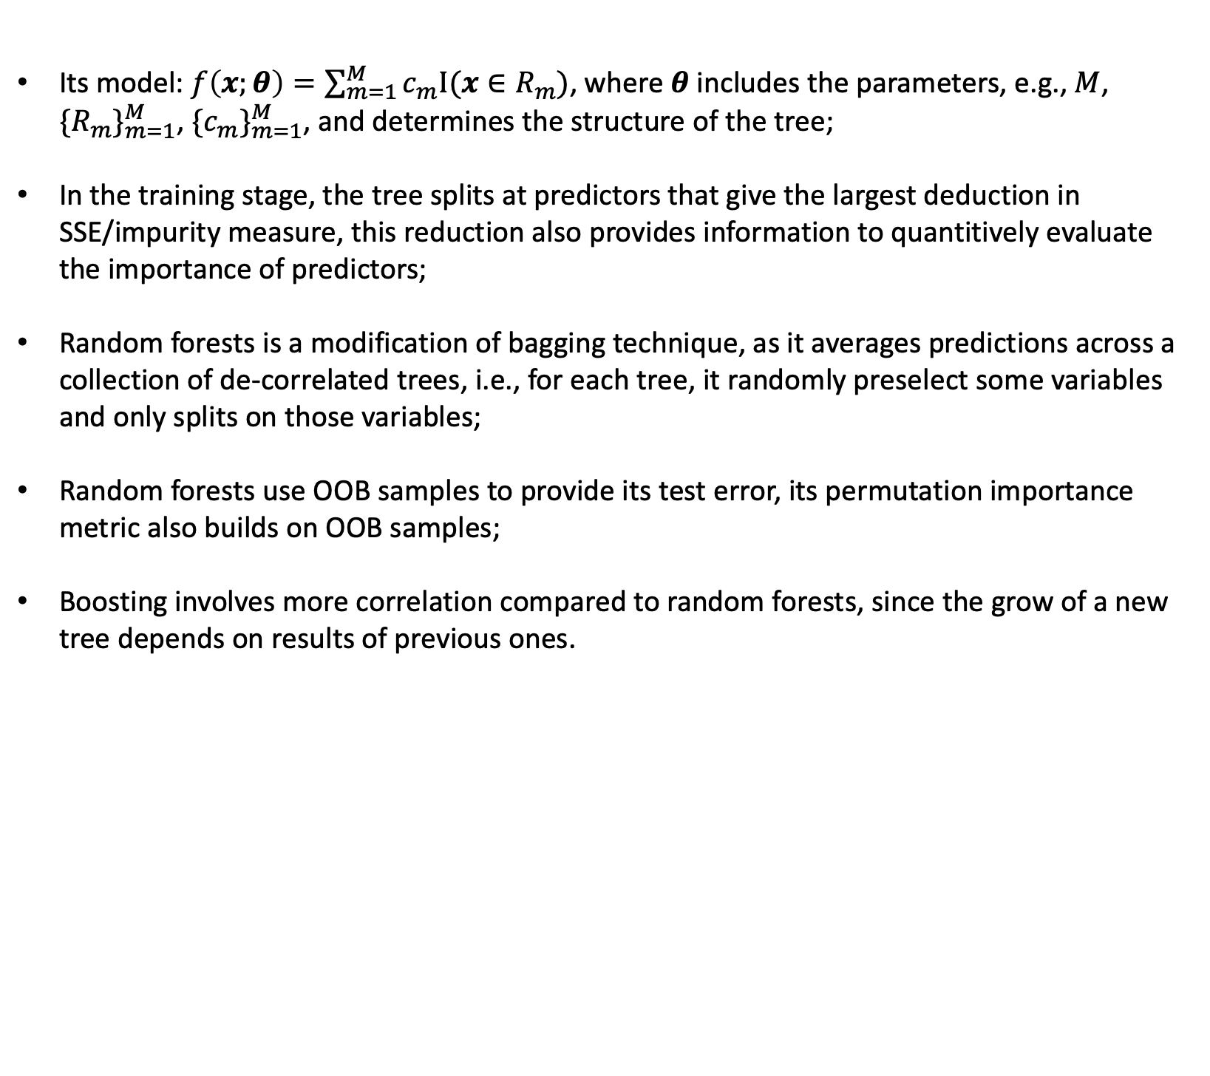
Trees and its associated models
Its model: $f\left(x;θ\right)=\sum_{m=1}^{M}{c_{m}Ι(x∈R_{m})}$, where $θ$ includes the parameters, e.g., $M$, ${\{R_{m}\}}_{m=1}^{M}$, ${\{c_{m}\}}_{m=1}^{M}$, and determines the structure of the tree;
In the training stage, the tree splits at predictors that give the largest deduction in SSE/impurity measure, this reduction also provides information to quantitively evaluate the importance of predictors;
Random forests is a modification of bagging technique, as it averages predictions across a collection of de-correlated trees, i.e., for each tree, it randomly preselect some variables and only splits on those variables;
Random forests use OOB samples to provide its test error, its permutation importance metric also builds on OOB samples;
Boosting involves more correlation compared to random forests, since the grow of a new tree depends on results of previous ones.

