Slide 1
KNN and GAM

Slide 2
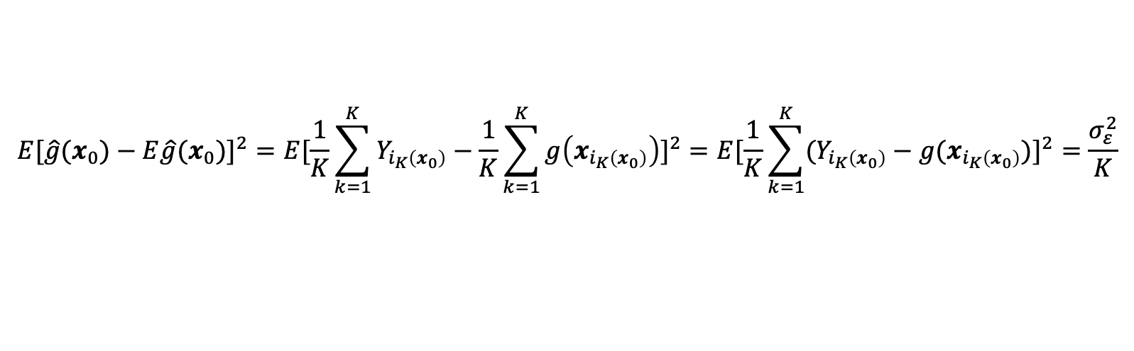
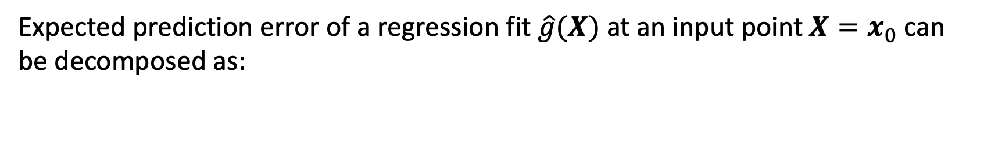
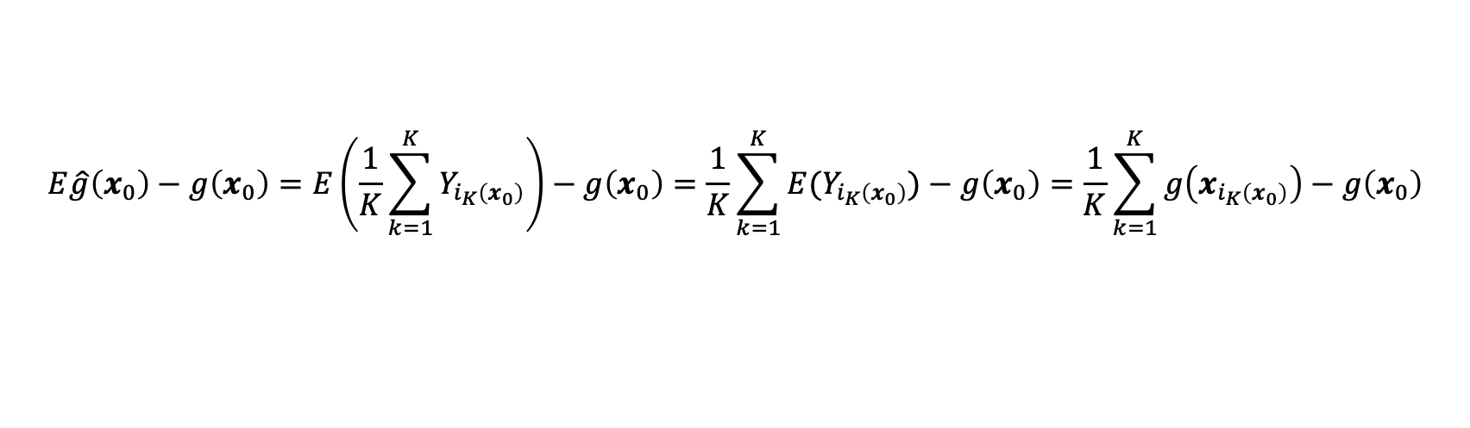


Bias-Variance decomposition
Expected prediction error of a regression fit $\hat{g}(X)$ at an input point $X=x_{0}$ can be decomposed as:
$$E{[(Y−\hat{g}(x_{0}))}^{2}\left|X=x_{0}\right]=σ_{ε}^{2}+{[E\hat{g}(x_{0})−g\left(x_{0}\right)]}^{2}+{E[\hat{g}(x_{0})−E\hat{g}(x_{0})]}^{2}$$
$${Bias}^{2}(\hat{g}(x_{0}))$$
$$Var(\hat{g}(x_{0}))$$
In KNN (notation being consistent with slide #11):
$$E\hat{g}\left(x_{0}\right)−g\left(x_{0}\right)=E\left(\frac{1}{K}\sum_{k=1}^{K}{Y_{i_{K}\left(x_{0}\right)}}\right)−g\left(x_{0}\right)=\frac{1}{K}\sum_{k=1}^{K}{{E(Y}_{i_{K}\left(x_{0}\right)})}−g\left(x_{0}\right)=\frac{1}{K}\sum_{k=1}^{K}{g\left(x_{i_{K}\left(x_{0}\right)}\right)−g\left(x_{0}\right)}$$
$${E[\hat{g}(x_{0})−E\hat{g}(x_{0})]}^{2}={E[\frac{1}{K}\sum_{k=1}^{K}{Y_{i_{K}\left(x_{0}\right)}}−\frac{1}{K}\sum_{k=1}^{K}{g\left(x_{i_{K}\left(x_{0}\right)}\right)}]}^{2}={E[\frac{1}{K}\sum_{k=1}^{K}{{(Y}_{i_{K}\left(x_{0}\right)}}−g(x_{i_{K}\left(x_{0}\right)})]}^{2}=\frac{σ_{ε}^{2}}{K}$$

Slide 3
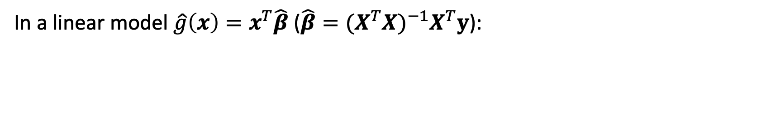

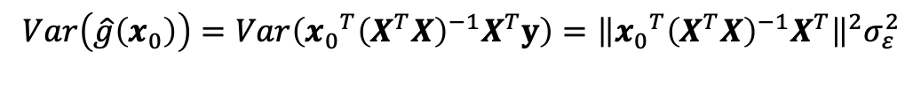

Bias-Variance decomposition
In a linear model $\hat{g}\left(x\right)=x^{T}\hat{β}$ ($\hat{β}={(X^{T}X)}^{−1}X^{T}y$):
$$E\hat{g}\left(x_{0}\right)−g\left(x_{0}\right)=E\left(\hat{g}\left(x_{0}\right)\right)−g\left(x_{0}\right)$$
$$Var\left(\hat{g}\left(x_{0}\right)\right)=Var\left({x_{0}}^{T}{\left(X^{T}X\right)}^{−1}X^{T}y\right)={\left\|{x_{0}}^{T}{\left(X^{T}X\right)}^{−1}X^{T}\right\|}^{2}σ_{ε}^{2}$$
$$Var\left(AX\right)=A(Var\left(X\right))A^{T}$$

Slide 4
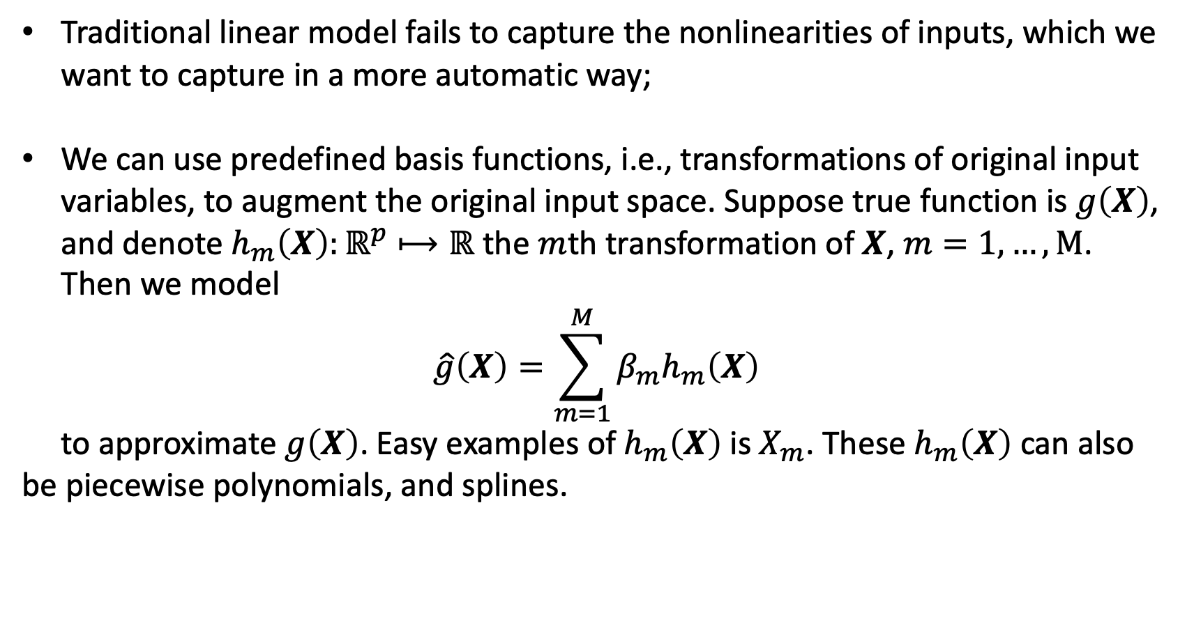
Generalized additive models
Traditional linear model fails to capture the nonlinearities of inputs, which we want to capture in a more automatic way;
We can use predefined basis functions, i.e., transformations of original input variables, to augment the original input space. Suppose true function is $g\left(X\right)$, and denote $h_{m}\left(X\right):ℝ^{p}⟼ℝ$ the $m$th transformation of $X$, $m=1,…,M$. Then we model
$$\hat{g}\left(X\right)=\sum_{m=1}^{M}{{β_{m}h}_{m}\left(X\right)}$$
to approximate $g\left(X\right)$. Easy examples of $h_{m}\left(X\right)$is $X_{m}$. These $h_{m}\left(X\right)$ can also be piecewise polynomials, and splines.

Slide 5
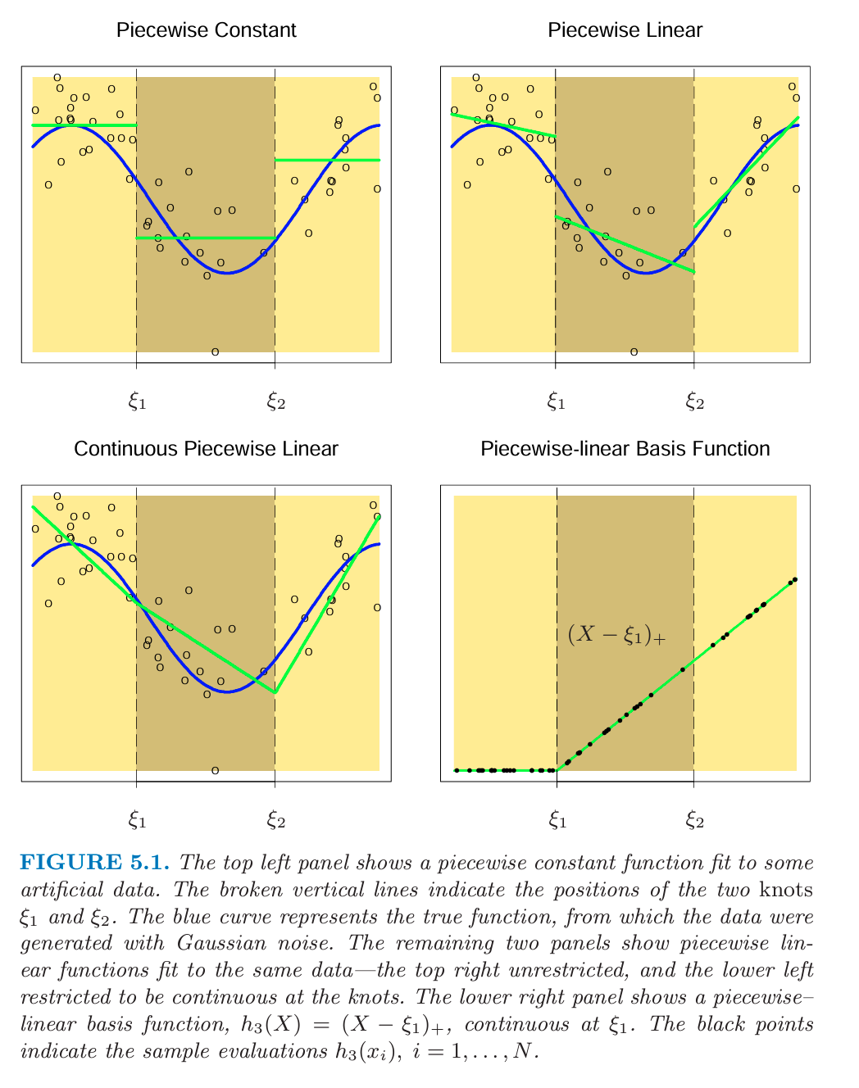




Some examples of splines
The basis functions of this piecewise constant (order-1 spline) are
$$h_{1}\left(X\right)=𝕀(X<ξ_{1})$$
$$h_{2}\left(X\right)=𝕀(ξ_{1}≤X<ξ_{2})$$
$$h_{3}\left(X\right)=𝕀(ξ_{2}≤X)$$
$${\hat{β}}_{m}={\overline{Y}}_{m}$$
knots

Slide 6



Some examples of splines
Compared to last one, we add
$$h_{4}\left(X\right)=𝕀(X<ξ_{1})X$$
$h_{5}\left(X\right)=𝕀(ξ_{1}≤X<ξ_{2})$ $X$
$$h_{6}\left(X\right)=𝕀(ξ_{2}≤X)X$$

Slide 7


Some examples of splines
Compared to last one, we add constrains to enforce continuity at knots
$$\hat{g}\left(ξ_{1}^{−}\right)=\hat{g}\left(ξ_{1}^{+}\right)$$
$$\hat{g}\left(ξ_{2}^{−}\right)=\hat{g}\left(ξ_{2}^{+}\right)$$

Slide 8




Some examples of splines
The previous basis functions can also be written as:
$$h_{1}\left(X\right)=1$$
$$h_{2}\left(X\right)=X$$
$$h_{3}\left(X\right)={(X−ξ_{1})}_{+}$$
$$h_{4}\left(X\right)={(X−ξ_{2})}_{+}$$

Slide 9
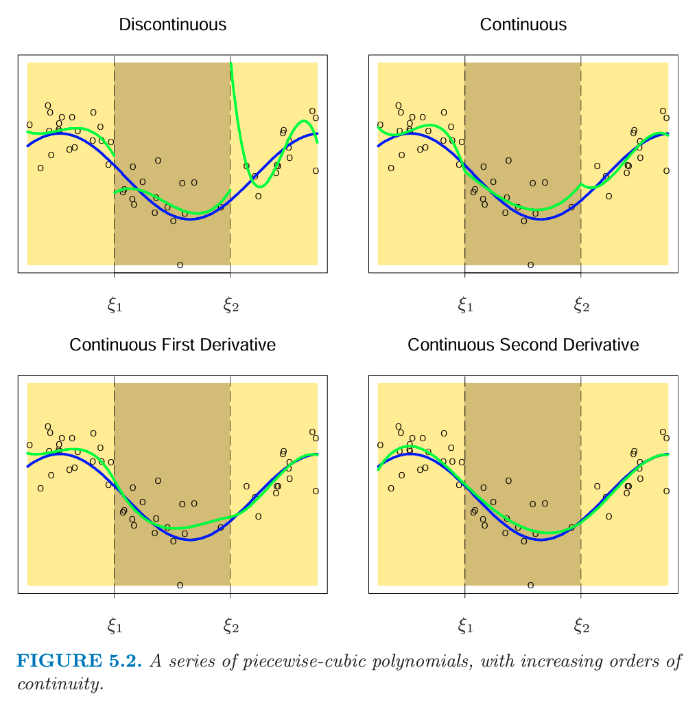






Some examples of splines
The basis functions of a cub spine (order-1 spline) could be
$$h_{1}\left(X\right)=1$$
$$h_{2}\left(X\right)=X$$
$$h_{3}\left(X\right)=X^{2}$$
$$h_{4}\left(X\right)=X^{3}$$
$$h_{5}\left(X\right)={(X−ξ_{1})}_{+}^{3}$$
$$h_{6}\left(X\right)={(X−ξ_{2})}_{+}^{3}$$

