Slide 1
IILM UNIVERSITY
School of Computer Science and Engineering
SUMMER INTERNSHIP • COURSE COMPLETION PRESENTATION
Introduction to Modern AI
A Cisco Networking Academy course, offered by IILM University
AYUSH VERMA
Roll No. 2410030722 | B.Tech Computer Science & Engineering

Slide 2



ABOUT THE LEARNING PROGRAM
A Cisco Networking Academy Course
Introduction to Modern AI is a self-paced course offered by IILM University and delivered through the Cisco Networking Academy — built to give students a foundational, applied understanding of modern AI concepts.
IILM University
Cisco Networking Academy
Purpose of the Course
Host institute for this B.Tech programme, providing access to industry-aligned learning platforms.
Cisco's global skills platform, delivering self-paced courses with interactive checkpoints and a verified certificate.
To build foundational AI literacy — covering ML, computer vision, translation, chatbots and generative AI — with no prior technical background assumed.
Introduction to Modern AI • Ayush Verma
02

Slide 3


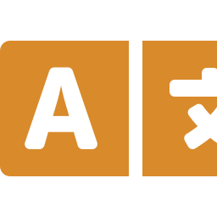



COURSE OBJECTIVES
What This Course Set Out to Teach
AI, ML & Models
Computer Vision
Machine Translation
Define the three terms and how they relate to one another.
Describe object detection, segmentation, similarity search and OCR.
Explain how word order, context and meaning interact.
Chatbot Behaviour
Effective Prompting
Generative & Multimodal AI
Understand response generation, hallucination and memory limits.
Apply techniques for writing and verifying chatbot output.
Explain image generation and combined image-text prompting.
Introduction to Modern AI • Ayush Verma
03

Slide 4
FOUNDATIONS
Artificial Intelligence, Machine Learning & Models
ARTIFICIAL INTELLIGENCE
The broad goal: systems that behave intelligently
MACHINE LEARNING
The approach: learning patterns from data, not fixed rules
MODELS
The trained artefact that turns an input into a prediction
The course explored these ideas conceptually — it did not involve training a model from scratch.
Introduction to Modern AI • Ayush Verma
04

Slide 5




SEEING WITH AI
Computer Vision
Object Detection
Similarity Search
Locates and labels objects within a scene.
Finds visually related images in a collection.
e.g. retail shelf monitoring
e.g. visual product search
Image Segmentation
Optical Character
Recognition (OCR)
Labels every pixel by region or object class.
Converts pictured text into machine-readable data.
e.g. medical image analysis
e.g. document digitisation
Introduction to Modern AI • Ayush Verma
05

Slide 6
UNDERSTANDING LANGUAGE
Machine Translation
Words
→
Word Order
→
Context
→
Meaning
Individual tokens
Grammar sequence
Resolves ambiguity
What must be kept
Why Context Matters
The word “bank” can mean a riverbank or a financial institution — only the surrounding sentence tells a translation system which meaning to preserve.
Introduction to Modern AI • Ayush Verma
06

Slide 7

CONVERSATIONAL AI
Chatbots: Capabilities & Limitations
CAPABILITIES
LIMITATIONS
• Predicts the most likely next word to form fluent responses
• Can hallucinate — stating confident but incorrect claims
• Answers questions, drafts and rewrites content on demand
• Limited working memory across long or separate sessions
• Adapts across a wide range of everyday and professional tasks
• Reliability varies by chatbot and by task difficulty
• Improves with clear, specific, well-structured prompts
• Output should be tested and verified before it is relied on
Introduction to Modern AI • Ayush Verma
07

Slide 8





USING AI RESPONSIBLY
Ways to Use a Chatbot Effectively
EXPAND
SYNTHESIZE
TRANSFORM
EVALUATE
CONVERSE
Answer questions
Summarize
Translate
Fact-check
Mock interviews
Generate ideas
Create lists
Rewrite & revise
Grade / score
Collaboration
Introduction to Modern AI • Ayush Verma
08

Slide 9



WORKING WITH AI
Prompting, Tools & Multimodal AI
Prompt
→
AI Output
→
Review
→
Verify
→
Refine
If the result is unclear, loop back and refine the prompt.
Image Generation
Personal Assistant Use
Multimodal Prompting
Producing new images from a written description.
Everyday help — drafting, planning, organising.
Combining an image with text in a single prompt.
This reflects responsible, AI-assisted usage explored in the course — not a system I built.
Introduction to Modern AI • Ayush Verma
09

Slide 10

LOOKING AHEAD
Generative AI & Skill Stacking
Generative & Multimodal AI
Skill Stacking
Generative AI produces new content — text, images, audio or code — rather than only analysing existing content. Multimodal prompting extends this further: combining an image and text in one prompt, and receiving a response that draws on both.
Combining AI literacy with an existing domain skill — writing, design, engineering, analysis — produces more value than either skill alone.
AI as an amplifier — not a replacement — for what you already know.
Chatbots are one text-based application of this broader generative category.
Introduction to Modern AI • Ayush Verma
10

Slide 11






WHAT I GAINED
Learning Outcomes
Foundational AI literacy across core Modern AI concepts
Understanding of how ML and trained models relate to AI
Awareness of computer vision tasks and real-world uses
Understanding of the challenges in machine translation
Insight into chatbot behaviour, memory and hallucination
Practical prompt-writing and output-verification habits
Awareness of generative and multimodal AI capabilities
A broader view of AI-assisted, skill-stacked workflows
Introduction to Modern AI • Ayush Verma
11

Slide 12
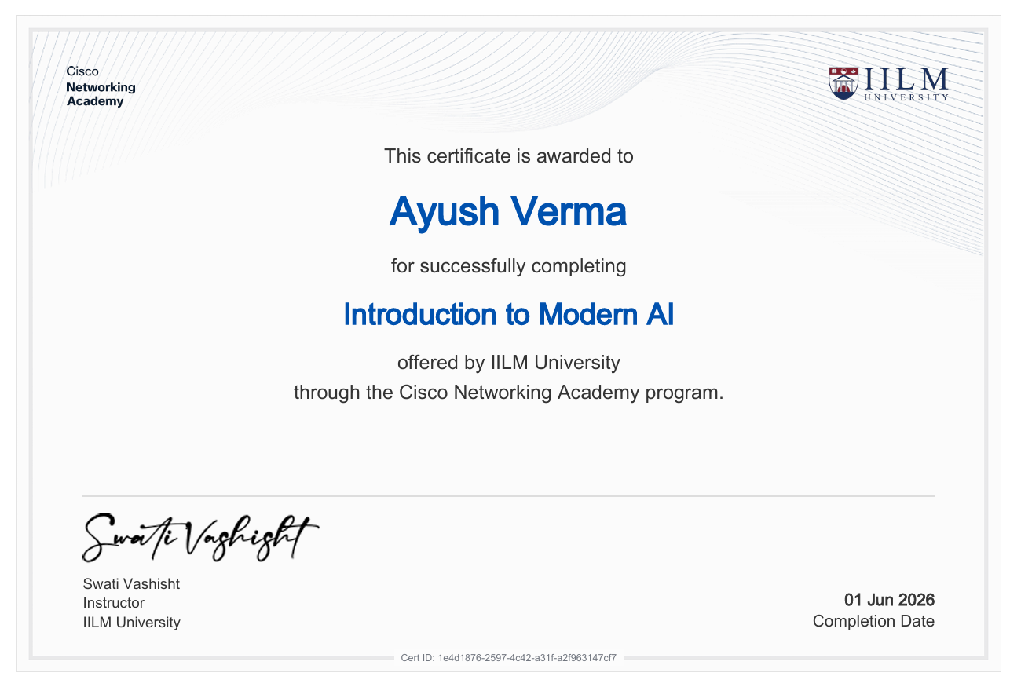
CONCLUSION
A Strong Foundation in Modern AI
CERTIFICATE OF COMPLETION
This course built a working, applied understanding of AI, ML, computer vision, translation, chatbots and generative AI — without requiring a prior technical background.
“Treat AI tools as capable but fallible assistants — review, verify, and refine, rather than accept automatically.”
THANK YOU
Recipient:
Ayush Verma
Completion Date:
01 June 2026
Introduction to Modern AI | Cisco Networking Academy Program
Certificate ID:
1e4d1876-2597-4c42-a31f-a2f963147cf7
Introduction to Modern AI • Ayush Verma
12

