Slide 1
AUTONOMOUS BUILDING ENERGY MANAGEMENT
Echo-Loop: A Building That Runs Itself
Autonomous closed-loop HVAC control using EnergyPlus, MCP and a local open-source LLM.
EnergyPlus supplies the physics. A local open-source LLM supplies the judgement. The Model Context Protocol carries every reading and every command between them — while the simulation is still running.
−8.5%
336 / 336
100%
HVAC Energy
Saved over a summer week
Agent Turns
Zero failures
Open Source
One laptop — no cloud, no API keys
Problem Statement ID 1 · Theme Clean & Green Technology
PS Category Software · Student Ayush Yadav · Student ID 23BAI10006
Repository github.com/ayushYadav1107/Eco_loop
Live demo eco-loop-agents.streamlit.app
ENERGYPLUS
→
MCP TOOLS
→
LOCAL LLM
→
SAFETY GATE
→
LIVE ACTUATORS
one closed loop, every 60 simulated minutes
ENERGYPLUS 26.1
PYENERGYPLUS
FASTMCP
MODEL CONTEXT PROTOCOL
OLLAMA + LLAMA 3.2 3B
PYDANTIC
STREAMLIT
Echo-Loop
1

Slide 2
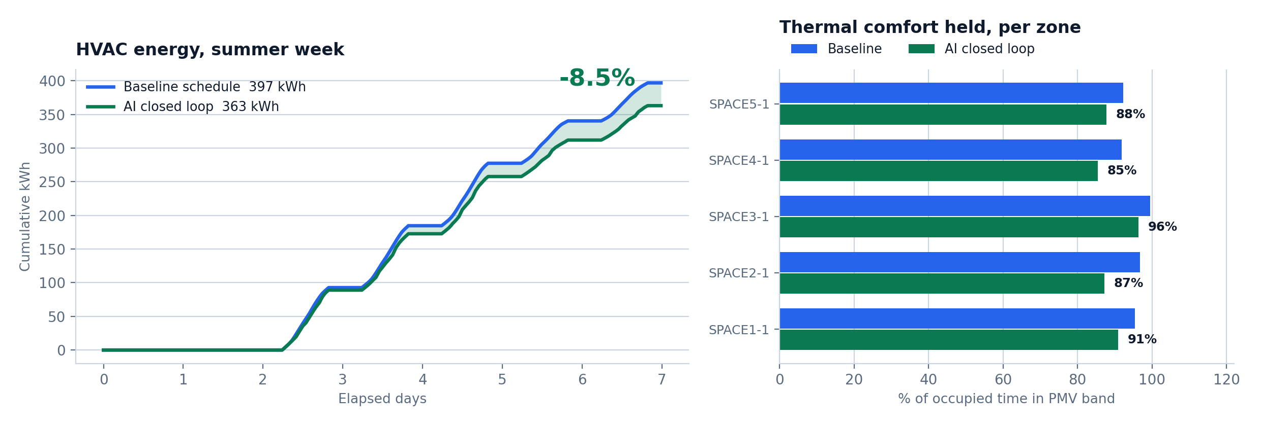
PROPOSED SOLUTION & INNOVATION
Traditional BMS follow rigid clock schedules.
Echo-Loop turns the building into a self-correcting agent.
How It Works
EnergyPlus runs in-process; sensors read every zone timestep
Every 60 simulated minutes the state reaches a local LLM via six MCP tools
The model weighs comfort, demand and grid carbon, then returns setpoints
Why It's Different
ONE LINE FROM A LIVE RUN
[ai 07-17 09:00] OAT=24.9C PMV=-1.02 kW=2.09
-> cool=24.8 heat=19.2 (llm, 1.3s)
Most LLM-and-simulation work rewrites the model file and re-runs it — it cannot react to a zone drifting out of comfort at 14:00 on day 3. Echo-Loop does.
Injected into the LIVE solver
No IDF rewrite, no restart.
Setpoints reach the actuator handles mid-solve.
Safety Boundary
MCP validates every command server-side.
Five gates; a rejected command never reaches the model.
Measured, Not Projected
PMV −0.43 → −0.02 while saving 8.5%.
Both runs are committed EnergyPlus output.
Echo-Loop
2

Slide 3
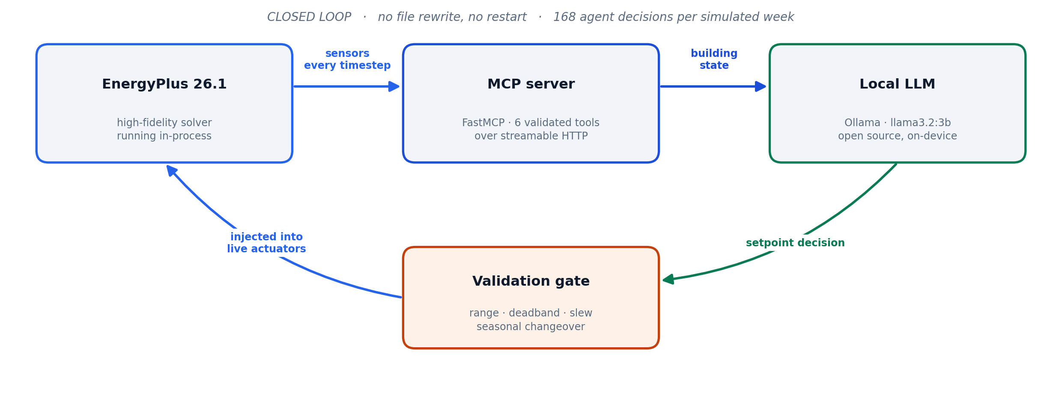
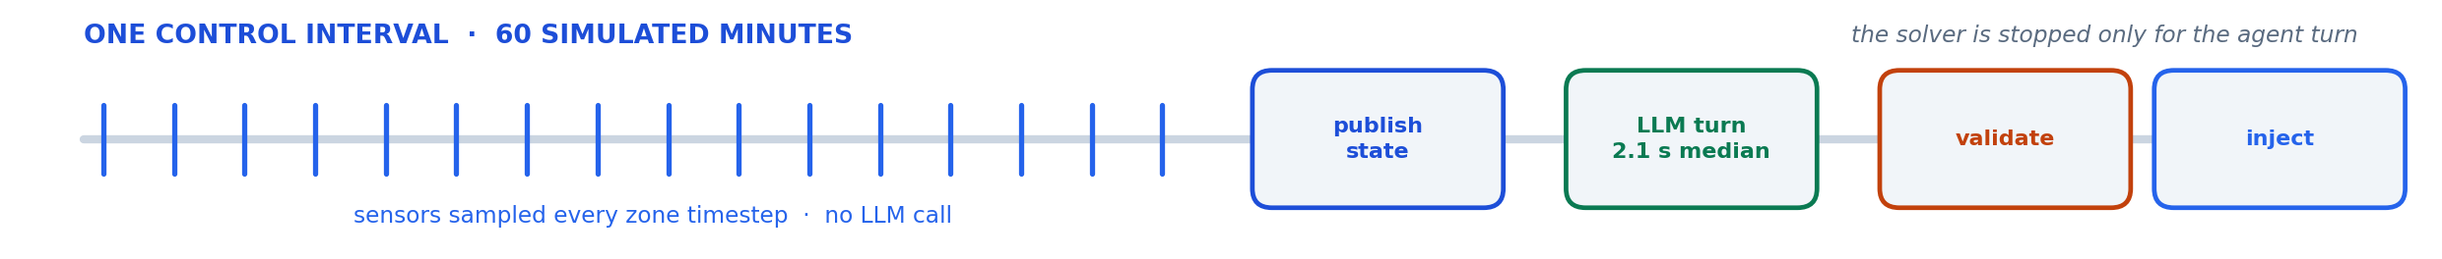
TECHNICAL APPROACH
The Closed Loop Architecture
Sample → Aggregate → LLM tool-calling turn → Validate gate → Inject into live actuators via the pyenergyplus C API
Echo-Loop
3

Slide 4
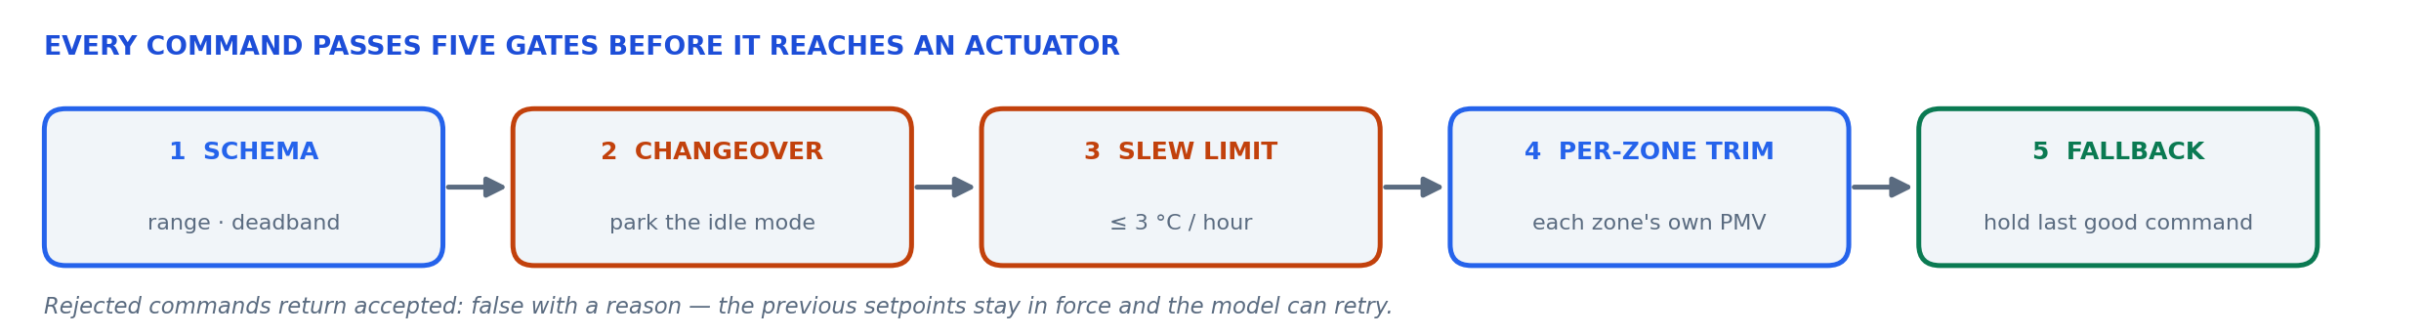
FEASIBILITY AND VIABILITY
Feasibility and Overcoming Constraints
336 / 336
−3.7%
2.1 s
Agent Turns
0 fallbacks · 0 timeouts · 0 errors
Winter Energy
Same loop, heating season
Median Latency
Fully on-device
Risks
Solutions
LLM latency inside a blocking simulation callback
A small model can move the wrong setpoint, or run heating against cooling
One setpoint pair cannot satisfy five differently-loaded zones
Hard per-turn deadline; on timeout the loop holds the last accepted command
Observations state the required direction — the model cannot invert physics
Seasonal changeover parks the idle setpoint; a per-zone trim corrects each zone
Echo-Loop
4

Slide 5
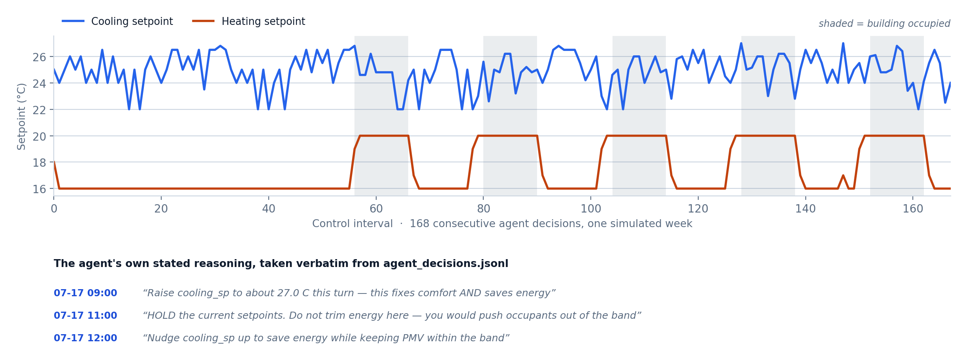
ARTIFACTS
Artifacts & References
Repository github.com/ayushYadav1107/Eco_loop Live demo eco-loop-agents.streamlit.app
Baseline and runtime-generated .idf models, agent_decisions.jsonl and per-timestep EnergyPlus results are all committed — a fresh clone reproduces every figure in this deck.
Simulation & Building Physics
168 setpoint decisions, one summer week
EnergyPlus Engineering Reference & EMS Application Guide
pyenergyplus Data Exchange API — get_variable_handle, set_actuator_value
ISO 7730:2005 & ASHRAE Standard 55 — PMV/PPD comfort model
Agent, Protocol & Inference
Model Context Protocol — modelcontextprotocol.io
FastMCP — gofastmcp.com
Meta Llama 3.2 served locally through Ollama — ollama.com
Every decision is logged with the model's own reason
outputs/ai/agent_decisions.jsonl — committed, one JSON record per control interval.
Echo-Loop
5

Slide 6
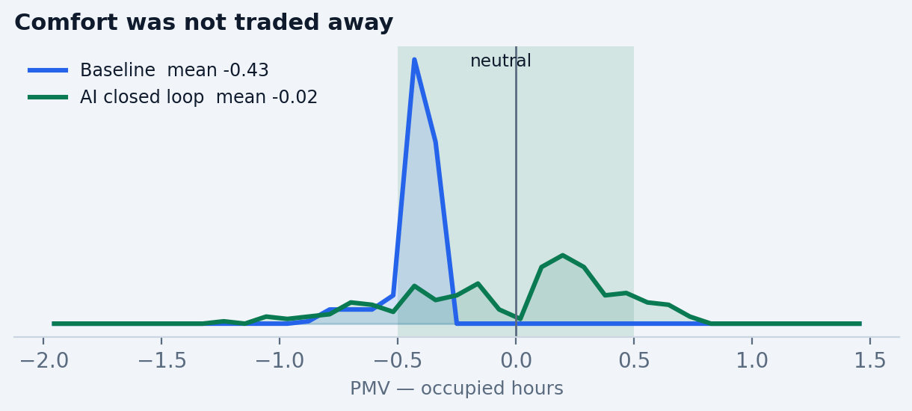
RESEARCH AND REFERENCES
Auditable, Not Anecdotal
The controller runs at temperature 0 — repeated runs return identical totals. Anyone can clone the repo and reproduce these exact figures.
python main.py prepare
python main.py run-baseline --start 07-15 --end 07-21
python main.py run-ai --start 07-15 --end 07-21
python main.py dashboard
# ~6 min end to end on a laptop — EnergyPlus 26.1 + Ollama,
# no cloud, no API key, no paid service anywhere in the loop
Four Commands. Full Reproduction.
prepare — stage and instrument the EnergyPlus model
run-baseline — the same building on its native schedule
run-ai — the closed loop, 168 agent decisions
dashboard — the savings comparison, side by side
Honest limitation
One setpoint pair drives five differently-loaded zones. Per zone the agent holds 85–96% of occupied time inside the PMV band; the stricter worst-zone metric is lower.
Per-zone setpoints are the next step — the actuator handles and per-zone PMV are already in place.
Stated in full in ARCHITECTURE.md §8 — nothing here is hidden.
Echo-Loop
6

