Slide 1
TITLE PAGE
A BUILDING THAT RUNS ITSELF
EnergyPlus supplies the physics. A local open-source LLM supplies the judgement. The Model Context Protocol carries every reading and every command between them — while the simulation is still running.
Problem Statement ID <<FILL IN>>
Problem Statement Title Eco-Loop Building Agents — autonomous closed-loop HVAC control using EnergyPlus, MCP and a local open-source LLM
Theme <<FILL IN>> · PS Category Software
Student Ayush Yadav
Student ID <<FILL IN>>
−8.5%
HVAC energy summer week
336/336
agent turns zero failures
TECH STACK
EnergyPlus 26.1 · pyenergyplus · FastMCP · Model Context Protocol · Ollama + Llama 3.2 3B · Pydantic · Streamlit
100% open source
One laptop — no cloud, no API keys, no per-query cost
Echo-Loop · 1

Slide 2
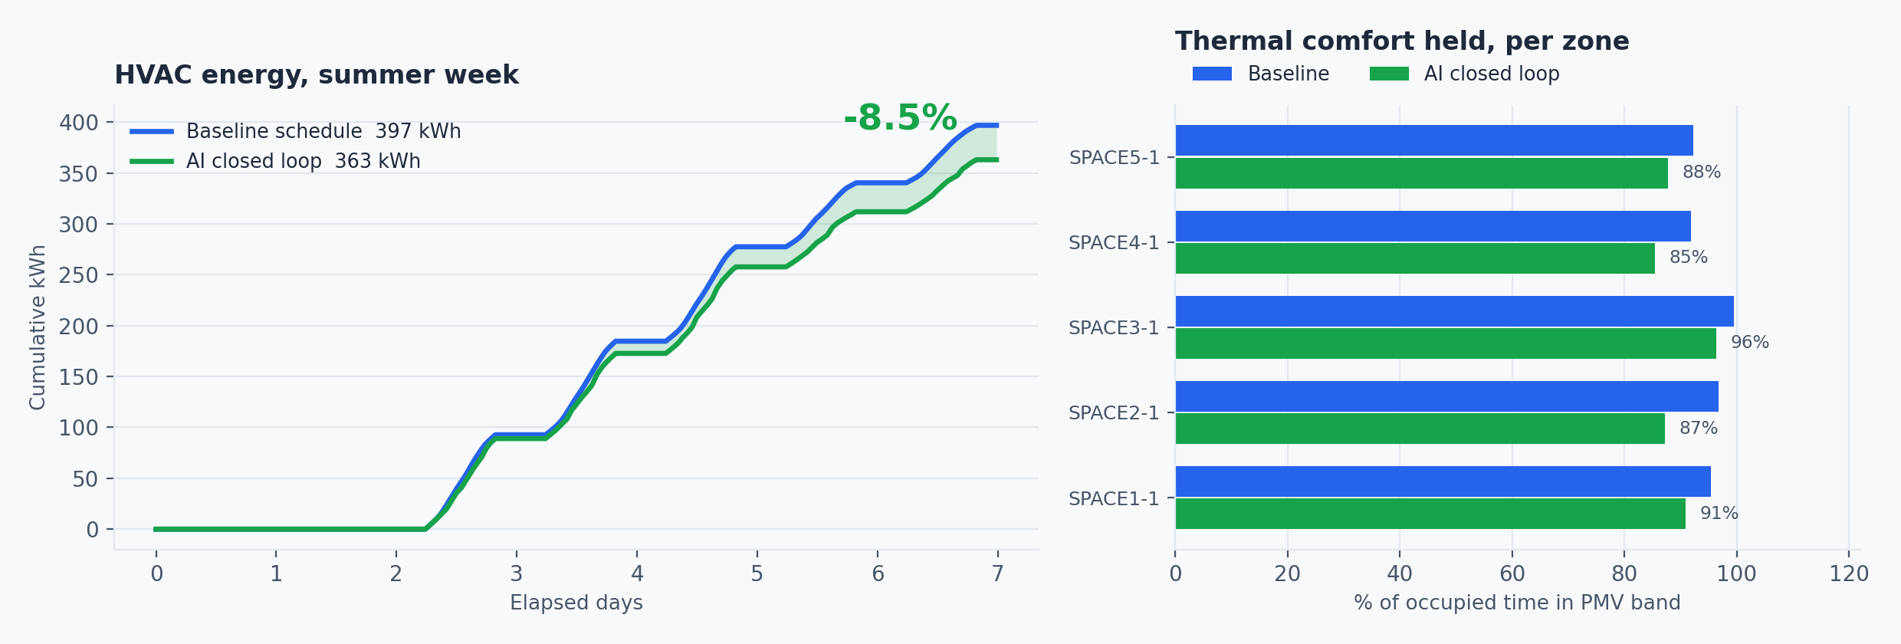
IDEA TITLE
1
PROPOSED SOLUTION
Traditional BMS follow rigid clock schedules. Eco-Loop turns the building into a self-correcting agent.
HOW IT WORKS
EnergyPlus runs in-process; sensors read every zone timestep
Every 60 simulated minutes the state reaches a local LLM via six MCP tools
The model weighs comfort, demand and grid carbon, then returns setpoints
INNOVATION
Injected into the LIVE solver — no IDF rewrite, no restart
MCP is the safety boundary: every command validated server-side
−8.5% HVAC energy
Measured, not projected — while holding occupants closer to thermal neutrality than the baseline (mean PMV −0.43 → −0.02)
WHY IT IS DIFFERENT
Most LLM-and-simulation work rewrites the model file and re-runs it — that can only compare finished runs. It cannot react to a zone drifting out of comfort at 14:00 on day 3.
Echo-Loop · 2

Slide 3
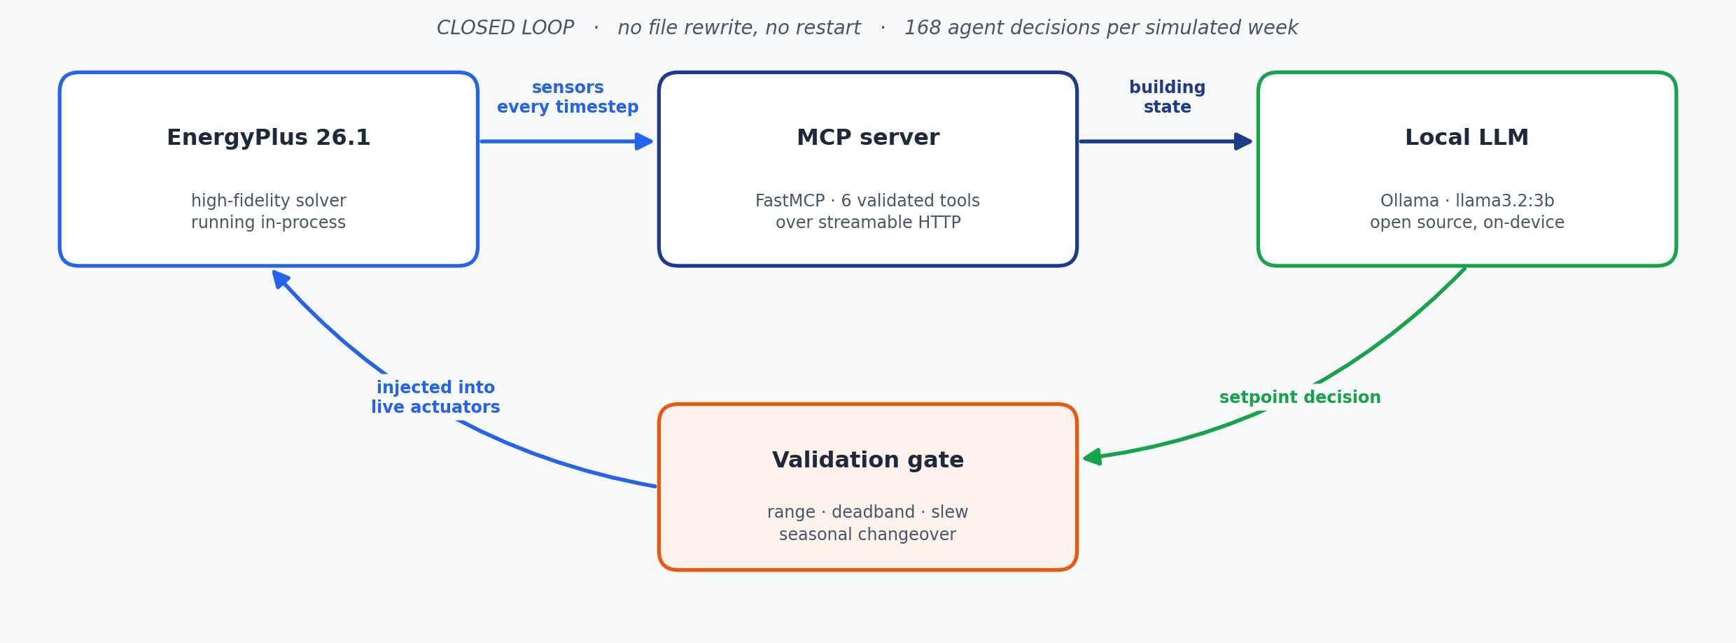
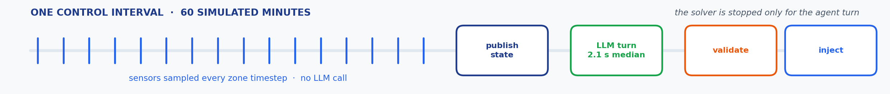
TECHNICAL APPROACH
2
TECHNOLOGIES EnergyPlus 26.1 (pyenergyplus C API) · Python · FastMCP over streamable HTTP · Ollama running Llama 3.2 3B · Pydantic · Streamlit + Plotly
METHODOLOGY sample every timestep → aggregate per control interval → LLM tool-calling turn → validate → inject into live actuators
Echo-Loop · 3

Slide 4
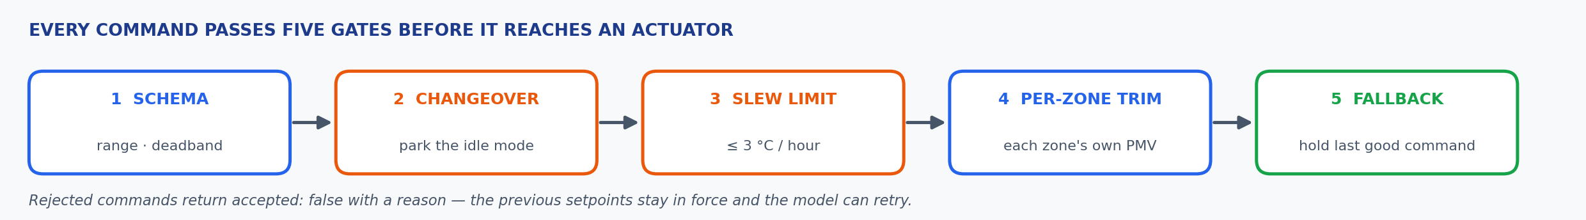
FEASIBILITY AND VIABILITY
336 / 336
agent turns — 0 fallbacks, 0 timeouts, 0 actuation errors
−8.5%
HVAC energy, summer week (−3.7% winter)
2.1 s
median agent decision latency, fully on-device
RISKS & CONSTRAINTS
LLM latency inside a blocking simulation callback
A small model can move the wrong setpoint, or run heating against cooling
One setpoint pair cannot satisfy five differently-loaded zones
HOW EACH IS SOLVED
Hard per-turn deadline; on timeout the loop holds the last accepted command
Observations state the required direction — the model cannot invert physics
Seasonal changeover parks the idle setpoint; a per-zone trim corrects each zone
VIABILITY AT SCALE Buildings are ~40% of global energy — a single-digit HVAC reduction is material at portfolio scale. The loop is model-agnostic, and a larger cognitive engine needs no change to the MCP tool layer.
Echo-Loop · 4

Slide 5
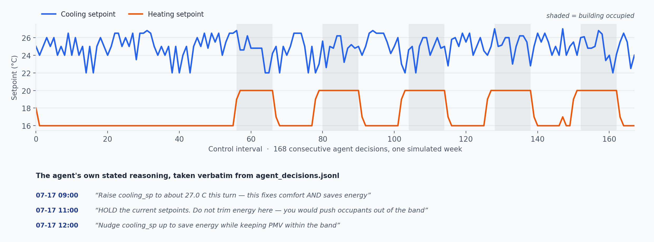
ARTIFACTS
4
github.com/ayushYadav1107/Eco_loop
Baseline and runtime-generated .idf models, the full agent decision trail (agent_decisions.jsonl), per-timestep EnergyPlus results and the savings dashboard are all committed — a fresh clone reproduces every figure here.
Echo-Loop · 5

Slide 6
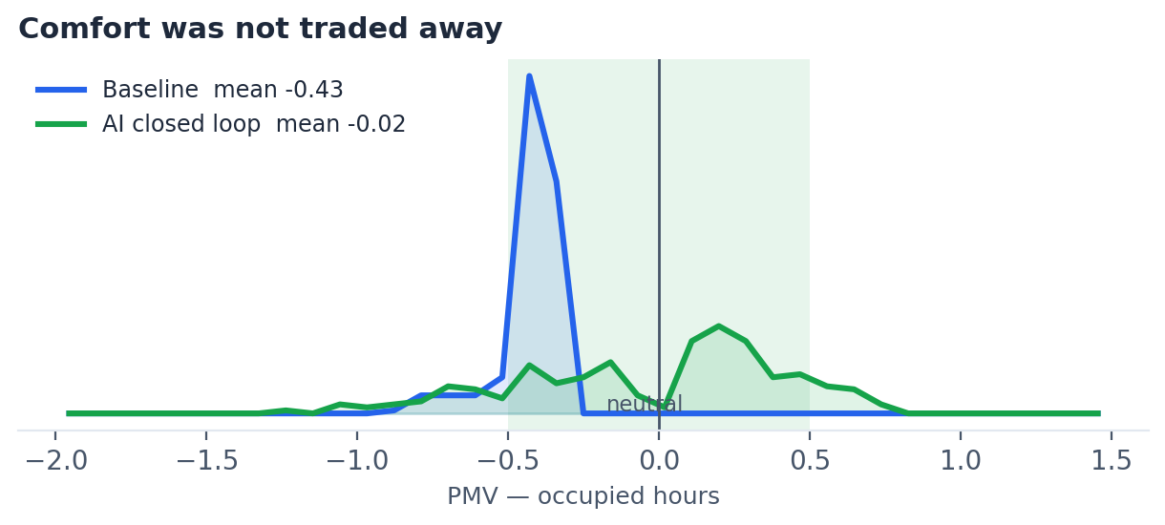
RESEARCH AND REFERENCES
5
SIMULATION & BUILDING PHYSICS
EnergyPlus Engineering Reference · EMS Application Guide
pyenergyplus Data Exchange API — get_variable_handle, set_actuator_value
ISO 7730:2005 · ASHRAE Standard 55 — PMV/PPD comfort model
AGENT, PROTOCOL & INFERENCE
Model Context Protocol — modelcontextprotocol.io · FastMCP — gofastmcp.com
Meta Llama 3.2 served locally through Ollama — ollama.com
REPRODUCE THE RESULT
python main.py prepare
python main.py run-baseline --start 07-15 --end 07-21
python main.py run-ai --start 07-15 --end 07-21
python main.py dashboard
AUDITABLE, NOT ANECDOTAL
The controller runs at temperature 0, so repeated runs return identical totals. Anyone can clone the repo and reproduce these exact figures.
HONEST LIMITATION
One setpoint pair drives five zones — per zone the agent holds 85–96% of occupied time in band. Per-zone setpoints are next; the actuator handles are already in place.
Echo-Loop · 6

