Slide 1

CIS508 : Machine Learning in Business
Abhinay Kalyankar
https://asu.zoom.us/rec/share/UW9c5VmYW7qfbRdy_tVNW8Z0QfJYu3pHYYqH8qy55d_WmROjPhTz1mFMivlwmQjg.NR-yQM02PpxcNaLC?startTime=1701038991000
Passcode: B=Bv3D3g

Slide 2
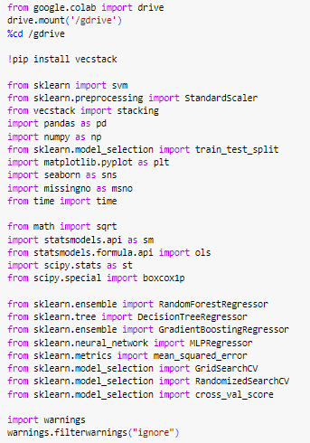
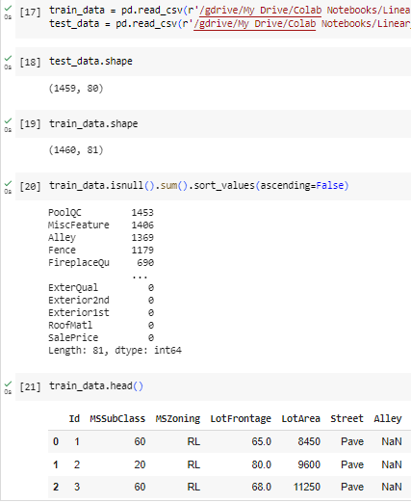
Step 1 : Importing all the required Libraries
Step 2 : Reading the data from files and Analyzing

Slide 3

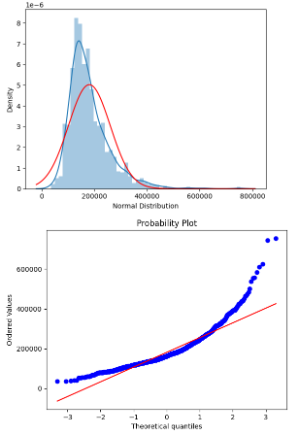
Step 3 : Combined Train & Test data
Analyzing the Target variable’s Distribution =>

Slide 4
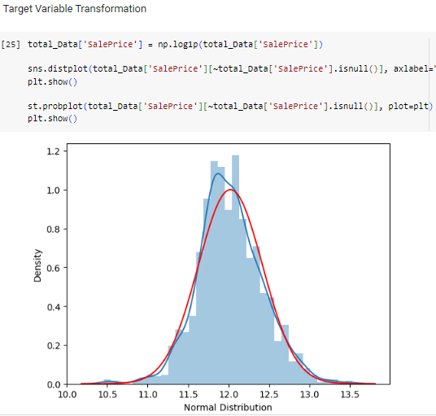
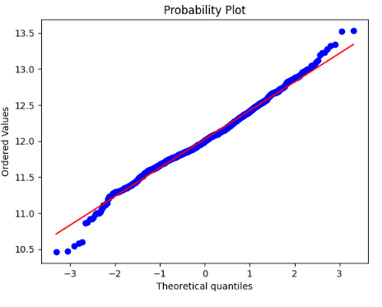
Step 4 : Target Variable Transformation

Slide 5
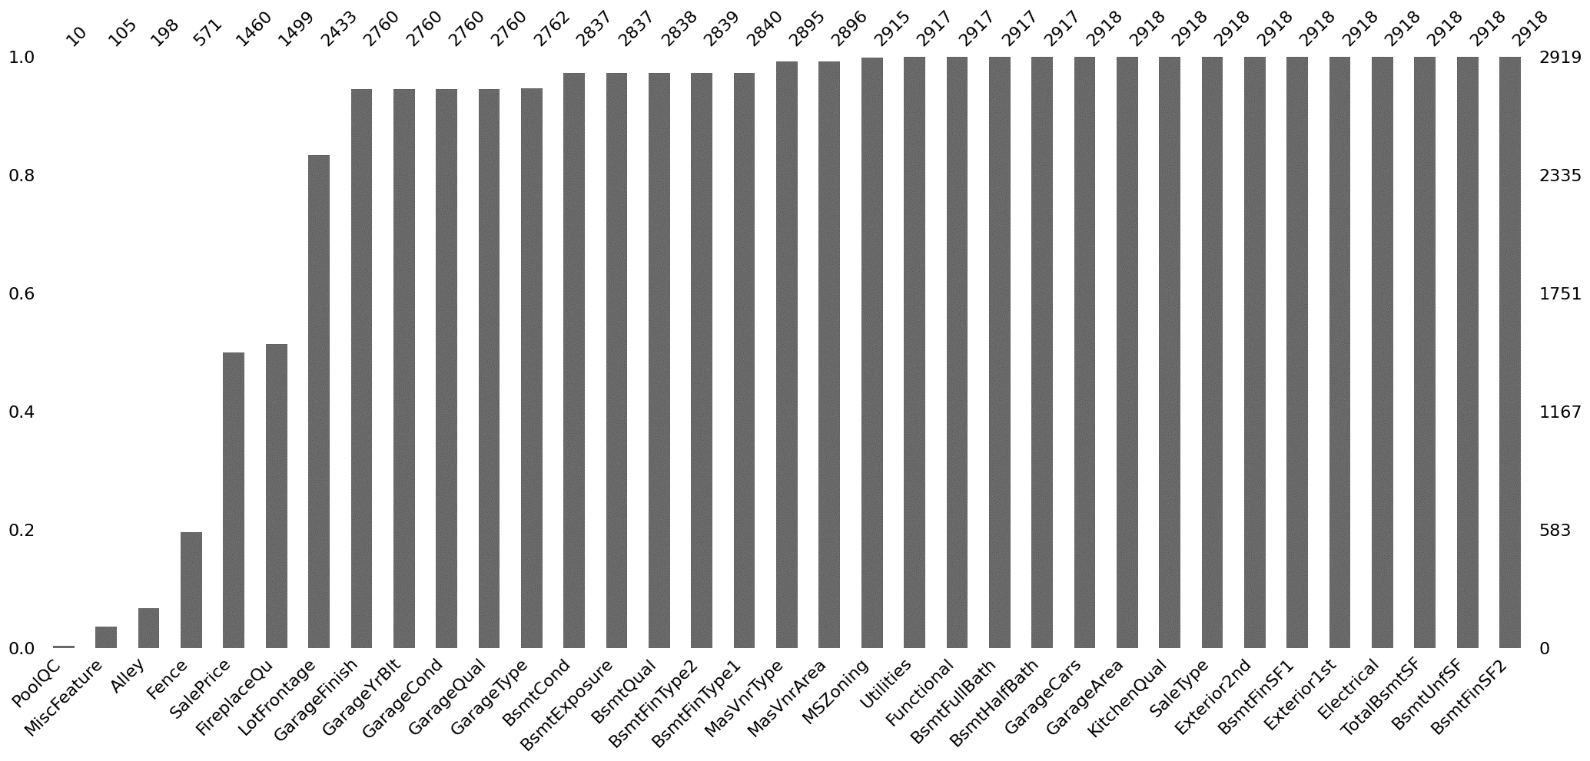
Total Missing Data after combining the train & test dataset :

Slide 6
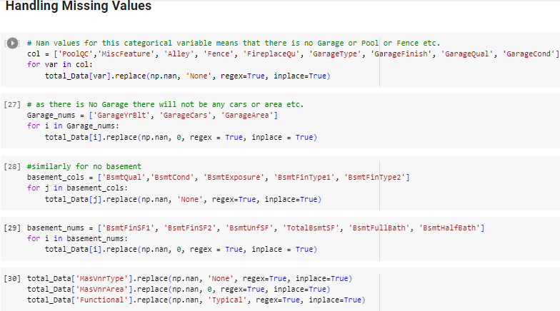
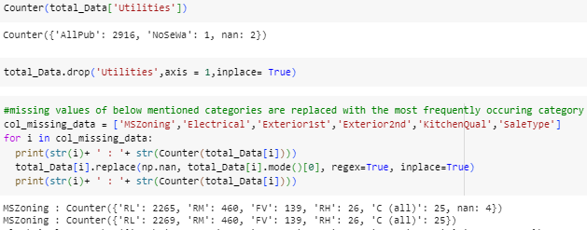
Step 5: Handling Missing Values

Slide 7
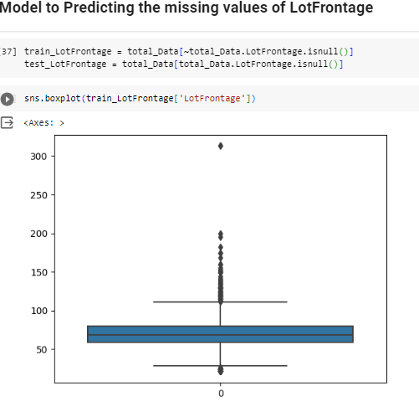
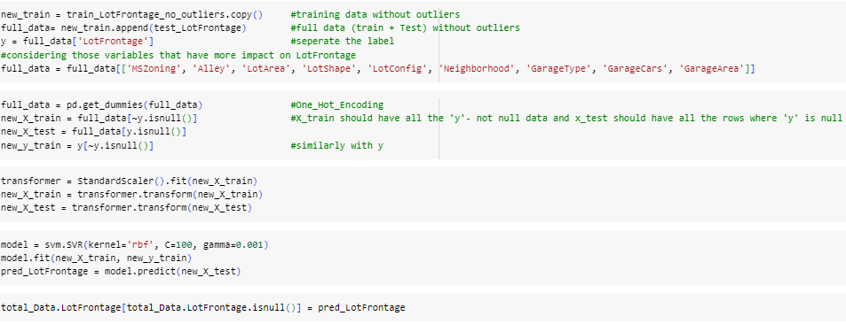

Slide 8
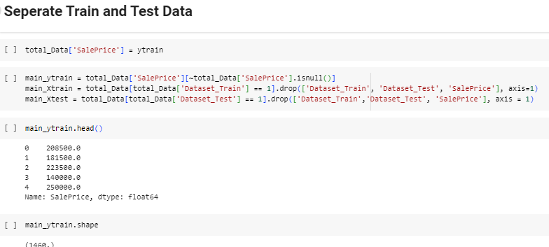
Step 6: Separating the data

Slide 9
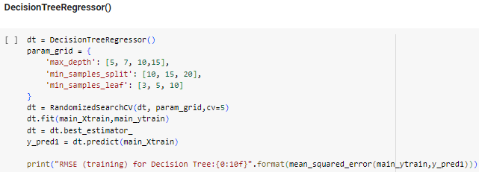
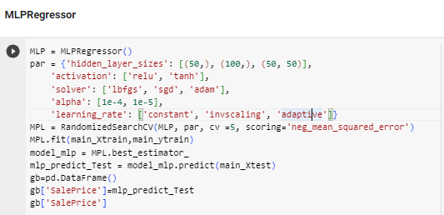
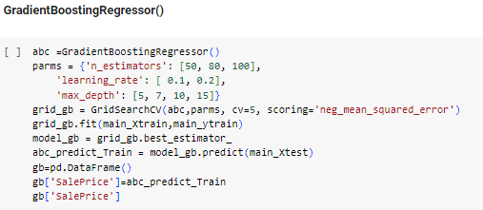
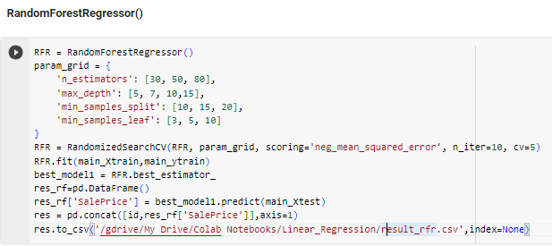
Regression Using Different Models

Slide 10
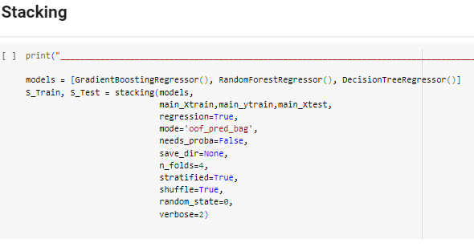
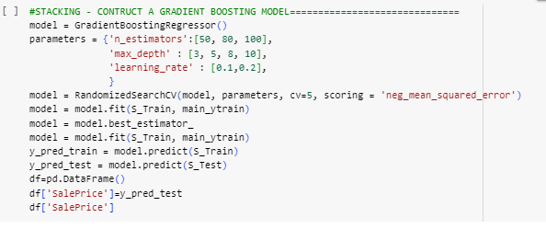

Slide 11
Results:
Hyper Tuned Model | RMSE
Stacked – Gradient Boosting Regressor | 0.13486
Gradient Boosting Regressor | 0.1305
Random Forest Regressor | 0.1506
Decision Tree Regressor | 0.18611
MLP Regressor | 0.38116
Best Model
In this Assignment we are performing the Regression which is different from previous assignments

Slide 12

Thank You!!

