Slide 1
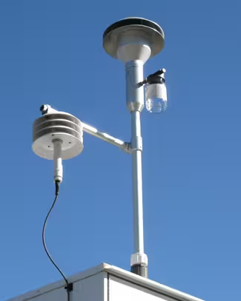
MD-STGAT: A Multi-Modal Dynamic Temporal Graph Attention Network for Air Quality Forecasting
Aduru Guhya 23BPS1009
Ayush Acharya 23BPS1078

Slide 2
Problem Statement
Background
Air pollution is a major global environmental and health concern.
Accurate PM2.5 forecasting supports early warnings and urban planning.
Existing models struggle to capture spatial, temporal, and weather-driven pollution dynamics.
Challenges
Missing and noisy sensor data.
Dynamic influence of meteorological conditions.
Spatial dependency between monitoring stations.
Physically unrealistic predictions in purely data-driven models.
Objective
Develop a multi-modal deep learning framework by integrating air quality and meteorological data for improved PM2.5 forecasting.
Capture dynamic spatial and temporal dependencies using Graph Attention Networks (GAT) and Transformer-based temporal modeling.
Generate accurate and physically consistent forecasts through physics-guided regularization, ensuring robustness to noisy and missing sensor data.

Slide 3
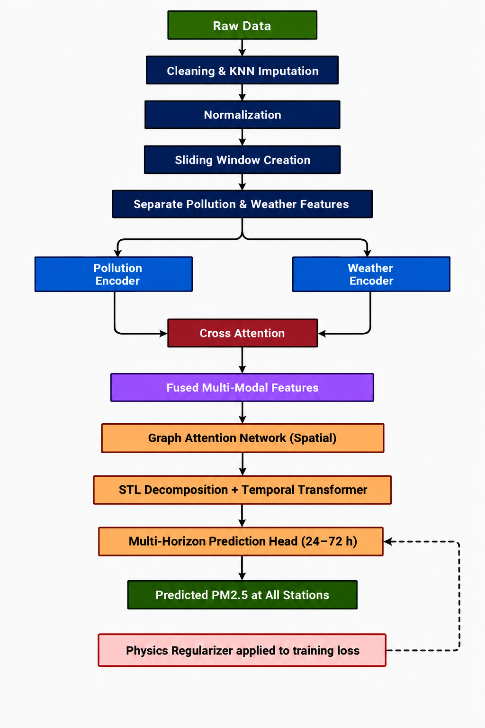
Proposed MD-STGAT Framework
Proposed MD-STGAT Framework
Preprocess air quality and weather data using KNN imputation, normalization, and sliding windows.
Extract and fuse pollution and weather features through dual encoders and Cross-Attention.
Learn spatial-temporal dependencies using Graph Attention Networks (GAT) and a Temporal Transformer.
Predict 24–72 hour PM2.5 concentrations with a physics-guided regularization for stable and realistic forecasts.

Slide 4
References
[1] X. Yi, J. Zhang, Z. Wang, T. Li, and Y. Zheng, "Deep Distributed Fusion Network for Air Quality Prediction," Proceedings of the 24th ACM SIGKDD International Conference on Knowledge Discovery & Data Mining (KDD), 2018.
[2] X. Zou, J. Zhao, D. Zhao, B. Sun, Y. He, and S. Fuentes, "Air Quality Prediction Based on a Spatiotemporal Attention Mechanism," Mobile Information Systems 2021.
[3] S. Du, T. Li, Y. Yang, and S.-J. Horng, "Deep Air Quality Forecasting Using Hybrid Deep Learning Framework," IEEE Transactions on Knowledge and Data Engineering, 2021.
[4] M. Pandey, V. Jain, N. Godhani, S. N. Tripathi, and P. Rai, "Spatio-Temporal Forecasting of PM2.5 via Spatial-Diffusion Guided Encoder–Decoder Architecture," arXiv preprint arXiv:2412.13935, 2024.
[5] Y. Qi, Q. Li, H. Karimian, and D. Liu, "A Hybrid Model for Spatiotemporal Forecasting of PM2.5 Based on Graph Convolutional Neural Network and Long Short-Term Memory," Science of the Total Environment, 2019.
[6] J. Xu, L. Chen, M. Lv, C. Zhan, S. Chen, and J. Chang, "HighAir: A Hierarchical Graph Neural Network-Based Air Quality Forecasting Method," arXiv preprint arXiv:2101.04264, 2021.
[7] S. Wang, Y. Li, J. Zhang, Q. Meng, L. Meng, and F. Gao, "PM2.5-GNN: A Domain Knowledge Enhanced Graph Neural Network for PM2.5 Forecasting," Proceedings of the 28th ACM SIGSPATIAL International Conference on Advances in Geographic Information Systems, 2020.
[8]P. S. S. Ejurothu, S. Mandal, and M. Thakur, "Forecasting PM2.5 Concentration in India Using a Cluster-Based Hybrid Graph Neural Network Approach," Asia-Pacific Journal of Atmospheric Sciences, vol. 59, no. 5, pp. 545–561, 2023.
[9] J. Ahn, J. H. Lee, P. Kordjamshidi, and M. Sioutis, "Spatial-Temporal Air Quality Prediction Using Graph Neural Networks and Transformers," in Proceedings of the 3rd International Workshop on Spatio-Temporal Reasoning and Learning (STRL 2024), CEUR Workshop Proceedings, vol. 3827, Jeju Island, South Korea, Aug. 2024.

