Slide 1
Data Structures and Algorithms -3 (25CS2103E)
Matrix Chain Multiplication Optimizer
Team 20 | Section 1
Ayusha Das – 2520039624
Tokala Pratyusha Reddy – 2520030612
M. Manasa – 2520030438
Under the Esteemed Guidance of
Dr. Ch Anuradha, Assistant Professor, CSE
Notes:
Introduce the team and the project: a tool that finds the cheapest order to multiply a chain of up to 500 matrices.

Slide 2
Contents
Abstract
Introduction
Literature survey
Problem Statement and Objectives
Flow Chart
Results
Hardware and Software requirements
Conclusion
Future Scope
Notes:
The sections follow the order of the slides.

Slide 3
Abstract
Multiplying a chain of matrices gives the same product in any bracketing, but the number of scalar multiplications can differ by orders of magnitude. This project builds a tool that uses interval dynamic programming to find the cheapest order for up to 500 matrices.
From the matrix dimensions alone it reports the minimum cost and the optimal parenthesization, and compares them with naive left-to-right multiplication. On the classic six-matrix example the cost falls from 40,500 to 15,125 multiplications.
≤ 500
O(n³)
89%
matrices supported
time, O(n²) space
fewer multiplications, 500-matrix test
Notes:
Summary of what the tool does and the headline numbers: up to 500 matrices, O(n^3) time, about 89 percent fewer multiplications on the 500-matrix test.

Slide 4
Introduction
Matrix multiplication is associative, so the product A1 × A2 × … × An is the same however it is bracketed. The cost is not: multiplying a p × q matrix by a q × r matrix needs p · q · r scalar multiplications, so the order decides how much work is done.
Example: A is 10×100, B is 100×5, C is 5×50
(A × B) × C
A × (B × C)
10×
more work
7,500
75,000
5,000 + 2,500 multiplications
25,000 + 50,000 multiplications
Notes:
Same product, ten times the work. Trying every bracketing is exponential, so we use dynamic programming.

Slide 5
Literature Survey
Source | What it covers
alexmolas.com blog | Brute force vs memoized DP in Python; memoization up to about 100,000× faster at n ≈ 18
HelloACM | Recursive, memoized and bottom-up versions in pseudocode; bottom-up runs in O(n³)
Bowdoin CS231 lecture (CLRS 15.2) | Recurrence and n × n table, O(n³); cost only, order left as an exercise
OpenDSA / SPLICE (Virginia Tech) | Visualizes the recursive call tree of the DP solution; a teaching aid, not a tool
AfterAcademy | Problem statement with worked examples (30,000 and 6,000); no solution or complexity
Medium article | Four-matrix walk-through with cost and bracket tables; no code or formal complexity
Gap: most sources explain the method or compute only the cost. Our tool also prints the optimal parenthesization, compares it with naive multiplication, validates the input and supports 500 matrices.
Notes:
Six existing resources were studied; their URLs are in the report references. Our contribution is the full tool with comparison and validation.

Slide 6
Problem Statement and Objectives
Problem statement: Develop an optimization tool that finds the order of multiplying a chain of up to 500 matrices that minimizes the total number of scalar multiplications, using dynamic programming.
Problem description: From the matrix dimensions alone, output the minimum cost and the optimal parenthesization, and compare them with naive left-to-right multiplication.
Objectives
1
Model the problem with an interval DP recurrence (optimal substructure, overlapping subproblems)
2
Compute the minimum cost for up to 500 matrices in O(n³) time and O(n²) space
3
Display the optimal parenthesization and its cost
4
Compare with naive left-to-right multiplication: savings and speed-up
5
Validate the input and verify on known examples
Notes:
Statement, description and the five objectives, as in the report.

Slide 7
Flow Chart
1
2
3
Read n and the n + 1 dimensions d0 … dn
Validate: n ≤ 500 and all dimensions > 0
Fill tables m and s by chain length L = 2 … n
6
5
4
Print optimal cost, order, naive cost, savings
Compute the naive left-to-right cost
Rebuild the brackets from table s
If validation fails, the program prints an error message and stops. The tables m (minimum costs) and s (best split points) are filled once, bottom-up.
Notes:
Walk through the six steps. Step 3 is the interval dynamic programming: chains of length 2, then 3, up to n.

Slide 8
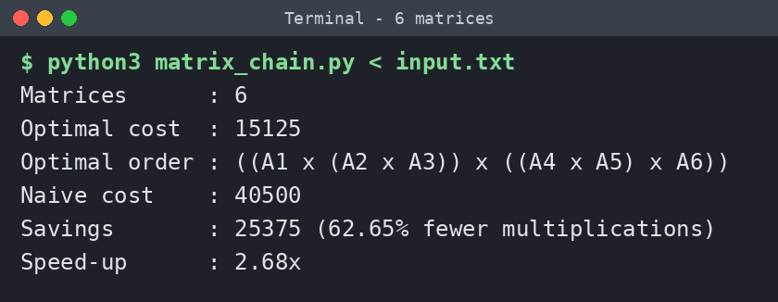
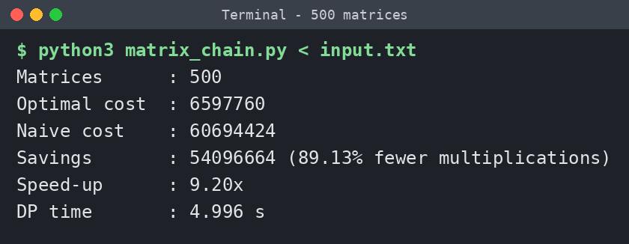
Results
6 matrices: optimal cost 15,125 against 40,500 for naive, 62.65% fewer multiplications.
500 random matrices: 6,597,760 against 60,694,424, 89.13% fewer, in about 5 seconds.
Test | Matrices | Optimal | Naive | Savings
Classic example | 6 | 15,125 | 40,500 | 62.65%
Naive already optimal | 4 | 30,000 | 30,000 | 0.00%
Random chain | 500 | 6,597,760 | 60,694,424 | 89.13%
An input of 501 matrices is rejected with an error message, as the limit is 500.
Notes:
Screenshots are real runs of the program. The saving depends on the dimensions; it is zero when naive order is already best.

Slide 9
Hardware and Software requirements
Hardware requirements
Software requirements
Computer with a dual-core processor or better
4 GB RAM or more (500 matrices need well under 100 MB)
Keyboard, display and a few MB of free disk space
Windows, Linux or macOS
Python 3.8 or later (standard library only)
Text editor or IDE such as VS Code, PyCharm or IDLE
Terminal or command prompt
Notes:
No extra packages are needed; the program uses only the Python standard library.

Slide 10
Conclusion
Objectives met
1
Finds the minimum cost and the optimal parenthesization for chains of up to 500 matrices.
Clear savings
2
Cost falls from 40,500 to 15,125 on the classic example, and by about 89% on a random 500-matrix chain.
Efficient
3
O(n³) time and O(n²) space; about 5 seconds for 500 matrices in plain Python.
Notes:
The project demonstrates optimal substructure, overlapping subproblems and bottom-up interval dynamic programming.

Slide 11
Future Scope
1
2
3
Near term
Medium term
Long term
A graphical front end that shows the cost and split tables step by step, and export of results to a file.
A faster core in C++ or NumPy, and multiplying real matrices in the optimal order to measure the actual time saved.
The Hu–Shing algorithm, which solves the problem in O(n log n) time, and cost models for sparse matrices or parallel hardware.
Notes:
Near, medium and long term ideas for extending the tool.

Slide 12
Thank you
Questions are welcome
Team 20 | Section 1 | Guide: Dr. Ch Anuradha

