Slide 1

- KAVANA S SALUNKHE
IIIT Dharwad

Slide 2
APACHE AIRFLOW
Apache Airflow is an open source workflow management tool that IT teams can use to streamline data processing and DevOps automation pipelines.
Based on Python and underpinned by a SQLite database, Airflow lets admins manage workflows programmatically and monitor scheduled jobs

Slide 3
WHEN SHOULD WE USE AIRFLOW?
This Python-based technology makes it easy to set up and maintain data pipelines.

Slide 4
WHAT IS AIRFLOW GOOD FOR?
Airflow makes it easy to monitor the state of a pipeline in their UI, and you can build DAGs with complex fan-in and fan-out relationships between tasks.
HOW DOES APACHE AIRFLOW WORK?
Apache Airflow is a platform to programmatically author, schedule, and monitor workflows.

Slide 5
Principles
Dynamic
Extensible
Extensible
Extensible
Scalable

Slide 6
Apache Airflow core concepts
Apache Airflow defines its workflows as code.
Workers
pipeline
DAGs
Pools

Slide 7
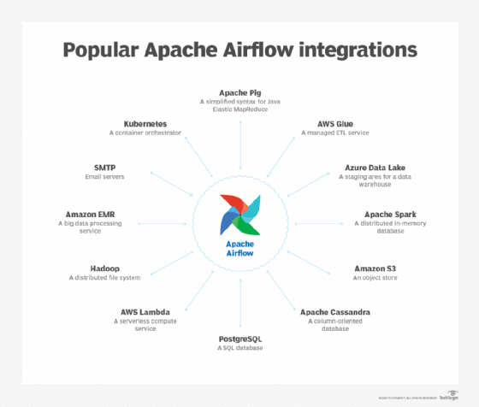
Airflow integrations

Slide 8
INSTALLING AIRFLOW
https://airflow.apache.org/docs/apache-airflow/stable/installation.html
PREREQUISITES:
Python: 3.6, 3.7, 3.8
Databases:
PostgreSQL: 9.6, 10, 11, 12, 13
MySQL: 5.7, 8
SQLite: 3.15.0+
Kubernetes: 1.18.15 1.19.7 1.20.2

Slide 9
SYSTEM DEPENDENCIES:
$ sudo apt-get install -y --no-install-recommends \
freetds-bin \
krb5-user \
ldap-utils \
libffi6 \
libsasl2-2 \
libsasl2-modules \
libssl1.1 \
locales \
lsb-release \
sasl2-bin \
sqlite3 \
unixodbc

Slide 10
$ pip3 install ‘apache-airflow[all]
(OR)
$ pip install apache-airflow

Slide 11
RUN AIRFLOW
Set environment variable AIRFLOWHOME to your current directory $(pwd):
# change the default location ~/airflow if you want:
$ cd /path/to/my/airflow/workspace
$ mkdir airflow_home
$ export AIRFLOW_HOME=`pwd`/airflow_home
Initialize the database :
$ airflow initdb
Start the web server and go to localhost:8080 to check out the UI:
$ airflow webserver --port 8080

Slide 12
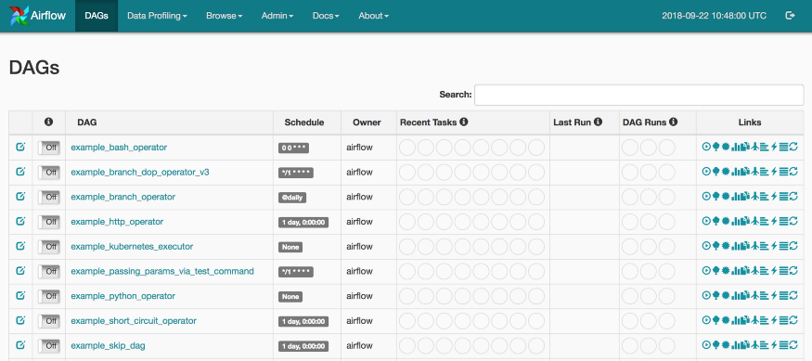

Slide 13
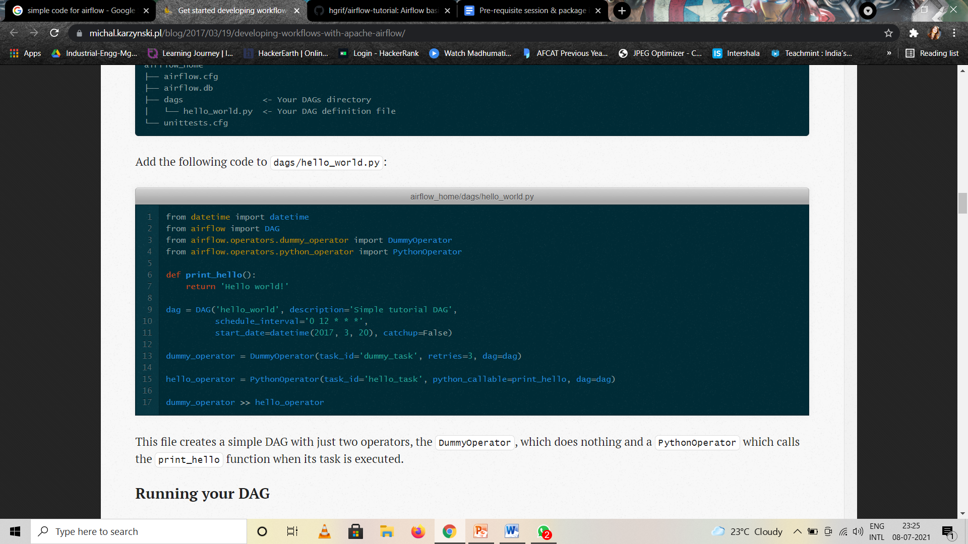
FIRST AIRFLOW DAG

Slide 14
Running your DAG
$ cd /path/to/my/airflow/workspace
$ export AIRFLOW_HOME=`pwd`/airflow_home
$ source /bin/activate
$ airflow scheduler

Slide 15
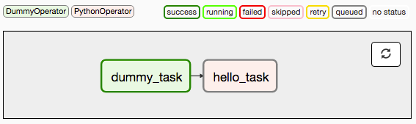
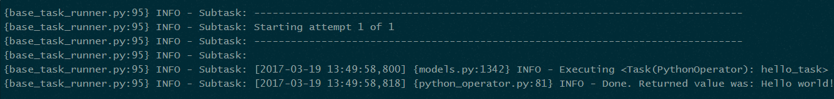

Slide 16
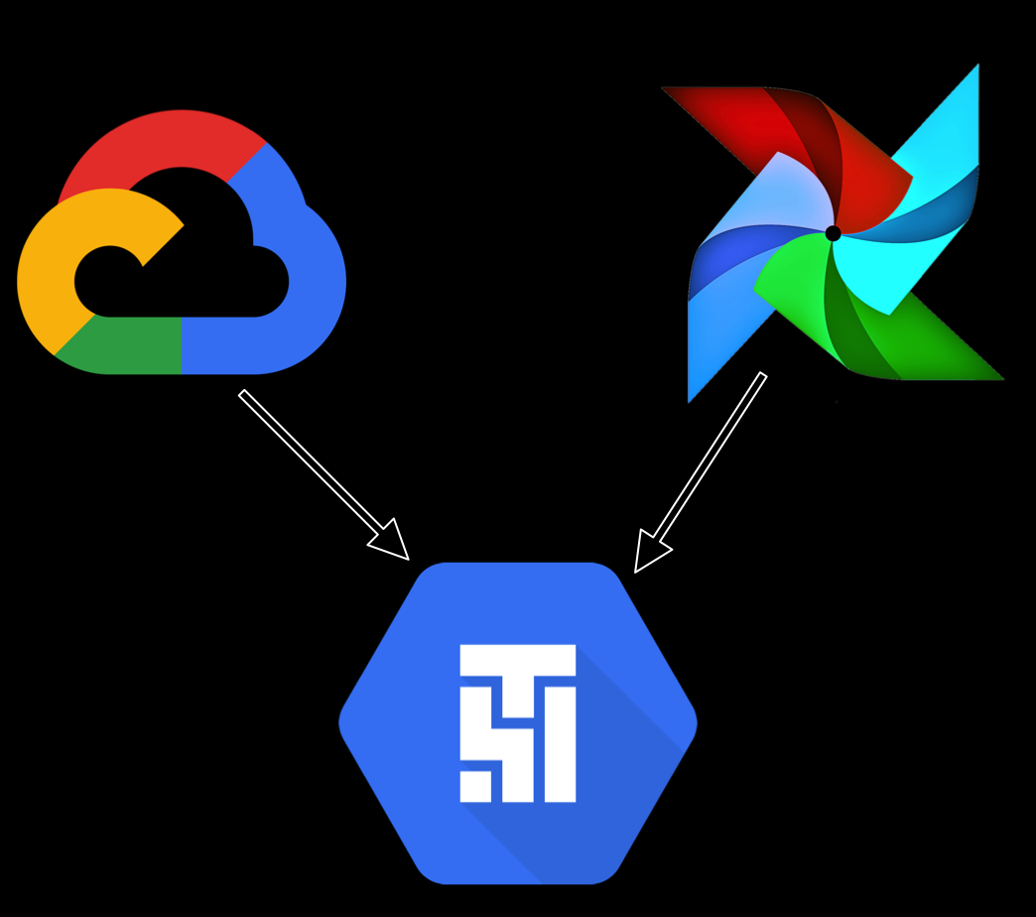
GOOGLE CLOUD COMPOSER

Slide 17
GOOGLE CLOUD COMPOSER
Google Cloud Composer is Google Cloud Platform product that helps you manage complex workflows with ease.

Slide 18
Key features
Multi-cloud
Open source
Hybrid
Integrated
Python programming language
Reliability
Fully managed
Networking and security

Slide 19
Cloud Composer environment architecture
Environment configurations
Public IP
Private IP
Private IP with Domain restricted sharing

Slide 20
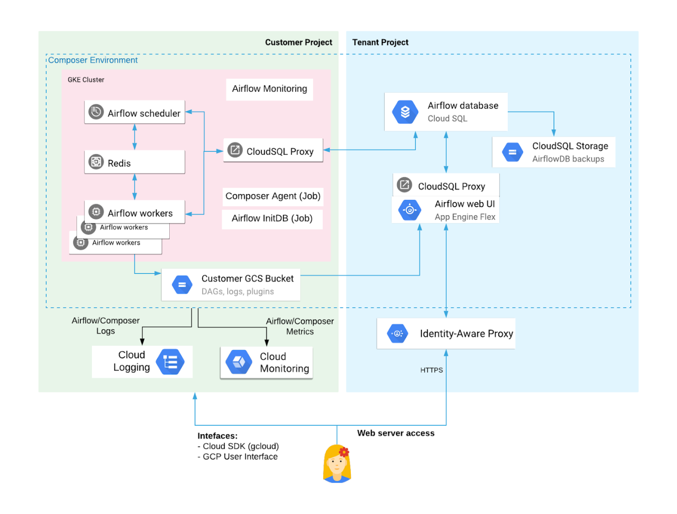
Cloud Composer Public IP architecture

Slide 21
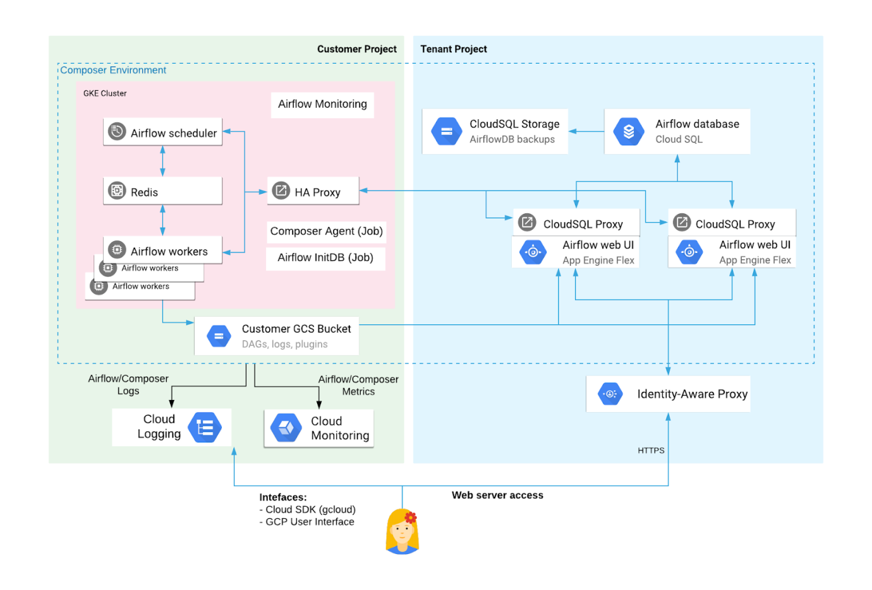
Cloud Composer Private IP architecture

Slide 22
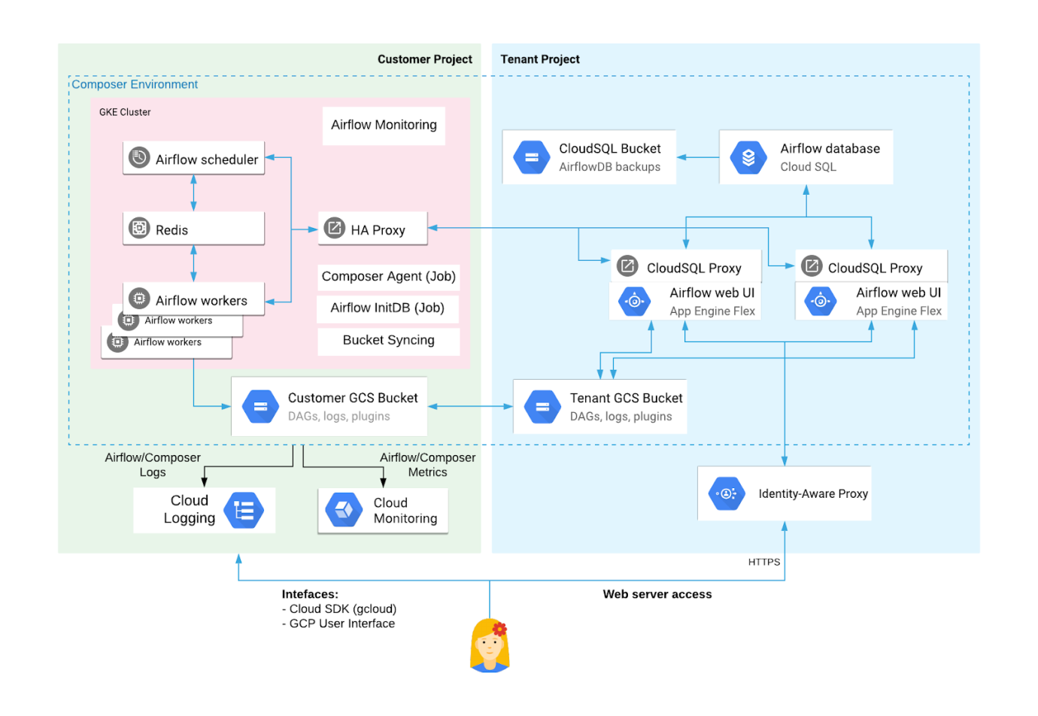
Cloud Composer Private IP with Domain restricted sharing

Slide 23
Tenant project resources
Cloud SQL
App Engine
Customer project resources
Cloud Storage
Google Kubernetes Engine
Cloud Logging and Cloud Monitoring
Airflow configuration information

Slide 24
Deploying Apache Airflow ON CLOUD COMPOSER
Create a Cloud Account
Create a Service Account
IAM & Admin Service Accounts

Slide 25
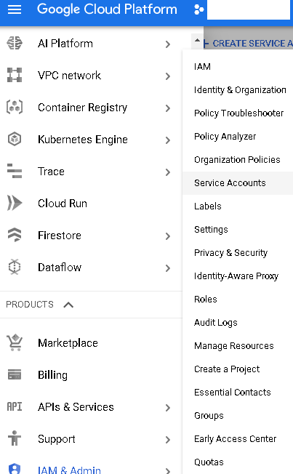
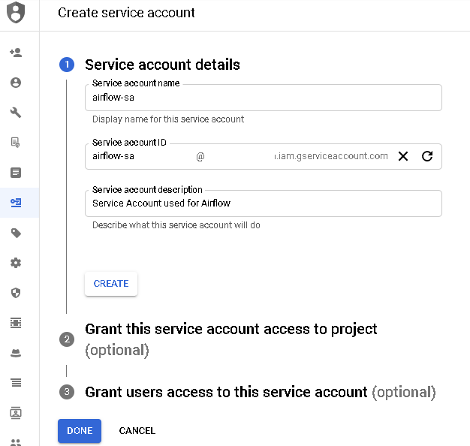

Slide 26
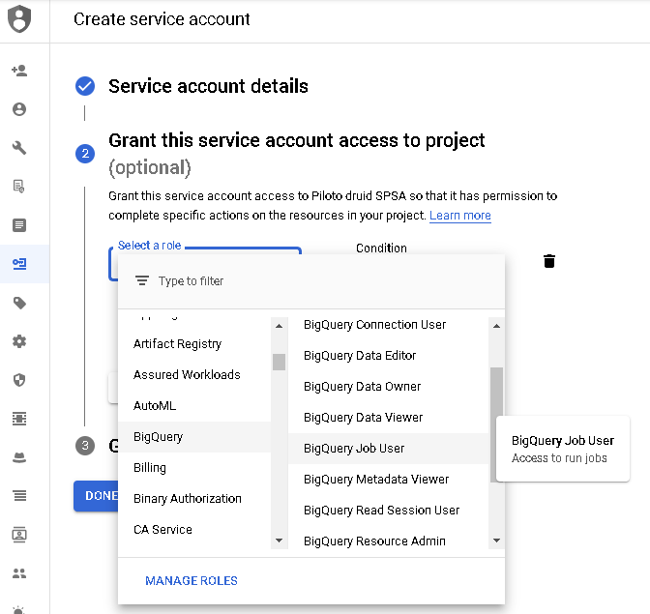
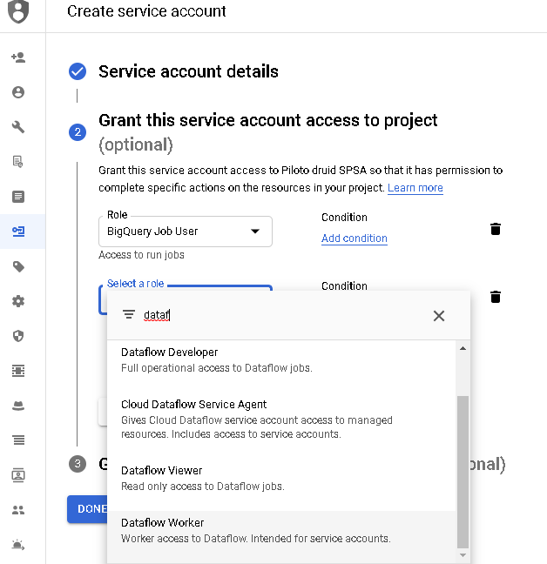

Slide 27
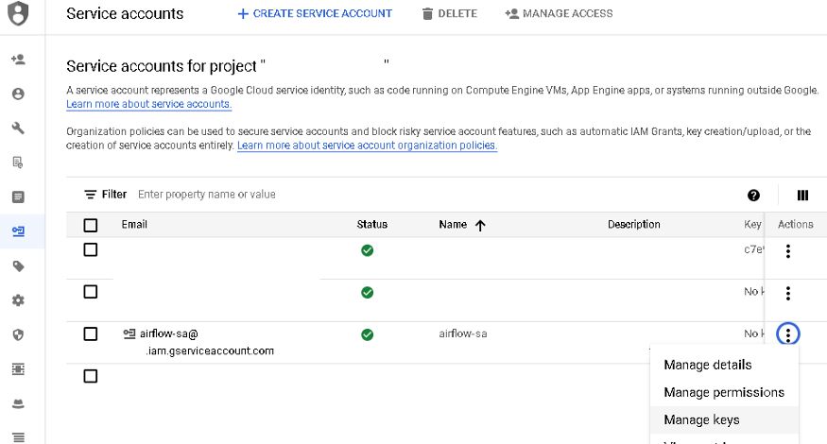
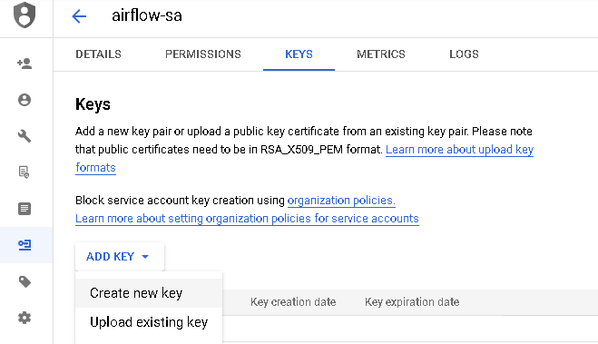

Slide 28
3. Create a Compute Engine instance
Deploy a Debian instance
e2-standard-2 (2vCPU, 8GB memory)
Debian 10
50 GB HDD
Allow HTTPS and HTTP traffic

Slide 29
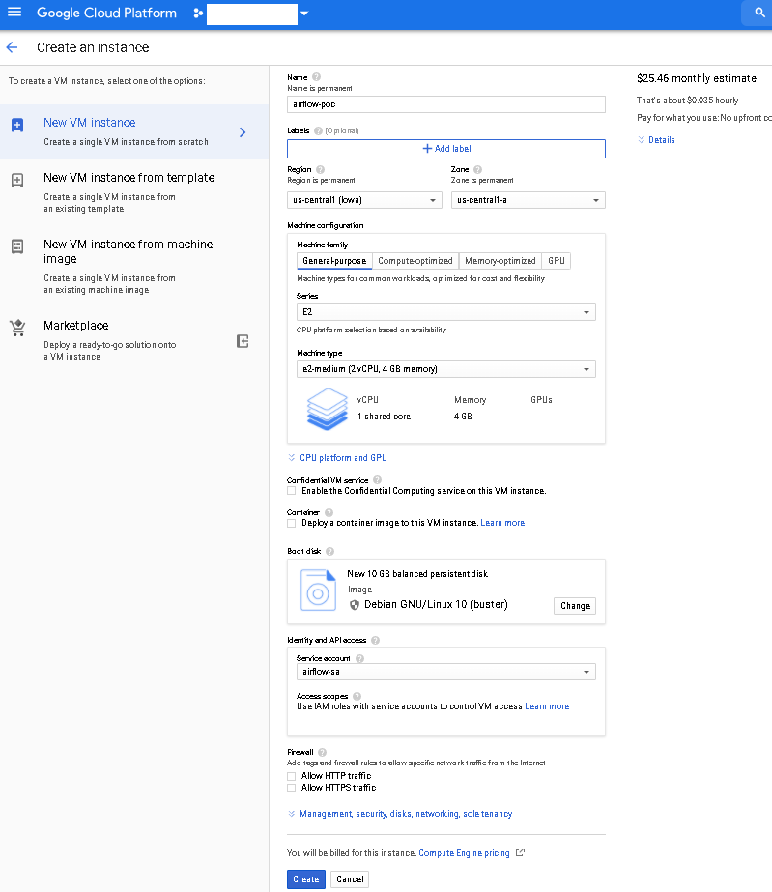

Slide 30
4. First-time setup
$airflow db init $airflow users create -r Admin -u username -p mypassword -e
$example@mail.com -f yourname -l lastname
5. First execution
Go to Firewall/Create Firewall Rule
Create the airflow-port rule

Slide 31
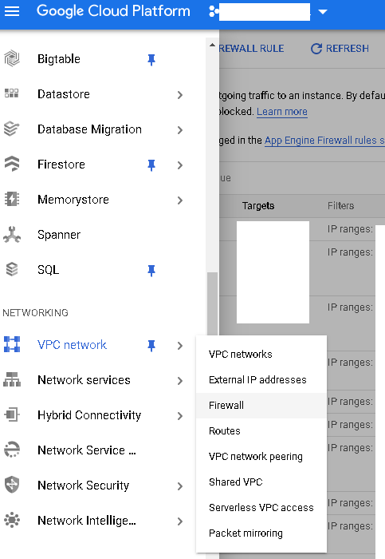
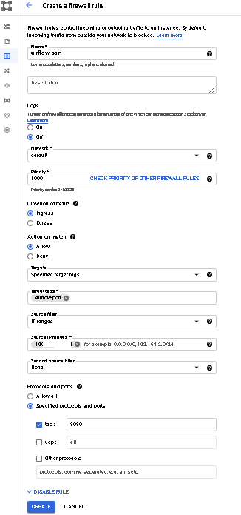

Slide 32
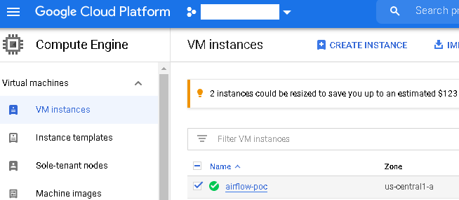
Go to Compute Engine/VM instances and click on airflow-poc

Slide 33
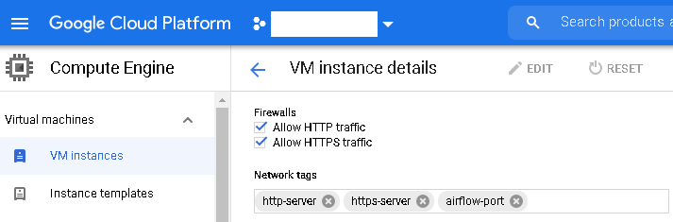
Add the firewall rule

Slide 34
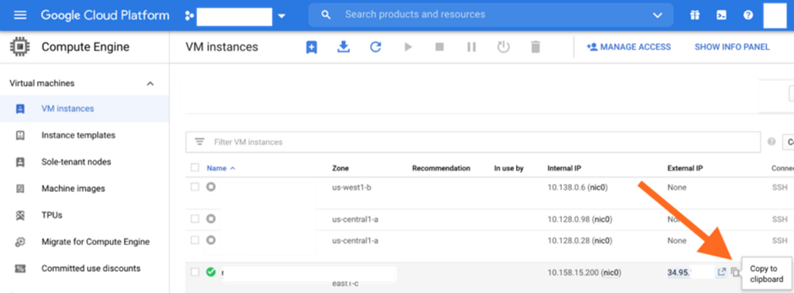
airflow webserver -p 8080

Slide 35
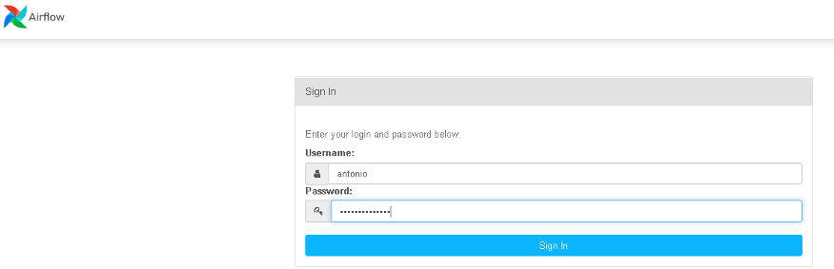
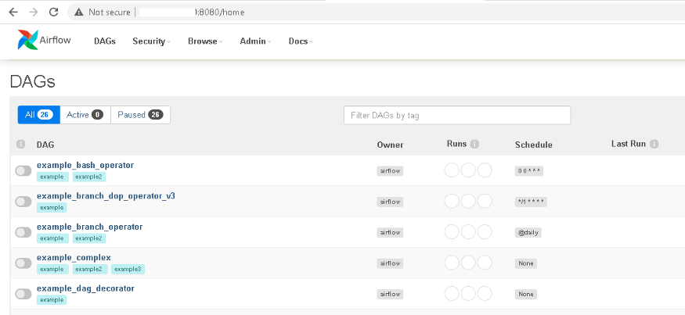

Slide 36
https://cloud.google.com/composer/docs/tutorials

Slide 37


