Slide 1
Risk-Aware Lane-Change Planning
via Online CVaR-Augmented MPPI
Ayush Agrawal · ECE M237 (Dynamic Programming) · UCLA Spring 2026

Slide 2
Where this project sits in ECE M237 (Dynamic Programming).
Two course pillars are combined: MDP value iteration (offline) and receding-horizon path-integral control (online). The CVaR objective extends both from risk-neutral to risk-sensitive DP.
Course topic | Lecture concept | This project
MDP formulation | (X, A, P, C, γ) | Lane × gap × ego speed × confidence y
Bellman optimality op. | V*(x) = min_a [C + γ E V*(x')] | CVaR-Bellman: T[V](x, y), eq. (2)
Value iteration | γ-contraction → fixed point | Offline V*(x, y) on 10³ × 21 grid
HJB / path integral | Cole-Hopf linearisation | MPPI sampling (Williams 2017)
Receding-horizon control | Truncate at K, replan every Δt | MPPI loop at 20 Hz, K = 30
Risk-sensitive DP | CVaR-MDP (Chow 2015) | Lagrangian penalty J_C per rollout
Two-stage method = offline DP (long horizon, coarse grid) + online RHC (fine state, K-step rollout). Both pieces are DP-derived.

Slide 3
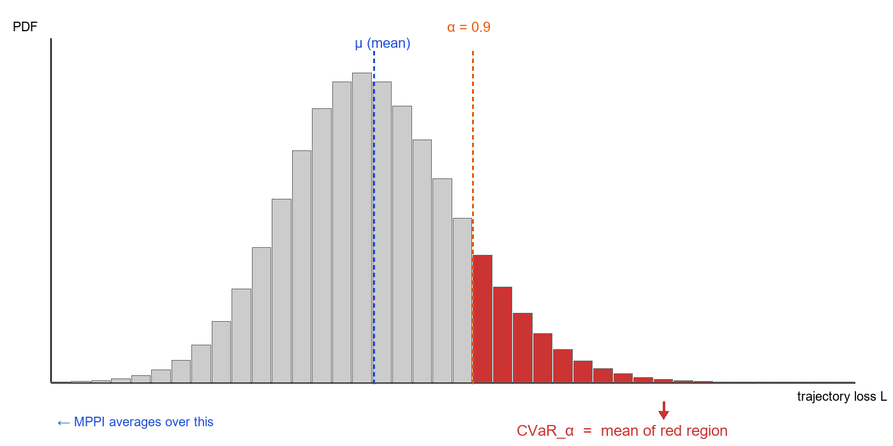
When optimising the mean isn't enough.
• Highway lane-changes: hundreds of routine outcomes for every catastrophic one.
• Standard MPC averages over all of them — the catastrophic 1-in-20 is invisible.
• The right object for that tail is CVaR.

Slide 4
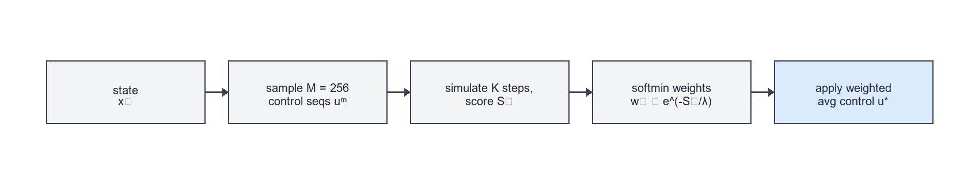
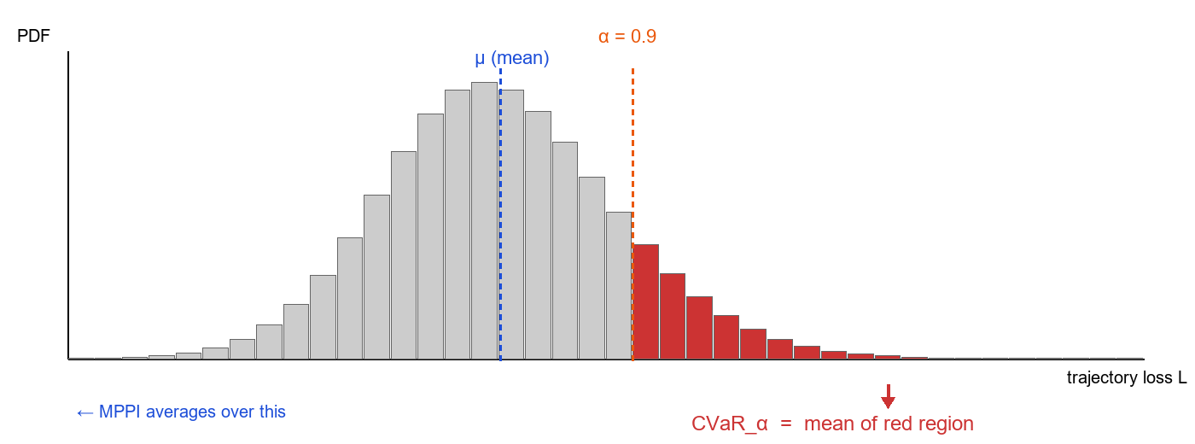
Two ideas in one slide.
MPPI = best-of-many-random-plans, weighted by cost.
Not just the mean, not just the worst case — the average over the bad tail.

Slide 5
Problem formulation.
min_v E[ φ(x_K) + Σ_{k=0}^{K-1} ( q(x_k) + (λ/2)·v_kᵀ·Σ_ε⁻¹·v_k ) ]
s.t. CVaR_α( L(x̃) ) ≤ C_u (1)
Symbol | Definition | Physical significance
x_k = (X, Y, ψ, v) ⊕ traffic | Joint ego–traffic state (bicycle pose + 10 IDM cars) | What the planner conditions on
u_k = v_k + ε_k, ε_k~N(0, Σ_ε) | Mean control + Gaussian exploration noise | Candidate controls MPPI scores
F, F̃ | Nominal / disturbed dynamics; E_w[F̃] = F (unbiased) | Plan on F, measure risk on F̃
q(x_k) | Running task cost: lane, speed, collision potential, effort | Drives lane change and comfort
φ(x_K) | Terminal cost = V*(x_K, y) from offline CVaR-VI | Tail risk beyond horizon K
(λ/2)·v_kᵀ·Σ_ε⁻¹·v_k | MPPI control regulariser from Cole-Hopf derivation | KL price of shifting noise mean
L(x̃) = Σ_k ℓ(x̃_k) | Trajectory risk: TTC shortfall + lateral encroachment | Random variable CVaR caps
CVaR_α(L) = E[L | L ≥ VaR_α] | Mean of the worst (1−α) tail of L over disturbances | How bad the rare events are
α ∈ (0,1) | Confidence level (we use α = 0.9 → worst 10 % tail) | Tunes risk aversion
C_u | Operator-chosen tail-risk budget | Hard cap on average tail severity
Objective is risk-neutral. The CVaR constraint forces tail-awareness.

Slide 6
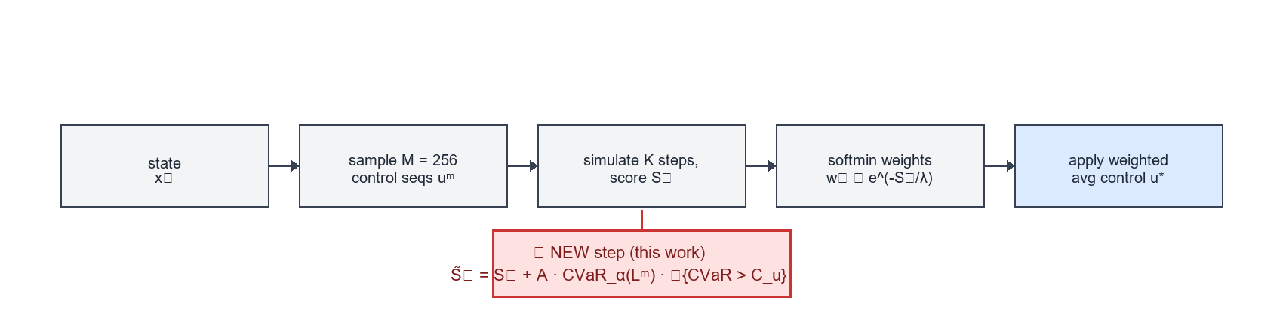
Online CVaR inside MPPI's cost aggregator.
min E[J_task] s.t. CVaR_α( L_risk ) ≤ C_u
 | Offline CVaR-MDP (Chow 2015) | Online CVaR-MPPI (this work)
CVaR computed | Pre-computed VI table (state × budget) | Monte-Carlo, every 50 ms
Continuous state? | Exponential blow-up | Sampling-based
Re-tunable in deploy? | Rebuild table | Change C_u & rerun
Real-time? | Offline | ≈ 80 ms / cycle on CPU

Slide 7
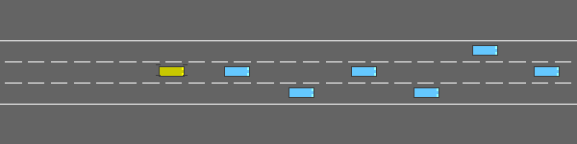
Same seed. Same noise. Different aggregator. Different outcome.
MPPI — crashed @ 6.5 s
CVaR-MPPI — survived 20 s
75 × TTC margin
 | MPPI | CVaR-MPPI
Outcome | 🔴 crashed 6.5 s | 🟢 survived 20 s
TTC_min | 0.01 s | 0.75 s
e_y,RMS | 0.762 m | 0.219 m
a_y,peak | 15.2 m/s² | 17.1 m/s² (cost of safety)

Slide 8
Across 30 paired runs — three stories.
Scenario | Seeds | MPPI crash | CVaR crash | Notable per-seed
lane_change (mixed dir.) | 10 | 0/10 | 1/10 ⚠ | seed 2: CVaR collides where MPPI survived
cutin | 10 | 1/10 | 1/10 | seed 2: min_dist 2.19 → 4.31 m (+97 %)
hard_brake (paired) | 1 | False | False (bit-identical) | CVaR silent ⇒ no-regret ✓
⭐
Helps decisively when F̃ spans the hazard (single-seed lane_change).
🟰
Silent when baseline is already safe — bit-identical trajectories on hard_brake = no-regret.
⚠
Can regress on noisy-tail seeds (sweep seed 2). Parameter-sensitive.

Slide 9
What I learned.
🎯
CVaR helps only when F̃ spans the hazard.
Scripted out-of-distribution braking ⇒ silent; natural traffic perturbations ⇒ active.
🛡
No-regret is provable and verified.
J_C ≡ 0 ⇒ S̃ = S bit-for-bit (confirmed on hard_brake).
🔧
Calibrating C_u is the hardest knob.
Built per-step n_over_budget / cvar_max logging so the penalty's activity is observable, not assumed.
📉
Soft constraints can regress at the margin.
Future work: hard-constrained CVaR via Chow's confidence-set formulation.
Online CVaR-MPPI delivers selective tail shaping: invisible when unneeded, decisive when needed, transparent when wrong.

