Slide 1
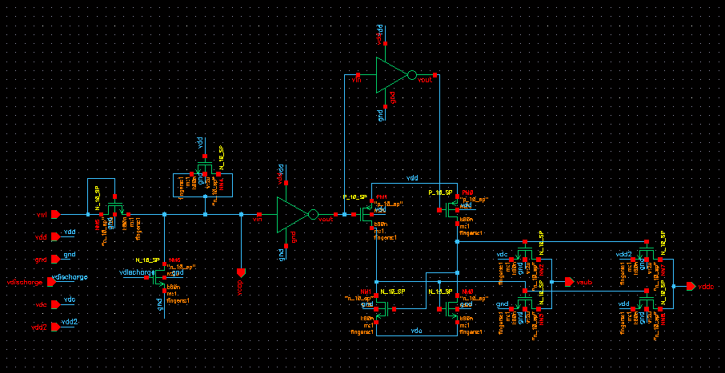
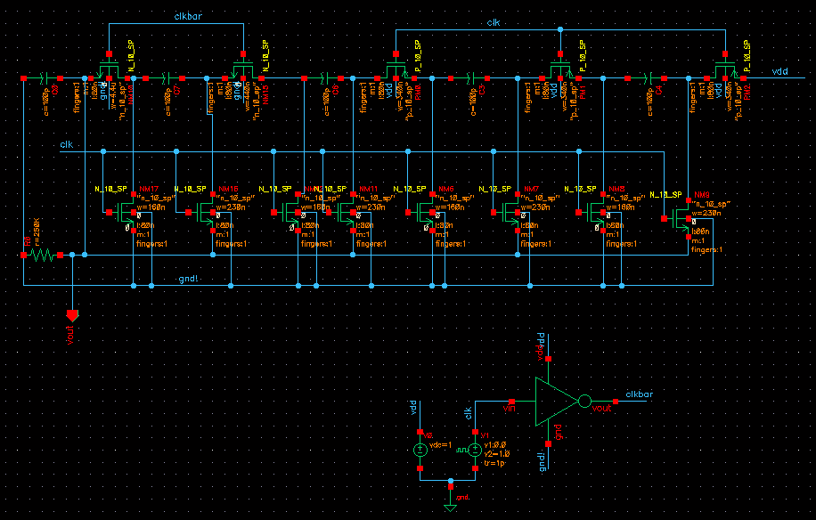
SRAM DESIGN for NANOSCALE TECHNOLOGY with DYNAMIC V_{th} and DYNAMIC STANDBY VOLTAGE for LEAKAGE REDUCTION
2015 International Conference on Signal Processing and Communication
YASHWANT SINGH, D. BOOLCHANDANI
Electronics and Communication Engg. Dept.
Malaviya National Institute of Technology, Jaipur, India
1. Introduction
Today’s battery mobile applications demand for devices with low power and high speed.
To achieve high dense, high speed and low power devices, VLSI industry is continuously following a down path for CMOS devices technology.
Reduction in Size of transistor also reduces the delay of transistor which satisfies the high performance need.
With scaling down of the supply voltage threshold voltage of the devices has also scaled down to meet the performance.
Scaling down of technology has resulted in devices with very thin oxide layer and very low threshold voltage.
Leakage current increases both in active and standby mode of operation.
Future prospects shows memory chip will occupy will most of the chip area in future.
Major leakage currents in SRAM cell
Subthreshold leakage current
Junction leakage current
Gate leakage current
3. Proposed Work
Includes benefits of both drowsy and dynamic v_{th} SRAM.
Time based scheme.
SRAM cells which are not accessed for a certain time period are assigned with high v_{th} and reduced standby voltage.
SRAM cells which are in frequent use are assigned with low v_{th} and normal v_{dd}.
RC decay circuit is used to determine that certain time period.
Fig. 1. Schematic of proposed scheme
Negative body biasing is used to convert MOSFETs to high V_{th} MOSFETs.
Switch capacitor technique is used for on chip conversion of V_{dd} to reduced V_{dd}.
Depending upon number of stages value of reduced Vdd can be changed.
Fig. 2. Schematic of five stage switch capacitor DC to DC converter
2. Literature Review
Conventional 6T SRAM cell
Group of six transistors along with a number of other peripheral devices such as row decoder, column decoder, sense amplifier, and write circuitry.
Read Operation
Row decoder and column decoder decode the address of the SRAM cell from where data has to read.
The bit lines are pre charged to V_{dd.}
Enabling of the word line discharges one of the bit line through an NMOS transistor connected to a “0” node of the cell.
Sense amplifier detects and amplify the small voltage difference between bit lines.
Write Operation
Row decoder and column decoder provide the address of a cell where data has to be written.
External devices provides the data to be written.
After enabling the word line, the write circuitry will write the data into the cell depending upon the condition of the column gate.
(b) Drowsy Scheme
Two mode of operations of SRAM cell – active and drowsy.
Drowsy mode of operation require low supply voltage for data retention and normal supply voltage is required for active mode.
Multiple supply voltage is used for leakage reduction.
(c) Dynamic V_{th} SRAM
Body biasing is used to reduce the sub threshold leakage current.
High V_{th} for unused cells and low V_{th} for cells which are in use.
Negative bias increases the discharge time of bit lines.
4. Simulation Setup and Results
90nm technology model file and simulation was done on Cadence virtuoso.
Read, write, and data retention operations are happened to be correctly.
Switching of power supply introduced the memory wake up delay.
Table 1. Comparison of leakage reduction techniques
Techniques | Average Power Dissipation(W)
 | “0” Case | “1” Case
Simple 6T SRAM | 4.19e-08 | 1.23e-06
Dynamic V_{th} SRAM | 4.07e-08 | 1.08e-06
Drowsy Scheme | 3.45e-08 | 2.13e-07
Proposed technique | 2.38e-08 | 6.87e-08
Paper ID: 3024995
Contact email: rajput.yashwant@gmail.com

