Slide 1
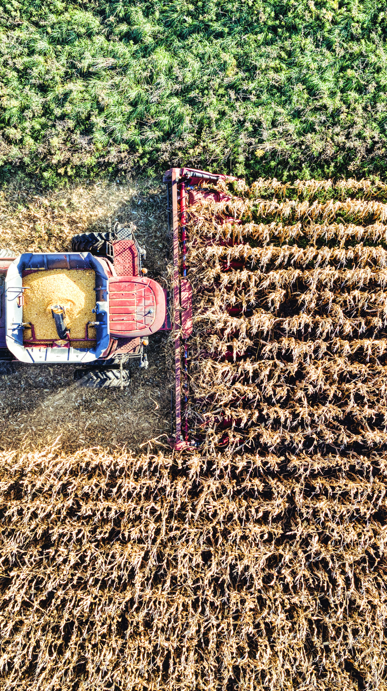
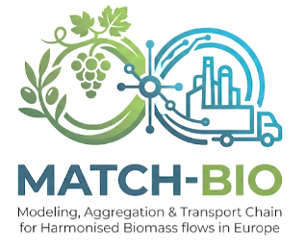
MATCH-BIO
Modeling, Aggregation and Transport Chain for Harmonised Biomass flows in Europe

Slide 2
Status Quo
Key Information
Steps done
Topic:HORIZON-CL6-2026-01-CIRCBIO-05: Understanding biomass flows in Europe
Type of Action: RIA (Research and Innovation Action)
Budget: €3,000,000 & Time: 36 months
Consortium is being drafted
Concept Note sent out
NDAs sent out for signature

Slide 3
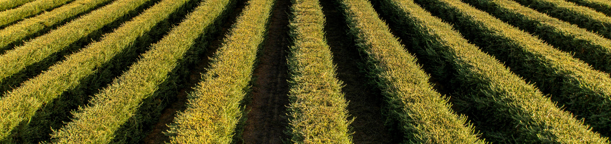
Challenge and Rationale
Europe's transition towards a sustainable, circular, and climate-neutral bioeconomy requires robust, harmonised, and data-driven systems capable of monitoring, modeling and optimizing biomass flow
Agricultural woody resides represent europes largest unmapped and underutilized circular economy opportunity
⟶ Logistical and chemical fragmentation!

Slide 4
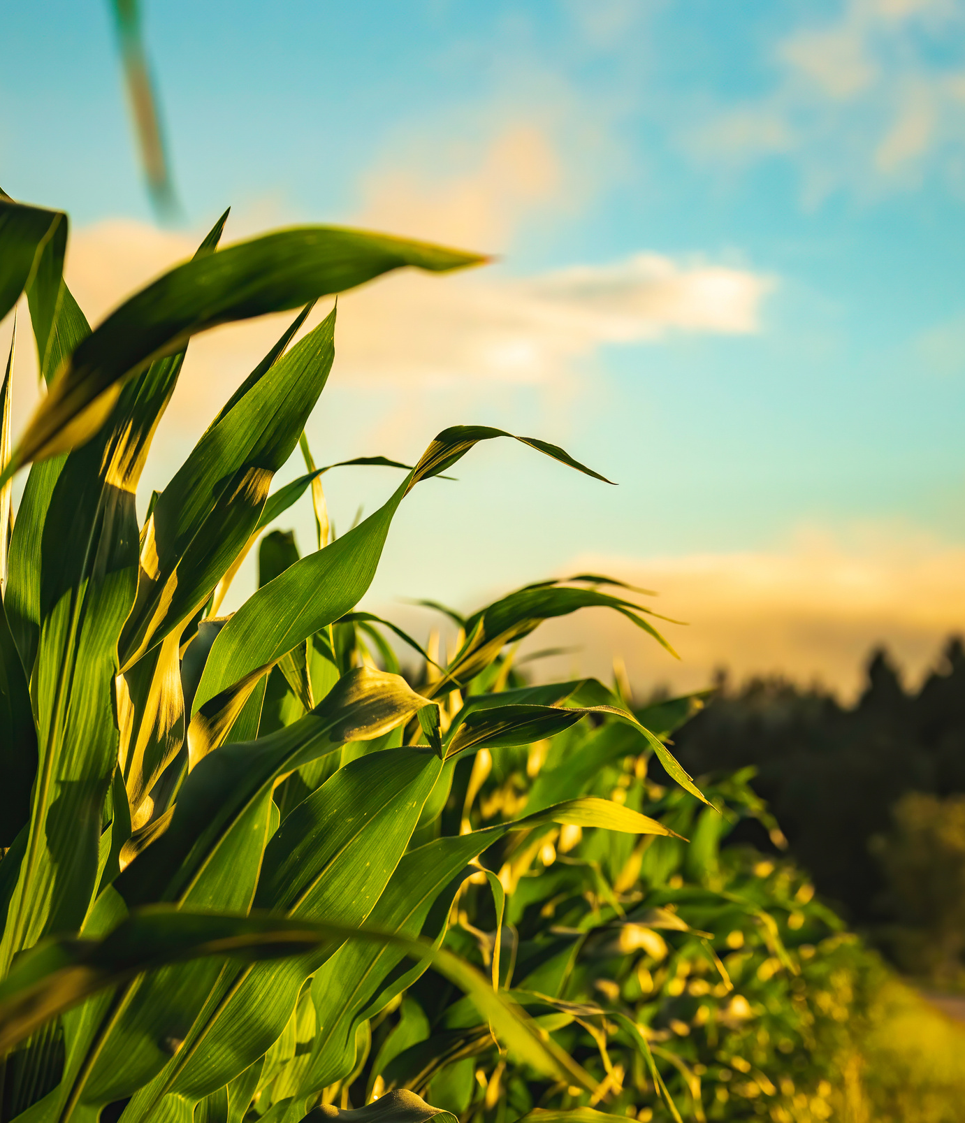
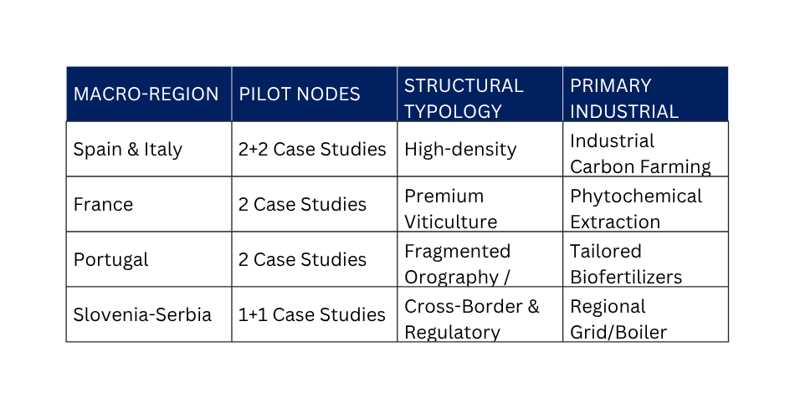
Objectives and Methodology
Optimized 'Lean Multi-Actor Framework' across a coordinated network of 10 Pilot Case Studies strategically distributed across 5 distinct European macro-regions: Spain (2), Italy (2), France (2), Portugal (2), and the Slovenia-Serbia transitioning corridor (2).
MATCH-BIO aims to develop and demonstrate a harmonized European framework for sustainable biomass management by combining satellite-based monitoring, advanced digital modeling, and territorial governance.

Slide 5
Expected Impact & EU Dimension
Delivery of an open-access European Toolbox, including interoperable and FAIR datasets, harmonised modelling methodologies, and policy dashboards that feed directly into the EU Bioeconomy Observatory.
Lean, data-driven digital architecture can be effortlessly transferred to other underutilized European streams—such as forestry residues in Northern Europe or landscape maintenance biomass—maximizing the long-term systemic impact and commercial return on the Union's investment.

Slide 6
KI1: E-Chemometric & Predictive Feedstock Characterisation
Key Innovations
SOTA: biomass inventories are static and based on obsolete data
Advancement: digital predictive chemometrics model
TRL: 3 to 6
KI2: Multi-Sensor Copernicus Fusion for Hyper-Fragmented Perennials
SOTA: remote sensing fails when applied to perennial crops due to extreme parcel fragmentation
Advancement: pioneering multi-source data fusion model
TRL: 4 to 6/7
KI3: Dynamic Cascading Matchmaking Engine
SOTA: platforms ignore environmental and economic potential of materials
Advancement: intelligent Decision Support System
TRL: 3 to 6
KI4: Digital Carbon Farming Verification Framework
SOTA: lack of harmonised, transparent and automated methodologies
Advancement: digital twin architecture as a verifiable environmental ledger
TRL: 4 to 6

Slide 7
WPs
WP1&WP2: Project Management and Coordination
To ensure timely, budget-compliant project execution; to manage legal, financial, and administrative risks; and to guarantee strict compliance with EU ethics, cross-border data flows, and FAIR data mandates.
WP3: Territorial Baseline, Data Harmonisation and Case Study
To standardize historical, bioclimatic, and cartographic data across the 5 participating nations and to formalize the digital infrastructure of the 10 multi-actor Regional Pilot Case Studies.
WP4 & WP5: Predictive AI, Chemometrics and Matchmaking Engine Development
To design, code, and train the core MATCH-BIO cloud software platform, materializing Key Innovations 1, 2, and 3 across diverse topographies and climate zones.
WP6: Multi-Territorial Validation and Pilot Case Studies Deployment
To deploy and field-test the MATCH-BIO cloud framework under real-world, multi-jurisdictional operating conditions across Spain, Italy, France, Portugal, and the Slovenia-Serbia transitioning corridor.
WP7: Sustainability, Carbon Certification Framework and Exploitation Models
to quantify the environmental and socio-economic impacts of the platform, validate the digital carbon MRV infrastructure (KI4), and build market-ready business models.
WP8& WP9: Dissemination, Communication and Policy Uptake
To maximize project visibility, feed harmonized datasets into the EU Bioeconomy Observatory, and facilitate replication across broader European regions.

Slide 8

Next Steps
Living document for WP description
Scheduling the next meeting

Slide 9
THANK YOU
Open questions?

