Slide 1
Capstone Project Airbnb Booking Analysis
By- Ayush Ambhore

Slide 2
Points for discussion
Data summary
Problem Statement
Distribution of room type
Area ranking with respect to hotel listings
Top 25 popular locations for hotel bookings
Top 10 most expensive locations for hotel bookings
Top 10 most cheapest locations for hotel bookings
Availbility of hotels
Minimum nights for stay in a hotel
Average night stays in different area
Price range of hotels
Average price of type of rooms in different areas
Geographic analysis

Slide 3
Data summary
id = unique ID for each hotel
name = name of the Hotel in the listing
host_id = unique host ID
host_name = Name of the host who listed the hotel
neighbourhood_group = location of the hotel
neighbourhood = area of the hotel
latitude = Latitude range
longitude = Longitude range
room_type = Type of the hotel room listed
price = price of the hotel in the listing
minimum_nights = minimum nights to be paid for the stay in the hotel
Number_of_reviews = Number of reviews of the given hotel
last_review = Date of the last review made for the hotel
reviews_per_month = Number of checks per month
calculated_host_listings_count= Total number of times host made listing
availability_365 = availability around the year of the hotel

Slide 4
Problem statement
We will analyse the Aribnb NYC 2019 Data and we will answer the following questions
What is the distribution of the property types (e.g., apartment, house, etc.) among the Airbnb listings in New York City in 2019?
Which is the most popular area in New York city in 2019?
What are the top 20 popular location in New York city for hotel listings in 2019?
Which is the most popular figure for availability of a hotel in days in New York city in 2019?
Which is the most popular figure for minimum nights to stay of a hotel in days in New York city in 2019?
What are the average night stays in different area in New york City in 2019?
Which is the most popular price for hotel listing in new york city in 2019?
Which room type is popular among different area in New york city in 2019?
What are the top 10 most expensive nieghbourhoods in New york city in 2019?
What are the top 10 most cheapest nieghbourhoods in New york city in 2019?

Slide 5
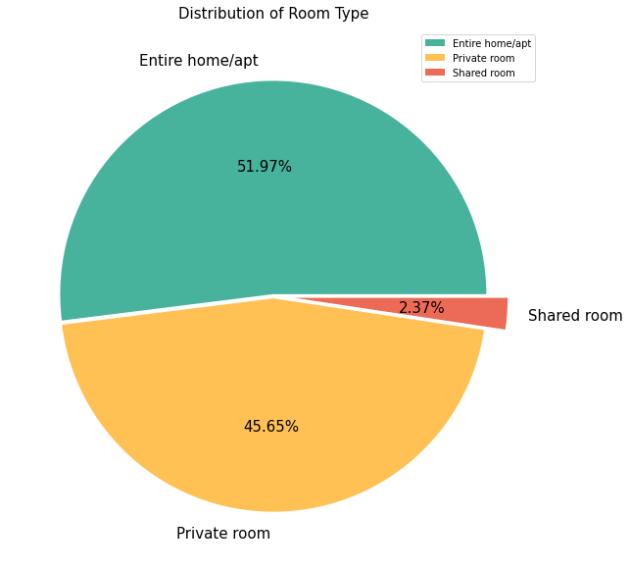
Distribution of room type
Entire home/apt consists of 51.97% of hotel listings in New York Airbnb 2019 data , and it is also the highest which we can clearly see in the pie chart on the right.
Private room consists of 45.65% of hotel listings in New York Airbnb 2019 data, and it is the second in the ranking.
Shared room is the least preferrable by the people as it consists only 2.37% of hotel.

Slide 6
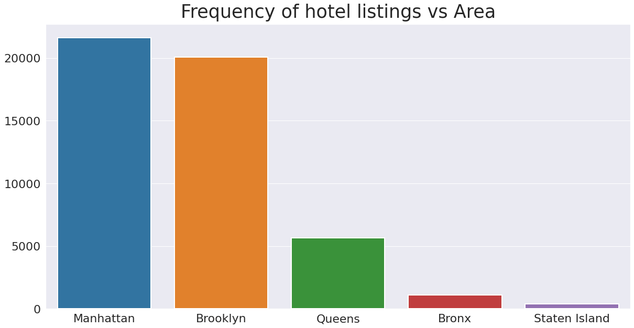
Area ranking wrt hotel listings
Manhattan have the most most number of listings more than 20000.
Brooklyn has is the second which has around 20000 listings.
Queens is the third which has listings around 5000.
Bronx and staten island has the least number of listings.

Slide 7
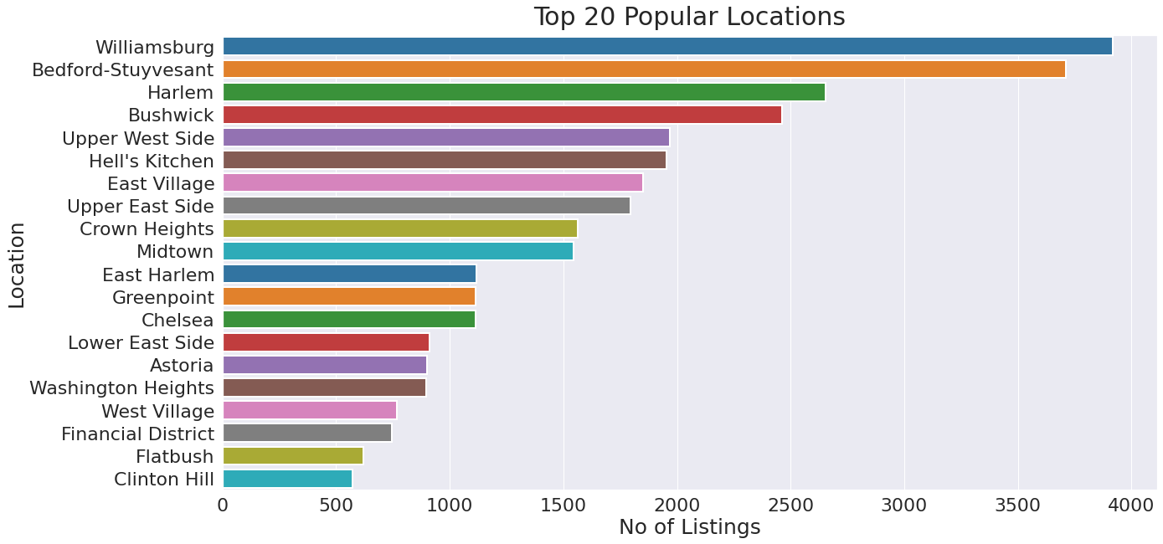
Top 20 popular Locations for hotel booking

Slide 8
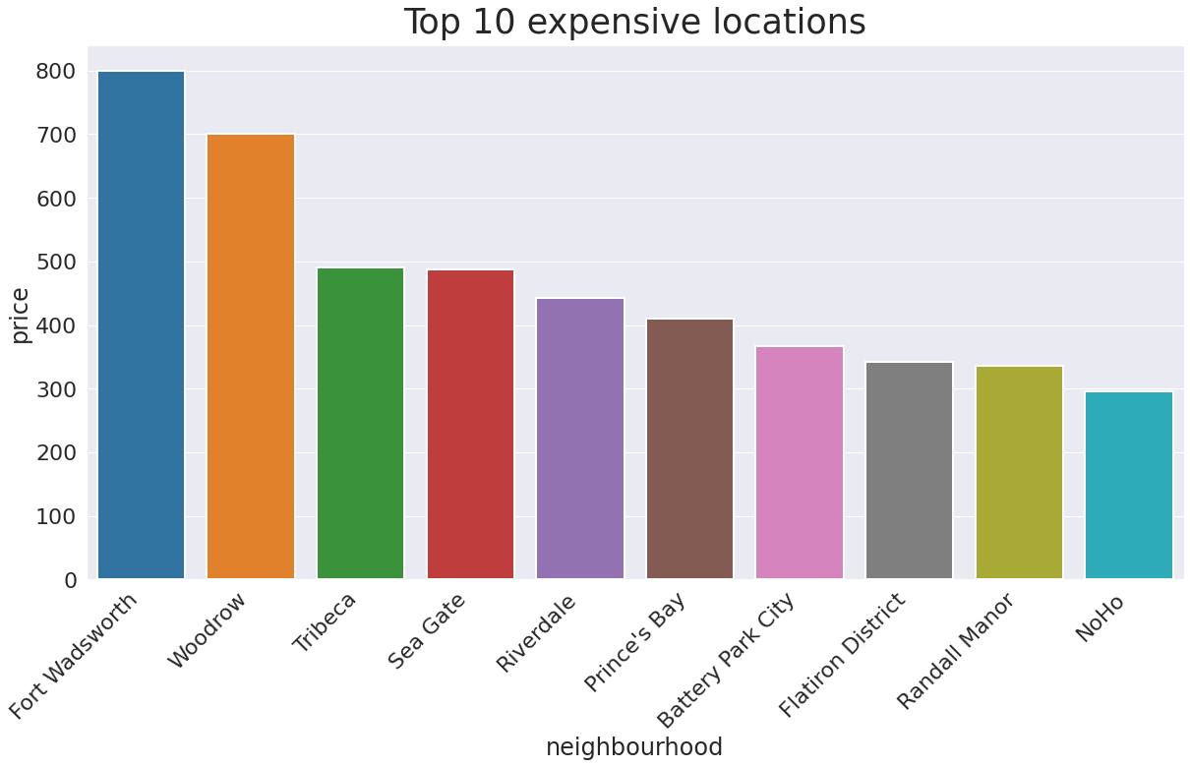
Top 10 expensive locations for hotel booking

Slide 9
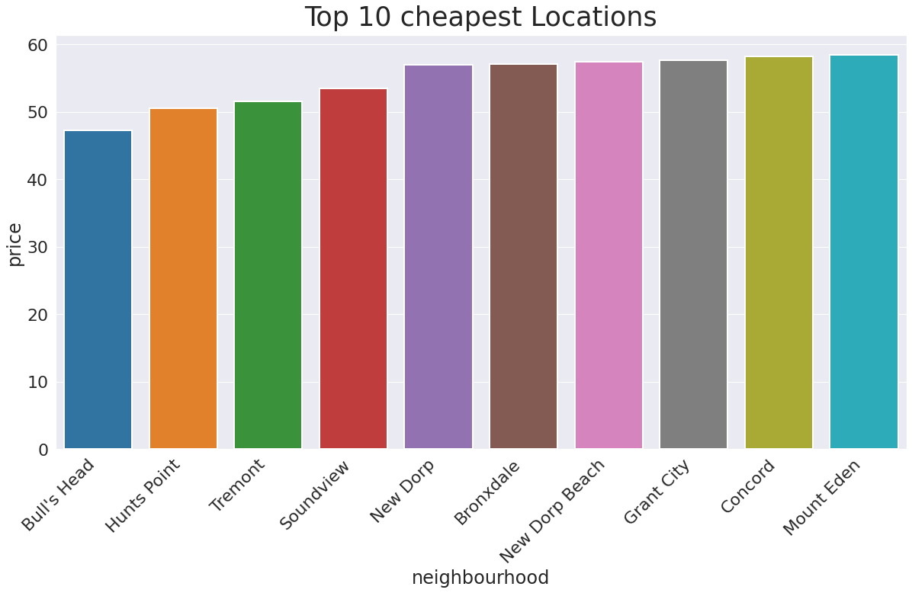
Top 10 Cheapest locations for hotel booking

Slide 10
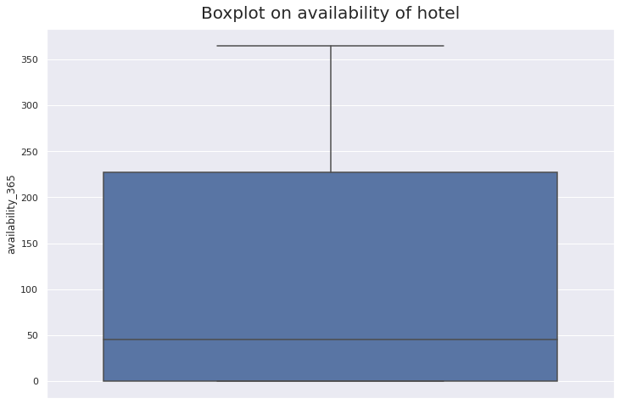
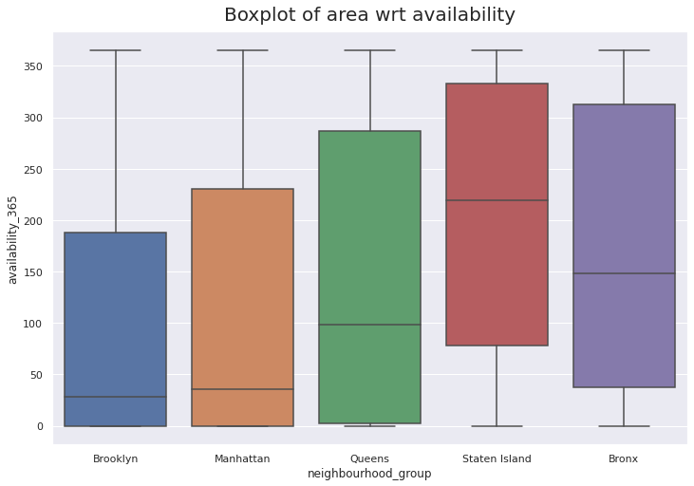
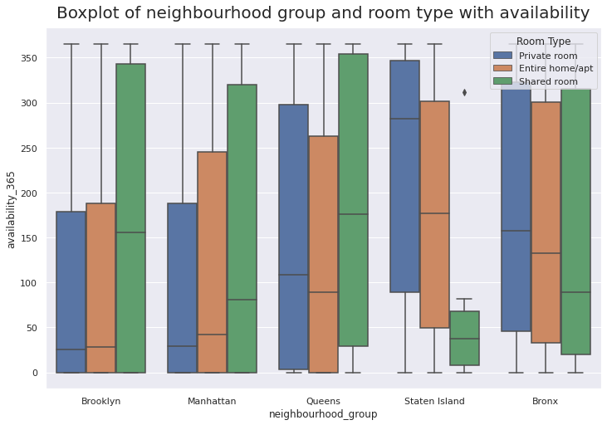
Availability of Hotel
My analysis shows that the most popular figure for availability was 365 days. This means that many hotel owners in New York City are offering their properties year-round, which is useful information for anyone looking to plan a trip to the city.

Slide 11
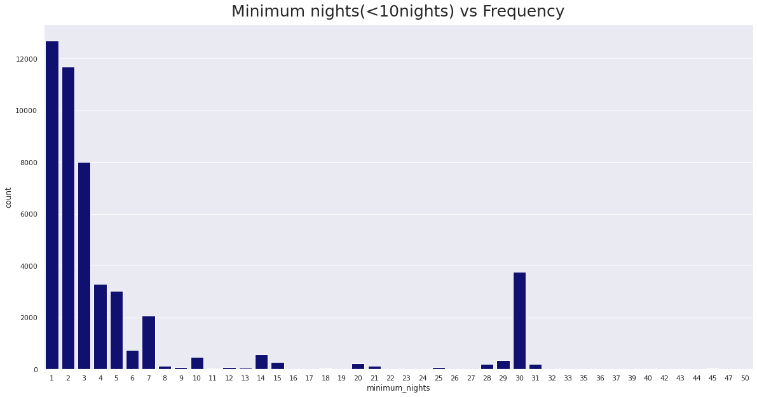
Minimum Nights for stay in Hotel
We can see that majority of people prefer booking hotel with minimum 3 night stay ,also minimum 30 days is slightly popular .

Slide 12
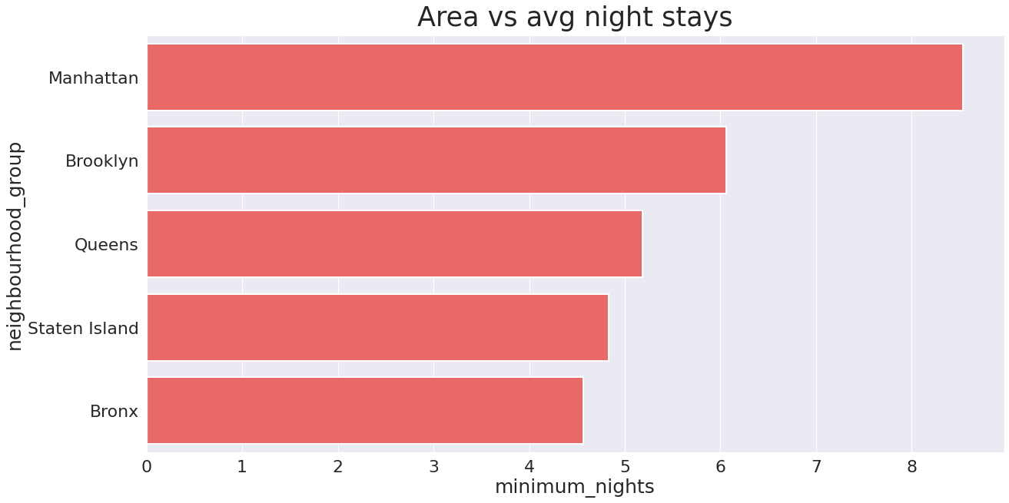
Average night stays in different Area
The average minimum night stays in Manhattan is approx. 8 nights which is the highest among other areas.
Brooklyn’s average minimum night stays is 6 which is second
Queens is third followed by staten island and Bronx and all the three areas have approx. 5 minimum night stays.

Slide 13
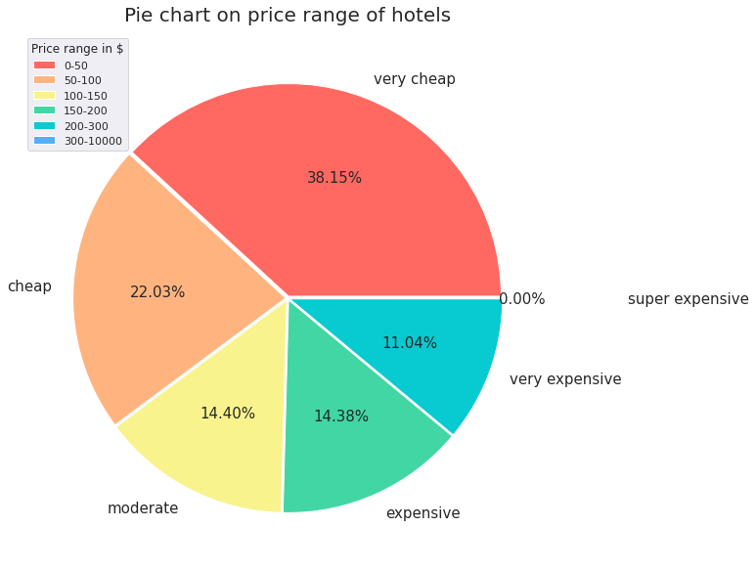
Price range of hotels
The most popular price range is Very cheap (0-$50) which consists of 38.15% of data.
Cheap ($50-$100) is the second most popular with 22.03% part of the data.
Moderate ($100-$150) is the third with 14.40% part of the data.
Expensive ($150-$200) is the fourth with 14.38% part of the data.
Very expensive ($200-$300) Is the fifth with 11.04% of the data.
And super expensive ($300-$10000) is the least popular price range.

Slide 14
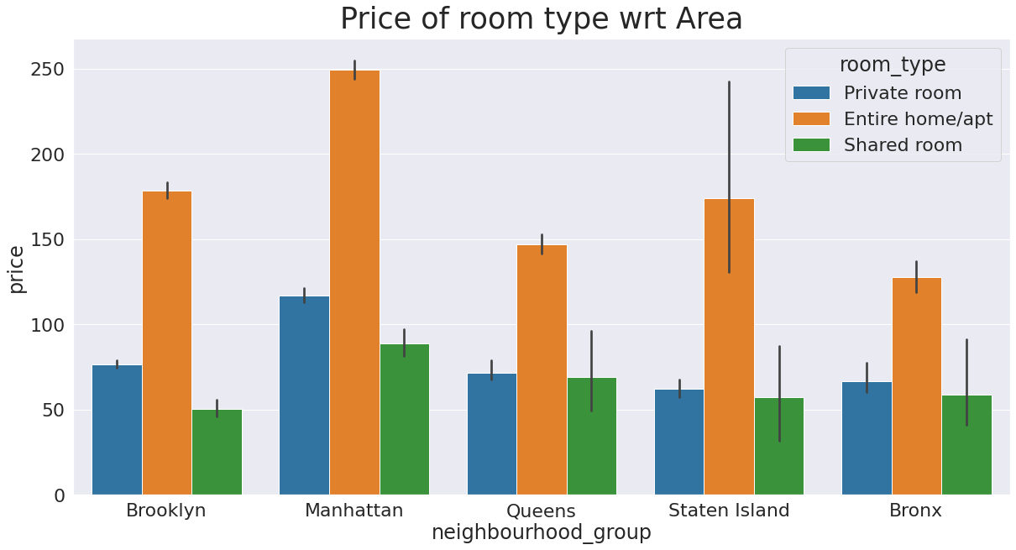
Average price of type of rooms in different areas
It is clear from the graph that entire home/apt room is the most expensive room in all the areas.
Private room is the second expensive in all the areas.
And the least is the shared room.

Slide 15
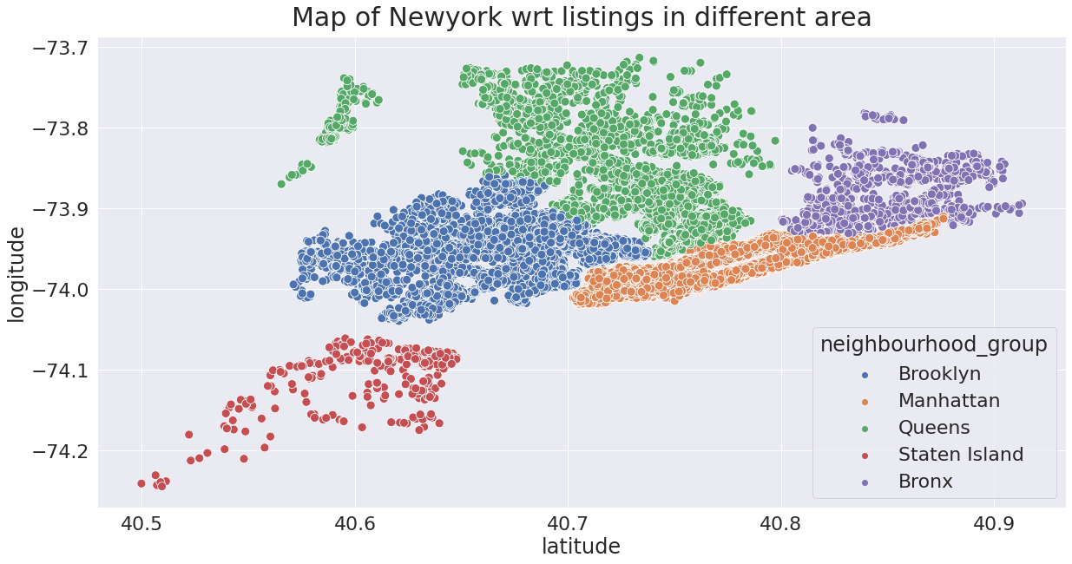
Geographic analysis

Slide 16
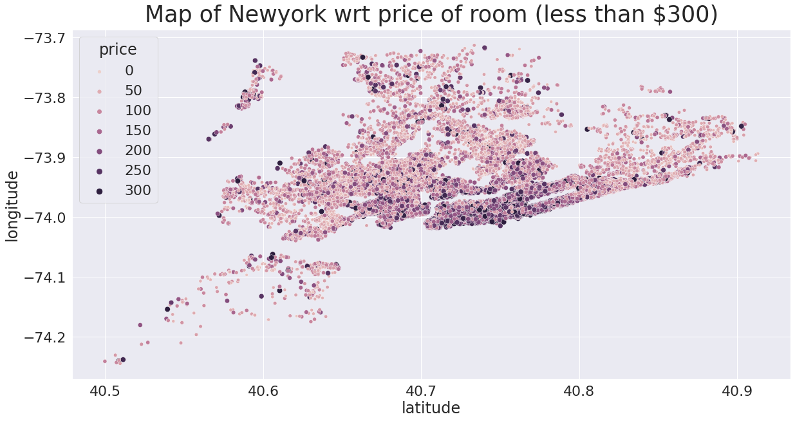
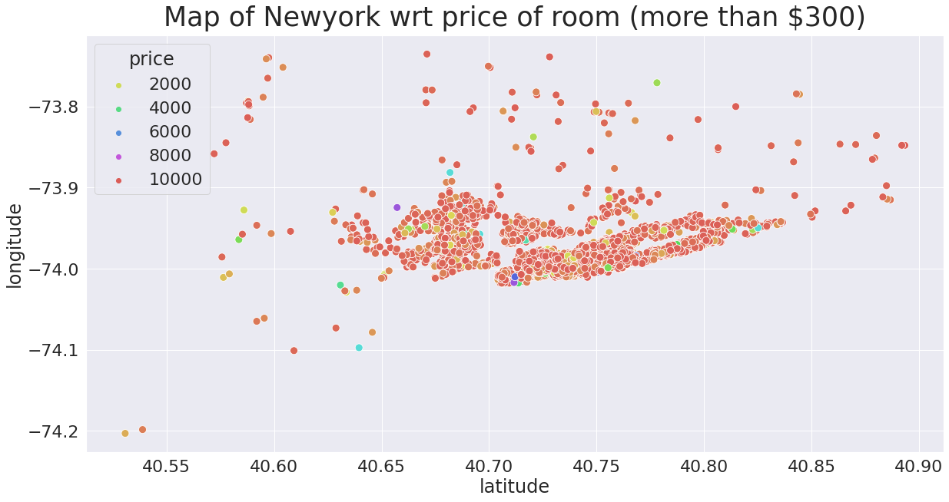
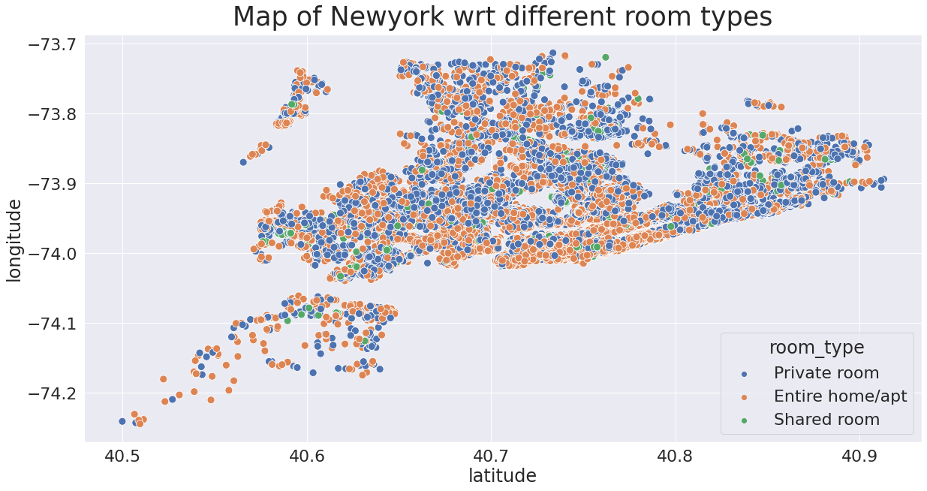
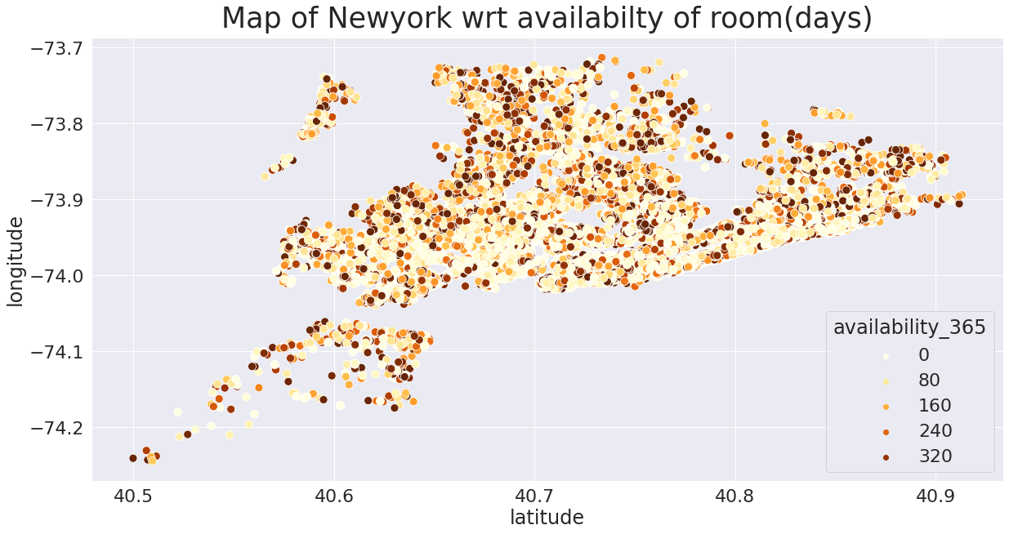

Slide 17
Conclusion
The most Popular room type is Entire home/pvt room.
The most popular area for the hotel listing is Manhattan.
The most popular location for hotel listing is Williamsberg.
Availability of the room can be low as 1 day as.
The poular figure of Minimum night stays for the hotel is 1 day.
The average night stay in manhattan is approx 8 nights , followed by brooklyn which is 6 nights then queens, staten island and bronx have approx 5 nights.
The most popular price range for hotel booking 0 to 50 dollars.
Entire home/apt is the most popular room type in every area.
The most expensive location to book a hotel is Fort wadsworth
The most cheapest location to book a hotel is Bulls head.

Slide 18
Thankyou

