Slide 1
FlavorPrint
Molecular Recipe Fingerprinting
Every dish has a molecular identity. Find flavor twins across 74 countries.
Team CodeCatalysts | ForkIT Challenge 2026 | IIIT Delhi CoSyLab

Slide 2
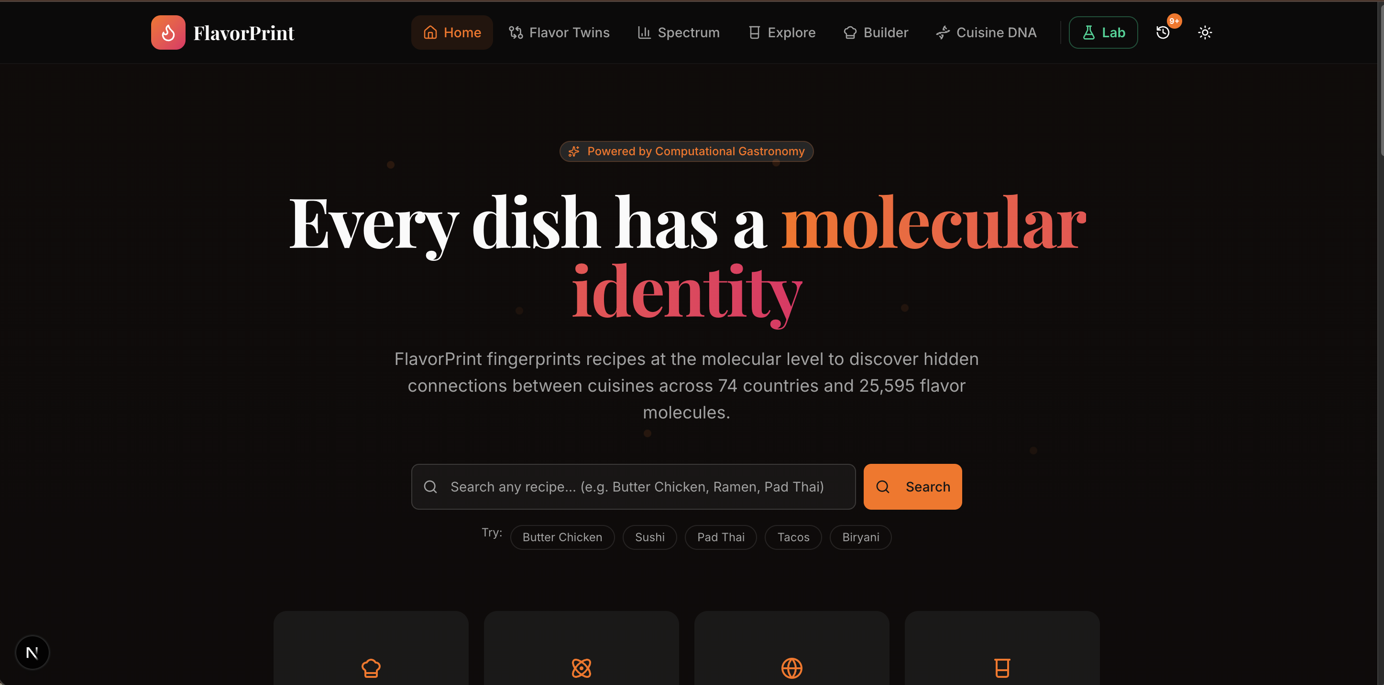
THE PROBLEM
"Finding recipes is easy. Understanding WHY flavors work together, discovering your dish has a twin 6,000km away, and exploring the molecular science behind every bite — that's what's missing."
118,000+
25,595
74
936
Recipes in RecipeDB
Flavor Molecules in FlavorDB
Countries Covered
Food Entities Mapped
The data exists across RecipeDB and FlavorDB. But no one has connected these datasets to reveal the hidden molecular relationships between the world's cuisines.

Slide 3
OUR SOLUTION
FlavorPrint — a web platform that uses molecular data to decode WHY flavors work, not just WHAT to cook.
Recipe Search Hub
Flavor Twins
Search 118K+ recipes by title, Recipe of the Day, search history with smart caching
Find recipes from different countries sharing molecular fingerprints
Philosophy Spectrum
Cuisine DNA
Classify recipes on the Pairing vs Contrast spectrum (Ahn et al., 2011)
Compare molecular profiles of up to 3 cuisines side-by-side with bar charts
Molecular Kitchen Lab
API Explorer
6-module experimental workspace: Kitchen, Library, Heatmap, Fusion, Live Analysis, API Explorer
Browse & test all 62 FlavorDB + RecipeDB endpoints with live runners

Slide 4
FOODOSCOPE API USAGE
We use BOTH RecipeDB and FlavorDB extensively
FlavorDB Endpoints
RecipeDB Endpoints
/entities/by-entity-alias-readable — Search ingredients
/recipe-bytitle/recipeByTitle — Search 118K+ recipes
/entities/by-name-and-category — Filter by category
/search-recipe/{id} — Full recipe details
/entities/by-natural-source — Filter by natural source
/instructions/{recipe_id} — Cooking instructions
/food/by-alias — Food pairing suggestions
/recipe/recipeofday — Recipe of the Day
/molecules_data/by-flavorProfile — Molecules by flavor
/recipe/recipesinfo — Paginated recipe list
/molecules_data/by-commonName — Molecule lookup
/recipes_cuisine/cuisine/{region} — Filter by cuisine
/molecules_data/filter-by-type — Chemical type filter
/properties/by-description — Property search
/properties/taste-threshold — Taste threshold filter
62 total endpoints documented and testable in our API Explorer

Slide 5
TECH ARCHITECTURE
Framework
Language
Styling
Visualization
Next.js 16.1.6
TypeScript 5
Tailwind CSS 4
D3.js 7.9
App Router + Turbopack
Strict mode
shadcn/ui + Radix UI
Recharts + Radial Charts
Animation
State
Data
APIs
Framer Motion 12
Zustand 5
React Query 5
RecipeDB + FlavorDB
Spring physics
Lightweight store
24h localStorage cache
CoSyLab, IIIT Delhi
Key Algorithms
Molecular Fingerprinting — Aggregate molecules per ingredient, classify into 8 categories, radial chart
Cross-Cultural Twinning — Jaccard similarity on molecule sets + low ingredient overlap = twin score
Philosophy Spectrum — Average shared molecules per pair vs random baseline (Ahn et al., 2011)
Ingredient Compatibility — Pairwise Jaccard similarity heatmap across ingredient palette

Slide 6
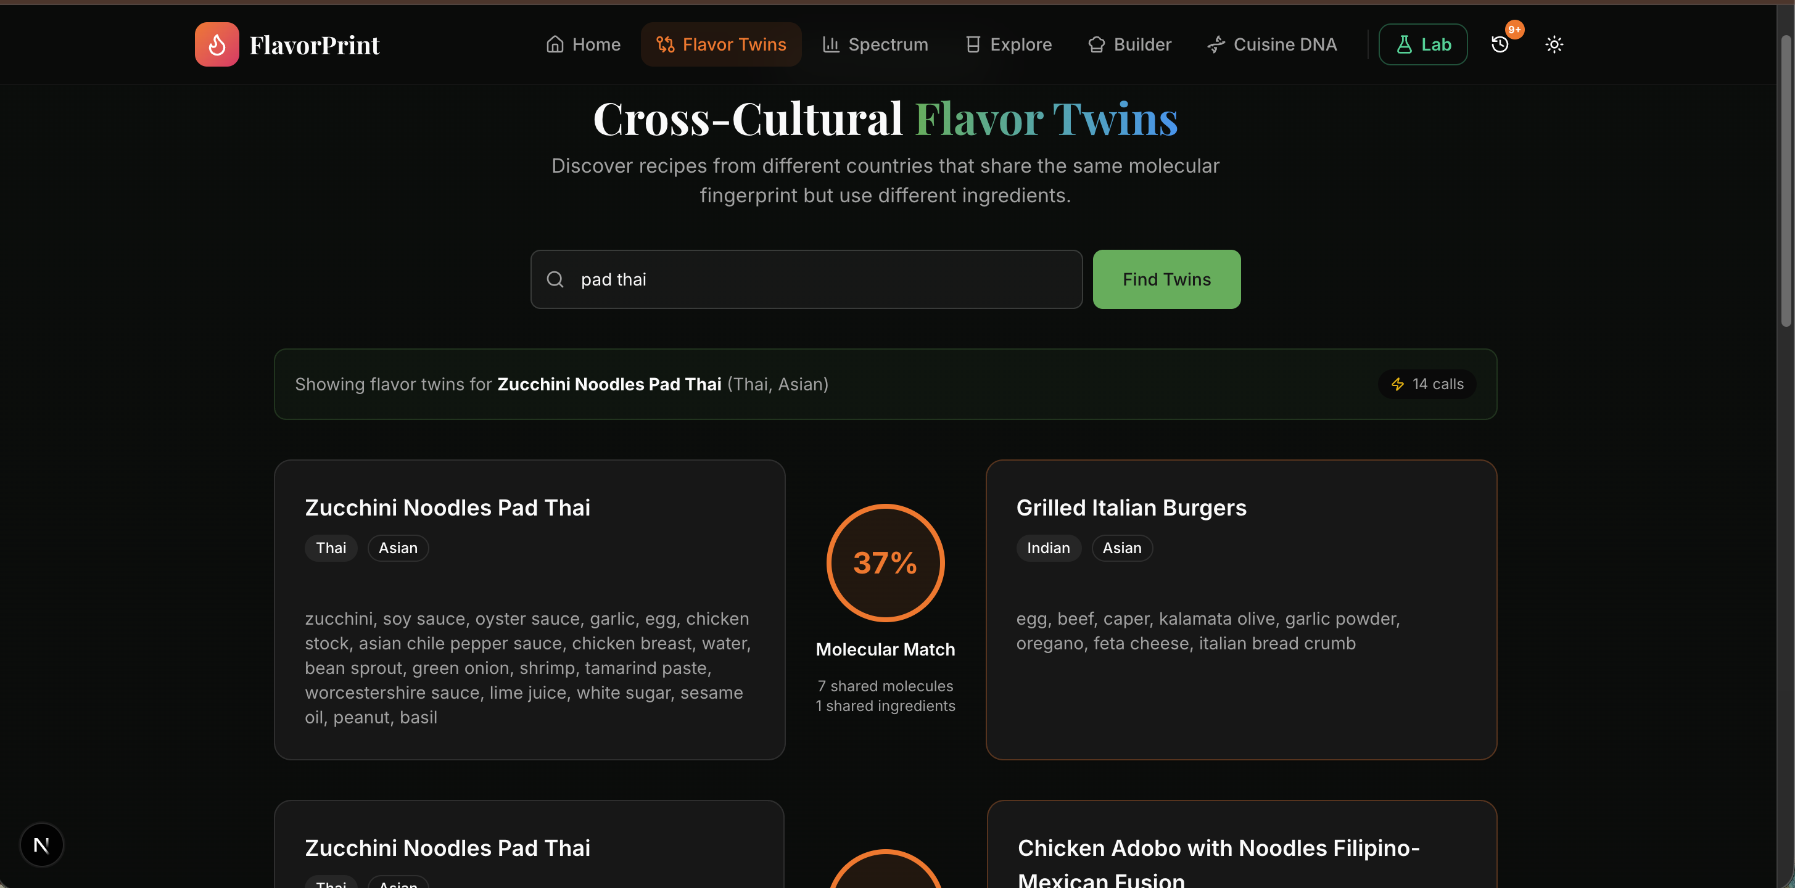
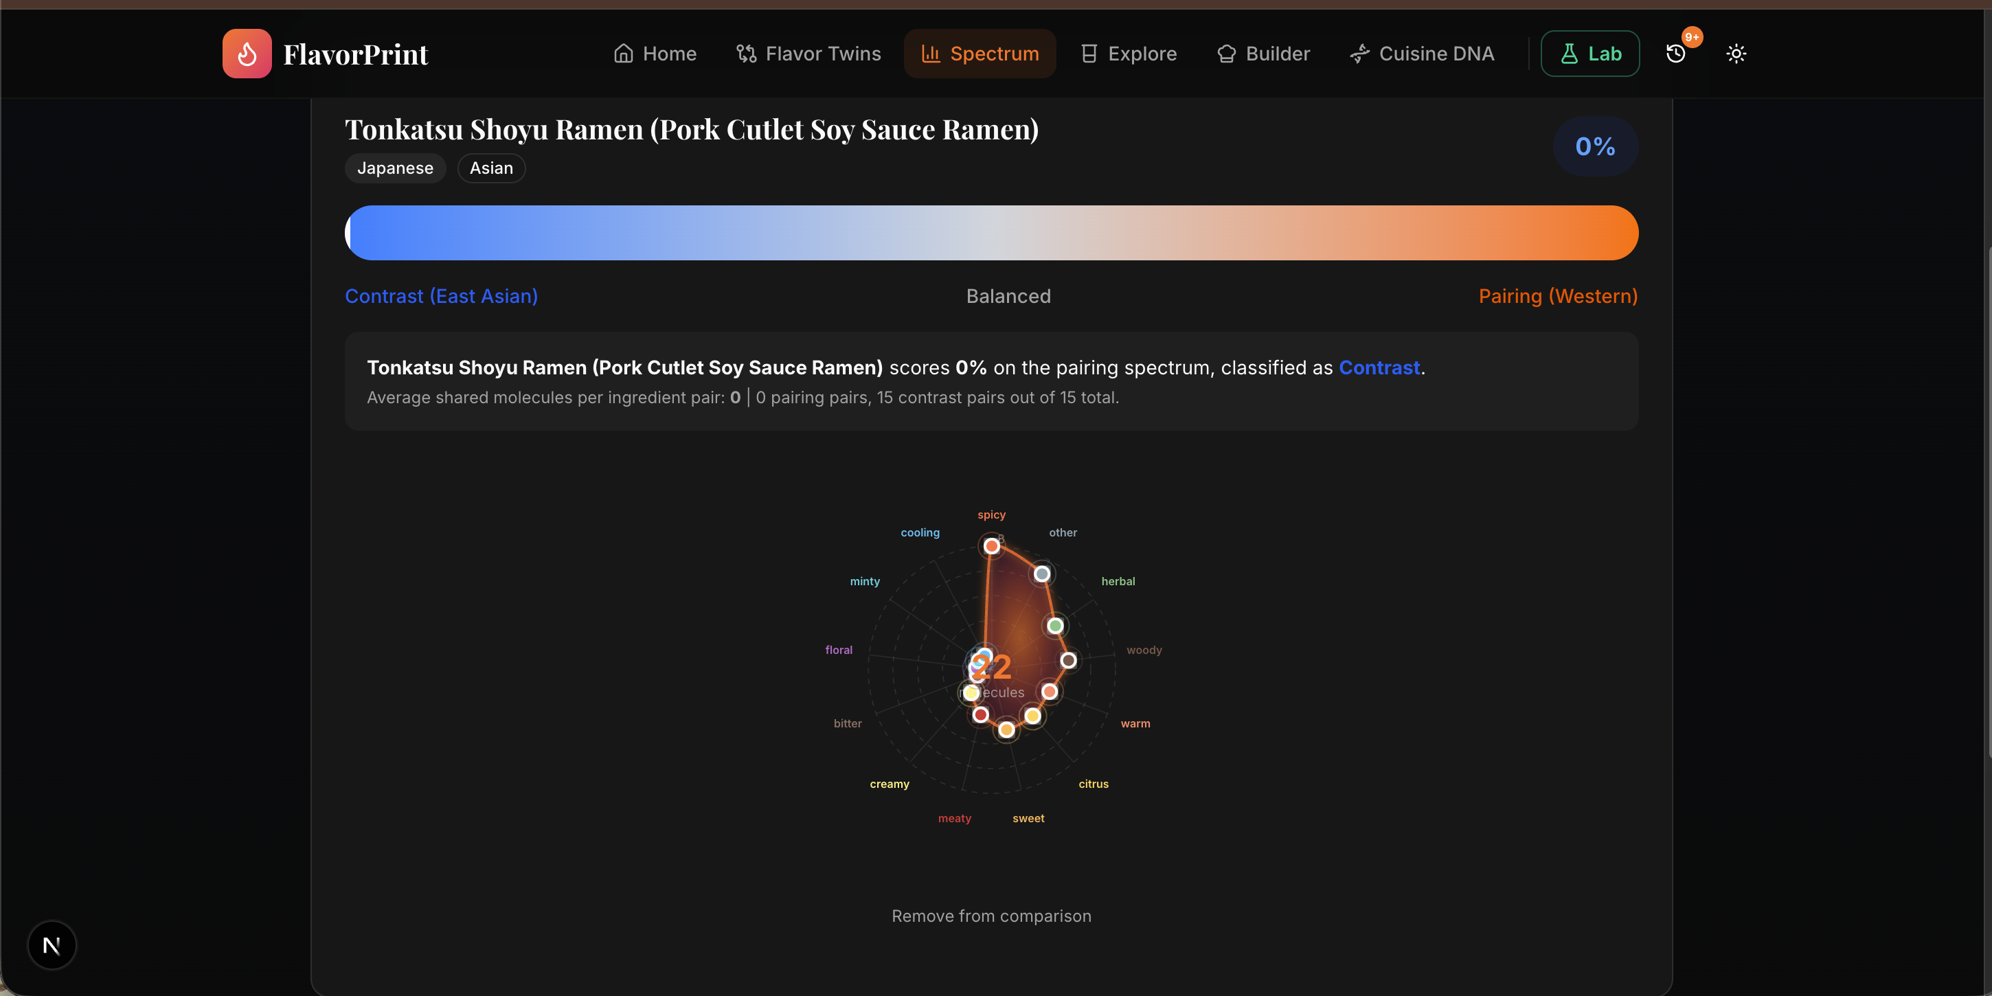
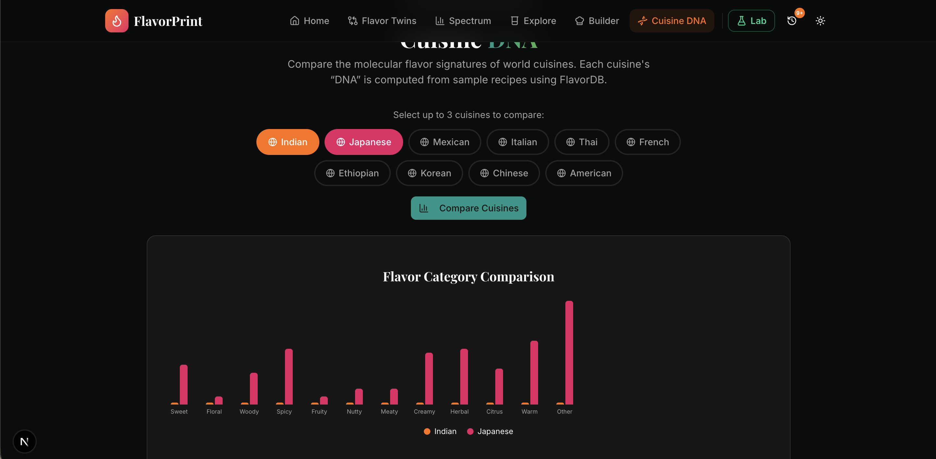
DEMO — CORE FEATURES
Home — Recipe Search Hub
Flavor Twins — Cross-Cultural Discovery
Philosophy Spectrum — Pairing vs Contrast
Cuisine DNA — Multi-Cuisine Comparison

Slide 7
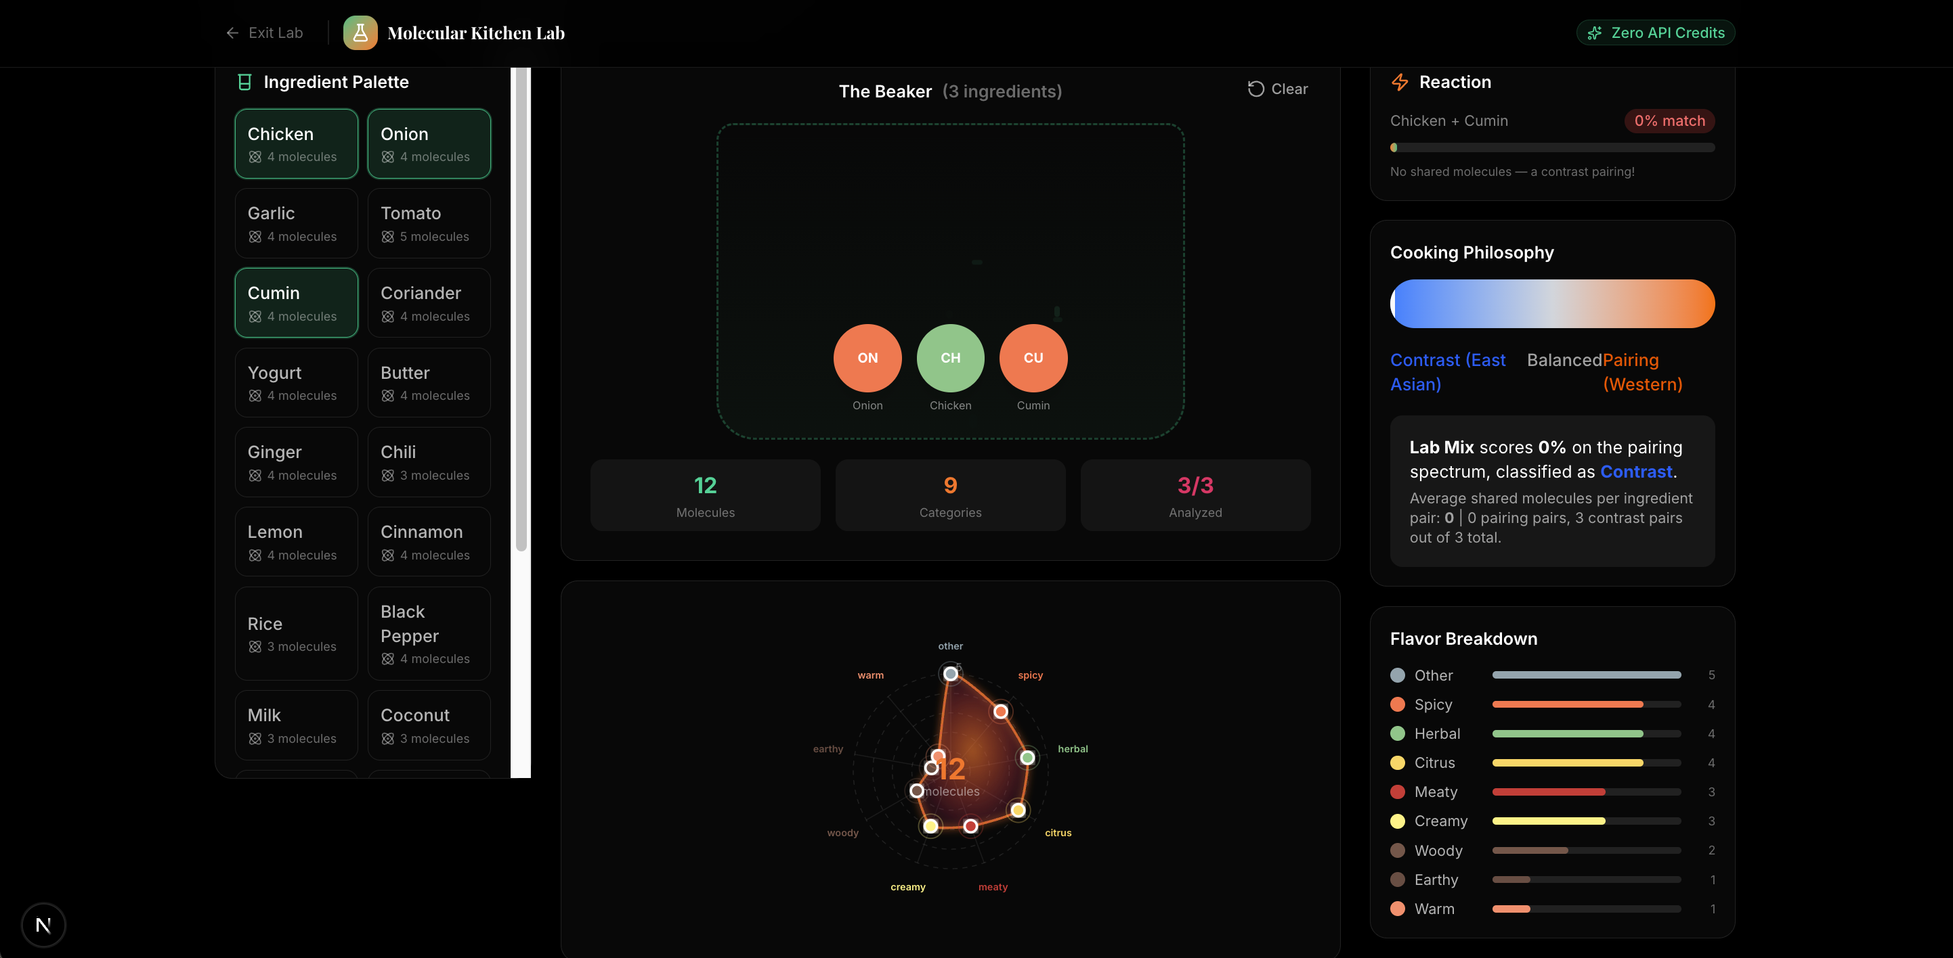
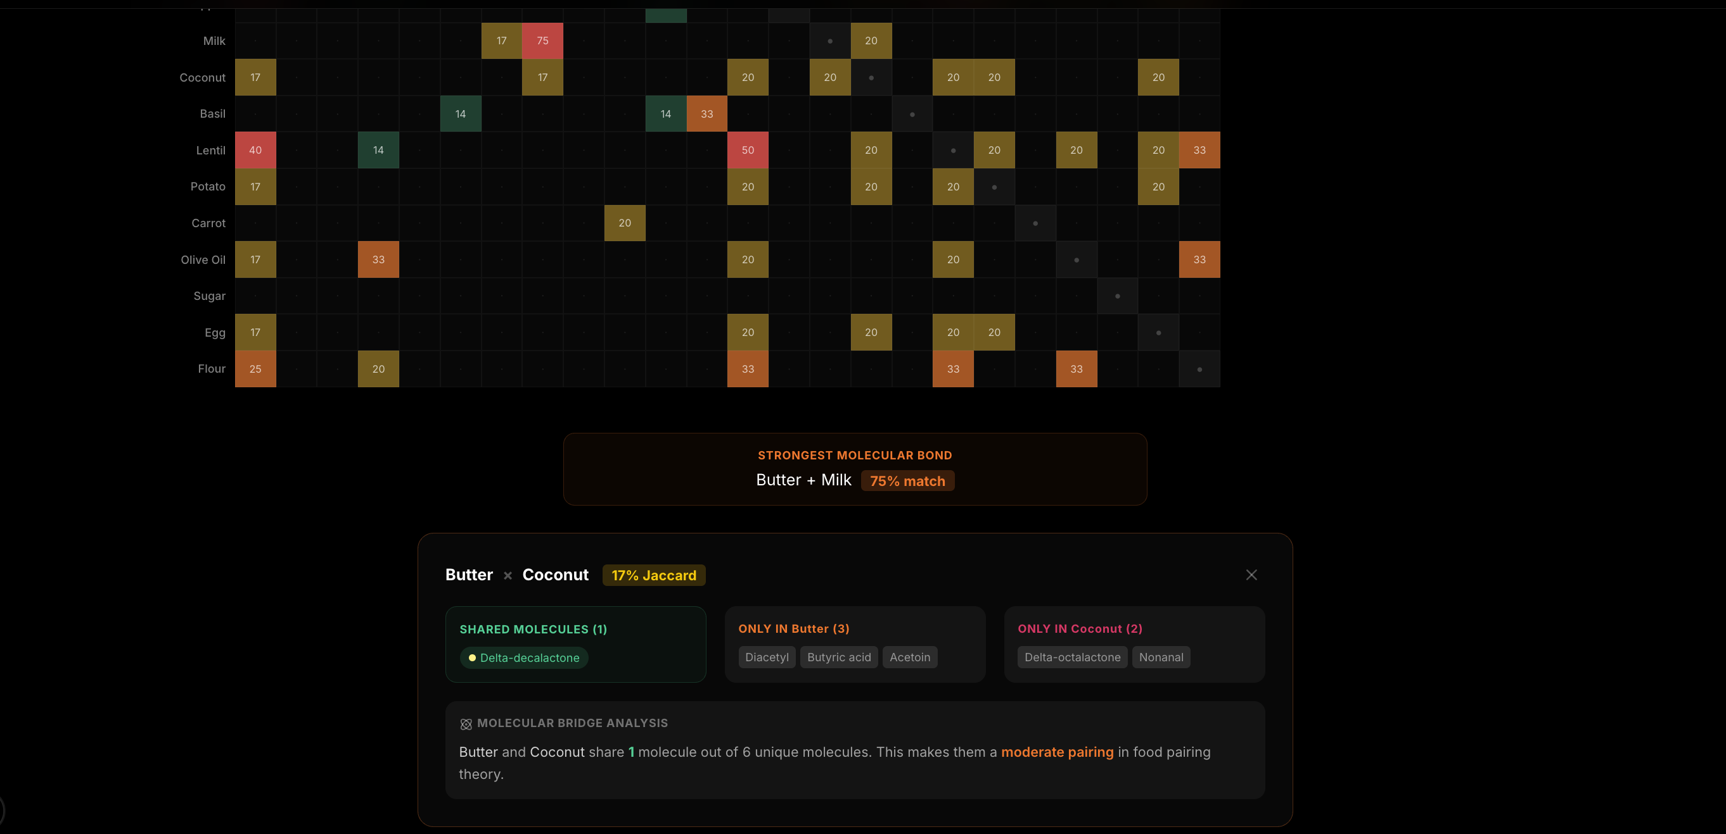
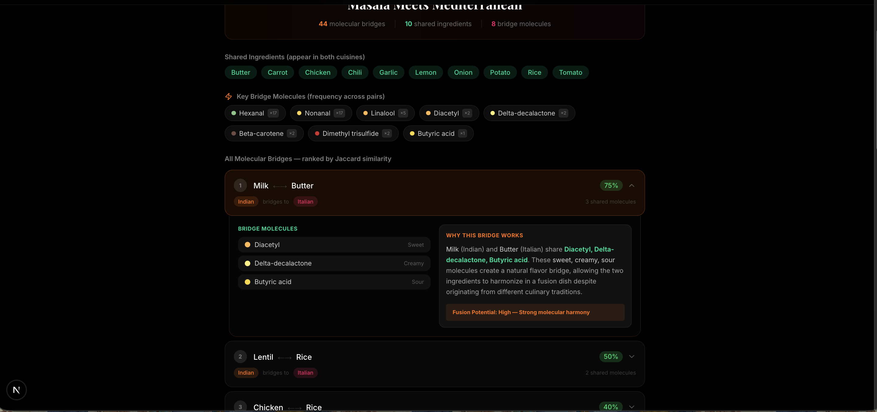
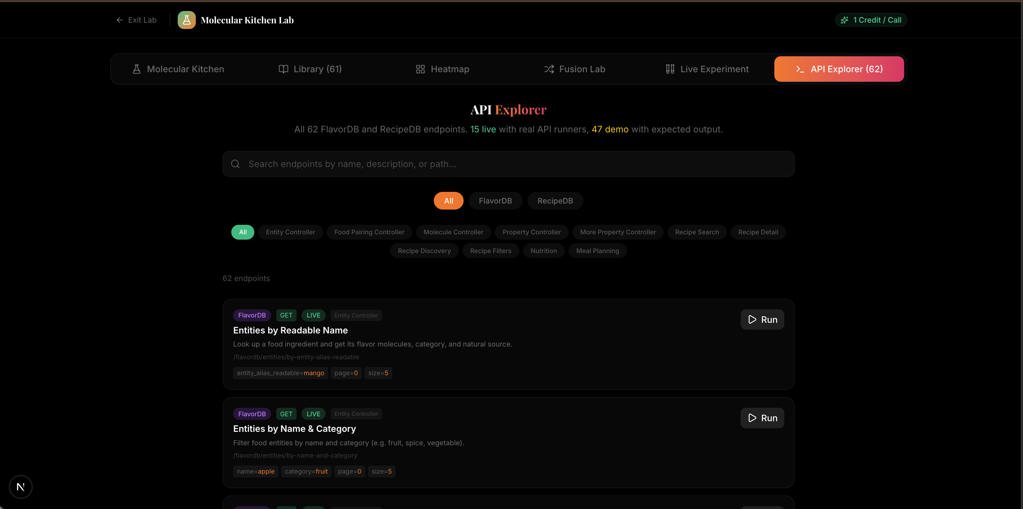
DEMO — MOLECULAR KITCHEN LAB
Molecular Kitchen — Drag & Drop Lab
Compatibility Heatmap — Jaccard Matrix
Fusion Lab — Cross-Cuisine Generator
API Explorer — 62 Live Endpoints

Slide 8
API ISSUE LOG
We documented API bugs and gaps constructively during development.
Issue #1 — CRITICAL
Entity endpoint returns metadata WITHOUT molecules
/entities/by-entity-alias-readable returns entity data but no molecules array. Cannot build live molecular analysis for arbitrary ingredients.
Workaround: Fallback to static FlavorDB molecule library (bundled dataset)
Issue #2 — MEDIUM
Parameter naming inconsistency (flavorProfile)
/molecules_data/by-flavorProfile uses camelCase URL but requires snake_case parameter 'flavor_profile' — 400 error with camelCase param.
Workaround: Use snake_case parameter names
Issue #3 — MEDIUM
Parameter naming inconsistency (commonName)
Same pattern as #2: /molecules_data/by-commonName likely requires 'common_name' instead of 'commonName'.
Workaround: Standardize parameter naming convention
Issue #4 — HIGH
No endpoint to get molecules by entity/ingredient
No way to ask 'What molecules does ingredient X contain?' Entity and Molecule controllers are disconnected.
Full report: ISSUES.md in repository
Workaround: Add GET /entities/{entity_id}/molecules endpoint

Slide 9
CHALLENGES & LEARNINGS
Mixed Protocols
Missing Molecule Mapping
API serves HTTP, Vercel deploys HTTPS. Built a proxy route (/api/proxy) to bridge the gap.
Entity endpoint returns metadata without molecules. Built a static 936-entity molecule cache as fallback.
Parameter Inconsistencies
Large Dataset Handling
Endpoint URLs use camelCase but parameters require snake_case. Documented in ISSUES.md.
118K recipes + 25K molecules. Implemented 24h localStorage caching with smart invalidation.
Zero-Credit Lab Design
Cross-Cultural Analysis
Built the entire Molecular Kitchen with pre-computed data — no API calls needed for experimentation.
Jaccard similarity + ingredient overlap filtering to find genuine molecular twins, not just similar recipes.

Slide 10
Thank You
Built with science, served with flavor.
Team CodeCatalysts | ForkIT Challenge 2026
github.com/ayushap18/Codecatalysts
API Issues documented in ISSUES.md

