Slide 1
Relay switching
and measurement front end
Proton precession magnetometer, ECE 455
Research, design, LTspice simulation, and the hardware work ahead
Fall 2026
Notes:
Scope: relay switching and the measurement front end. The polarization power circuit is outside this presentation. Research sources include PyPPM v1.3 schematics, Ruhunusiri and Jayananda (2008), and the JPM-4 design paper.

Slide 2
Two circuits connect the sensor to a usable signal
The relay routes both coil leads. The receive chain then raises and conditions the microvolt FID for frequency capture.
Sensor coil
~10 µV FID
~2.2 kHz
DPDT relay
selects coil
connection
Tune + protect
690 nF LC
clamp + damping
INA stage
differential
gain ~50
Filter + gain
band-pass
near 2.2 kHz
Comparator
logic edges
for capture
The relay’s measurement state reconnects the coil to the preamp after switching.
Model input: 10 µV peak at 2.214 kHz with a 200 ms decay constant. These are simulation assumptions, not measured coil data.
02
Notes:
The complete-system netlist models a 7.5 mH, 5.5 Ω coil and a synthetic 10 µV, 2.214 kHz exponentially decaying FID source. This slide focuses on relay switching and signal conditioning, not the polarization power circuit.
Sources: local LTSpice complete-system netlist; PyPPM v1.3 receive and relay schematics: https://github.com/geekysuavo/pyppm/tree/main/designs/ppm-1.3

Slide 3
Reference projects informed the architecture
PyPPM v1.3
Differential receive front end and a two-pole relay that switches the sensor between polarization and measurement paths.
Sheets 7 and 13
Ruhunusiri & Jayananda, 2008
Describes relay-controlled polarization-to-amplifier sequencing, coil resonance, a low-noise preamp, and a multiple-feedback band-pass stage.
Sections 2.2–2.4
JPM-4
Uses the sensor coil and tuning capacitor as a parallel resonator, followed by amplification and signal shaping.
Sensors and Materials
Project adaptation: 690 nF tunes the modeled 7.5 mH coil near 2.214 kHz. These values are project choices, not universal requirements.
03
Notes:
PyPPM is the closest hardware reference for the relay and receive architecture. The Sri Lanka build documents practical relay sequencing, sensor tuning and an MFB amplifier chain. JPM-4 documents the coil-capacitor resonator and signal-shaping architecture. Our chosen values adapt those patterns to the modeled local coil.
Sources: PyPPM schematics, Sheets 7 and 13: https://github.com/geekysuavo/pyppm/tree/main/designs/ppm-1.3 ; Ruhunusiri & Jayananda, Construction of a Proton Magnetometer (2008), https://ipsl.lk/documents/TechSession/2008/ipsl0812.pdf ; JPM-4 design paper, https://sensors.myu-group.co.jp/sm_pdf/SM2789.pdf ; local MEASURING_CIRCUIT_AND_RELAY.md.

Slide 4
The DPDT relay changes both coil connections together
Two poles keep both sensor leads isolated from the receiver during the switching interval.
DPDT relay
2 Form C
Polarization
path
Measurement
preamp
Sensor coil
lead pair
Energized: coil connects to polarization path
Released: coil connects to measurement preamp
1.0–1.2 ms pull-in
relay held through polarization and quench
14.0–14.2 ms release
LTspice models relay contacts as voltage-controlled switches. Real coil delay, contact bounce, and isolation still need bench measurement.
04
Notes:
The two-pole relay switches both coil terminals. In the complete-system netlist, the relay command ramps from 0 to 5 V over 1.0–1.2 ms, remains energized through the polarization and quench interval, then ramps low over 14.0–14.2 ms. Voltage-controlled switches approximate contact routing and do not reproduce a physical relay’s coil inductance, operate/release delay, or bounce.
Sources: PyPPM v1.3 relay schematic, Sheet 13: https://github.com/geekysuavo/pyppm/blob/main/designs/ppm-1.3/13-relay.sch ; Ruhunusiri & Jayananda (2008), https://ipsl.lk/documents/TechSession/2008/ipsl0812.pdf ; local LTSpice/complete_system/complete_system.cir.

Slide 5
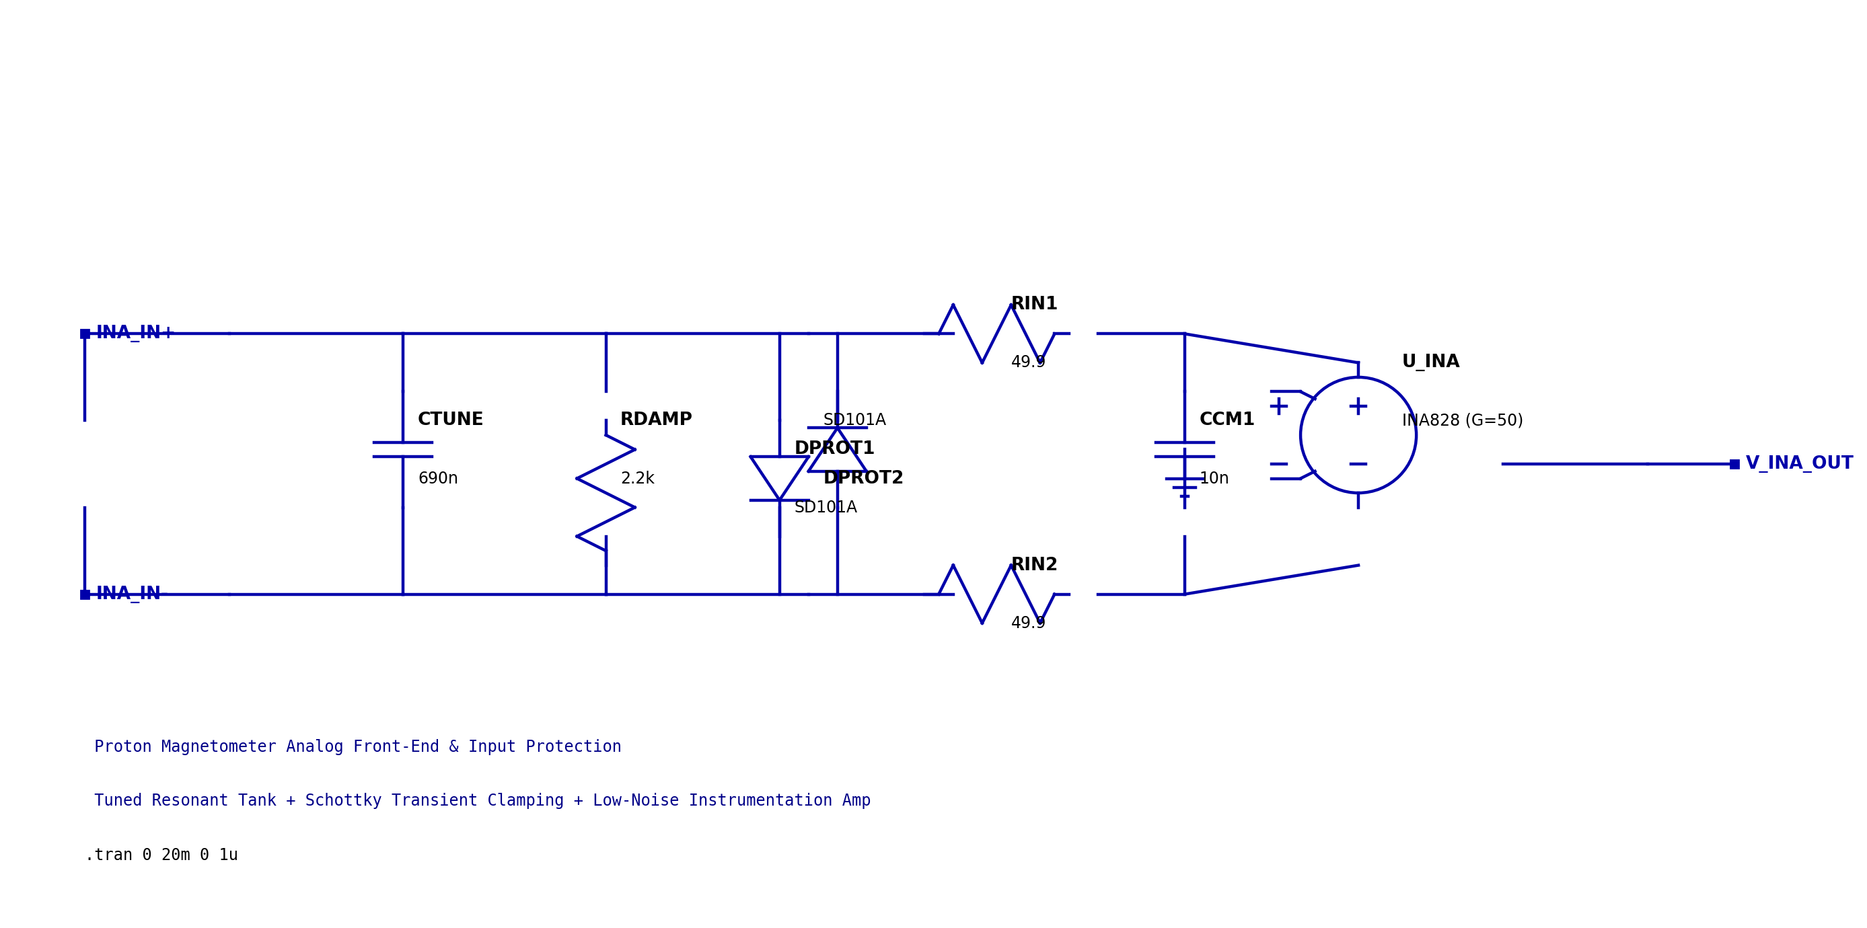
Measurement front end: tune, protect, amplify
LC tank
690 nF
~2.2 kHz
Protection
2.2 kΩ damping
Schottky clamps
Input
49.9 Ω per leg
10 nF common-mode
INA
gain ~50
differential
MFB + gain
band-pass
~2.2 kHz
Comparator
±15 mV
0–3.3 V
Simulation values
7.5 mH coil + 690 nF resonates near 2.21 kHz
2.2 kΩ parallel damping limits tank ringing
INA stage gain is modeled as 50 V/V
MFB filtering and final gain drive the comparator
The schematic shows the front-end input stage; later filter and comparator blocks are modeled in the netlist.
05
Notes:
The input front end uses a parallel 690 nF tuning capacitor across the modeled 7.5 mH coil, 2.2 kΩ damping resistor, antiparallel Schottky clamps, 49.9 Ω input resistors, common-mode capacitors, and an instrumentation amplifier model with gain 50. The complete-system netlist includes additional MFB filtering, gain and comparator blocks.
Sources: local LTSpice measuring_circuit.cir and complete_system.cir; PyPPM v1.3 receive chain, Sheets 7–10: https://github.com/geekysuavo/pyppm/tree/main/designs/ppm-1.3 ; JPM-4: https://sensors.myu-group.co.jp/sm_pdf/SM2789.pdf ; Ruhunusiri & Jayananda (2008): https://ipsl.lk/documents/TechSession/2008/ipsl0812.pdf.

Slide 6
LTspice confirms signal-chain amplification
Standalone measuring-circuit netlist, 20 ms transient, synthetic FID input
Input scenario
10 µV peak
2.214 kHz
200 ms decay constant
100 mV 60 Hz common-mode hum
10 mV 10 kHz series ripple
What this shows
The modeled receive chain amplified the synthetic input through the INA and final stage. Idealized amplifier blocks mean this does not establish hardware noise, stability, or sensitivity.
06
Notes:
These values were obtained by running LTspice in batch mode on the standalone measuring_circuit.cir netlist. The log reports V_INA_PEAK = 0.129531 V and V_AMP_PEAK = 1.39228 V over the 20 ms transient. They are maximum node values over the simulation, not a simultaneous gain measurement. The netlist applies a 100 mV 60 Hz source at the common-mode reference and a separate 10 mV 10 kHz series source at the coil negative node. It uses idealized behavioral amplifier models and synthetic FID input.
Source: local LTSpice/measuring_circuit/measuring_circuit.cir and its LTspice .log output.

Slide 7
Hardware build and bench validation remain
Before assembly
Build and test
Confirm the exact relay part, pinout, coil voltage, and DC carry rating against measured coil current.
Measure the real sensor coil’s resistance and inductance, then tune with cable and board parasitics included.
Freeze amplifier, comparator, connector, supply, and grounding choices; current netlists use simplified device models.
Assemble relay and analog front end as separate prototype sections.
Scope relay operate/release timing, contact bounce, and break-before-make behavior before connecting the preamp.
Inject a calibrated 2.2 kHz microvolt signal and measure gain, filter bandwidth, noise pickup, and comparator edges.
Connect the sensor and sample, tune at the test site, and compare measured frequency with a reference field.
Build gate: verify relay current rating and analog noise performance before integrating the magnetometer.
07
Notes:
The remaining work is physical component selection, prototype assembly, instrumented verification, and integration. The modeled coil current is near 2 A, while the referenced G6A-2 relay in the local design notes is rated for 2 A carry; verify the selected relay’s exact datasheet and measured coil current. The LTspice relay switch model does not include mechanical delay or bounce.
Sources: local POLARIZATION.md and MEASURING_CIRCUIT_AND_RELAY.md; PyPPM v1.3 relay and receive schematics: https://github.com/geekysuavo/pyppm/tree/main/designs/ppm-1.3.

Slide 8
References
[1] PyPPM v1.3 hardware, relay and receive schematics, Sheets 7–10 and 13
[2] W. D. S. Ruhunusiri and M. K. Jayananda, “Construction of a Proton Magnetometer,” Institute of Physics, Sri Lanka, 2008
[3] X. Guo et al., “Study on Methods of Sensitivity Evaluation of JPM-4 Proton Magnetometer,” Sensors and Materials, vol. 34, no. 1, pp. 13–26
[4] Project LTspice files: measuring_circuit.cir and complete_system.cir
[5] Project notes: MEASURING_CIRCUIT_AND_RELAY.md and POLARIZATION.md
08
Notes:
Full source links:
[1] https://github.com/geekysuavo/pyppm/tree/main/designs/ppm-1.3
[2] https://ipsl.lk/documents/TechSession/2008/ipsl0812.pdf
[3] https://sensors.myu-group.co.jp/sm_pdf/SM2789.pdf
[4] Local repository, LTSpice/measuring_circuit/measuring_circuit.cir and LTSpice/complete_system/complete_system.cir
[5] Local repository documentation files.

