Slide 1
Classification
Classification is used to identify the category of a new observation on the basis of training data whose categories are know.
We used transformed numercial and boolean features and the vectorised textual columns to predict the rating scores for new applications.
The scores were categorised into classes ranging from 0 to 5.

Slide 2
Algorithms for Classification
Gaussian Naive Bayes
Bernoulli Naive Bayes
Random Forest Classifier
Logistic Regression Classifier
SGD Classifier
Ridge Classifier
Decision Tree Classifier
K Nearest Neighbors Classifier
Linear SVC

Slide 3
Methodolgy for Classifcation
The feature set had large number of
columns after vectorisation. Principal Component Analysis (PCA) was implemented to reduce the dimensions of feature set.
Then K-fold Cross validation was implemented and accuracy for various classifiers was studied for k=10.
The dataset is splitted into k consecutive folds. Each of the k folds is used as a validation set while remaining k-1 is used training set.

Slide 4
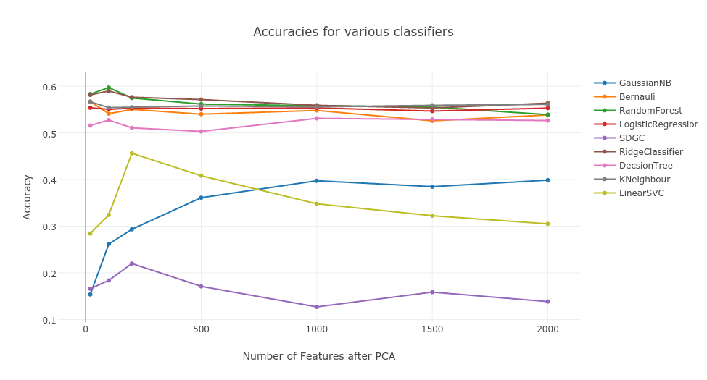
Comparison of Classifier Performance

Slide 5
Tuning of Classifier
Selected classifiers with higher accuracies.
Implemented Grid Search techinque to get set of optimal parameters.
Grid Search creates a grid of all possible parameter combinations and tests the model with all the combinations
It gives us idea about which set of parameters gives the best results.

Slide 6
Results After Tuning
 | Accuracy Before Tuning (%) | Accuracy After Tuning (%)
Random Forest | 59.7 | 69.33
Ridge Classifier | 58.9 | 64.7
KNN Classifier | 55.4 | 62.11
Logistic Regression | 55 | 65.7
Decision Tree | 52 | 60
 | Number of Components | 100
 | Data Points | 3000
Best Results: Random Forest ~ 70% accurate

Slide 7
Issues
The hardware infrastrucure we have was not enough for vectorising overall dataset we have.
Limited ourself to only 3000 data points to avoid memory error.
The vectoriser was limited to use only english words to handle memory issues.

