Slide 1

CSE 4990/6990 – Big Data and Data Science
Predicting PlayStore Rating for Apps
Team: 5DBMinds
Ayush Raj Aryal
Lucas Andrade Ribeiro
Naila Bushra
Naresh Adhikari

Slide 2
Project Overview
Predicting Google PlayStore Ratings for new applications
Used data of a large number of existing applications
Selected App attributes based on their influence on the ratings

Slide 3
Data Collection
The data of this project has been collected from the author of the github repository GooglePlayAppsCrawler
GitHub Link: https://github.com/MarcelloLins/GooglePlayAppsCrawler.git

Slide 4
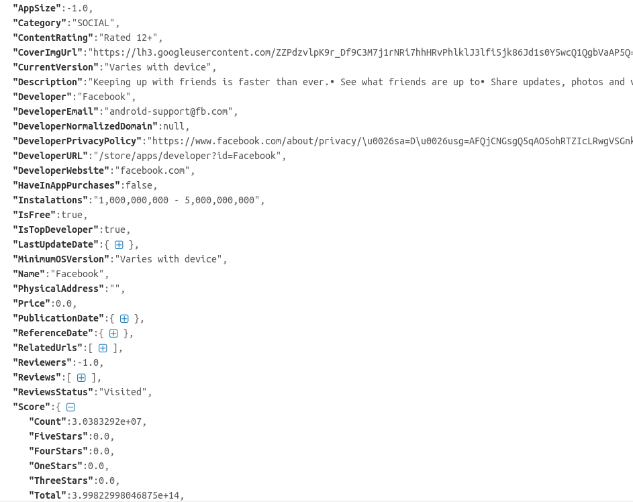
Data Collection

Slide 5
Data Preprocessing
Finalized attributes
AppSize
Price
IsTopDeveloper
HaveInAppPurchase
IsFree
PublicationDate
LastUpdateDate
Installations
Category
Developer
Name
ContentRating
Description

Slide 6
Data Transformation
AppSize, Price
Numerical Attributes
IsTopDeveloper, HaveInAppPurchase, IsFree
Have True and False values
PublicationDate, LastUpdateDate, Installations
Text to numerical value conversion
Category, Developer, Name, ContentRating, Description
Requires text vectorization

Slide 7
Document Vectorization
Why Document Vectorization?
Machine Learning Algorithms are ‘noumbrevorous’
Supervised/Unsupervised: Algorithms take inputs, give outputs thus generate a ‘the most general’ mapping of the data.
All inputs/outputs == numbers

Slide 8
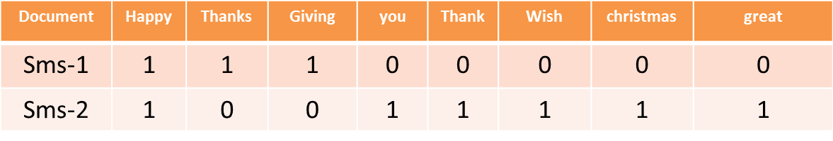
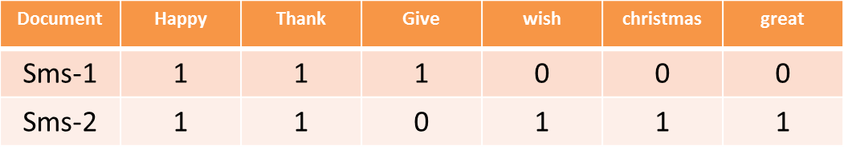
Document Vectorization
Vectorization By Example:
SMS-1: “Happy Thanks Giving !”
SMS-2: “ Happy. Thank you. Wish you great Christmas.”
Un-Stemmed Vectorization: Use the word as you find it.
Stemmed Vectorization: Remove Basic Words and Use only base or root of a word.

Slide 9
Document Vectorization
STEPS FOR VECTORIZATION:
Step-1: Tokenization
Generate collection of words fro each documents, Throw Away Redundant Words or punctuation marks: ‘you’, ‘!’
Step-2: Counting
Find Frequency of occurrences of a word/token in a document
Step-3: Normalization
Divide vectors SMS-1 and SMS-2 by |SMS-1| and |SMS-2|

Slide 10
Document Vectorization
Apps’ Attributes Vectorized:
Category : 41 Categories, monolingual corpus
Description: One app one description. Multilingual corpus
Name: one app one name, multilingual corpus
Content Rating
Developer

Slide 11
Document Vectorization
Sparsity: Unstemmed Vectorization
Sparsity: Stemmed Vectorization
Notes:
<number>

Slide 12
Document Vectorization
Sparsity: Stemmed Vs Unstemmed Words

Slide 13
Linear Regression
A simple regression model for supervised learning
Used to predict a target variable Y which is linearly dependent on other independent variable(s) X
Given the independent variables X1, X2,…,XN for k data points the model can be represented as
Yk = β0+ β1Xk1+…+ βNXkN+ε

Slide 14
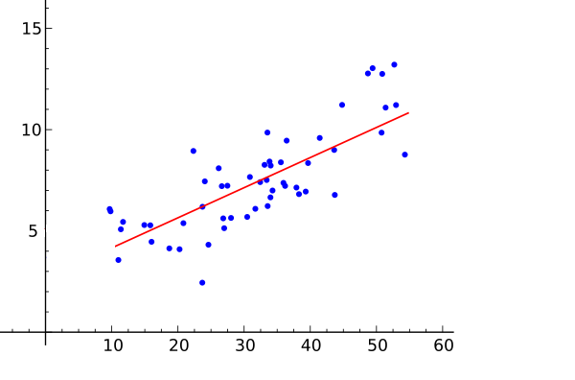
Linear Regression

Slide 15

Linear Regression
Residual sum of squares (RSS), e = y-y’
Returns the coefficient of determination R^2 of the prediction
The coefficient R^2 is defined as (1 - u/v)
u = RSS
V = residual sum of squares
((y_true - y_true.mean()) ** 2).sum()

Slide 16
Linear Regression
Used cross validated prediction to visualize prediction errors
K-fold cross validation (k=4) technique was applied to randomize the train and test dataset
Vectorization resulted in high dimensional feature set
Principal Component Analysis was done to reduce the number of features to around 100

Slide 17
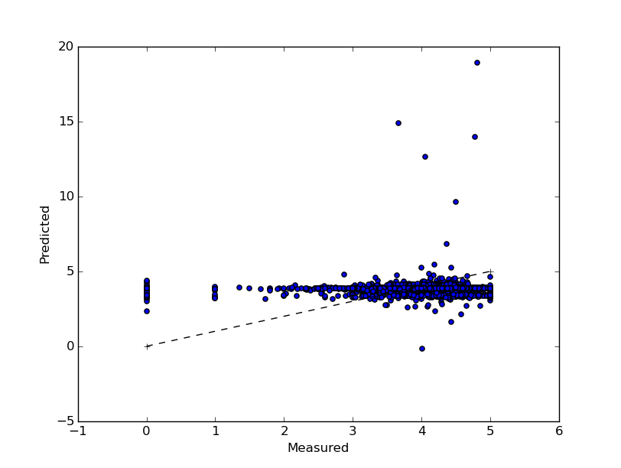
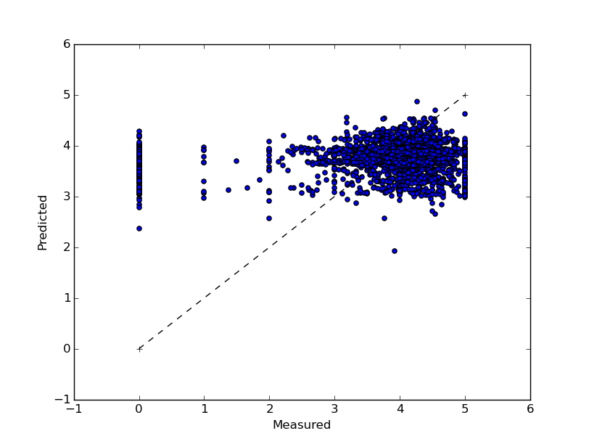
Linear Regression
All features
Without higher dimensional features

Slide 18
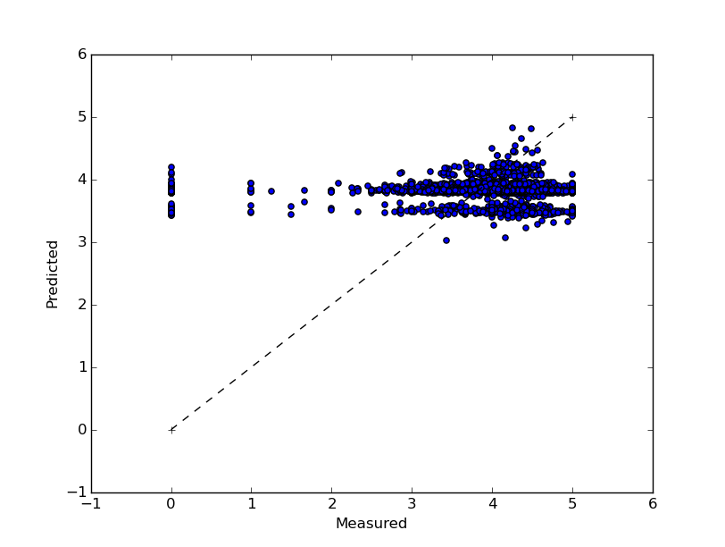
Linear Regression
Without vectorized features

Slide 19
Linear Regression
All features
Without higher dimensional features
4 fold cross validation | iter1 | iter2 | iter3 | iter4
Residual sum of squares | 1.27 | 1.38 | 1.36 | 1.10
Variance score | 0.56 | 0.31 | 0.40 | 0.23
4 fold cross validation | iter1 | iter2 | iter3 | iter4
Residual sum of squares | 1.36 | 1.33 | 1.18 | 1.20
Variance score | 0.49 | 0.38 | 0.19 | 0.25
Without vectorized features
4 fold cross validation | iter1 | iter2 | iter3 | iter4
Residual sum of squares | 1.10 | 1.27 | 1.30 | 1.33
Variance score | 0.37 | 0.45 | 0.12 | 0.24

Slide 20
Classification
Classification is used to identify the category of a new observation on the basis of training data whose categories are know.
We used transformed numerical and boolean features and the vectorized textual columns to predict the rating scores for new applications.
The scores were categorized into classes ranging from 1 to 5.

Slide 21
Algorithms for Classification
Gaussian Naive Bayes
Bernoulli Naive Bayes
Random Forest Classifier
Logistic Regression Classifier
SGD Classifier
Ridge Classifier
Decision Tree Classifier
K Nearest Neighbors Classifier
Linear SVC

Slide 22
Methodology for Classification
The feature set had large number of columns after vectorization. Principal Component Analysis (PCA) was implemented to reduce the dimensions of feature set.
Then K-fold Cross validation was implemented and accuracy for various classifiers was studied for k=10.
The dataset is splitted into k consecutive folds. Each of the k folds is used as a validation set while remaining k-1 is used training set.

Slide 23
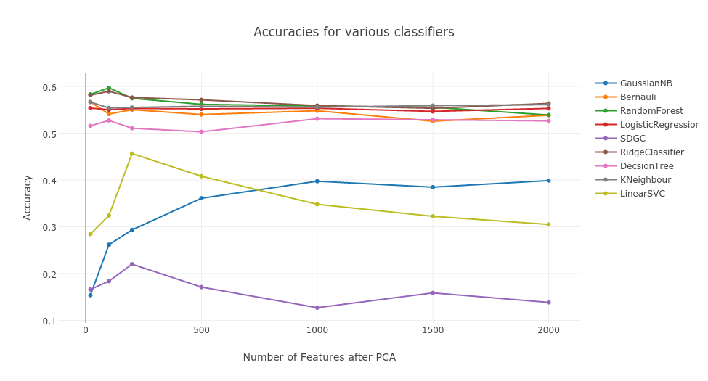
Comparison of Classifier Performance

Slide 24
Tuning of Classifier
Selected classifiers with higher accuracies.
Implemented Grid Search technique to get set of optimal parameters.
Grid Search creates a grid of all possible parameter combinations and tests the model with all the combinations
It gives us idea about which set of parameters gives the best results.

Slide 25
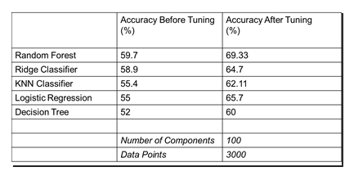
Results After Tuning
Best Results: Random Forest ~ 70% accurate

Slide 26
Issues
The hardware infrastructure we have was not enough for vectorizing the whole dataset of 600K applications
Used only 3000 data points in order to limit the computational time and memory usage.
The vectorizer was filtered to use only the English words to avoid memory issues.

Slide 27
Scope of improvements
Use parallel processing to handle all available data
Use correlation between features to find out most usable features

Slide 28
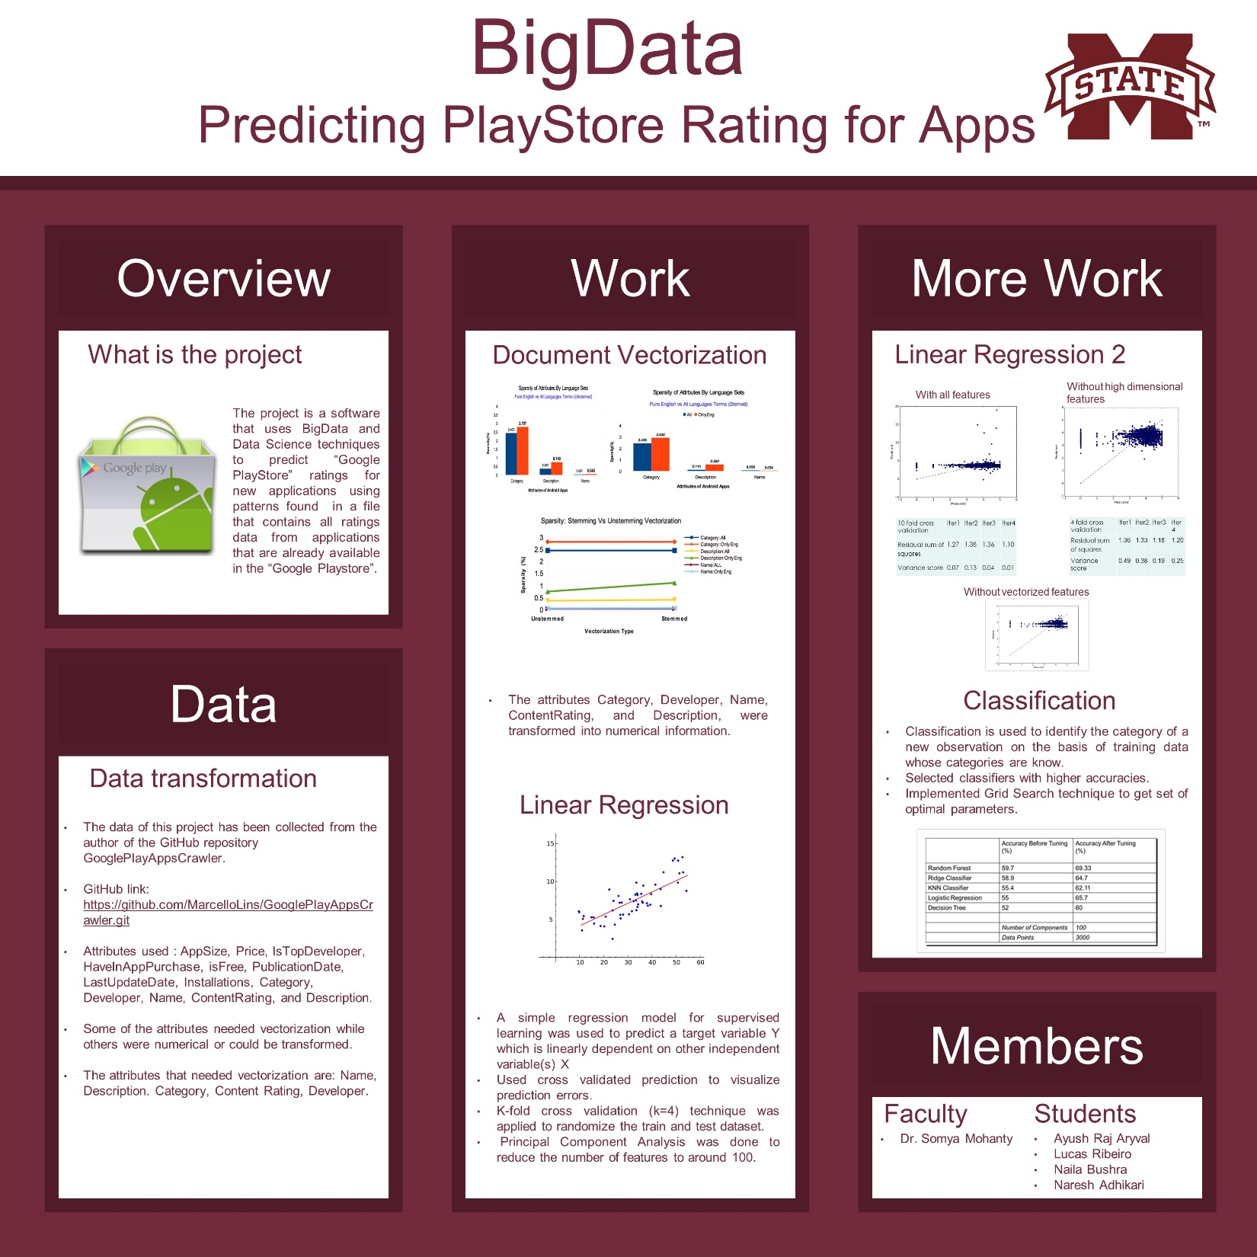

Slide 29
Thank you

