Slide 1

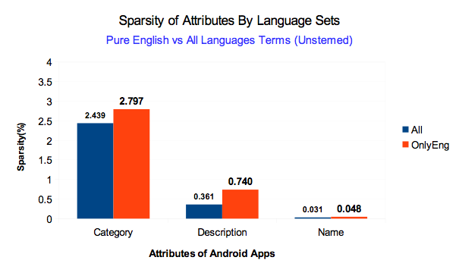
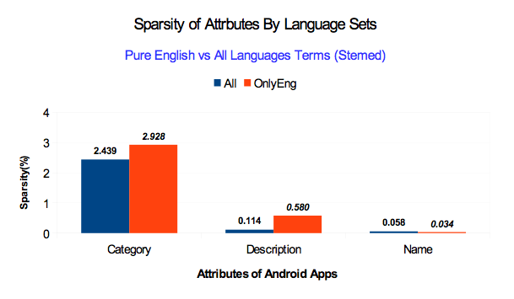
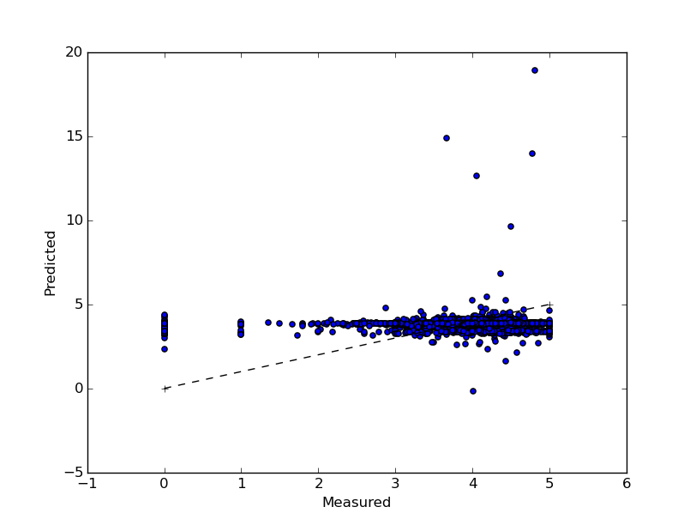
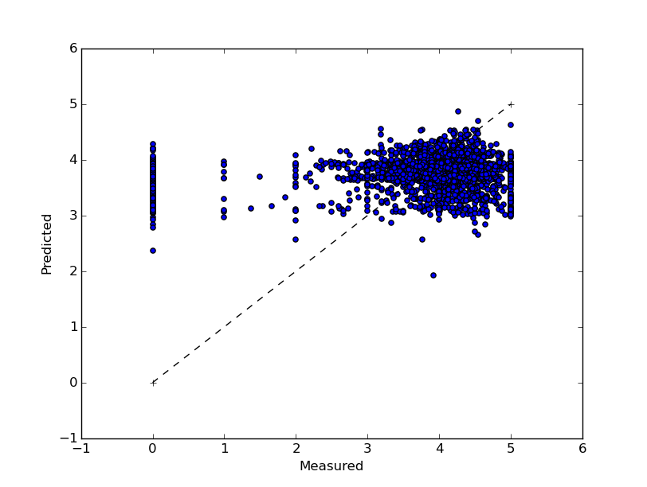

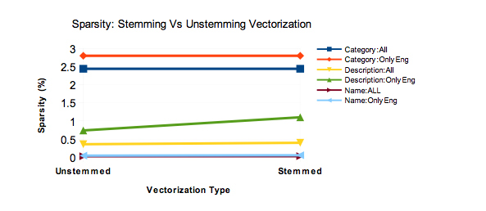
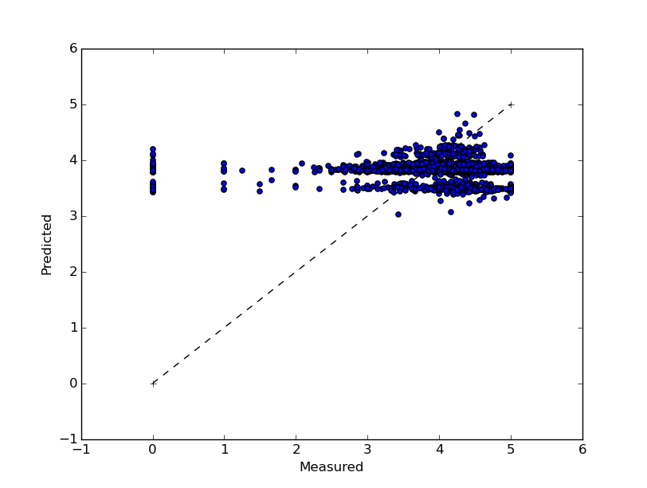
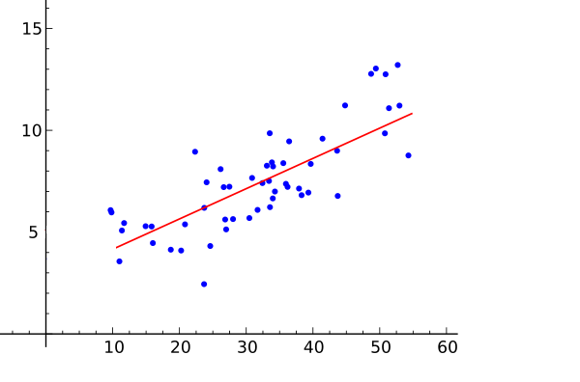
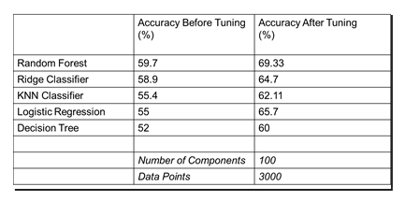
BigData
Predicting Google App Rating
Overview
Work
More Work
What is the project
Document Vectorization
Linear Regression 2
The project is a software that uses BigData and Data Science techniques to predict “Google PlayStore” ratings for new applications using patterns found in a file that contains all ratings data from applications that are already available in the “Google Playstore”.
Without high dimensional features
With all features
10 fold cross validation | iter1 | iter2 | iter3 | iter4
Residual sum of squares | 1.27 | 1.38 | 1.36 | 1.10
Variance score | 0.07 | 0.13 | 0.04 | 0.01
4 fold cross validation | iter1 | iter2 | iter3 | iter4
Residual sum of squares | 1.36 | 1.33 | 1.18 | 1.20
Variance score | 0.49 | 0.38 | 0.19 | 0.25
Without vectorized features
Data
There was some attributes that needed text vectorization because algorithms that analyze BigData just use numbers, so in the attributes Category, Developer, Name, ContentRating, and Description, all the text information was transformed in numerical information.
Classification
Classification is used to identify the category of a new observation on the basis of training data whose categories are know.
Selected classifiers with higher accuracies.
Implemented Grid Search technique to get set of optimal parameters.
Data transformation
All the ratings data have a pattern that could or not need to pass through a data transformation. This decision was based in the type of data, normalization to use the planned techniques or issues from multiple languages.
This is all the information got from ratings: AppSize, Price, IsTopDeveloper,HaveInAppPurchase, isFree, PublicationDate, LastUpdateDate, Installations, Category, Developer, Name, ContentRating, and Description.
The data of this project has been collected from the author of the GitHub repository GooglePlayAppsCrawler.
GitHub link: https://github.com/MarcelloLins/GooglePlayAppsCrawler.git
Linear Regression
Was used a simple regression model for supervised learning to the machine. Used to predict a target variable Y which is linearly dependent on other independent variable(s) X
Used cross validated prediction to visualize prediction errors.
K-fold cross validation (k=4) technique was applied to randomize the train and test dataset.
Principal Component Analysis was done to reduce the number of features to around 100.
Members
Professor
Students
Somya Mohanty
Ayush Raj Aryval
Lucas Ribeiro
Naila Bushra
Naresh Adhikari
Expetenda reprimique id eos, ius eius

