Slide 1
Sales performance dashboard
Task 8 — Simple Sales Dashboard Design | Power BI
$370.79K
$50.34K
1,450
West
Total sales
Total profit
Total orders
Top region
Dataset: Superstore_Sales.csv | Period: Jan 2023 – Dec 2024 | Visuals: line, bar, donut chart + region slicer

Slide 2
Key insights
01
West region leads by a wide margin
02
West sees a sharp Q3 seasonal spike
West generated $168.6K in sales — about 62% more than East and over 3x South — contributing roughly 34% of total company sales.
West region sales rose 73% from Q2 2024 ($19.5K) to Q3 2024 ($33.8K), pointing to a strong seasonal buying window worth targeting.
03
Technology drives the most profit
04
Technology spikes during the holidays
Technology holds a 20.8% profit margin vs 12.2% for Office Supplies and just 3.9% for Furniture — 37% of Furniture orders sold at a loss.
November–December account for roughly 23% of Technology's full-year sales, consistent with year-end electronics demand.

Slide 3
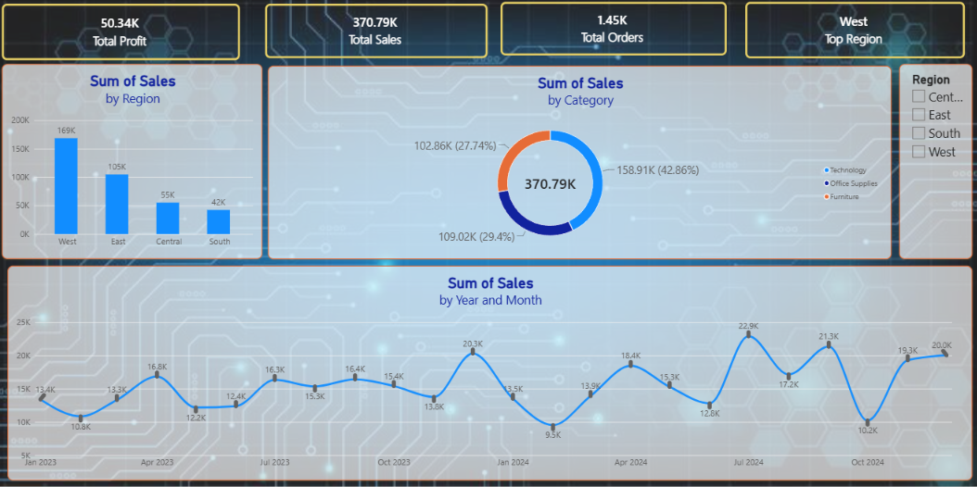
Power BI dashboard
Sales by region, category, and month — with a region slicer for interactivity

Slide 4
How the dashboard was built
01
02
03
Import the data
Format the date
Build core visuals
Loaded Superstore_Sales.csv into Power BI via Get Data > Text/CSV.
Converted Order Date into a Month-Year field for time-based grouping.
Added a line chart (sales by month), bar chart (sales by region), and donut chart (sales by category).
04
05
06
Add interactivity
Highlight the story
Export and summarize
Added a Region slicer so viewers can filter every visual at once.
Custom theme, accent color on West's bar, and stat cards for total sales, profit, and orders.
Exported the dashboard as an image/PDF and wrote up the key insights.

