Slide 1
UN/CEFACT
October 4th, 2017
Document subject to frequent revisions

Slide 2
Potential Impact: The cost of global trade is estimated at $1.8 trillion annually¹ with potential savings from more efficient processes of ~10%
The World Economic Forum³ estimates that reducing trade barriers will significantly enable trade
Increase in trade* and GDP (trillion US$)
4,7%
14,5%
Trade facilitation halfway to global best practice
Trade facilitation halfway to regional best practice
All tariffs removed globally
The GDP effect of reducing supply chain barriers is much higher than for tariffs
Source: 1) Maersk Strategy Group (May 19, 2016) based on World Bank data for World Trade Costs
2) Anderson and Wincoop E. (2004) Trade costs. National Bureau of Economic Research
3) World Economic Forum: Enabling Trade Valuing Growth Opportunities 2013
*Based on export value; includes only the effect if “Border Aministration” and “Telecommunication and Transport Infrastructure”.

Slide 3

The case for Global Trade Digitization (GTD)
Blockchain changes the game
Never before could disparate entities securely and confidently process paperwork filings digitally
TODAY
Inconsistent information across organizational boundaries and “blind spots” throughout the supply chain hinder the efficient flow of goods
Complex, cumbersome, and costly peer-to-peer messaging
Manual, time-consuming, paper-based processes; high air courier expense and delays
Risk assessments often lack sufficient information; clearance processes subject to fraud
The administrative cost of handling a container shipment is comparable to the cost of the actual physical transport
TOMORROW
Instant, secure access to end-to-end supply chain information; single source of the truth
Assurance of the authenticity and immutability of digital documents; trusted cross-organizational workflows
Better risk assessments and fewer unnecessary interventions
Far lower administrative expenses and elimination of costs to move physical paper across international borders
Estimated global savings from more efficient sharing of information: $27 billion
Authority
Consignee
Global Trade Digitization
Exporter
Authority
Authority
Forwarder
Exporter
Trucker
Authority
Forwarder
Consignee
Terminal
Authority
Authority
Carrier
Terminal
Authority
Authority
Carrier

Slide 4
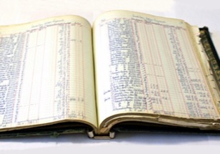
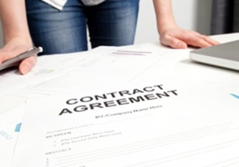


Blockchain addresses the underlying challenges inherent in collaborating across a distributed, fragmented supply chain ecosystem
A shared replicated, permissioned ledger ensures consensus, provenance, immutability and finality
Append-only distributed system of record shared across business network
A network of trusted, neutral participants maintains a distributed, permissioned ledger with copies of document filings, relevant supply chain events, authority approval status, and full audit history; every change results in a new, immutable block.
Business terms embedded in transaction database & executed with transactions
The export and import documentation requirements and authority approvals are pre-programmed and built into Blockchain and distributed to and endorsed by the network
Shared ledger
Smart
contract
Ensuring appropriate visibility; transactions are secure, authenticated
& verifiable
Cryptography enables permissioned access for only participating parties in a specific shipment can submit, edit or approve related data
Transactions are endorsed by relevant participants
Information such as documentation filings and authority approvals can only be changed if endorsed by the parties taking part in the shipment; full audit history maintained on the Blockchain
Privacy
Trust

Slide 5
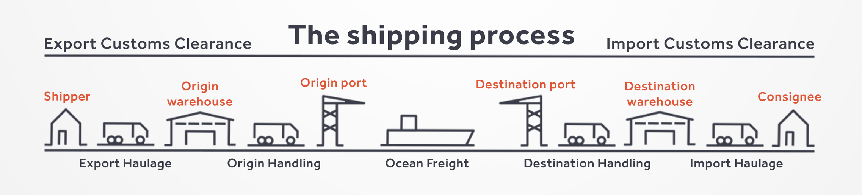
A Closer Look
Source: https://transporteca.co.uk/shipping-process/
Selective Endorsement
Endorsing and Non-endorsing peers (all have ledger visibility)
Allows for control of which parties verify transactions
Identity and Privacy
Membership identity service
Identity: Members know each other and identities are verified
Privacy: Members do not know what others are doing outside of roles in transactions
Channels
Private sub-net within the blockchain for conducting private and confidential transactions
Isolates certain ledger data and peers from the larger network (e.g., business competitors)

Slide 6
Smart Contracts
Encode business rules and business logic into software
Business terms embedded in transaction database and executed with transactions
Properties:
Efficient: Instantaneous when all terms of the contract have been met
Visible: All users on the blockchain see the requirements and results of the smart contract
Automated: Legal process between parties is automated through instantiation in software
Example:
Shipment secured with contract activated “smart lock”
Smart contract #1 releases lock upon contract completion
  Delivery is made to consignee
  Conditions of shipment have been met
Smart contract #2 releases payment from consignee to shipper
  Smart Contract #1 has been executed
  Shipment is intact and fully accounted
  No additional duty fees were assessed in customs
Ocean Carriers
Transportation Management.
Supply Chain Actors
Customs Systems
Supply Chain Visibility Systems
GTD Platform
Ports and Terminals
Trade Associations
Provider of interface:
value-add partners
Supply Chain Management
Logistic actors internal systems
Port Community Systems; Terminal Operating Systems
Freight Forwarders
Authorities

Slide 7
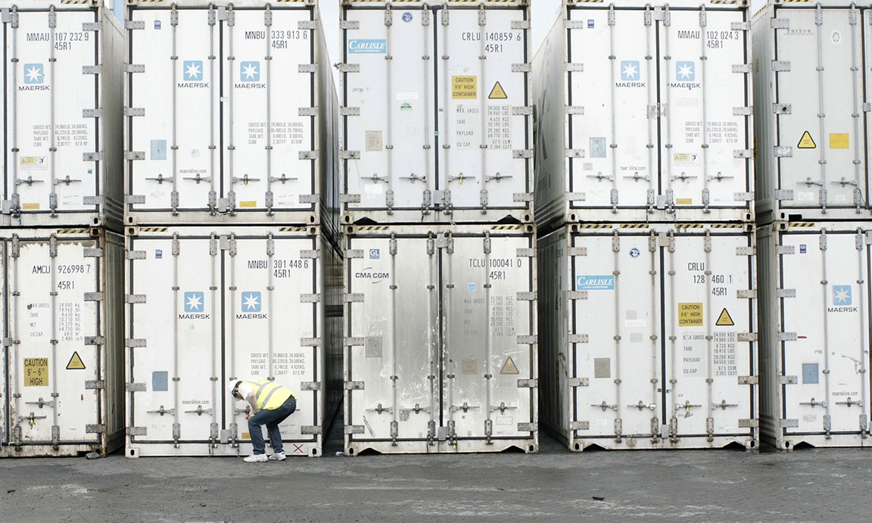
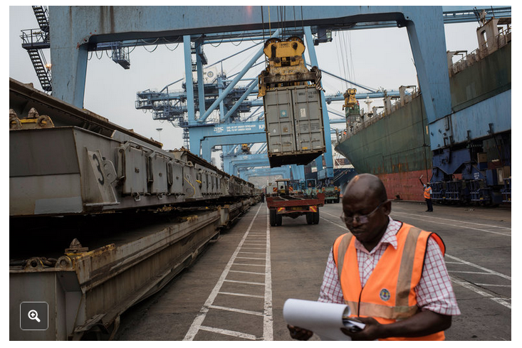
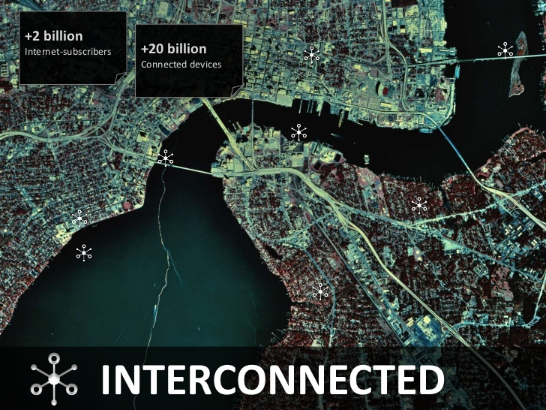
Oracle
Mechanism that connects smart contract to the real world
Properties:
Identify and verify real world information (3rd party)
Submit that information to the blockchain – used in smart contract
Provide a secure and trusted mechanism for information transfer
Example:
Temperature impact on goods in shipment
Sensor provides continuous record of temperature in container
Oracle is software of sensor data to the Blockchain (via Smart Contract)
Smart contract is written to include temperature data in payment structure

Slide 8

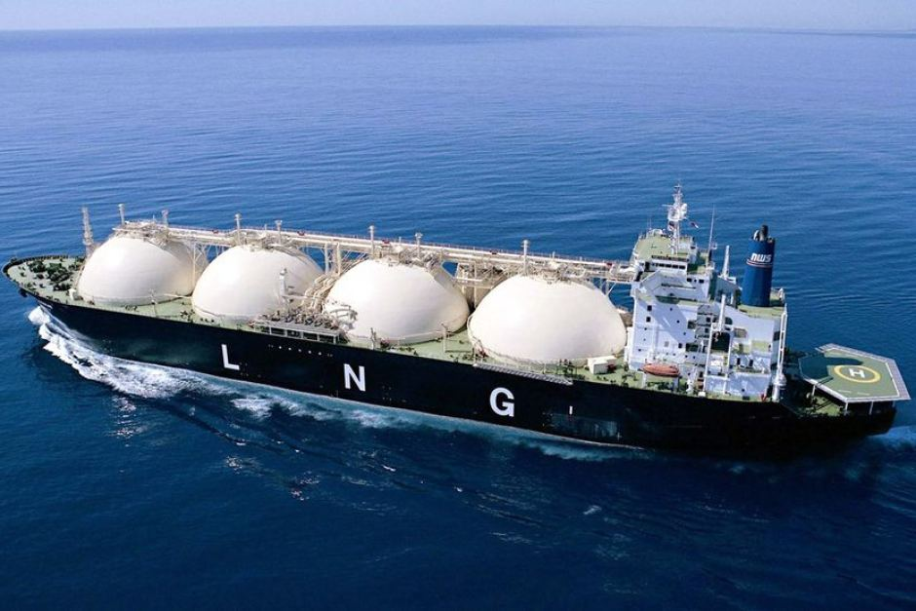
Token
An ”IOU” that can be redeemed for goods or services at a specified data in the future
Properties:
Originally designed and built for crypto-currencies
Used as a digital representation of physical object (stationary)
Overlap with smart contracts in other applications
Example:
Physical assets in transit and physically inaccessible
Assets are being traded while in transit
Tokens are used to provide digital representation of assets
Token guarantees ownership
  Specify the amount of asset traded
  Specify the time (schedule) for repayment
Shipment arrives, physical assets are distributed

Slide 9
Challenges: Standardization and Granularity
Increasing automation of contracts requires increasing specificity (Content, Location, Timing)
UN/EDIFACT
  Enable move from batch to realtime processing
  Increase flexibility of formats
Single set of commodity codes:
  Build on HS6, standardize with country specific codes (e.g., HTS 10 Schedule B)
High Resolution Locations
  Increase granularity in Location Codes (UN/LOCODE)
  Increased standardization of location codes across shipping lines
Digitization of Trade Documents
Increase electronic alternatives to physical documents
Define increasing specification of types and purposes of trade documents

Slide 10
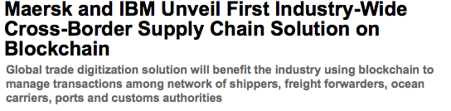
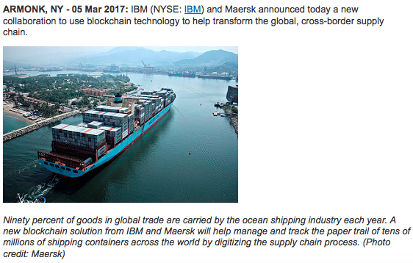
Global Trade Digitization
Our vision is to reduce global trade barriers and increase efficiency across international supply chains
GTD: a trade platform for containerized shipping connecting the supply chain ecosystem
GTD consists of two components:
  The Shipping Information Pipeline (SIP) provides end-to-end supply chain visibility that enables all actors involved in a global shipping transaction to securely and seamlessly exchange shipment events in real time
  Paperless Trade digitizes and automates paperwork filings by enabling end users to securely submit, stamp and approve documents across national and organizational boundaries
GTD is built on an open technology stack and is underpinned by Blockchain technology
GTD is the platform underpinning WP23 of the European Commission CORE initiative
Following a successful pilots across trade lanes in Africa, Europe and the U.S., IBM/Maersk are now on-boarding early stage ecosystem participants for the Beta release
Involvement across a much broader set of players is now being sought for the Limited Availability release for early 2018

Slide 11
For more information
Maersk and IBM collaboration press release
http://www-03.ibm.com/press/us/en/pressrelease/51712.wss
What is GTD (Douane Cassandra video)
https://www.youtube.com/watch?v=jqdGvjzUVNA&
IBM and Maersk Demo: Cross-Border Supply Chain Solution on Blockchain
https://www.youtube.com/watch?v=dcddYatMCGQ&feature=youtu.be
Can the cloud lift global trade?
http://www.maersk.com/en/the-maersk-group/about-us/publications/maersk-post/2015-2/can-the-cloud-lift-global-trade
Blockchain: A Better Way to Track Pork Chops, Bonds, Bad Peanut Butter?
https://www.nytimes.com/2017/03/04/business/dealbook/blockchain-ibm-bitcoin.html?_r=1

