Slide 1
PATENT
ANALYSIS
An approach towards Patent Document Analysis.

Slide 2
Agenda Style
Why this approach?
Patent documents are important intellectual resources of protecting interests of companies. Patent retrieval, as a new research area, aims to assist patent analysts in retrieving, processing and analyzing patent documents
Patent documents are lengthy and full of technical and legal terminologies, Even for domain experts it takes great amount of time to read, analyze and summarize a single patent document.
Hence, it is imperative to automate this process and assist the analysts in reviewing the relationship between the query and the retrieved patents.
motivation

Slide 3
Agenda Style
What is this approach?
Typical patent retrieval tasks often require examining how similar/different two patent documents are in multiple aspects.
This approach analyzes and summarizes a patent document in terms of similarities and differences.
Patent documents are lengthy a consumes time for analysis, this approach automates the process and gives a comparative summary of two patent documents.
The algorithm takes two patent documents as input and gives a comparative summary of the two patents.
Final output is summary of two patents which covers both discriminative and similar aspects of the documents.
Introduction

Slide 4
Agenda Style
What is this approach?
The algorithm is divided into four modules:
Summary Generation
Sentences are selected from the two
patent documents by using the connected dots on the generated feature tree.
Introduction
Feature Tree Construction
The discriminative and common features are represented as a tree-based structure.
Feature Graph
Undiredcted feature graph is constructed and discriminative features are mapped on the graph
Discriminative feature selection
Given two documents, Discriminative features (i.e. nouns) are extracted..

Slide 5
<PatCom>
Module wise detailed description

Slide 6
Agenda Style
Discriminative Feature Selection
Patent documents often differ from each other on specific aspects. Hence, as first step discriminative features (nouns) are extracted from patent documents.
These terms can be regarded as aspects that distinguish the two patents being compared.
Each patent document is treated as a class and nouns as features, and further formulated as a feature selection problem.
Feature selection, also known as attribute selection, is the process of selecting a subset of relevant features for use in model construction.
Module 1

Slide 7
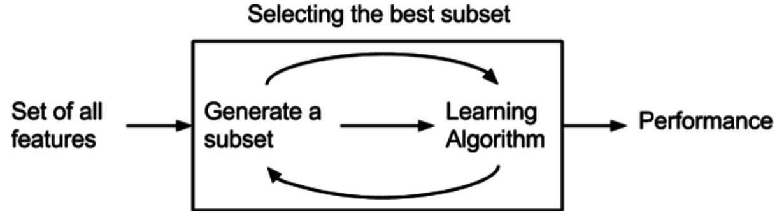
Agenda Style
Discriminative Feature Selection
Suppose there are 't' feature variables from the two patent documents, denoted by {xi|xi ∈ F}, where F is the full feature index set, having |F| = t.
There is class variable, C = {c1, c2}.
The problem of feature selection is to select a subset of features, S ⊂ F, to accurately predict the target class variable C.
Module 1

Slide 8
Agenda Style
Discriminative Feature Selection
Types of feature selection algorithms:
Filter Methods
Filter feature selection methods apply a statistical measure to assign a scoring to each feature e.g. Chi squared test
Wrapper Methods
Wrapper methods consider the selection of a set of features as a search problem, where different combinations are prepared, evaluated and compared to other
combinations. e.g. recursive feature elimination algorithm
Embedded Methods
Embedded methods learn which features best contribute to the accuracy of the
model while the model is being created e.g. Elastic Net and Ridge Regression.
Module 2

Slide 9
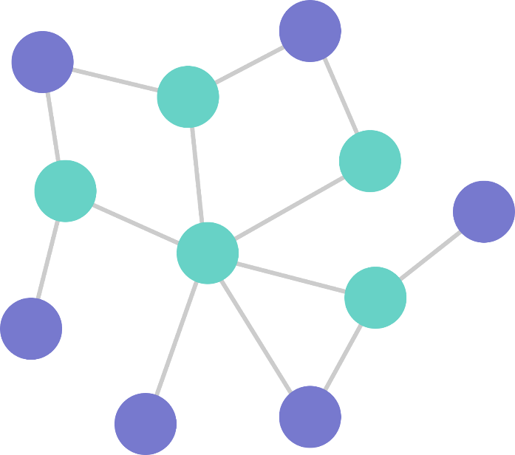
Agenda Style
Feature Graph Construction
A comparative summary of two patent documents should include both different and common aspects.
To obtain the common aspects and link them to the differences, graph-based approach is used.
Here an undirected graph G is constructed to represent two patent documents, where G = (V,E).
G contains a set of vertices (i.e., features) V , where each vertex represents the nouns in patent documents.
Module 2

Slide 10
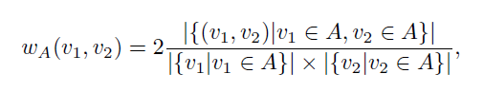
Agenda Style
Feature Graph Construction
Two vertices connect to each other only if they co-occur in the same sentence.
In order to link two vertices, both their cooccurrence and their corresponding frequencies in each document is considered.
A linkage score of two vertices v1 and v2 in a single document A is defined as
Module 2
where |{v1|v1 ∈ A}| and |{v2|v2 ∈ A}| denote the frequencies of v1 and v2 in document A, respectively.
|{(v1, v2)|v1 ∈ A, v2 ∈ A}| represents the number of times that v1 and v2 appear in the same sentence of A.

Slide 11
Agenda Style
Feature Graph Construction
wA(v1, v2) essentially models the co-occurring probability of v1 and v2 in A.
Given two patent documents A and B, v1 and v2 is connected if their averaged linkage score on both A and B exceeds a predefined threshold.
Module 2

Slide 12
Agenda Style
Feature Tree Extraction
The discriminative features obtained from feature selection are capable of representing the difference of patent documents.
However,there might be some gaps among these features, that is, they may not be well connected in the feature graph.
In order to provide a fluent structure of comparative summary, a relationship must be discovered among discriminative features.
This can possibly be achieved by connecting the discriminative vertices and the vertices shared by two patent documents.
Module 3

Slide 13
Agenda Style
Feature Tree Extraction
Here it is formulated as the minimum Steiner tree problem.
Given a graph 'G' and a subset of vertices 'S' (the discriminative features), a Steiner tree of 'G' is similar to minimum spanning tree, defined as the subtree of ‘G’ that contains ‘S’ with the minimum number of edges.
Definition: Given a graph G = (V,E), a vertex set S ⊂ V (terminals) and a vertex v0 ∈ S from which every vertex of S is reachable in G, the problem ofminimum Steiner tree (MST) is to find the subtree of G rooted at v0 that subsumes S with minimum number of edges.
Module 3

Slide 14
Agenda Style
Feature Tree Extraction
The generated Steiner tree of the feature graph gives an elegant representation of patent comparison, which describes the transitions among all the other discriminative features, connected by the common features shared by two patents.
Once the Steiner tree is generated, a concise feature-based comparative summary can be easily obtained of the given patent documents.
Module 3

Slide 15
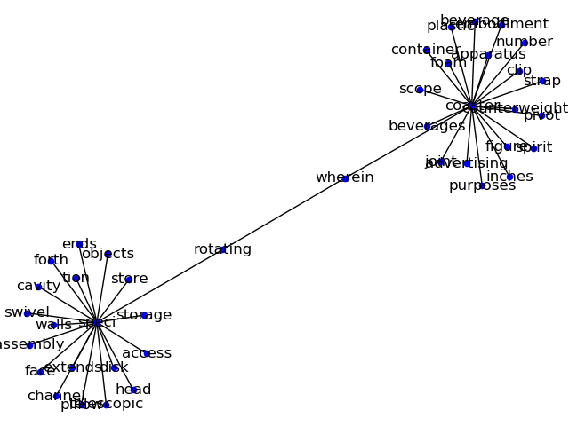
Agenda Style
Feature Tree Extraction
Module 3

Slide 16
Agenda Style
Comparative Summary Generation
The Steiner tree obtained from provides us the basis to generate comparative summaries of two patent documents.
Goal is to select the minimum set of sentences from the original documents, by which the features in the Steiner tree can be fully covered.
Each sentence can be represented as a subgraph of the entire feature graph, whereas the Steiner tree can also be regarded as a subgraph.
Hence, the problem is to select the minimum set of subgraphs that cover the Steiner tree.
Module 4

Slide 17
Agenda Style
Comparative Summary Generation
Formally, the union of two graphs is defined as Ga = (Va,Ea) and Gb = (Vb,Eb) as the union of their vertex and edge sets, i.e., Ga ∪Gb = (Va ∪ Vb,Ea ∪ Eb).
Each sentence is denoted as Gi = (Vi,Ei), which is a subgraph of G(V,wv,E,we).
Problem of generating comparative summaries is then formulated as the problem of finding the smallest subset of subgraphs whose union covers the Steiner tree.
Module 4

Slide 18
Agenda Style
Comparative Summary Generation
Definition:
Given a graph G = (V,E), a set of subgraphs S, and a Steiner tree T of G, the subgraph cover problem (SGCP) is to find a minimum subgraph set C ⊂ S, whose union, U = (VU,EU), covers all the vertices and edges in T .
Module 4

