Slide 1
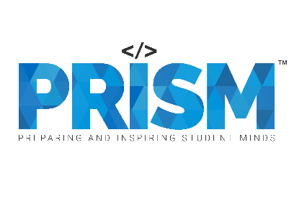

| Tech Management, SRI-B
CLAWS
CLASH OF THE
MSRIT_VOID_CREW
Control your entire computer using natural language.
Ayush Kumar
Jaidev Narayan Singh
Kovid Tyagi
Chidakash Choudhury

Slide 2
Idea
Problem Statement
Current computer workflows are fragmented and inefficient. Users constantly switch between apps, files, and terminals just to complete simple tasks. Existing AI assistants can chat, but can't actually execute workflows autonomously.
That’s why, we chose the Productivity theme because the way people work today is broken at a fundamental level.
Every computer user loses hours daily not doing work, but navigating tools: opening apps, switching tabs, typing repetitive messages. There's no unified AI layer that understands intent and acts on it.
This affects everyone:
Students: Juggling PDFs, notes, and meetings manually
Professionals: Balancing emails, calendars, and files across tools
Developers: Repeating setup workflows, commands, and tab management
Knowledge workers switch apps 300+ times a day, losing up to 2 hours daily to navigation overhead. Users have adapted remarkably well, but they shouldn't have to. Our tools should be working harder, not the other way around. Computers still make people adapt to them, not the other way around.

Slide 3
Idea
Current Solution & Gaps
Existing Solutions
Tool | What it does
Cortana, Siri, Alexa | Answer questions, set reminders only
ChatGPT, Copilot desktop | Conversational AI but cannot act on your computer
Zapier, Make.com | Automates workflows but needs pre-built rules, no natural language
OpenAI Operator, Browser Use | Browser-only agents, can't touch local files or native apps
What’s Missing / What’s Broken?
All available products address only one aspect and none integrate browser, files, terminal, and messages.
They need manual configuration (script, rules, APIs) or can only respond (provide the answer, but not do anything).
No history or memory, each execution resets the slate; there is nothing learned from previous executions.
No rollback failure at any point crashes the whole process without recovery.
Can’t control Windows applications or native desktop workflows.
Opportunity
Build an AI operating layer that:
Understands natural language
Automates complete workflows
Controls browser, apps, files & messaging
Learns from previous tasks
Reduces repetitive computer work

Slide 4
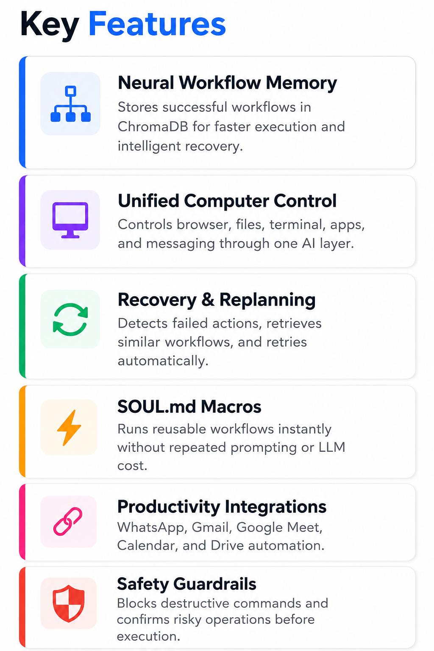
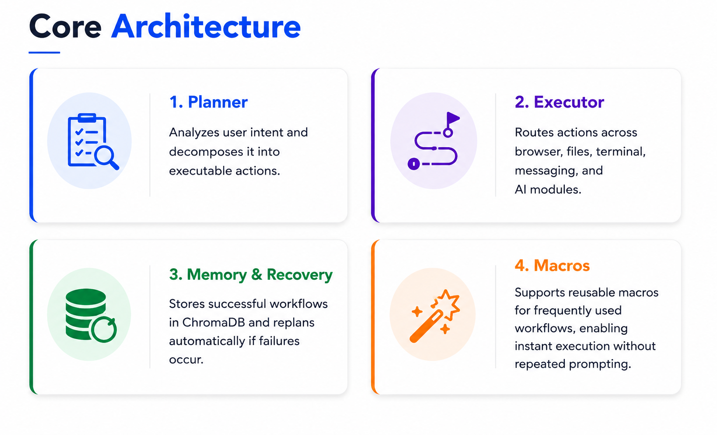
Idea
Your Solutions
IntentOS is an intent-based AI operating layer that enables users to control their computer using natural language. Instead of manually switching between apps, browsers, files, and messaging platforms, users simply describe the task, and the system executes the workflow automatically.
The platform combines AI reasoning, browser automation, desktop control, workflow memory, and recovery into a unified execution system.

Slide 5
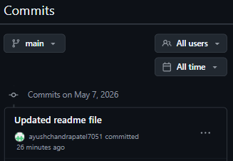
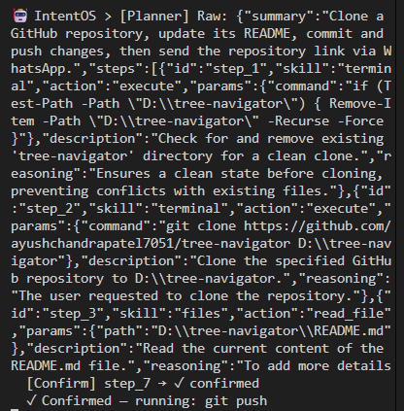
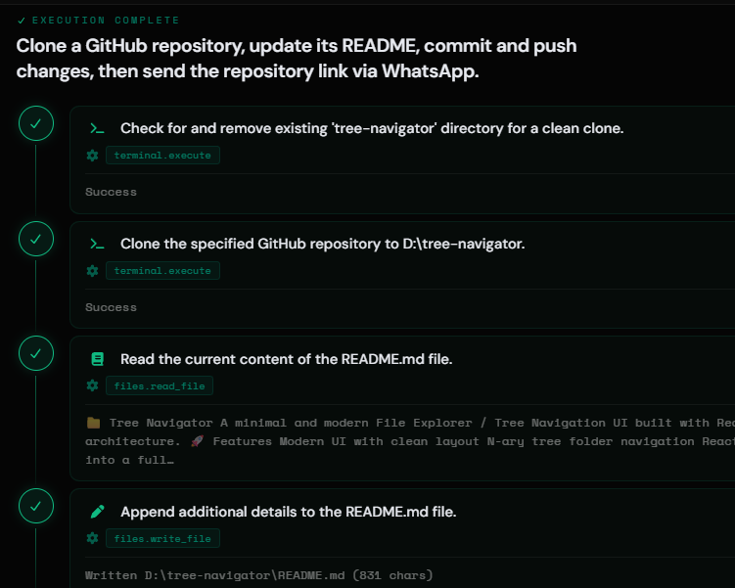
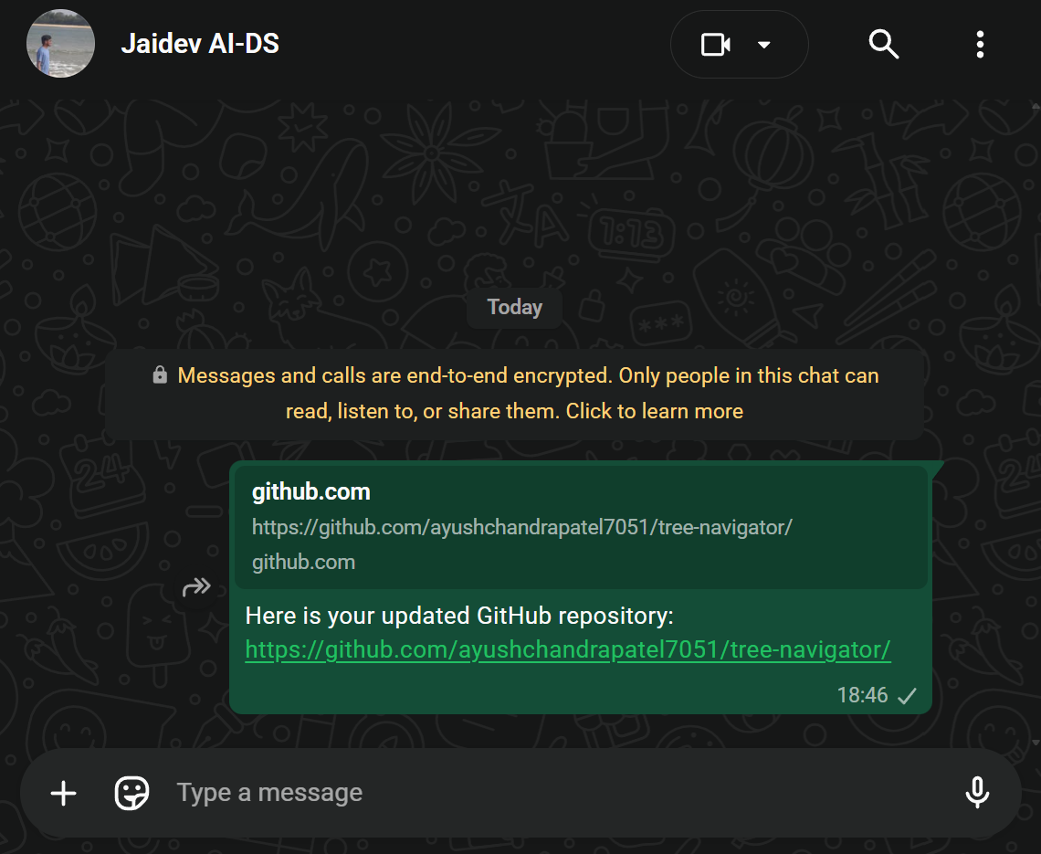
Idea
Demo/Product Walkthrough

Slide 6
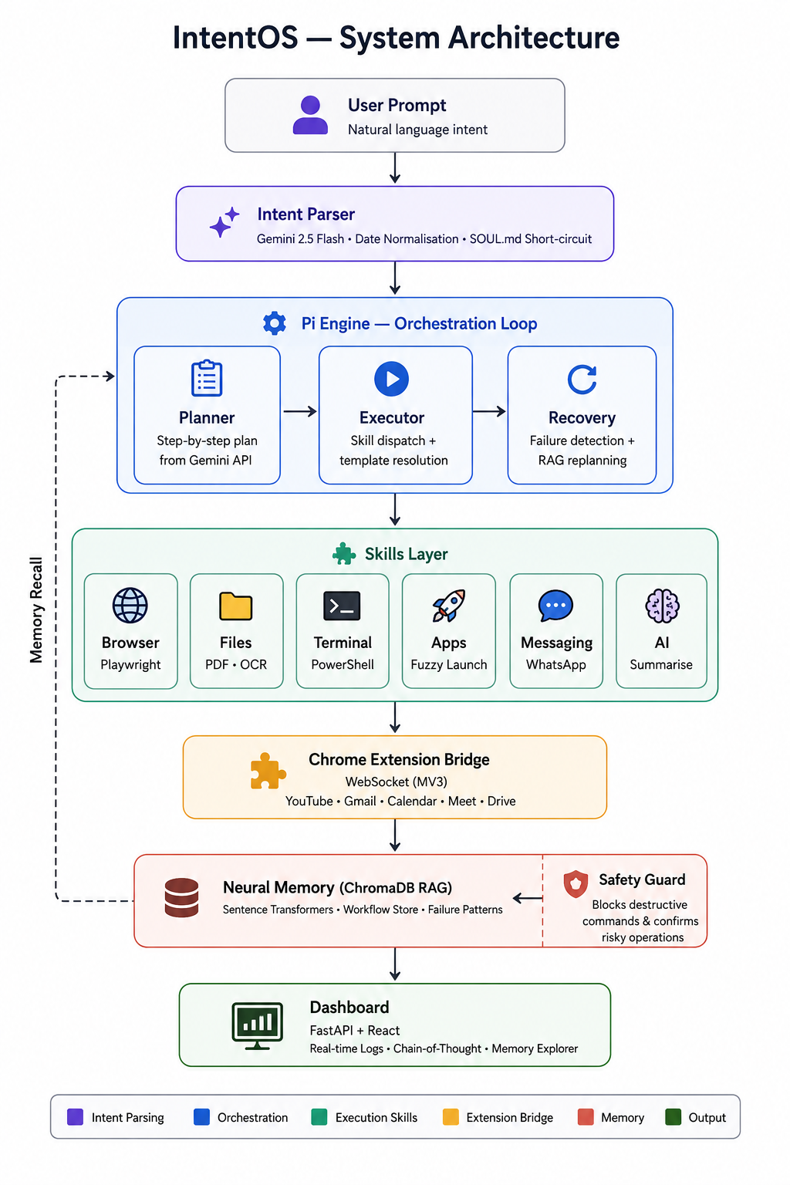
Idea
Tech & Architecture
Tech Stack
Frontend: React.js, Vite
Backend: Python, FastAPI, WebSocket
AI Orchestration: Pi Engine, Planner → Executor → Recovery
LLM: Gemini 2.5 Flash, intent parsing & planning
Memory: ChromaDB and Sentence Transformers, workflow recall
Browser: Playwright with Chrome Extension (Manifest V3)
Messaging: WhatsApp & Telegram via desktop automation
Terminal: PowerShell subprocess execution
AI Usage
Gemini 2.5 Flash, decomposes intent into atomic executable steps
ChromaDB and Sentence Transformers, semantic recall of past workflows & failures
Sarvam AI STT, voice to text before planning
SOUL.md Macros, bypasses Gemini entirely for named routines

Slide 7
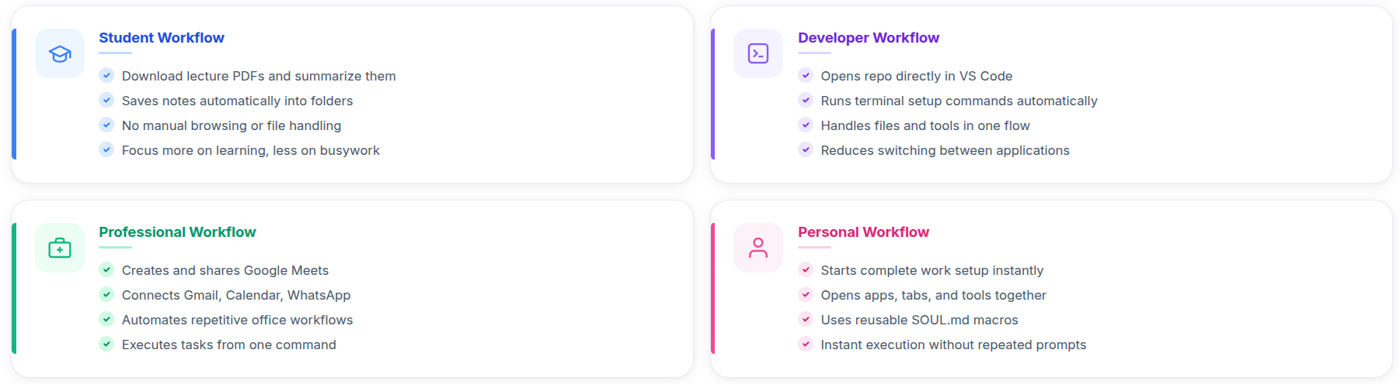
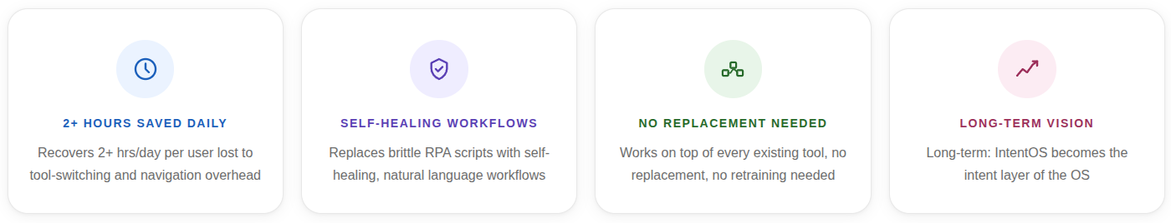
Idea
Impact & Use cases
Scale Potential

Slide 8
Idea
Differentiation
Unified Operating Layer
Every existing tool covers one environment only, browser OR files OR terminal, never all
IntentOS unifies browser, desktop apps, files (PDF/DOCX/OCR), terminal, messaging, and Google Workspace in one agent loop
One sentence spans every tool, no manual handoff needed
Dynamic Workflow Planning
Zapier/Make.com need pre-built rule graphs; IntentOS generates plans at runtime from natural language
SOUL.md macros bypass LLM entirely for known routines, zero token cost, instant execution
Step-level failure detection triggers automatic replanning, partial progress is never lost
MOAT 1 — Neural Workflow Memory
Successful runs stored as ChromaDB vector embeddings (Sentence Transformers)
Similar future intents retrieve and reuse past execution patterns automatically
Failure patterns stored too, system avoids known failure paths on retry
MOAT 2 — Recovery & Replanning Engine
Detects failure at step level, preserves partial progress, not a full restart
Queries RAG memory for closest successful workflow, patches plan, re-executes
Extension Bridge v3.1: 3x retry + verified delivery for Gmail, Calendar, Meet
Result: adaptive automation, not static rule execution.

Slide 9
Idea
Demo Link
GitHub Repository
Link: github.com/ayushchandrapatel7051/IntentOS
Demo
Project Video Demo Link: https://drive.google.com/file/d/1x0mhyvkGGOudKDBIoXwq-48ukniB6knK/view?usp=sharing
Submitted Documents
Project Video Demo — Solution explanation + full walkthrough
Complete Source Code — agent, skills, memory, dashboard, Chrome extension
README — Problem, solution, setup instructions, usage guide
AI Disclosure — Link
PPT — Attached (Samsung Hackathon format)
APK/SDK — Not applicable (desktop application)

Slide 10
Idea
Future Impact
Redefining Human–Computer Interaction
• Move from manual software navigation to intent-driven computing.
• Reduce repetitive digital workflows through autonomous execution.
• Enable AI systems that can understand, plan, execute, and recover tasks independently.
• Improve productivity for students, developers, professionals, and enterprises.
• Create a foundation for AI-native operating environments across desktop systems.
• Expand toward voice-controlled, multi-agent, and cross-device automation ecosystems.
Vision
“IntentOS aims to become the intelligent operating layer between humans and computers.”

