Slide 1

Void Crew
Void Crew presents a data-driven strategy to optimize library operations.
Our analysis covers two years of data and offers actionable solutions for improvement.
Ayush Kumar 1MS24AD015 Kovid Tyagi 1MS24AD033
Jaidev Narayan Singh 1MS24AD029 Swaroop H K 1MS24AD062

Slide 2

Data Overview: Scope and Key Fields
Scope: Jan 2023 - Dec 2024
Analyzed two years of library data.
Book Data
Title, Author, Barcode
Borrower Data
Card Number, Name, Department, Category, Transaction, Penalties paid

Slide 3

Data Processing: Cleaning and Transformation
Data Cleaning
Tools
Missing values, inconsistencies
Python
GammaAI, JuliusAI, Chatgpt

Slide 4
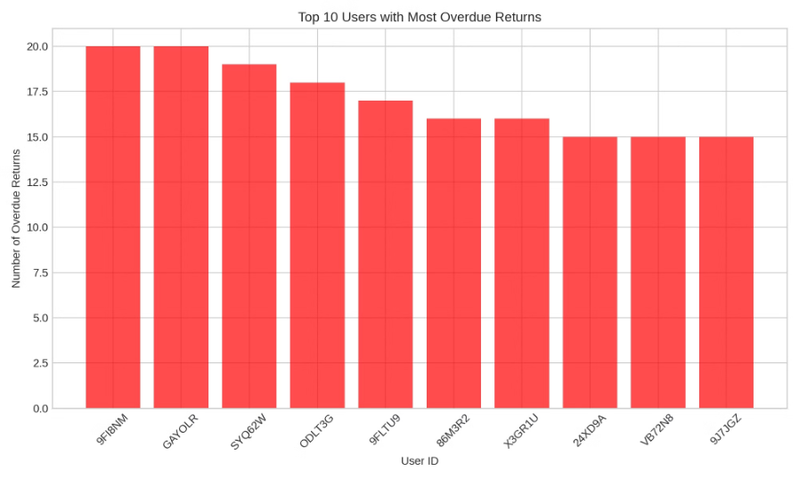
Insight 1: Reducing Late Returns
Issue: Many users return books late, especially those who frequently renew books.
Improvement Strategy:
Implement automated reminders via email/SMS a few days before the due date.
Introduce late return penalties or limit renewals for users with repeated delays.

Slide 5
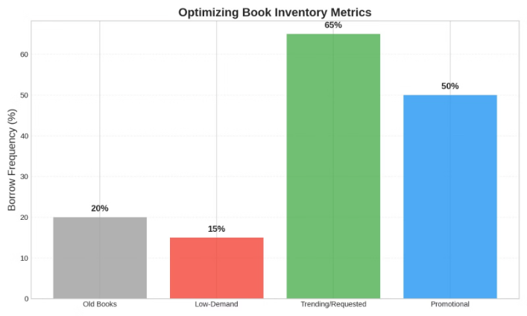
Insight 2: Optimizing Book Inventory
Issue: Some books are aging and are borrowed less over time.
Improvement Strategy:
Identify low-demand books and replace them with trending or requested titles.
Organize book promotion events (e.g., book discussions, themed weeks).

Slide 6
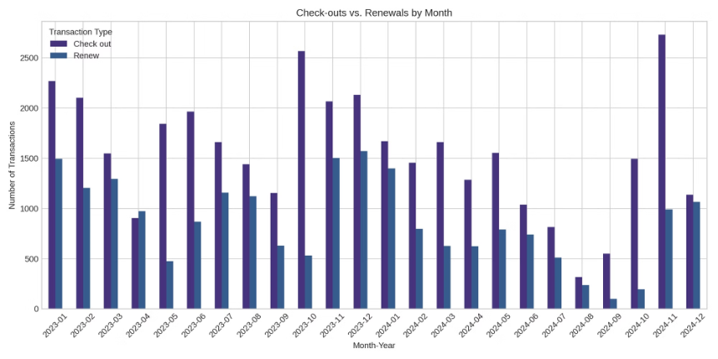
Insight 3: Balancing Check-outs vs. Renewals
Issue: A significant portion of transactions are renewals rather than new check-outs.
Improvement Strategy:
Set a renewal limit (e.g., max 2 renewals per book) to encourage circulation.
Implement dynamic renewal pricing (e.g., free for first renewal, small fee for more).

Slide 7
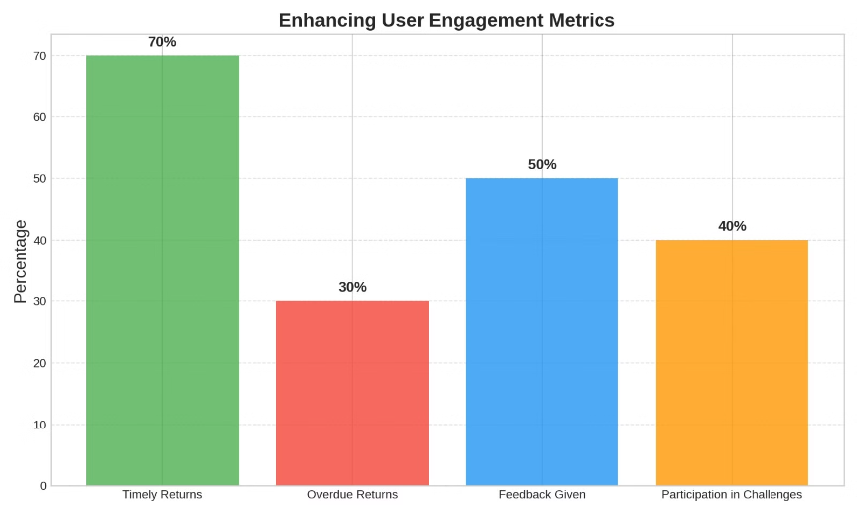
Insight 4: Enhancing User Engagement
Issue: Some users check out multiple books but do not return or renew them on time.
Improvement Strategy:
Create a user reward system for timely returns (e.g., loyalty points, discounts).
Encourage user feedback on borrowed books to enhance book recommendations.

Slide 8
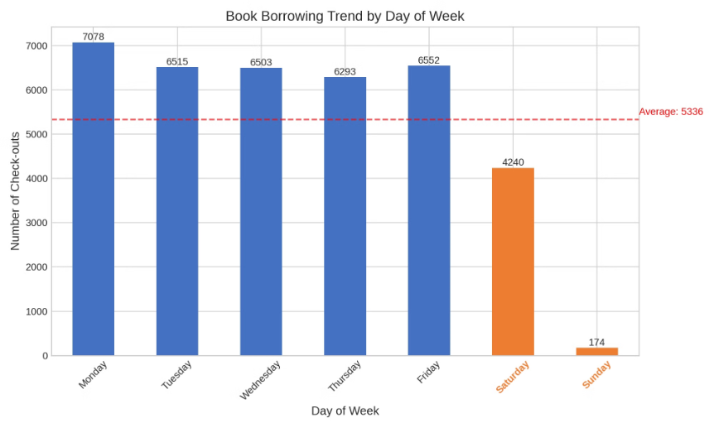
Insight 5: Improving Weekend Borrowing Trends
Issue: Borrowing activity drops significantly on weekends.
Improvement Strategy:
Offer special weekend discounts or extended loan durations for weekend check-outs.
Promote themed weekend borrowing programs (e.g., "Weekend Reads").

Slide 9
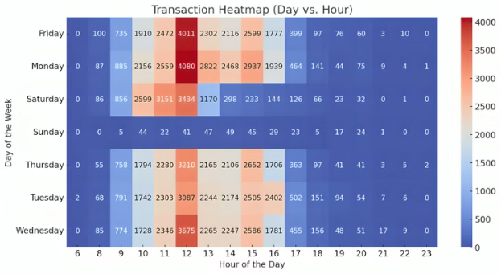
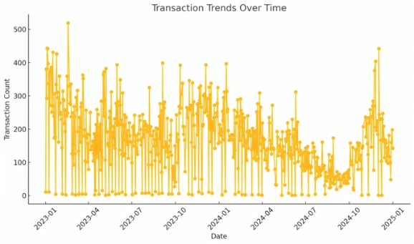
Data Visualization

Slide 10
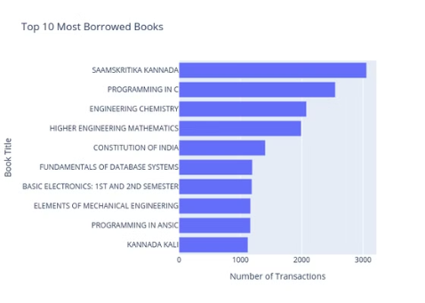
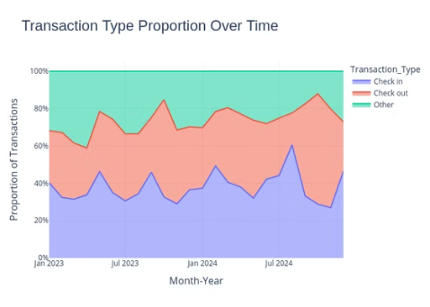
Data Visualization

Slide 11

Thank You
We appreciate your time and attention. We hope that these insights will lead to improvements.

