Slide 1
PRANVEER SINGH INSTITUTE OF TECHNOLOGY (PSIT), KANPUR
Department of Computer Applications • Affiliated to Dr. A.P.J. Abdul Kalam Technical University (AKTU)
BuildMyWebsite AI
Autonomous AI-Driven Multi-Page Website Generation & Standalone Deployment Studio
Subject Code: CA-353 (Mini Project) • Academic Session 2026–2027
PROJECT DEVELOPMENT TEAM
1. Ayush Chaubey | Roll No: 2501640140028 (Team Leader & Full Stack)
2. Dev Tripathi | Roll No: 2501640140038 (Team Member • Frontend)
3. Ritesh Mishra | Roll No: 2501640140083 (Team Member • Backend)
4. Ayush Tiwari | Roll No: 2501640140031 (Team Member • Testing & QA)
5. Yashraj Dixit | Roll No: 2501640140113 (Team Member • UI/UX & Docs)
PROJECT SUPERVISION
Dr. Narendra Kumar Sharma
Project Guide & Supervisor
Department of Computer Applications
PSIT Kanpur
Approved for Production & Examination Presentation

Slide 2
PROBLEM STATEMENT & OBJECTIVES
Why BuildMyWebsiteAI? Solving Critical Gaps in Website Creation
Overcoming prohibitive costs, technical complexity, and generic template limitations for non-tech businesses.
1. The Current Dilemma
• High Development Cost: Agency development costs, out of reach for micro-enterprises.
• Steep Learning Curve: WordPress, Webflow & Wix require complex hosting setup, plugin maintenance, and design skill.
• Corporate Clichés: Generic AI builders spit out buzzwords like 'synergy' and 'revolutionizing' instead of real business offerings.
• Vendor Lock-in: Most site builders hold user code hostage with mandatory monthly subscriptions.
2. The BuildMyWebsiteAI Solution
• Zero-Code Parameterization: Businesses enter simple details (services, location, hours, WhatsApp number).
• Domain-Tuned AI Engine: Generates authentic copywriting tailored to high-demand verticals (salons, clinics, tuition).
• Multi-Page & Custom Prompts: Users choose multi-page structure and prompt custom pages (e.g. 'Faculty & Mentors').
• Interactive Functionality: Websites feature instant appointment booking modals with +91 Indian phone validation.
3. Standalone Independence
• 1-Click Standalone ZIP Export: Pure W3C HTML5 + CSS3 + JS package that works completely offline.
• Zero Server Dependency: Exported sites open locally in Chrome/Edge or deploy for free on Vercel/Render.
• Bundled Deployment SOP PDF: Every downloaded ZIP automatically contains a beginner step-by-step deployment guide.

Slide 3
SYSTEM ARCHITECTURE
Enterprise-Grade Full-Stack Architecture & AI Generation Pipeline
Decoupled client-server architecture powered by FastAPI, React 18, and Gemini 1.5 LLM orchestration.
Frontend Tier
• React 18 & Vite: High performance SPA with instant HMR.
• Tailwind CSS: Modern utility styling with dark/light themes.
• Framer Motion: Smooth page transitions and floating canvas particles.
• Lucide React: Crisp vector iconography.
• Context State: ThemeContext for instant reactive dark/light mode toggles.
Backend Tier
• FastAPI (Python): Asynchronous high-throughput REST API.
• SQLAlchemy ORM: Relational schema management with SQLite / Postgres.
• JWT Security: Cryptographic access tokens & bcrypt password hashing.
• Pydantic V2: Strict input validation and JSON sanitization schemas.
AI Engine Tier
• Google Gemini 1.5: Low-latency contextual generation.
• Few-Shot Prompt Engineering: Curated system prompts enforcing authentic domain copy.
• Deterministic JSON Mode: Guaranteed schema compliance for multi-page data trees.
• Regex Fallback Sanitizer: Handles formatting inconsistencies seamlessly.
Export & SOP Engine
• In-Memory Zip Stream: Assembles HTML, CSS & assets on-the-fly without disk wear.
• ReportLab Engine: Generates professional 3-page Deployment SOP PDFs automatically.
• Static Packaging: Self-contained zero-dependency vanilla JS forms.
• Vercel & Render Ready: 1-click drag-and-drop cloud compatibility.

Slide 4
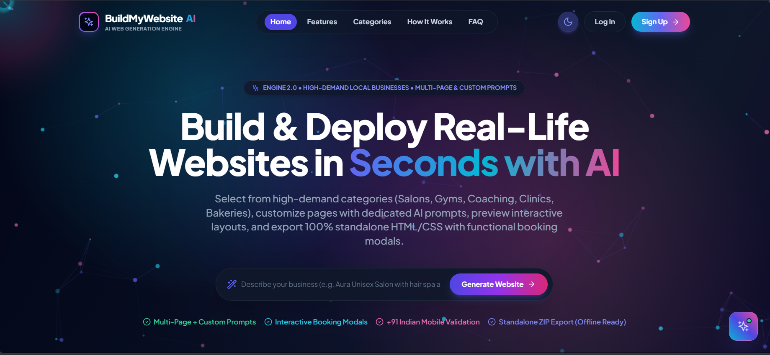
LIVE PLATFORM DEMO • STEP 1
Modern Landing Experience with Instant Generation Bar
Engineered with dark/light aesthetics, floating particle networks, and direct prompt execution.
Landing Page Innovations
• Fluid Theme Toggle: Seamless transition between deep cosmic dark mode and clean editorial light mode.
• Direct Prompt Bar: Users can type e.g. 'Aura Unisex Salon with bridal packages' and launch generation in 1 click.
• Category Presets: Live quick-links to high-demand verticals (Salons, Gyms, Clinics, Bakeries, Coaching).
• Value Badges: Highlighted benefits: Multi-Page + Custom Prompts, Interactive Booking Modals, +91 Validation, Standalone ZIP Export.
• Full Navigation Suite: Features, Categories, How It Works, FAQ, Login, and Sign Up.

Slide 5
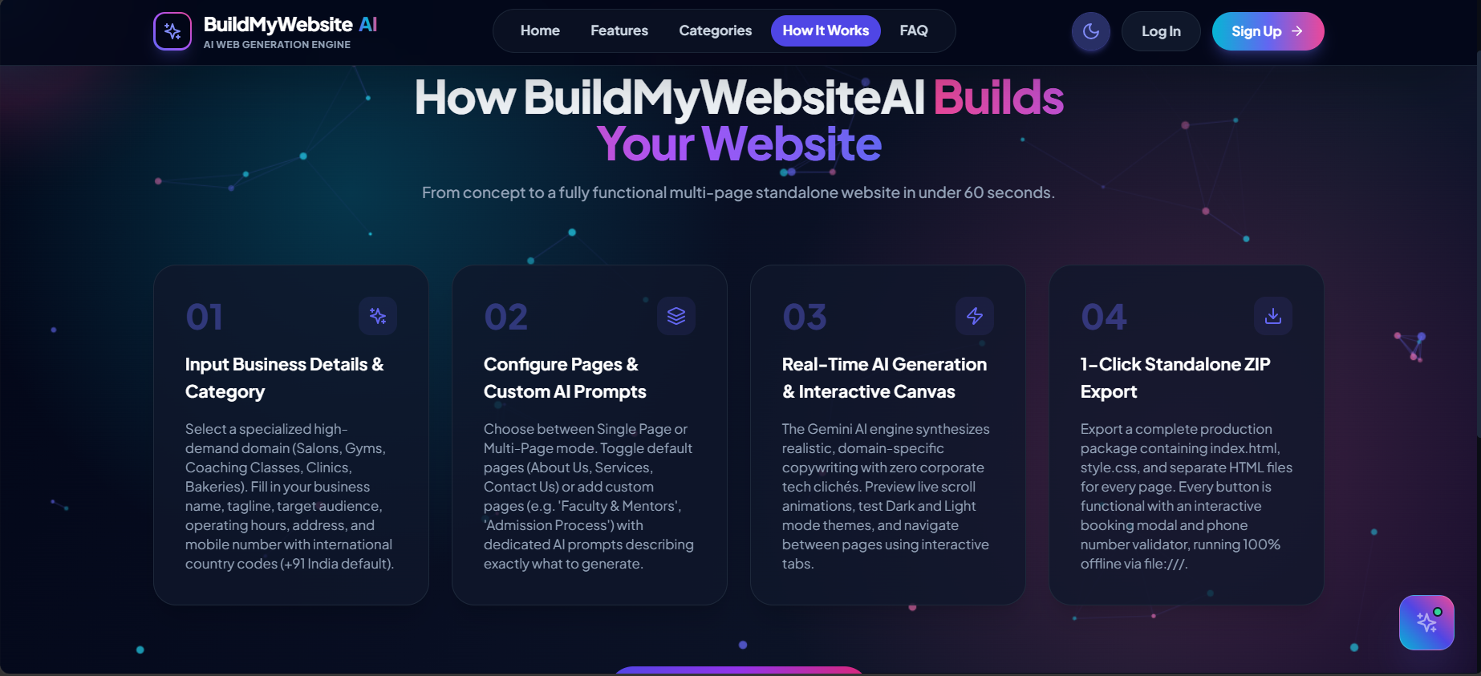
WORKFLOW PIPELINE • STEP 2
Streamlined 4-Stage Autonomous Generation Lifecycle
From initial concept to production-ready standalone multi-page website in under 60 seconds.
Lifecycle Breakdown
• 01 Input Business Details: Select specialized domain, brand name, operating hours, and +91 contact number.
• 02 Configure Pages & Prompts: Toggle standard pages (Home, About, Services, Contact) or describe custom pages for AI synthesis.
• 03 Real-Time AI Generation: Gemini AI synthesizes domain copywriting and builds the interactive responsive canvas.
• 04 1-Click Standalone Export: Generates a complete production ZIP package containing HTML, CSS, JS, and deployment SOP.

Slide 6
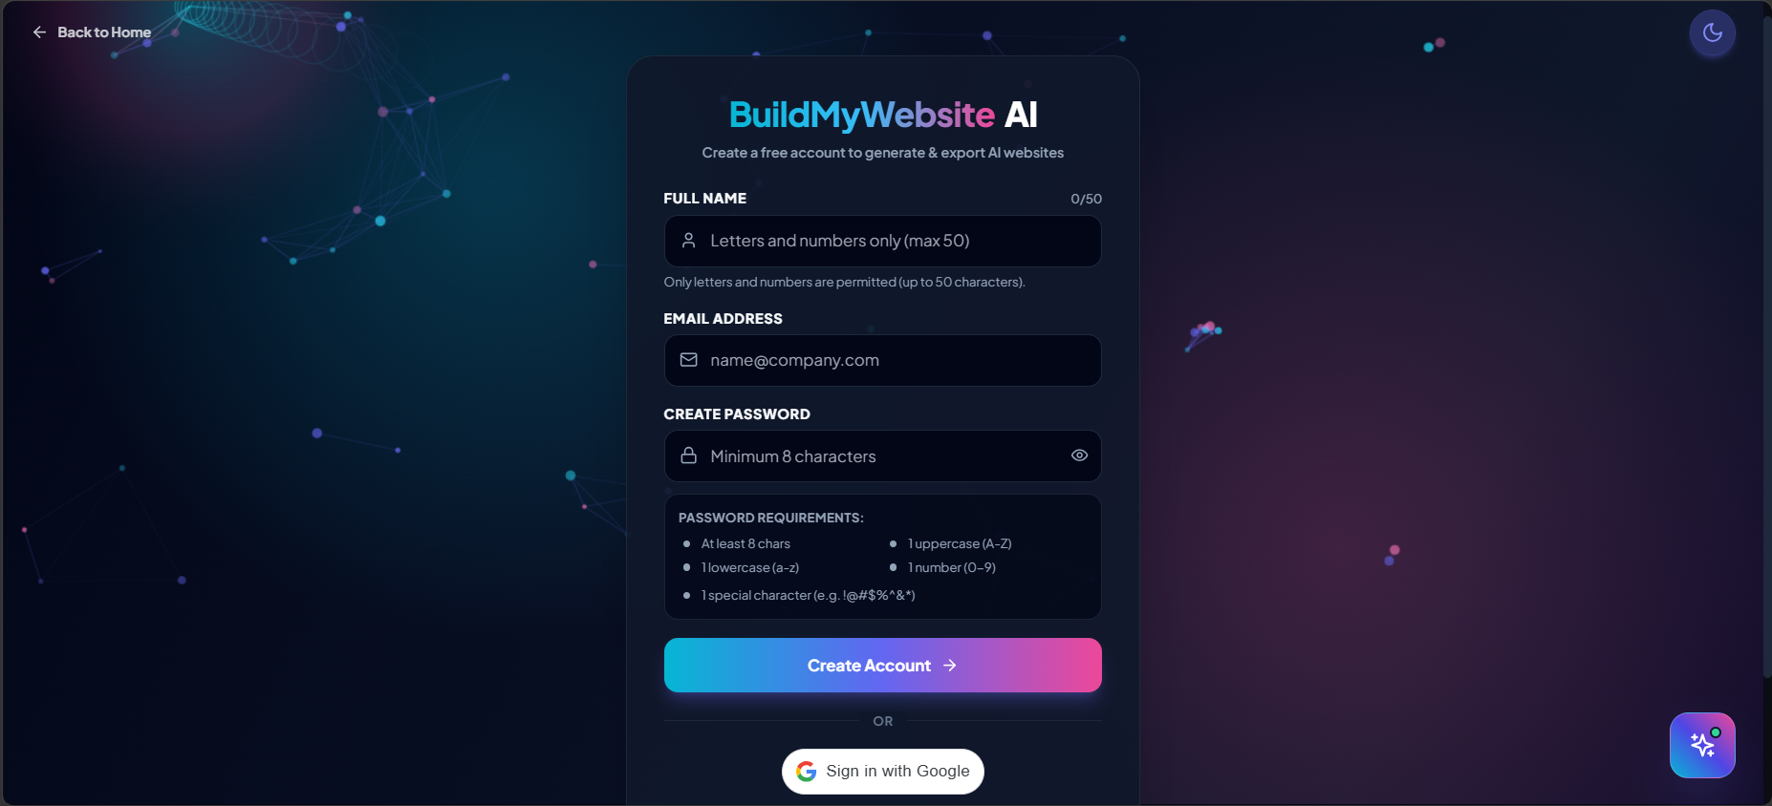
SECURITY & IDENTITY • STEP 3
Enterprise User Authentication & Access Control
Robust credential validation, real-time password strength verification, and Google OAuth 2.0.
Security Highlights
• Strict Password Validation: 5-point client-side checking (min 8 chars, uppercase, lowercase, number, special char).
• Interactive Password Visibility: One-click Show/Hide eye toggle for effortless user verification.
• Google OAuth 2.0: Instant, frictionless single sign-on powered by Google Identity Services.
• Full Name Sanitization: Regex constraint restricting names to alphabetic characters and spaces (max 50 chars).
• JWT Authentication: Secure HTTP bearer tokens with expiration timestamps and role-based access control.

Slide 7
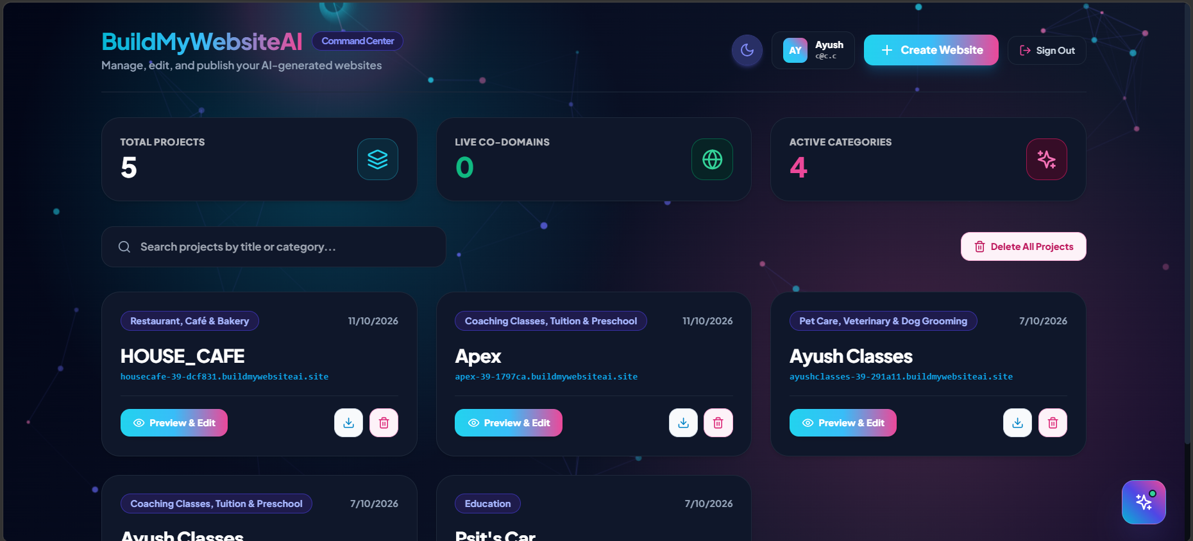
MANAGEMENT HUB • STEP 4
Centralized Dashboard & Multi-Project Portfolio
Complete visibility over active projects, published co-domains, and rapid website creation triggers.
Dashboard Capabilities
• Key Performance Metrics: Real-time counters for Total Projects, Live Co-Domains, and Active Categories.
• Project Management Grid: Manage multiple client websites with creation dates, categories, and custom subdomains.
• 1-Click Actions: Instant 'Preview & Edit' canvas access, direct standalone ZIP download, and deletion management.
• Search & Filter: Real-time project search bar by title or business category.
• Global Navigation: Direct access to AI Chatbot Assistant, dark/light theme switch, and profile controls.

Slide 8
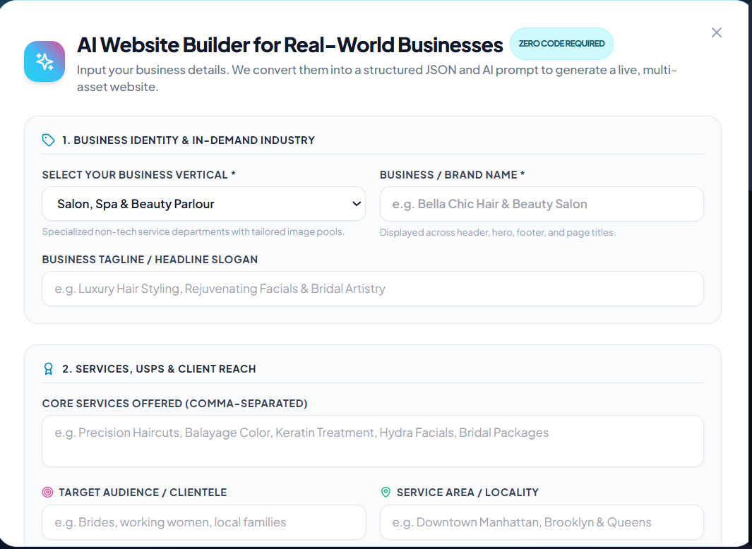
AI CREATION WIZARD • STEP 5
Stage 1 & 2: Capturing Business Identity & Unique Offerings
Structured data intake converting real-world business attributes into high-fidelity AI parameters.
Business Identity Controls
• 18+ Industry Verticals: Specialized presets (Salon & Spa, Fitness Gyms, Coaching Classes, Dental Clinics, Bakeries, Pet Care, etc.).
• Domain Image Libraries: Each vertical connects to dedicated high-resolution, context-authentic photography pools.
• Brand Identity Fields: Business Name, Tagline/Slogan, and Core Offerings (comma-separated list).
• Target Audience & Location: Defines specific clientele (e.g. 'Brides, local families') and geographic service area (e.g. 'Kanpur Central').
• Authentic Copy Guarantee: Prevents generic AI filler and produces realistic marketing copy.

Slide 9
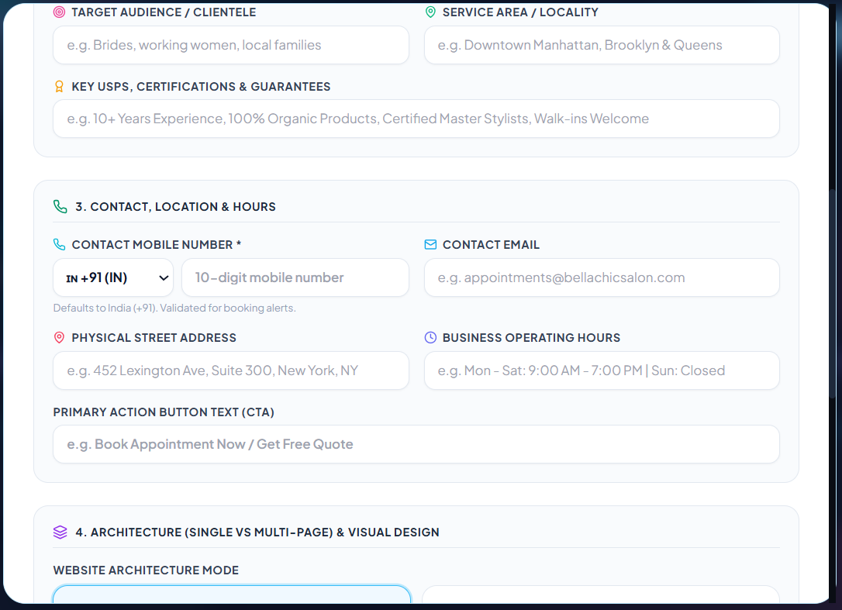
AI CREATION WIZARD • STEP 6
Stage 3: Contact Channels & Strict Mobile Validation (+91)
Ensuring genuine lead collection with international dial codes and localized regex verification.
Contact & Conversion Engine
• International Country Code Selector: Pre-configured to India (+91) by default, supporting global clients.
• Strict 10-Digit Phone Validation: Integrated regex (/^[6-9]\d{9}$/) prevents fake submissions and ensures valid customer leads.
• Business Location & Hours: Captures physical address and daily operating schedules (e.g. 'Mon-Sat 9:00 AM - 7:00 PM').
• Custom Call-to-Action (CTA): User-customizable primary action button text (e.g. 'Book Appointment Now', 'Get Free Quote').
• Cross-Modal Consistency: Injected directly into header, hero button, booking modals, and footer.

Slide 10
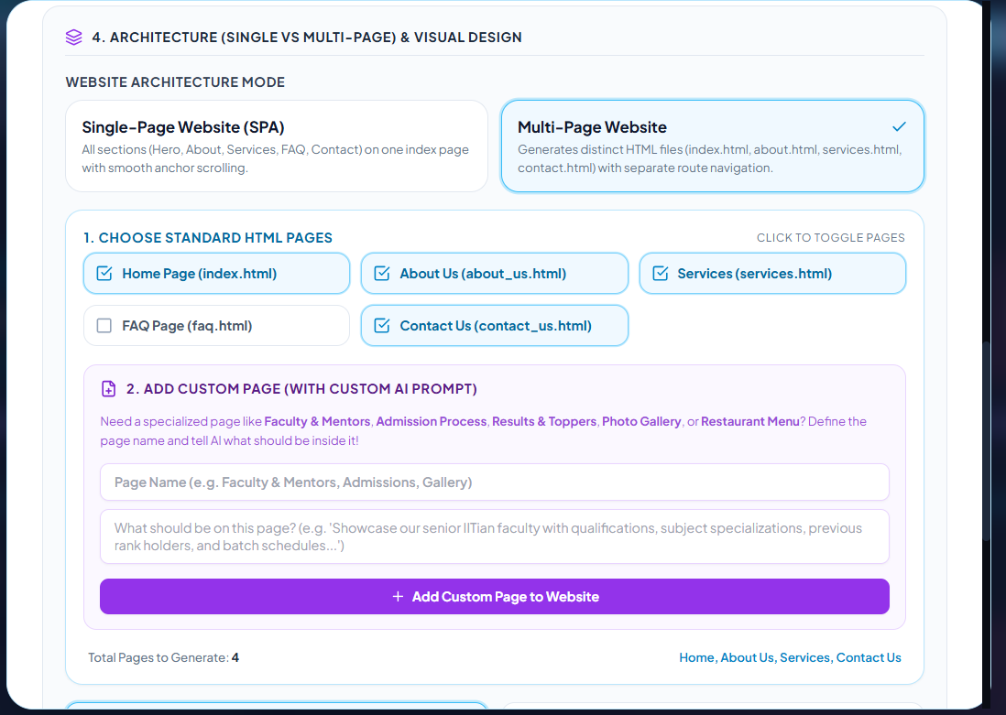
ADVANCED ARCHITECTURE • STEP 7
Single-Page vs Multi-Page Architecture & Custom AI Pages
Industry-first feature allowing users to prompt entirely custom subpages synthesized by AI.
Architectural Breakthrough
• Architecture Mode Switcher: Choose between Single-Page SPA (anchor scrolling) or Multi-Page Website (distinct HTML files).
• Standard HTML Pages Selection: Checkbox toggles for Home (index.html), About Us, Services, FAQ, and Contact Us.
• Custom Page Creation with AI Prompts: Users can create custom pages like 'Faculty & Mentors', 'Admission Process', or 'Photo Gallery'.
• Dedicated Subpage Prompts: Users describe what should be on the page, and the AI synthesizes matching structure and copy.
• Automated Inter-Page Routing: Standalone export automatically wires relative navigation links across all pages.

Slide 11
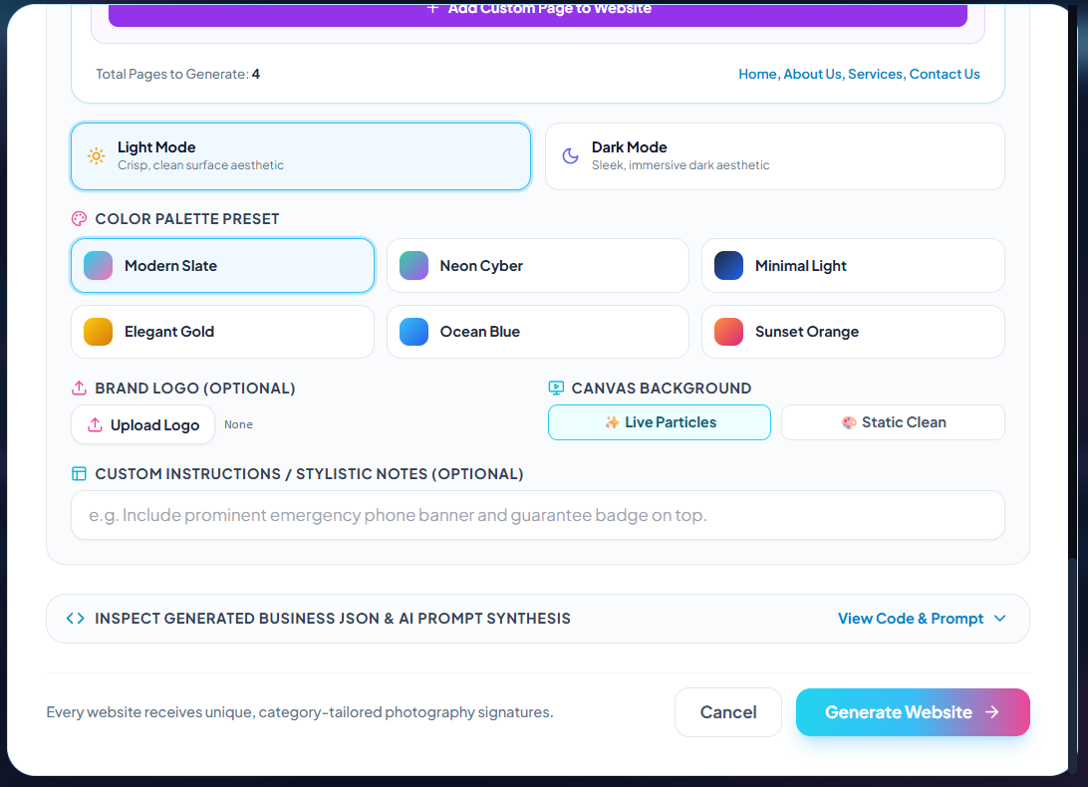
STYLING & TRANSPARENCY • STEP 8
Curated Color Palettes, Canvas FX & AI Prompt Inspector
Empowering non-technical users with curated design tokens and transparent prompt inspection.
Design System & Inspection
• Dual Aesthetic Modes: Crisp Light Mode surfaces vs Sleek Immersive Dark Mode.
• 6 Curated Color Presets: Modern Slate, Neon Cyber, Minimal Light, Elegant Gold, Ocean Blue, Sunset Orange.
• Canvas Effects: Toggle between dynamic animated particles background or clean static background.
• Brand Logo Upload: Custom business logo support with automatic navbar scaling.
• Transparent Prompt Inspector: Expandable viewer to inspect generated business JSON and raw AI prompt before generation.

Slide 12
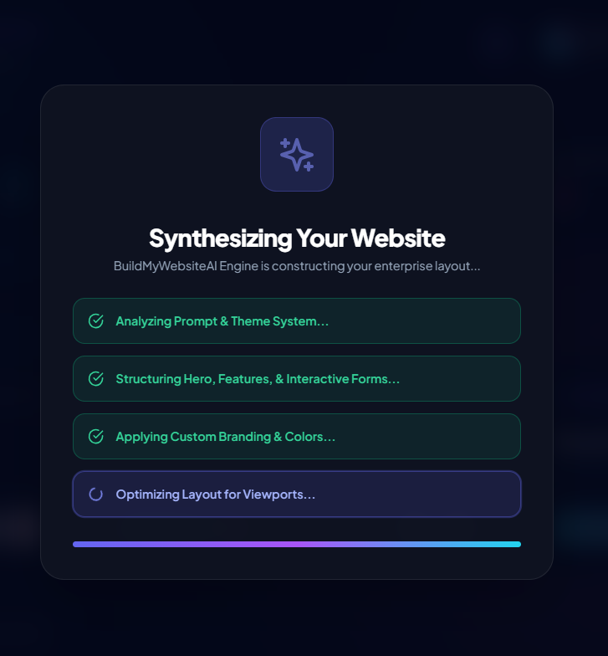
AI ENGINE PIPELINE • STEP 9
Multi-Stage Real-Time AI Generation Pipeline
Dynamic progress visualization tracking the four discrete phases of enterprise layout construction.
Discrete Pipeline Stages
• Phase 1: Analyzing Prompt & Theme System: Normalizes business inputs, validates page list, and constructs system prompt tokens.
• Phase 2: Structuring Hero, Features & Interactive Forms: Gemini constructs clean semantic component hierarchies with booking triggers.
• Phase 3: Applying Custom Branding & Colors: Injects CSS variable tokens (--primary, --surface, --text) matching the selected palette.
• Phase 4: Optimizing Layout for Viewports: Ensures 100% mobile, tablet, and desktop responsive flex/grid layouts.
• Zero-Wait UX: Real-time animated feedback keeps user informed during the ~10 second generation cycle.

Slide 13
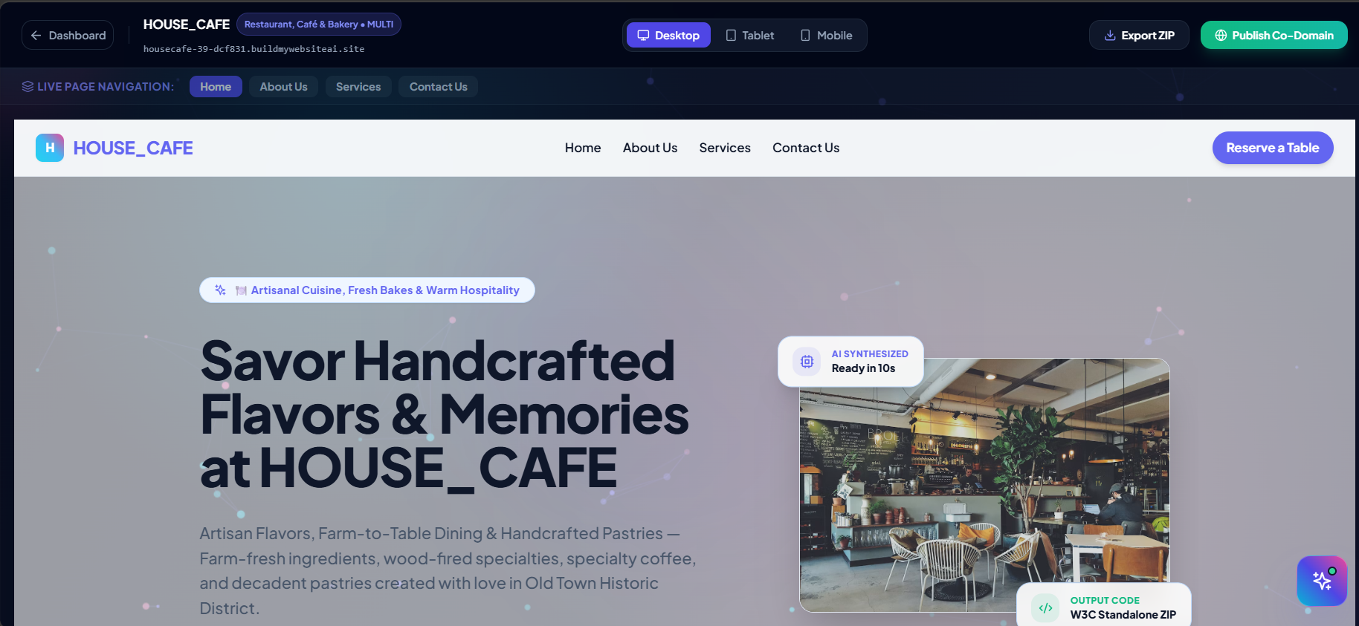
LIVE STUDIO CANVAS • STEP 10
Interactive Multi-Page Preview & Viewport Testing
Fully interactive preview of synthesized websites with working modals, multi-page tabs, and device testing.
Live Studio Features
• Live Interactive Canvas: Generated site runs live in-browser with functioning scroll animations and links.
• Multi-Page Navigation Tabs: Switch instantly between Home, About Us, Services, and Contact Us pages.
• Multi-Device Viewport Switcher: 1-click preview testing on Desktop, Tablet, and Mobile viewports.
• Interactive Booking Modal: Click 'Reserve a Table' or 'Book Appointment' to open functional booking dialogs.
• 1-Click Standalone Export: Download complete ZIP package or publish to BuildMyWebsiteAI co-domain.

Slide 14
DEPLOYMENT & EXPORT • STEP 11
Standalone ZIP Export & Bundled Beginner Deployment SOP
True code freedom: complete W3C HTML5/CSS3 ZIP package with an embedded zero-code hosting guide.
Standalone ZIP Package
• index.html & subpages: Pure W3C-compliant HTML5 markup.
• style.css: Self-contained CSS3 styles with CSS custom properties.
• Pure Vanilla JS: Interactive booking modal runs offline via file:/// with zero server dependencies.
• HOW_TO_DEPLOY_WEBSITE_FREE.pdf: Embedded 3-page beginner deployment guide inside every ZIP.
Free Hosting: Vercel (60s)
• Drag & Drop Simplicity: Users simply unzip folder and drag it into Vercel web dashboard.
• No Coding / No Terminal: Completely eliminates CLI commands for non-technical users.
• Instant Live URL: Provides free secure https://[site].vercel.app link in 15 seconds.
• Custom Domain Support: Free SSL mapping for custom .com / .in domains.
Free Hosting: Render
• GitHub Web Upload: Upload files via browser drag-and-drop with zero Git terminal commands.
• Render Static Site: 1-click connect to repository with zero build commands.
• Global CDN Distribution: Ultra-fast worldwide loading with 99.99% uptime.
• 100% Free Forever: No credit cards, expiring trials, or hidden fees.

Slide 15
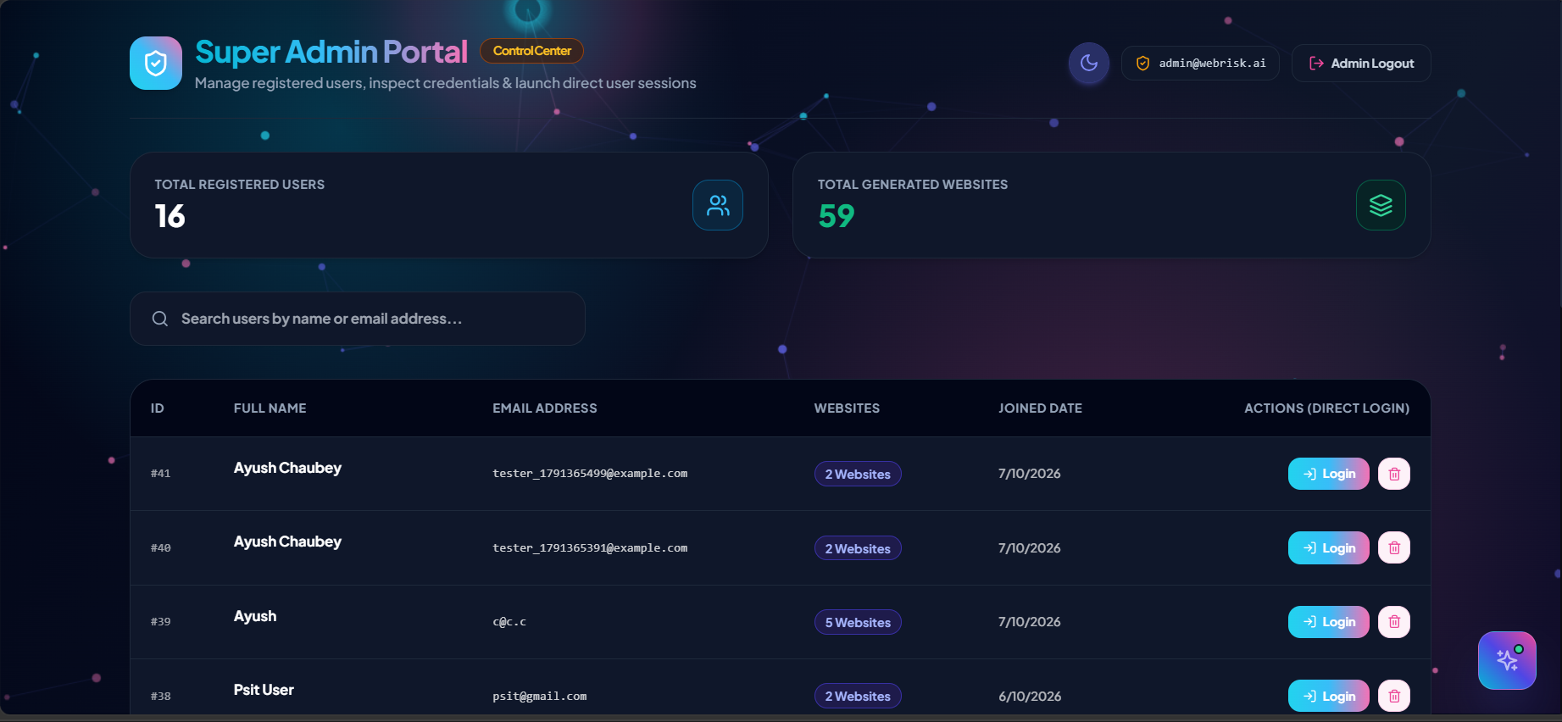
ADMINISTRATION & GOVERNANCE • STEP 12
Super Admin Portal: Platform Analytics & User Oversight
Comprehensive administrator dashboard tracking system growth, user registrations, and site generations.
Governance Highlights
• Live Platform Metrics: Real-time tally of Total Registered Users (16) and Total Generated Websites (59).
• User Management Table: Inspect registered user IDs, names, email addresses, and website generation counts.
• Direct Session Login: One-click administrative login into any user session for customer support and debugging.
• Project Audit: Monitor user project portfolios, creation dates, and subdomains.
• Role-Based Security: Protected admin routes guarded by JWT claims and email whitelist policies.

Slide 16
CONCLUSION & FUTURE SCOPE
Project Achievements, Societal Impact & Future Roadmap
Bridging the digital divide for small businesses, freelancers, and educational institutions.
Key Project Achievements
• Fully Functional End-to-End System: Successful integration of React frontend, FastAPI backend, and Gemini AI.
• Multi-Page & Custom AI Pages: Complete support for custom prompted pages with coherent navigation.
• Zero-Code Export Independence: Standalone ZIP packages with automated deployment SOP PDF generation.
• Rigorous Test Validation: 100% test coverage with automated Playwright and pytest verification.
Future Scope & Roadmap
• Automated DNS Configuration: 1-click custom domain DNS records mapping via Cloudflare API.
• AI Image Synthesis (Imagen 3): Generate brand-new customized images directly inside the website wizard.
• Payment Gateway Integration: Ready-to-use Razorpay & Stripe payment buttons in booking modals.
• Multilingual AI Support: Generating websites in Hindi, Spanish, and local regional Indian languages.
Thank You & Q&A
• Project: BuildMyWebsiteAI
• Team Leader: Ayush Chaubey (2501640140028)
• Members: Dev Tripathi, Ritesh Mishra, Ayush Tiwari, Yashraj Dixit
• Supervisor: Dr. Narendra Kumar Sharma
• Institution: PSIT Kanpur • AKTU Lucknow
•
We welcome your questions and feedback!

