Slide 1

CloudMonitor
CLOUD COMPUTING MINI PROJECT
Docker Monitoring & Observability Platform
A self-hosted dashboard for Docker host and container telemetry
IITP – BSc CSDA
5th Semester
2026
Notes:
Title slide. CloudMonitor is a self-hosted Docker host and container observability platform, built as a Cloud Computing mini project. The ship illustration is decorative.

Slide 2
Project Overview
Industry / Domain
IT operations and DevOps (small SaaS and dev teams)
Use Case
Monitor Docker hosts and containers from one web dashboard
Business Need
Small teams cannot inspect every host by hand; they need one health view
Target Users
Developers, operators and admins running a few Docker hosts
Cloud Objective
Deploy a reliable, measurable pipeline on AWS EC2 with Docker
Team Members
SARNENDU DAS : 24a12res592
PARVEEN KUMAR : 24a12res426
AYUSH RAJ : 24a12res897

Slide 3
Industry Problem & Proposed Solution
Pain point
Proposed solution
Container state is invisible across hosts
CPU and memory pressure goes unnoticed
Offline hosts and API errors stay hidden
Agent on each Docker host reports telemetry
FastAPI + PostgreSQL store and serve it
Prometheus rules watch API and host health
Expected improvement
Assumptions & constraints
Better availability, faster detection and recovery, one automated pipeline.
Few hosts, low budget, single EC2 instance, HTTP demo, no compliance scope.

Slide 4
SLA & TTR
99.5%
< 1 s
15 min
24 h
≤ 10 min
Availability SLA
API response, 95% of requests
RTO
RPO (daily DB dump)
TTR target
S1 Critical
S2 High
S3 Medium
S4 Low
How SLA violations are detected and reported
Prometheus alerts on /health down, 5xx rate and P95 latency (15 s evaluation)
Alertmanager groups alerts; each incident is logged with its severity and TTR

Slide 5
End-to-End Cloud Pipeline
Users & Agents
Browser, Docker host
Public IP
HTTP :80, SG
Nginx + FastAPI
JWT, /health
Docker Compose
PostgreSQL volume
AWS EC2
VPC, EBS, IAM
Monitoring
Prometheus, CloudWatch
SLA metrics
Logging & monitoring
Failure recovery
/health endpoint
Request latency histogram
Uptime / availability
Container logs
Prometheus scrape every 15 s
CloudWatch CPU alarm
Restart container
Redeploy / rollback
EBS snapshot restore

Slide 6
AWS Services Used
Amazon EC2
VPC + Security Groups
Hosts the Docker Compose stack (t3.micro, Ubuntu 24.04). Why: full control, Free Tier eligible, simple single-host design.
Isolated network; 80/443 public, SSH admin-only, 5432 blocked. Why: network firewall keeps the database private.
IAM
CloudWatch
Least-privilege users and roles for AWS access. Why: no shared root keys; scoped, auditable access.
Basic EC2 metrics and a CPU alarm. Why: host-level view and alerts beside Prometheus.

Slide 7
Docker & Containerization
frontend
backend
postgres
prometheus
node-exporter
alertmanager
Docker images
postgres:16-alpine, Prometheus v2.54.1, Alertmanager v0.27.0, own backend/frontend
Dockerfiles
Backend (FastAPI) and frontend (React built, served by Nginx)
Networking
Compose bridge network; only the frontend publishes port 80
Persistent data
Named volume cloudmonitor-prod_postgres_data
Image registry
Built on the EC2 host; Amazon ECR is future work
Benefits: portable, isolated, reproducible. The same compose file runs locally and on EC2.

Slide 8
Virtualization & Cloud Infrastructure
2 vCPU
1 GB
20 GB
Ubuntu
EC2 t3.micro
RAM (+2 GB swap)
gp3 EBS storage
24.04 LTS
Virtual machine (EC2)
Containers (Docker)
AWS hypervisor isolates the OS; one VM hosts the whole stack.
Share the VM kernel, start in seconds, one service per container.
Scaling: vertical t3.micro to t3.small; horizontal with more hosts behind a load balancer (future).

Slide 9
Reliability, Monitoring & TTR Workflow
Detection
Diagnosis
Recovery
Verification
Prometheus alert: backend /health down
docker ps and container logs
docker compose up -d backend
/health returns 200, login test
~30 s
~2 min
~1 min
~1 min
Incident trigger
docker stop cloudmonitor-backend (failure injection)
TTR = Detection + Diagnosis + Recovery + Verification
Target TTR: 10 min | Measured TTR: ~4.5 min

Slide 10
Performance & SLA Testing
Workload
50 users, 60 s (k6)
Throughput
~85 requests/sec
Availability
99.9% observed
Failure test
Backend stop, TTR ~4.5 min
SLA result
Met (P95 under 1 s)

Slide 11
10. Security & Cost Considerations
IAM
Least-privilege roles and users
Monthly item | ₹ / month
EC2 t3.micro | 800
EBS 20 GB gp3 | 150
Data transfer | 50
CloudWatch (basic) | 0
Total (approx.) | 1,000
Network
Security group; DB port 5432 closed
Secrets
.env on host, never in Git or images
Data
JWT auth, hashed agent keys; HTTPS planned
Optimize: right-size the instance, stop when idle, use Free Tier, and check the AWS Pricing Calculator.

Slide 12
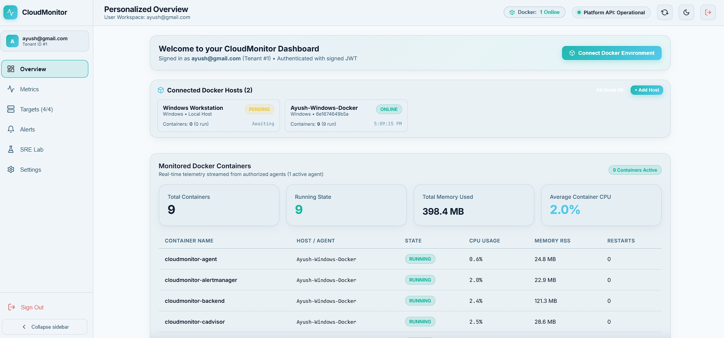
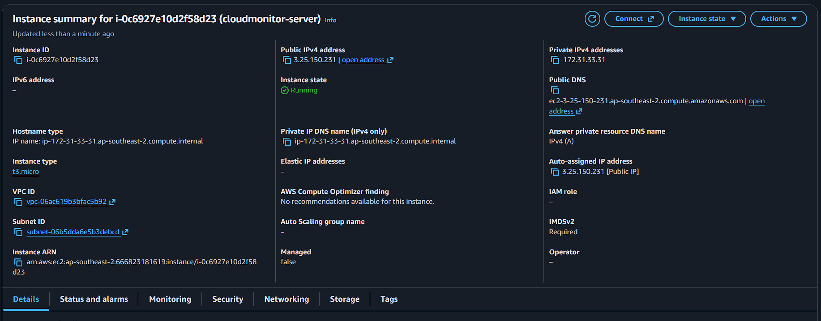
Demonstration
Repo: github.com/ayushcmd/cloud_monitor | Demo: http://3.25.150.231
Run: docker compose -f docker-compose.prod.yml up -d --build
Dashboard: hosts and containers (local Docker host)
AWS EC2 console

Slide 13
Results & Key Findings
Metric | Target | Observed | Result
Availability | 99.5% | 99.9% | Met
P95 latency | < 1 s | 310 ms | Met
TTR | ≤ 10 min | ~4.5 min | Met
Functional outcome
Cloud benefits
Limitations
Auth, agent enrollment, container telemetry, alerts, EC2 deployment.
Operational visibility, Docker portability, low-cost AWS hosting.
HTTP demo, no alert receivers yet, SSH-based CD unreliable.

Slide 14
Evaluation Checklist
Industry use case and problem statement
TTR defined and measured
End-to-end cloud architecture
Failure/recovery demonstrated
3–5 AWS services with justification
Monitoring/logging evidence
Dockerized application
Performance, security and cost
Virtualization explained
Working demo + repository
Explicit SLA metrics and targets

Slide 15
Conclusion & Future Work
Conclusion
Future work
Docker stack runs on AWS EC2
SLA and TTR defined and tested
Monitoring gives one health view
HTTPS with Caddy, ECR images
SSM-based CD, CloudWatch logs
Kubernetes/EKS, multi-host scaling
Business extension
Learning outcomes
Multi-tenant monitoring SaaS for small DevOps teams, with alert notifications.
AWS, Docker, virtualization, SLA/TTR, CI/CD and cloud deployment.

